Slide 1
Seeing Beyond the Surface: Monitoring the Efficacy of Rituximab with Salivary Gland Ultrasound in IgG4-Related Disease
Amy Trang MD
Division of Rheumatology, Department of Medicine, David Geffen School of Medicine, UCLA

Slide 2
Case Presentation
HPI
A 55-year-old male presented with swollen eyelids, BL parotid swelling and dry mouth
Positive/abnormal: Rheumatoid factor 119 | IgG4 1120 | ESR 21 | SPEP / IFE: No monoclonal bands; IgG immunoglobulin pattern on IFE is atypical with disproportionate elevation of IgG4
Negative/normal: IgE 97 (ref <113), ANA, dsDNA, Sm/RNP, C3, C4, C1q binding, CCP, SSA/SSB, CRP, ANCA, cryocrit, TSH, FT4, TPO ab, TG ab, TSI, TBII, ACE, Jo-1 ab, k/L ratio

Slide 3
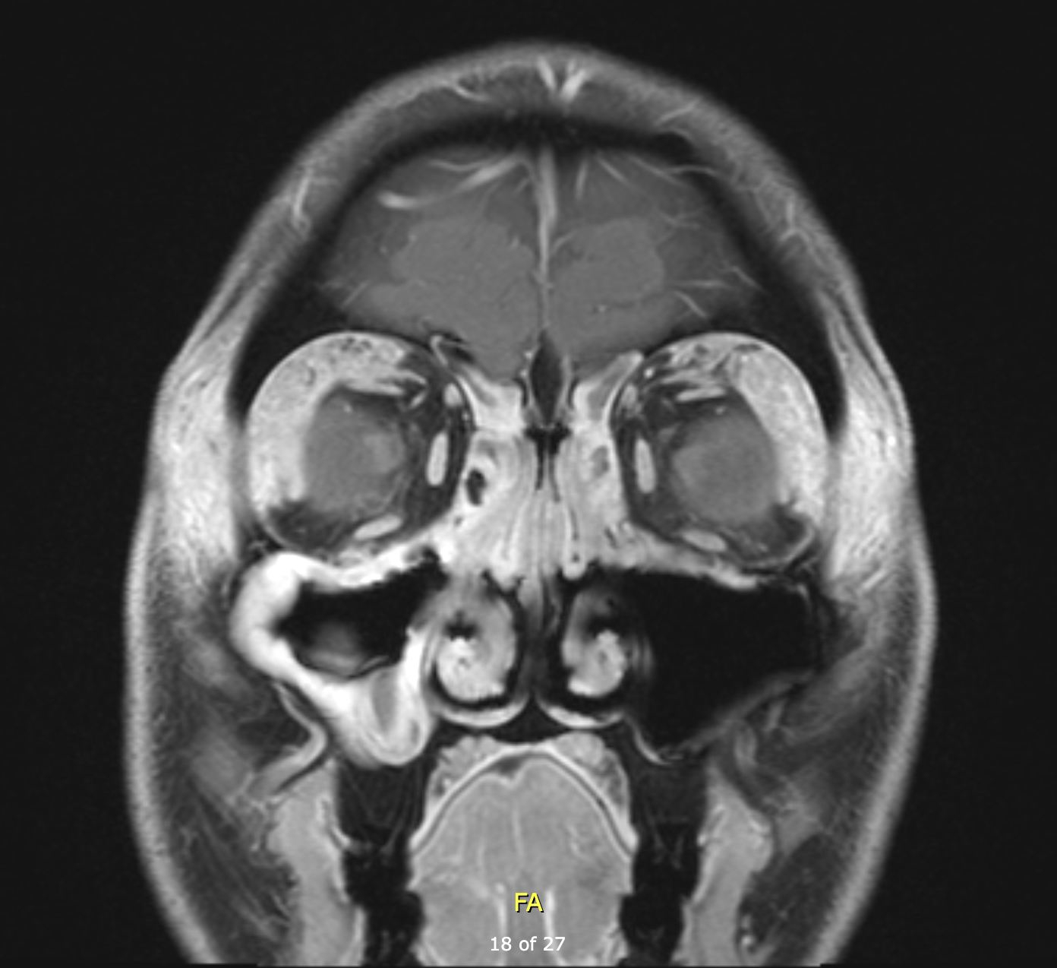
Orbital MRI
Infiltrative T1-hyperenhancing soft tissue involving both lacrimal glands and adjacent orbital soft tissues

Slide 4
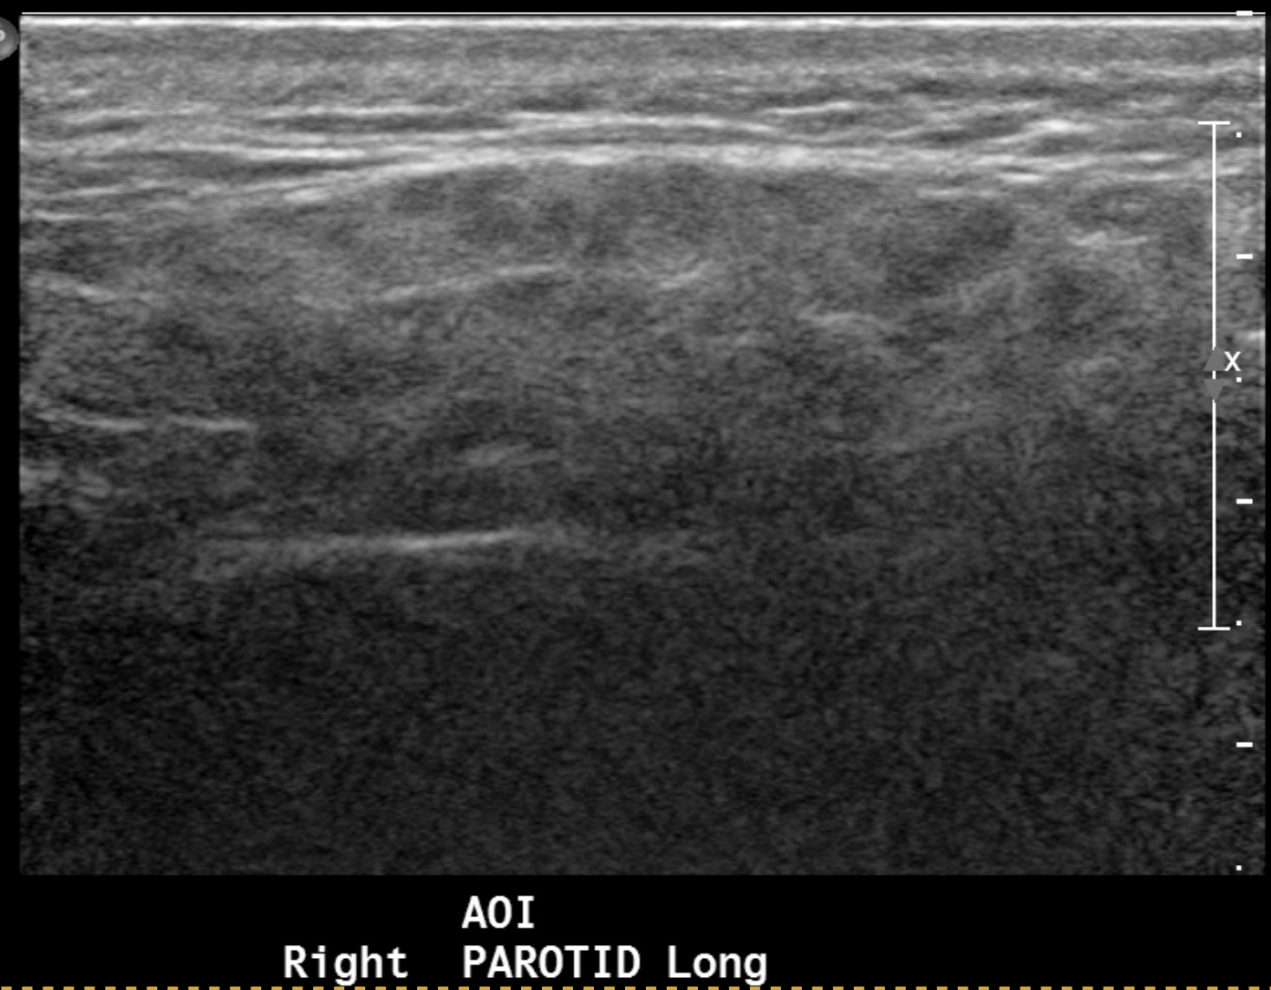
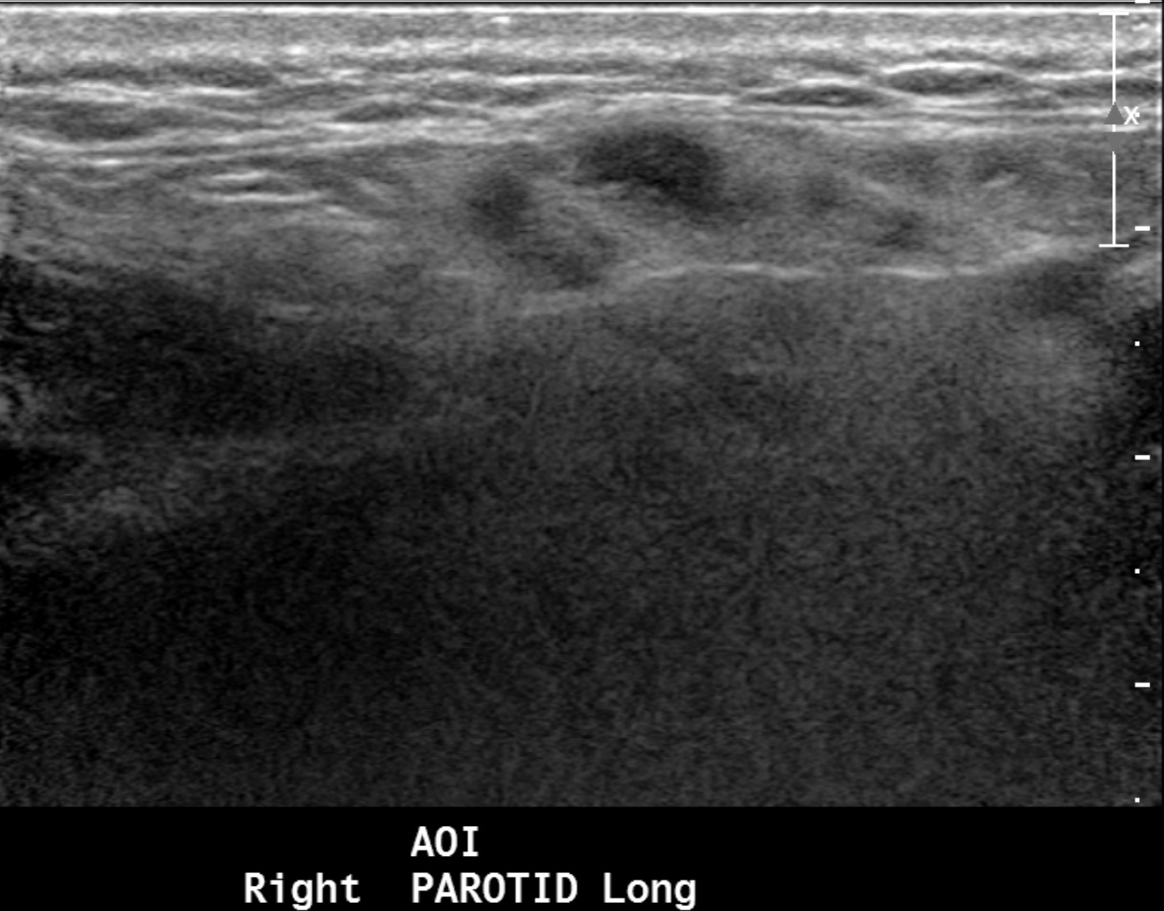
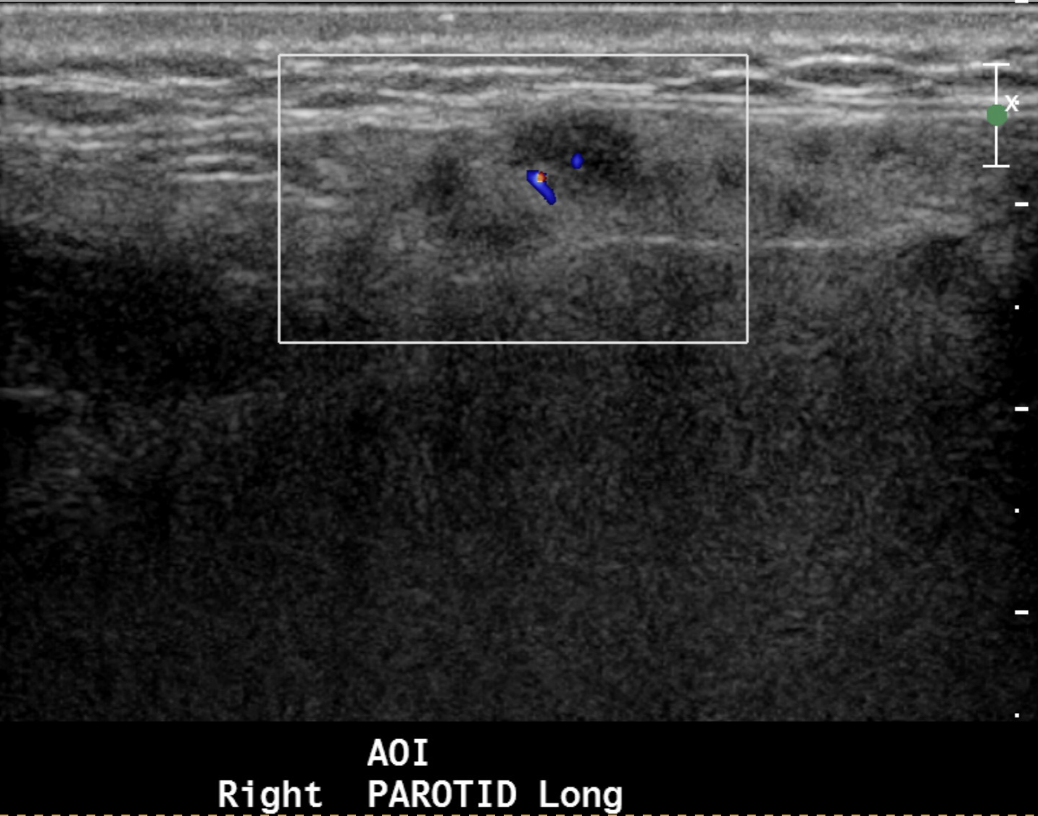
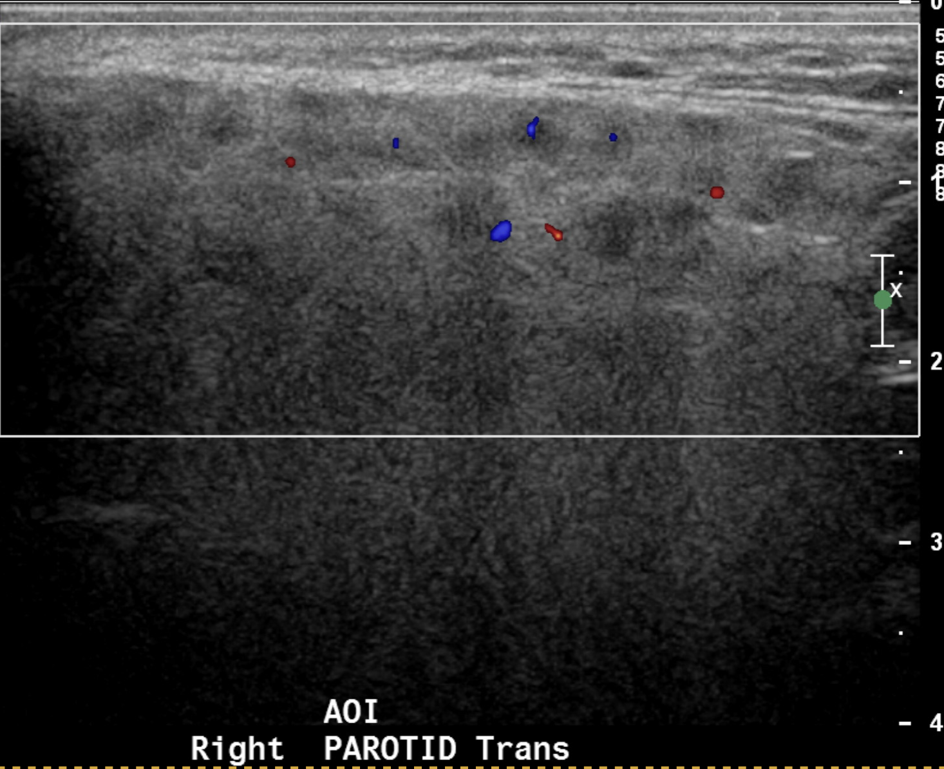
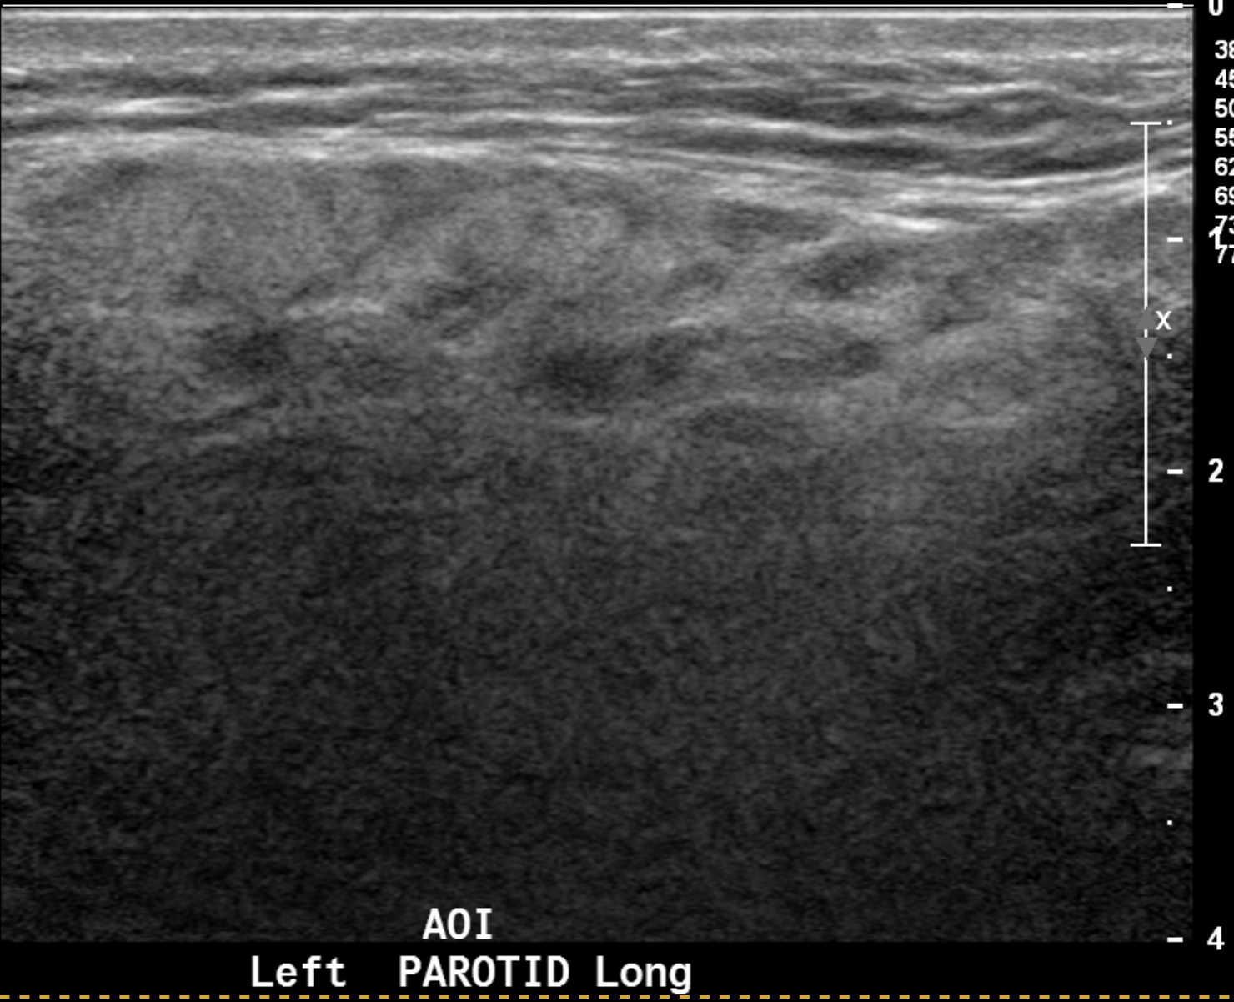
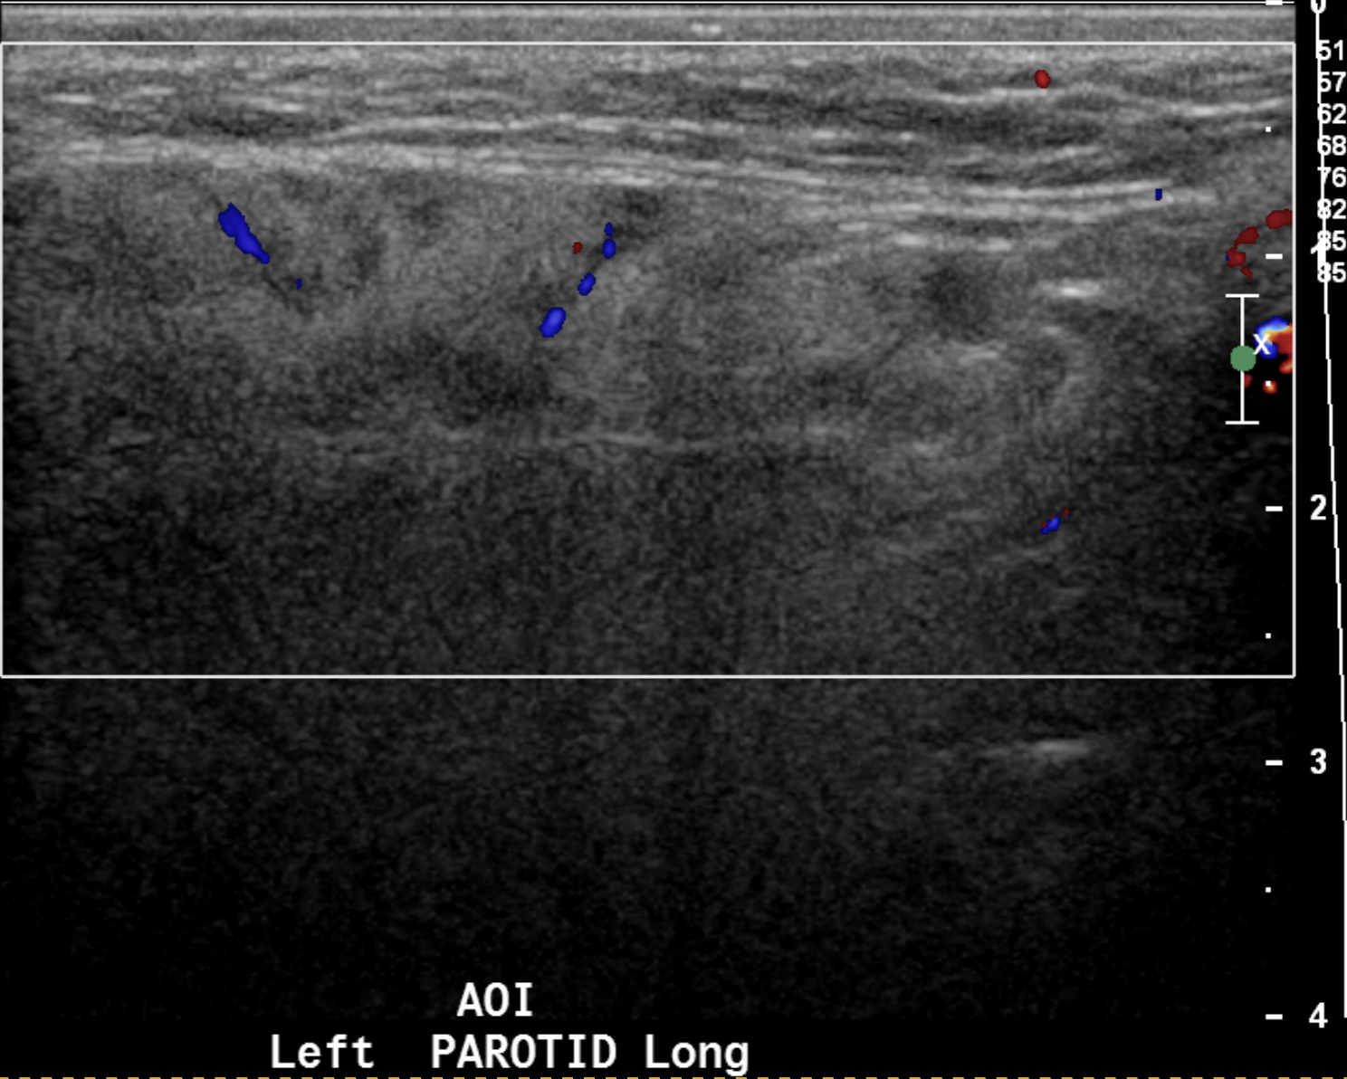
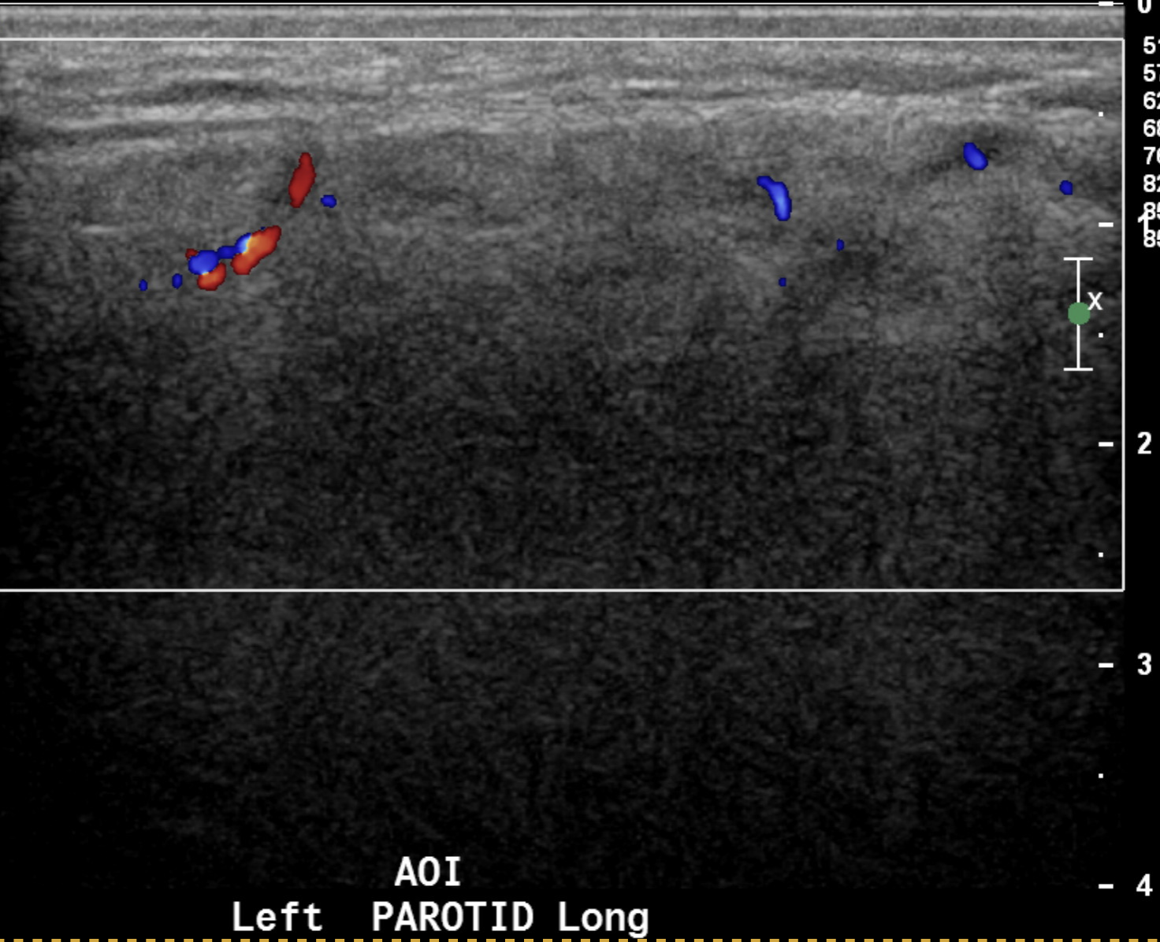
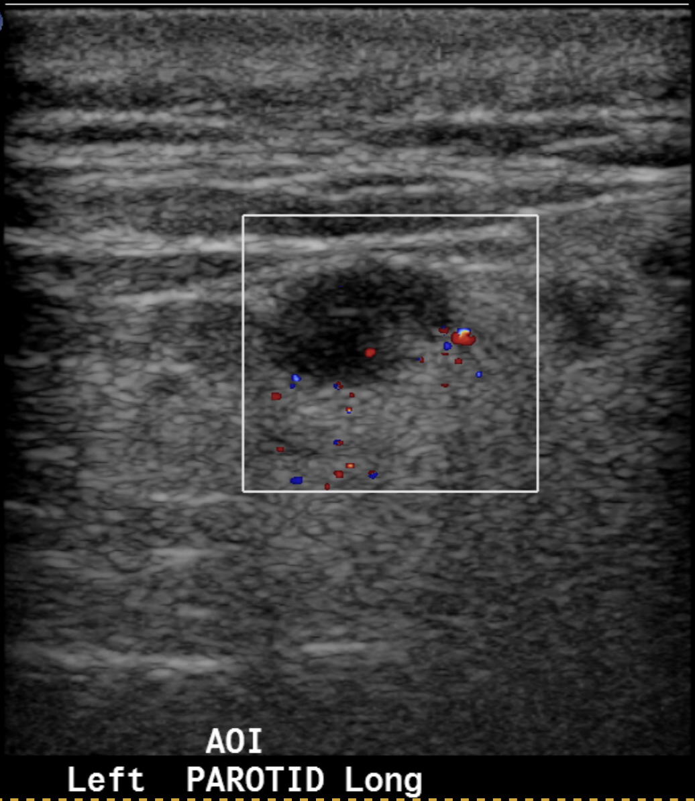
Parotid Ultrasound (formal) – prior to diagnosis
02.2020
Diffuse parenchymal heterogeneity with several sub-centimeter short axis intra-parotid lymph nodes with maintained fatty hila.
No ductal dilation. No calcifications. No glandular hyperemia.

Slide 5
Right lacrimal gland biopsy
Severe chronic dacryoadenitis and predominant reactive lymphoid hyperplasia, negative flow cytometry
IgG4 staining shows reactivity in numerous plasma cells in the interstitium between lymphoid follicles
Areas with the highest density of IgG4 positive cells exceed 51/HPF
“While there is fibrosis in this case, it is not in a storiform pattern and obliterative phlebitis is not seen”
Eosinophils (pink) present in infiltrate between follicles
Notes:
IgG was not done in this case because Heme path did not think the work up was warranted and the background staining of IgG on paraffin processed slides in our IHC lab is excessive and we have not had a case where we got a reasonable ratio. Background must be low. That said the main feature in this biopsy is reactive lymphoid hyperplasia. While the hematopathologist did not feel this would be consistent with IgG4 disease and indeed there is a lack of critical histologic features such as mentioned in the addendum to the case (see below). So the case would not meet the criteria regardless of the number of IgG 4 positive cells. However, if you take the areas with the highest density of IgG4 positive cells, it does exceed 51/HPF.
Kimura disease

Slide 6
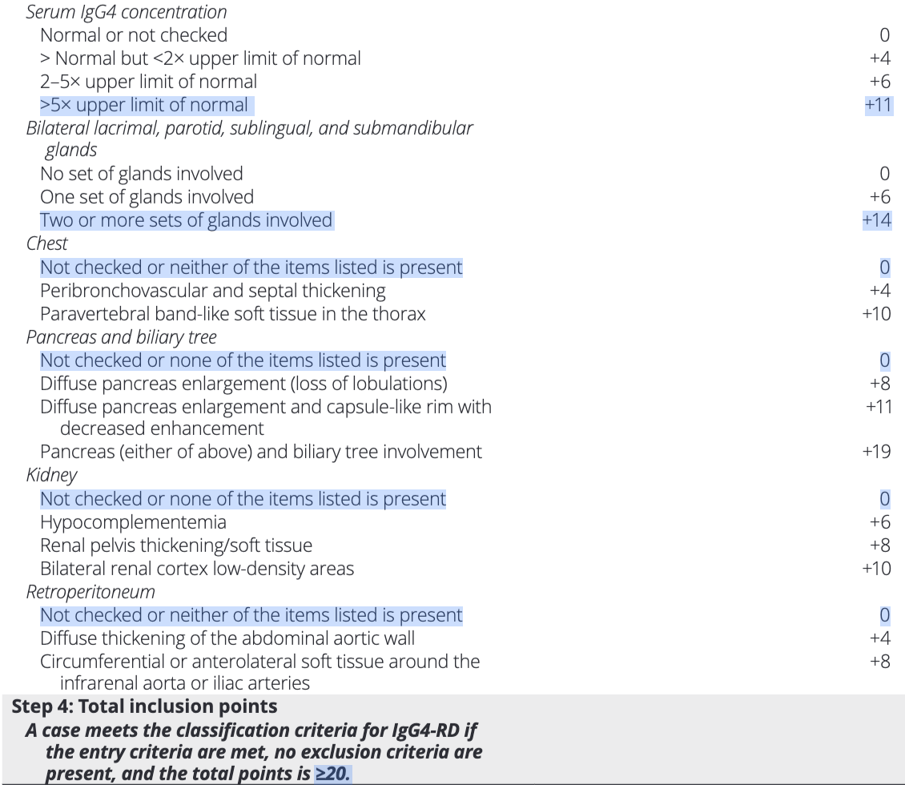
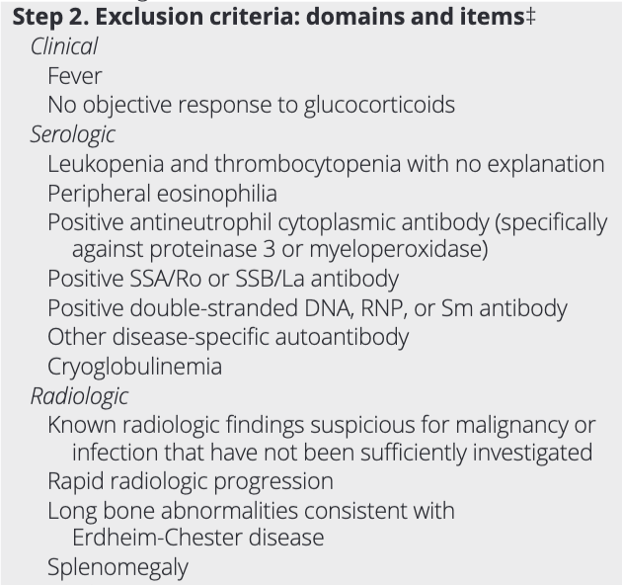
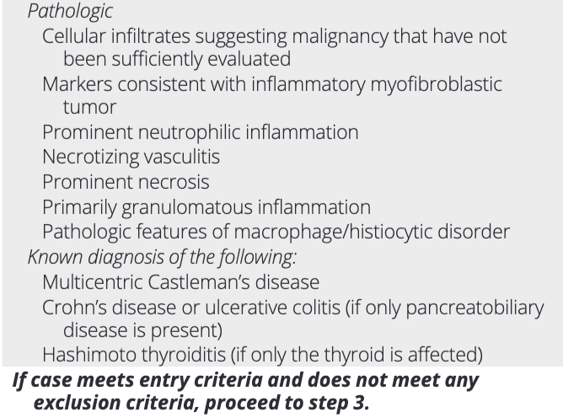
2019 ACR/EULAR classification criteria for IgG4-RD
Total points 25
Notes:
Remember classification criteria are not diagnostic criteria!

Slide 7
Treatment Course
Upon diagnosis | Prednisone 40 mg daily
1 week later | Underwent live MMR vaccine ID recommended lowering steroids Prednisone 15 mg daily
3 months later | Prednisone 15 mg → 7.5 mg daily Left submandibular swelling, rising IgG4 levels Increased prednisone to 10 mg daily Add methotrexate 20 mg weekly
9 months later | Methotrexate 20 mg weekly OFF prednisone
21 months later | Methotrexate 20 mg weekly Right parotid swelling
Upon diagnosis, started prednisone 40 mg daily
1 week into therapy: underwent live MMR vaccine; ID recommended lowering steroid dose to 15 mg daily
3 months into therapy: tapered from prednisone 15 mg → 7.5 mg daily
At prednisone 7.5 mg: increased left submandibular swelling and rising IgG4 levels
Increased to prednisone 10 mg; added methotrexate 20 mg weekly
9 months into therapy: methotrexate 20 mg weekly therapy, OFF prednisone
21 months into therapy: monotherapy with methotrexate, developed right parotid swelling
Notes:
Make into table?

Slide 8
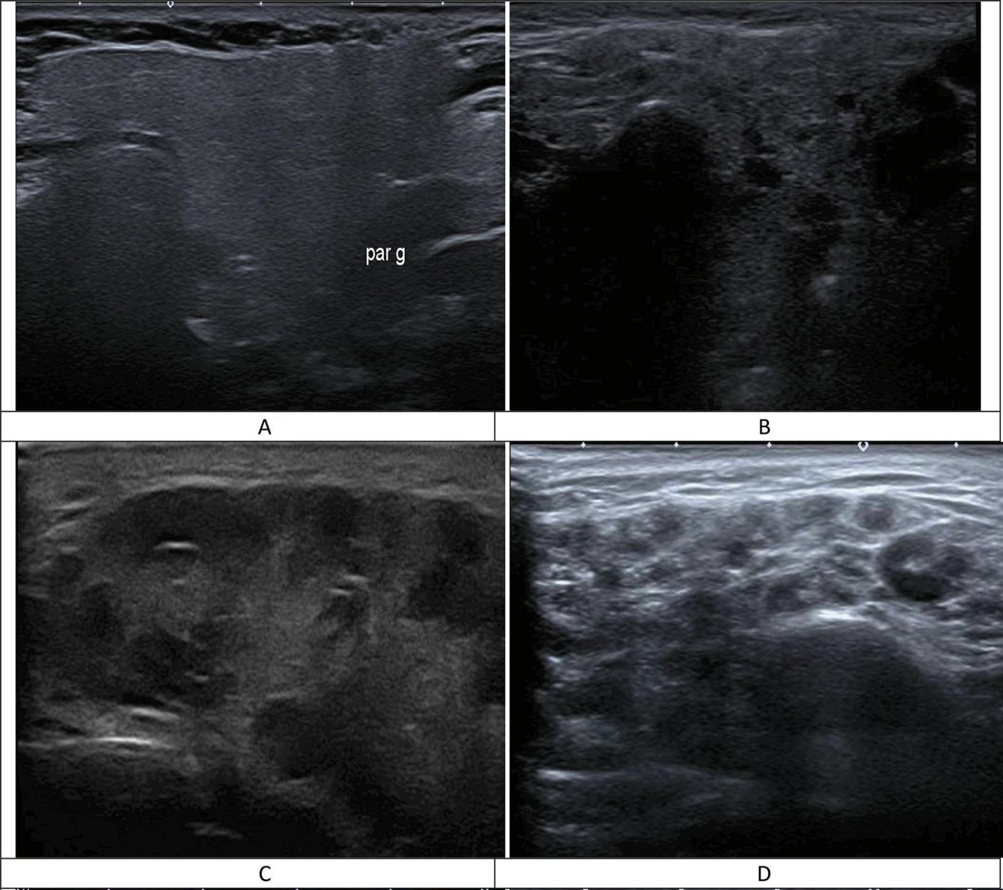
OMERACT – Grey Scale
GREY SCALE
Grade 0 | Normal parenchyma
Grade 1 | Mild inhomogeneity without anechoic/hypoechoic areas
Grade 2 | Moderate inhomogeneity with focal anechoic/hypoechoic areas but surrounded with normal tissue
Grade 3 | Diffuse inhomogeneity with anechoic/hypoechoic areas occupying the entire gland surface but surrounded with no normal tissue
Outcome Measure in Rheumatology (OMERACT) group defined SGUS lesions in pSS with great intra-rater and inter-rater reliability¹
0
1
Jousse-Joulin S, D'Agostino MA, Nicolas C, et al. Video clip assessment of a salivary gland ultrasound scoring system in Sjögren's syndrome using consensual definitions: an OMERACT ultrasound working group reliability exercise. Ann Rheum Dis. 2019 Jul;78(7):967-973. doi: 10.1136/annrheumdis-2019-215024. Epub 2019 Apr 29. PMID: 31036626.
2
3
Notes:
*Gland volumes in asymptomatic controls (Wernicke, et al, Journal of Rheumatology 2008)
Submandibular: Women: 4.8ml +/- 1.5ml Men: 6.1ml +/- 1.7ml
Parotid: Women: 14.4 +/- 5.2ml Men: 18.2+/- 5.1ml
OMERACT scoring system is a semiquantitative method for evaluating salivary glands using ultrasound. It's used to assess the homogeneity of the glands and the presence of hypoechoic areas. The OMERACT scoring system is used to diagnose Sjögren's syndrome (SS) and other conditions.

Slide 9
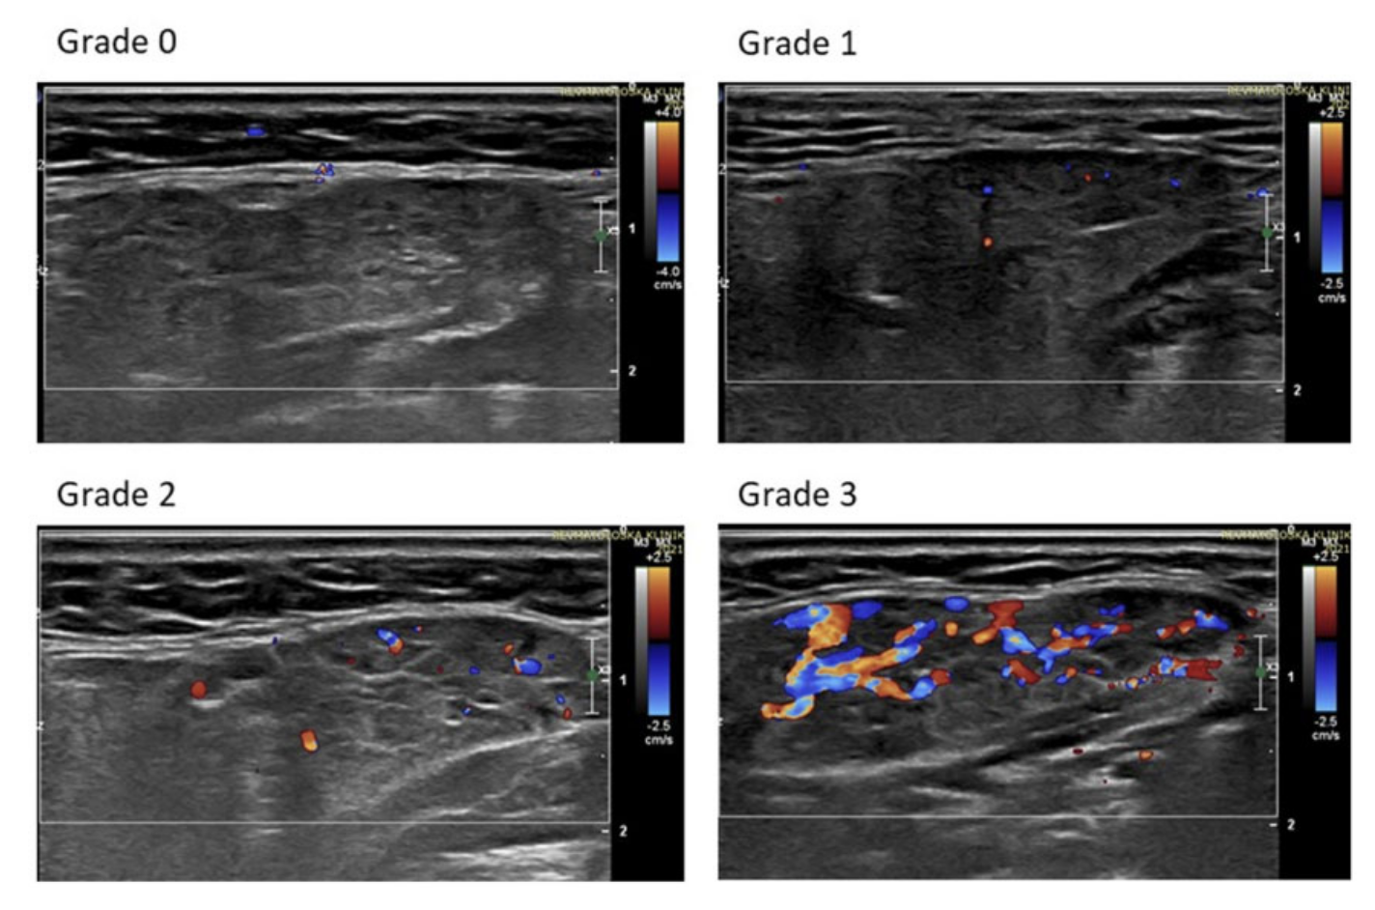
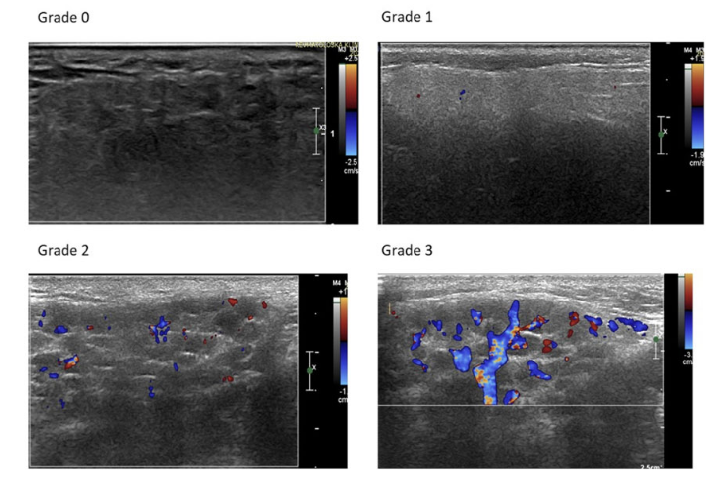
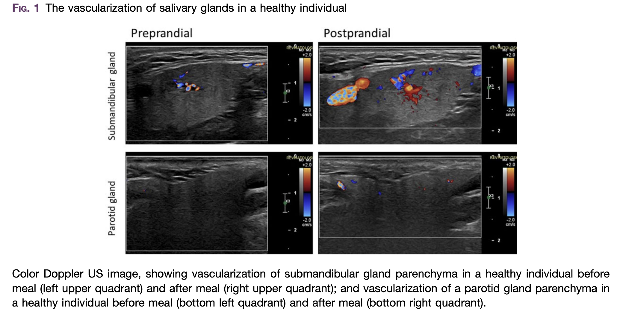
OMERACT – Doppler
Submandibular
Parotid
Evaluating salivary gland inflammation in pSS patients
Vascularization of glands may indicate parenchymal inflammation
Doppler activity may be a surrogate for evaluating gland inflammation
DOPPLER
Grade 0 | No visible vascular signals in glandular parenchyma
Grade 1 | Focal, dispersed vascular signals in the glandular parenchyma
Grade 2 | Diffuse vascular signals detected in <50% of the gland
Grade 3 | Diffuse vascular signals in >50% of the glandular parenchyma
Jousse-Joulin S, et al. Development of a new ultrasound scoring system to evaluate glandular inflammation in Sjögren's syndrome: an OMERACT reliability exercise. Rheumatology (Oxford). 2022 Aug 3;61(8):3341-3350. doi: 10.1093/rheumatology/keab876. PMID: 34849616.
Notes:
Fasting is required for at least 1 h before the US examination D1, 80.0%
Teeth brushing, smoking and chewing are not permitted for at least 1 h prior to the
US examination

Slide 10
POC Right Parotid US
Abnormal texture
Grey Scale Grade 2
Doppler Grade 1
02.2023
Restarted prednisone 40 mg
Continued methotrexate 20 mg weekly
Started IV rituximab 1g
Notes:
Findings:
Static real-time views in longitudinal and transverse orientation were obtained on this patient.
RIGHT PAROTID GLAND:
Size subjectively Normal
Hypoechoic foci compatible with lymphoid aggregates: Less than 50% of gland involved/abundant
- Among the lymphoid aggregates some were observed to be notably more hyperemic than the others.
The overall sonographic texture is abnormal
- Also observed is cyst measuring 0.76x0.54cm
LEFT PAROTID GLAND:
Size subjectively Normal
Hypoechoic foci compatible with lymphoid aggregates: Less than 50% of gland involved/abundant
- Among the lymphoid aggregates none were observed to be notably more hyperemic than the others.
The overall sonographic texture is abnormal
- Also observed is lymph nodes measuring 0.47cm x 0.42cm
RIGHT SUBMANDIBULAR GLAND:
Size subjectively Small
Hypoechoic foci compatible with lymphoid aggregates: greater than 50% of involved
- Among the lymphoid aggregates none were observed to be notably more hyperemic than the others.
The overall sonographic texture is abnormal
LEFT SUBMANDIBULAR GLAND:
Size subjectively Small
Hypoechoic foci compatible with lymphoid aggregates: greater than 50% of involved
The overall sonographic texture is abnormal
IMPRESSION:
RIGHT PAROTID GLAND: Grey Scale Grade 2. Doppler Grade 1. Number of lymph nodes 0/1. cyst measuring 0.76x0.54cm
LEFT PAROTID GLAND: Grey Scale Grade 2. Doppler Grade 1. Number of lymph nodes 0/1. lymph nodes measuring 0.47cm x 0.42cm
RIGHT SUBMANDIBULAR GLAND: Grey Scale Grade 3. Doppler Grade 2. Number of lymph nodes 0/1.
LEFT SUBMANDIBULAR GLAND: Grey Scale Grade 3. Doppler Grade 2. Number of lymph nodes 0/1.
OMERACT Grey Scale Definition.
• Grade 0: Normal parenchyma
• Grade 1: Minimal changes: mild inhomogeneity without anechoic/hypoechoic areas.
• Grade 2: Moderate changes: moderate inhomogeneity with anechoic/hypoechoic areas occupying the entire gland surface but surrounded with normal tissues.
• Grade 3: Severe changes: severe inhomogeneity with anechoic/hypoechoic areas occupying the entire gland surface but surrounded without normal tissues.
OMERACT Doppler Definition.
• Grade 0: No visble vascular signals in glandular parenchyma.
• Grade 1: Focal, dispersed vascular signals in the glandular parenchyma.
• Grade 2: Diffuse vascular signals detected in < 50% of the gland
• Grade 3: Diffuse vascular signals in >50% of the glandular parenchyma.
Reference:
1. Jousse-Joulin S, D'Agostino MA, Nicolas C, Naredo E, Ohrndorf S, Backhaus M, Tamborrini G, Chary-Valckenaere I, Terslev L, Iagnocco A, Collado P, Hernández-Díaz C, Gandjbakhch F, Schmidt WA, Filippou G, Dejaco C, Stradner MH, Mortada MA, Hočevar A, Chrysidis S, El Mardenly G, de Agustín JJ, Thiele R, MacCarter DK, Finzel S, Hanova P, Zabotti A, Glaser C, Alavi Z, Hammenfors DS, Gatineau F, Bruyn GA. Video clip assessment of a salivary gland ultrasound scoring system in Sjögren's syndrome using consensual definitions: an OMERACT ultrasound working group reliability exercise. Ann Rheum Dis. 2019 Jul;78(7):967-973. doi: 10.1136/annrheumdis-2019-215024. Epub 2019 Apr 29. PMID: 31036626.
2. Hočevar A, Bruyn GA, Terslev L, De Agustin JJ, MacCarter D, Chrysidis S, Collado P, Dejaco C, Fana V, Filippou G, Finzel S, Gandjbakhch F, Hanova P, Hammenfors D, Hernandez-Diaz C, Iagnocco A, Mortada MA, Inanc N, Naredo E, Ohrndorf S, Perko N, Schmidt WA, Tamborrini G, Tomšič M, Chary-Valckenaere I, Zabotti A, Keen HI, Pineda C, D'Agostino MA, Jousse-Joulin S. Development of a new ultrasound scoring system to evaluate glandular inflammation in Sjögren's syndrome: an OMERACT reliability exercise. Rheumatology (Oxford). 2022 Aug 3;61(8):3341-3350. doi: 10.1093/rheumatology/keab876. PMID: 34849616.
*Gland volumes in asymptomatic controls (Wernicke, et al, Journal of Rheumatology 2008)
Submandibular: Women: 4.8ml +/- 1.5ml Men: 6.1ml +/- 1.7ml
Parotid: Women: 14.4 +/- 5.2ml Men: 18.2+/- 5.1ml
Howard Yang, MD, RhMSUS
Clinical Instructor
08/14/2023 10:59 AM

Slide 11
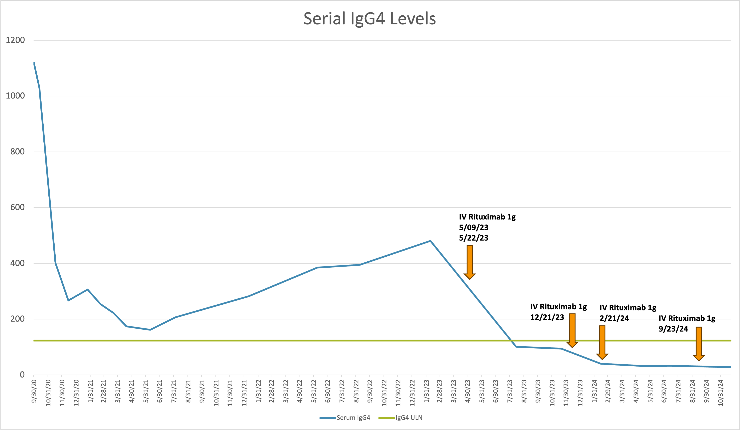
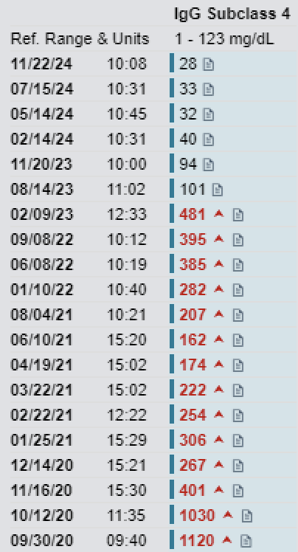
Serial IgG4 Levels and Rituximab Treatment
Notes:
Rituximab 1g
05/09/23
05/22/23
12/08/23
12/21/23
02/21/24
09/23/24

Slide 12
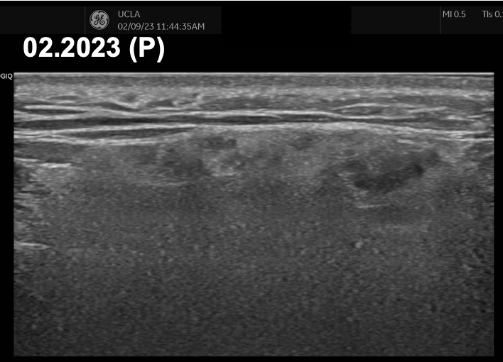
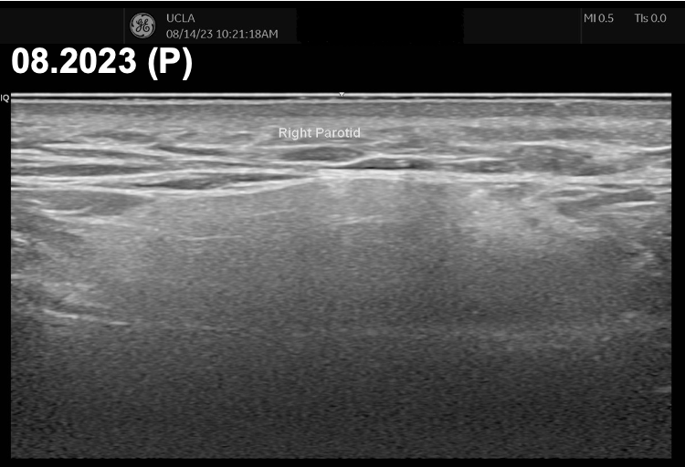
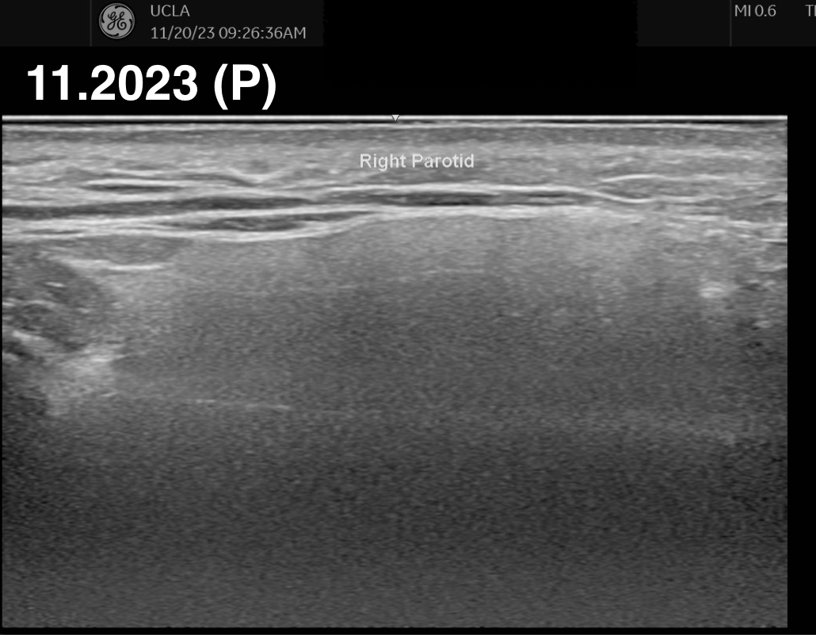
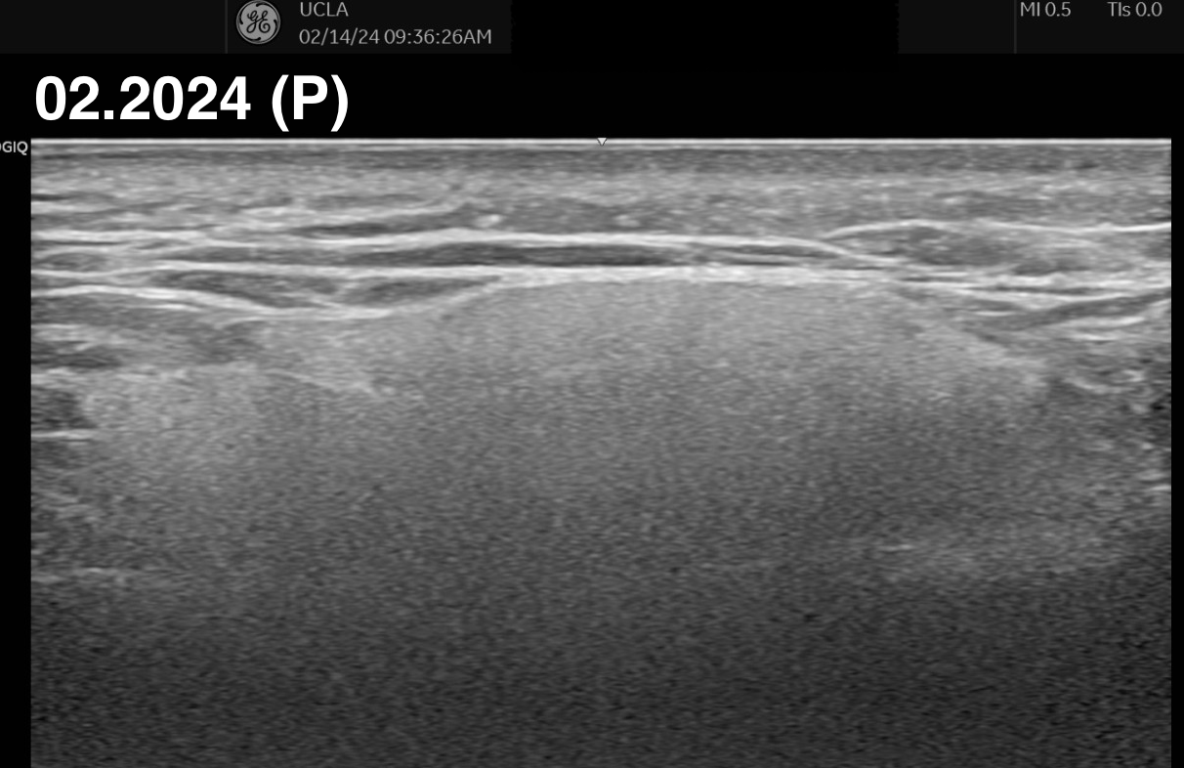
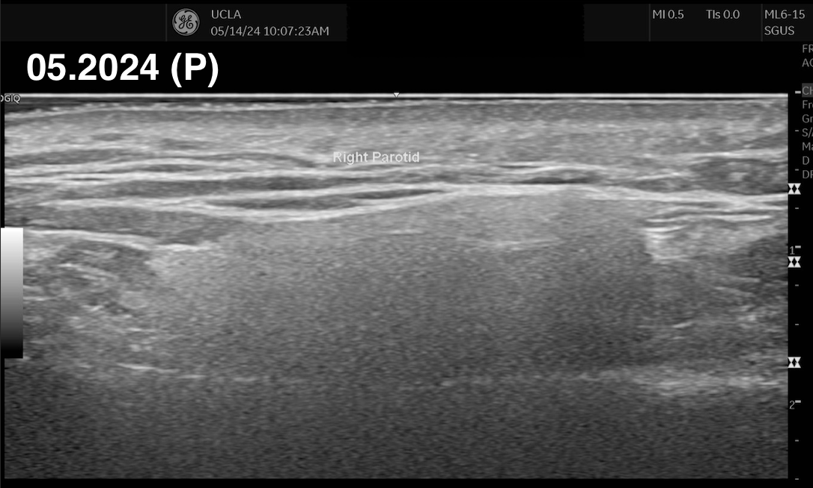
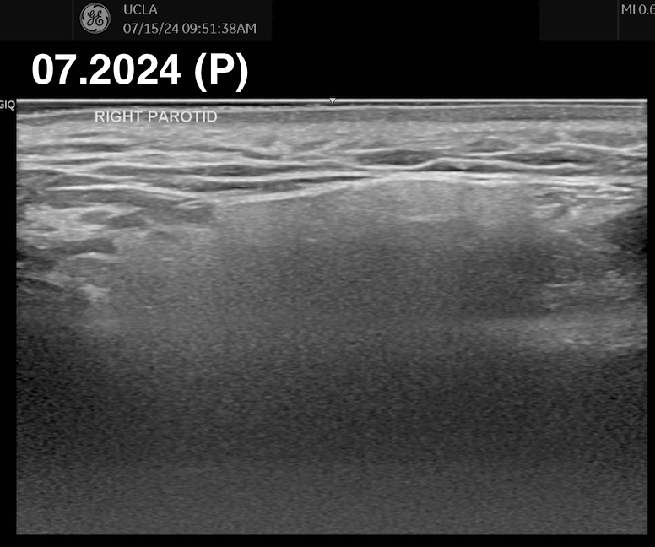
Right parotid after rituximab
= IV rituximab 1 gram
02.2023 (P)
08.2023 (P)
05.09.23
05.22.23
12.08.23
12.21.23
02.21.24
09.23.24

Slide 13
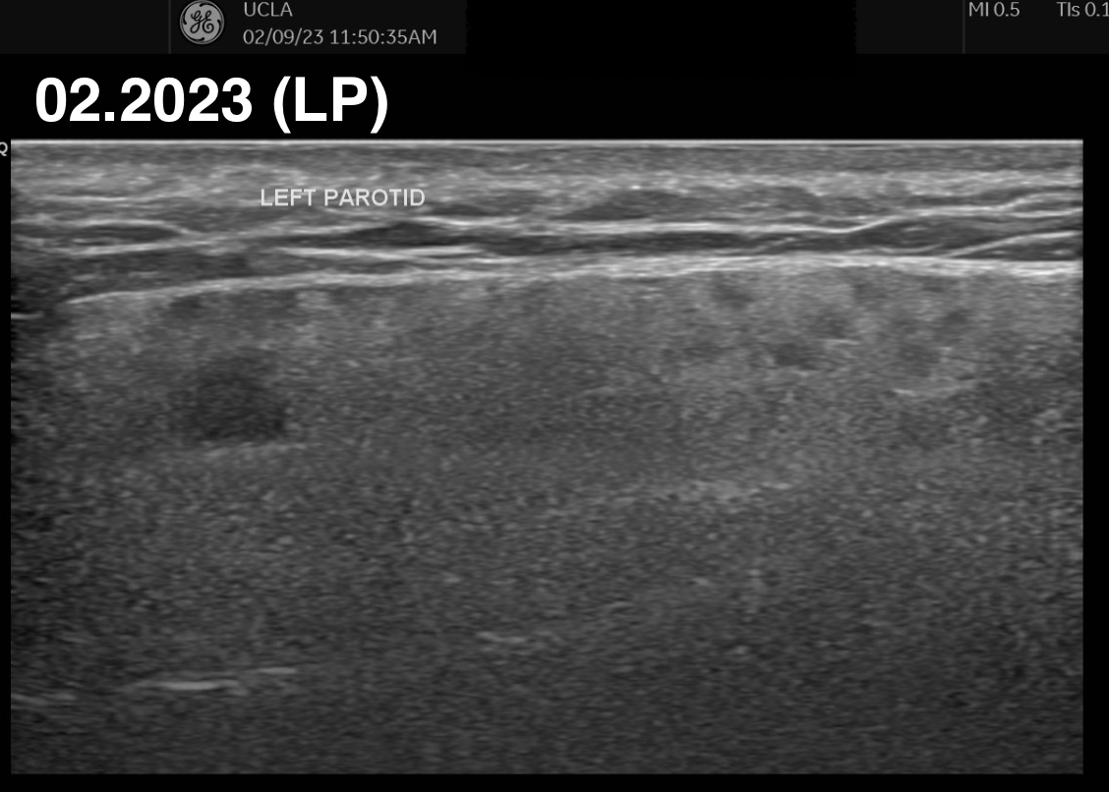
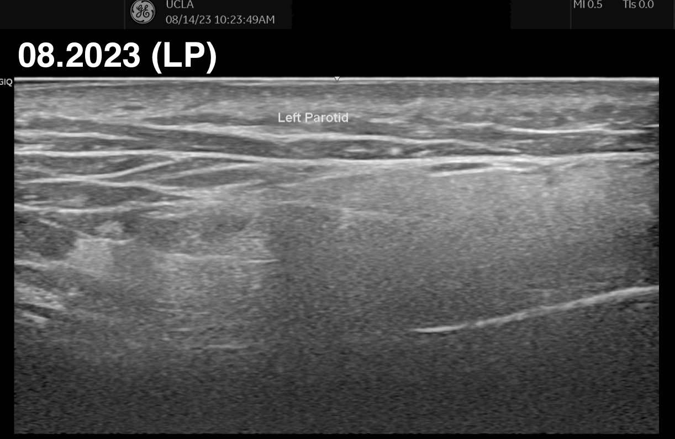
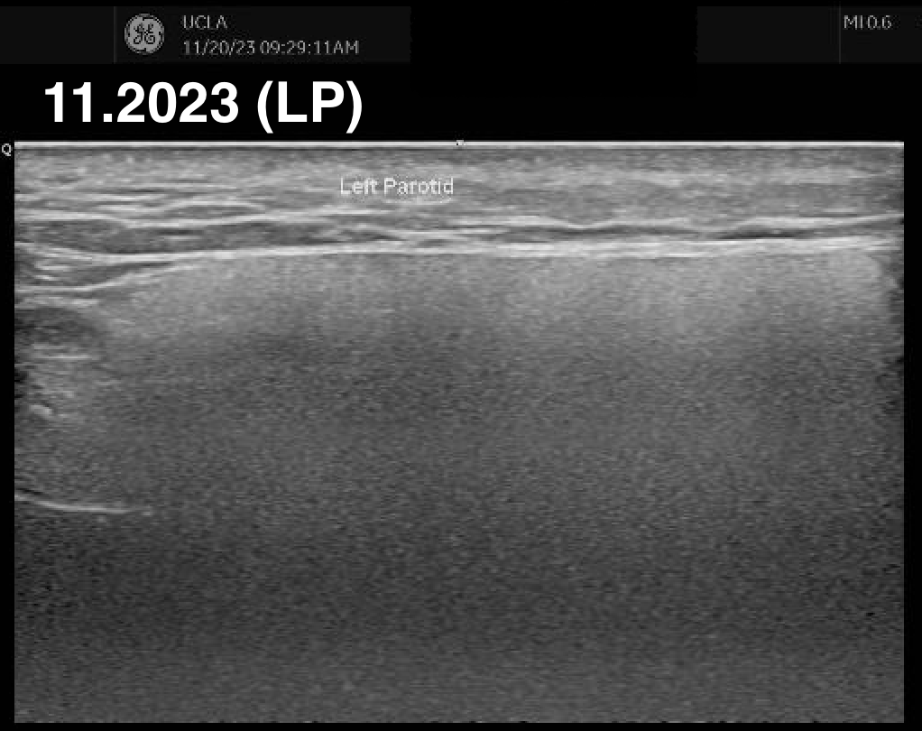
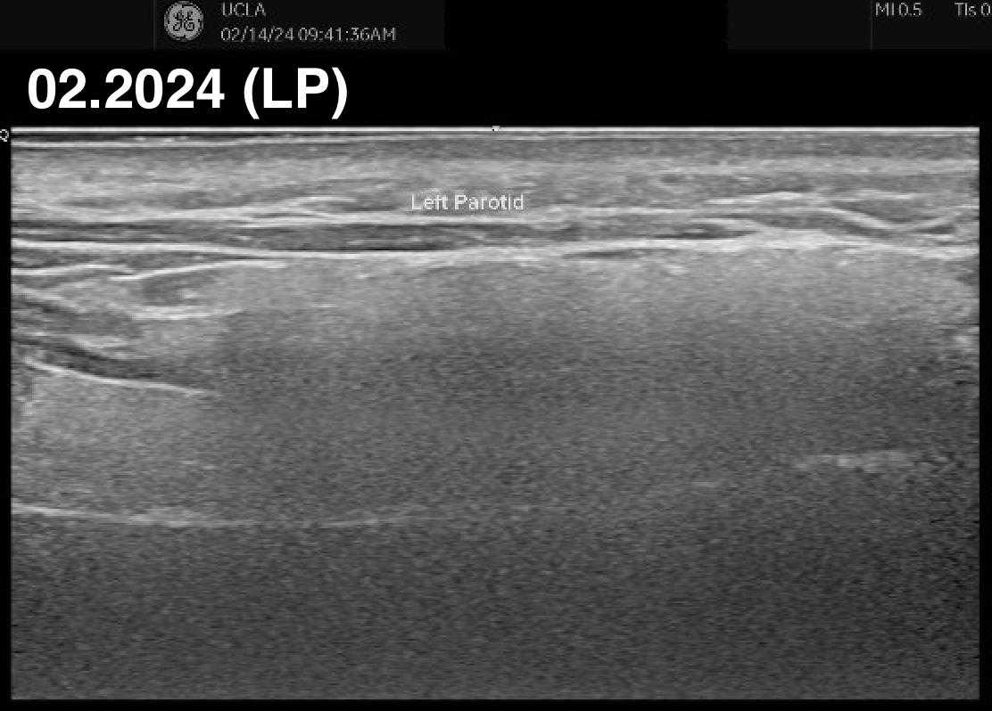
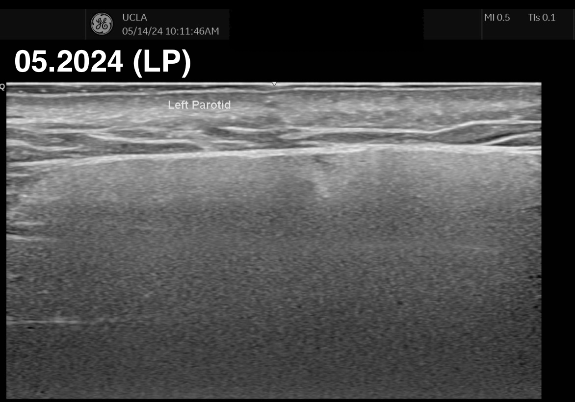
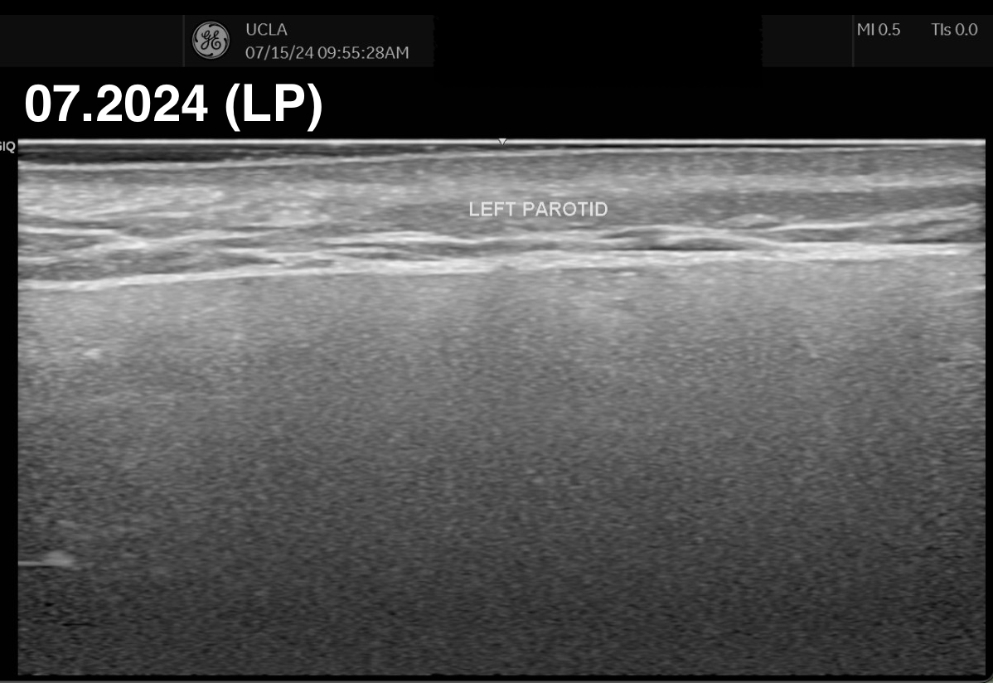
Left parotid after rituximab
= IV rituximab 1 gram
02.2023 (P)
08.2023 (P)
05.09.23
05.22.23
12.08.23
12.21.23
02.21.24
09.23.24

Slide 14
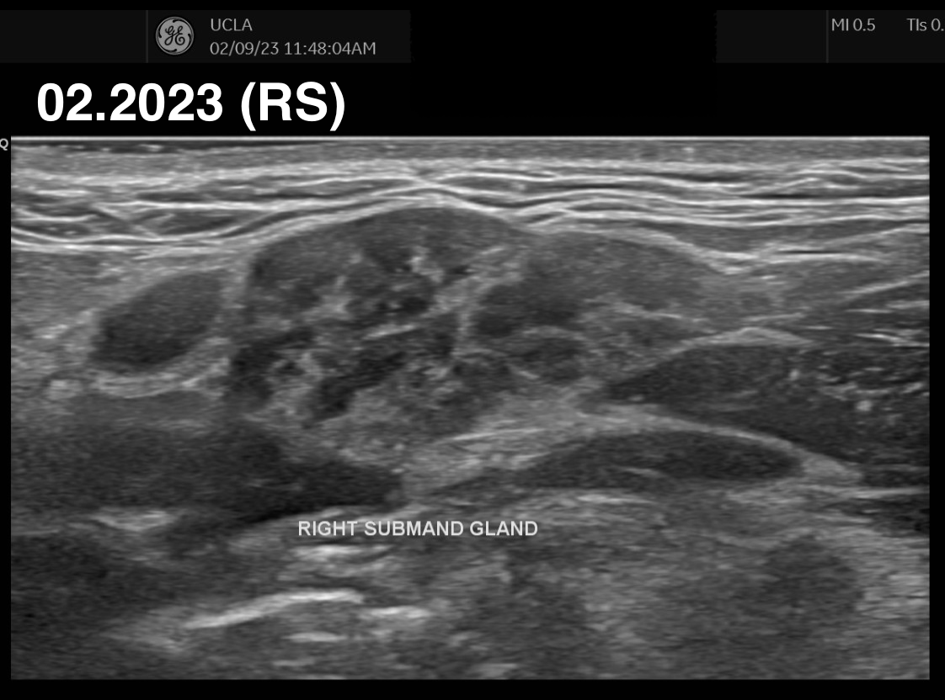
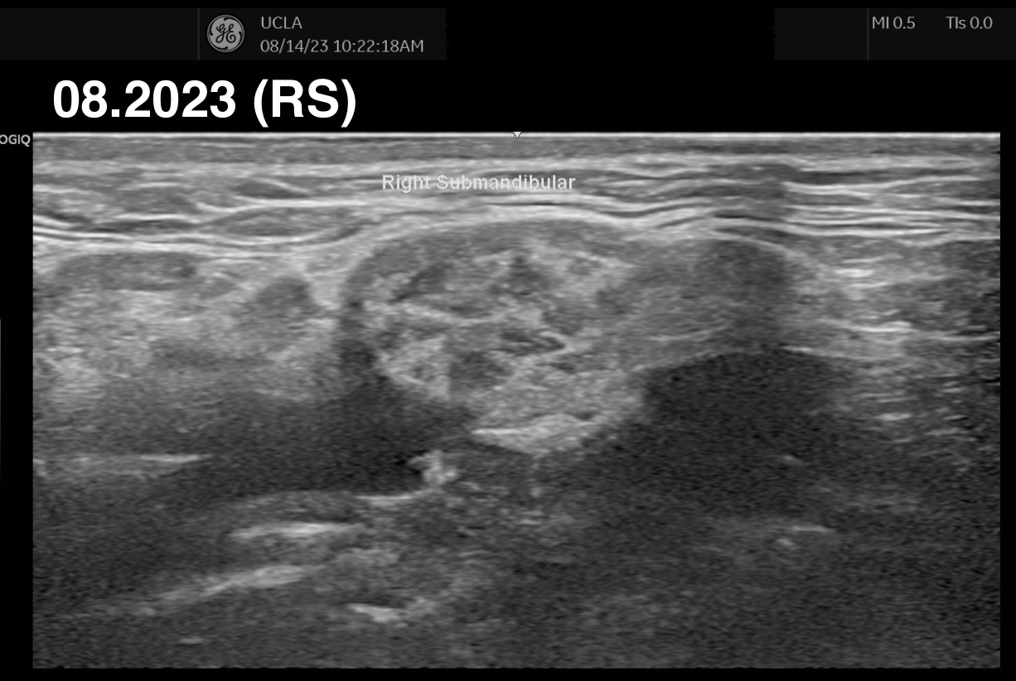
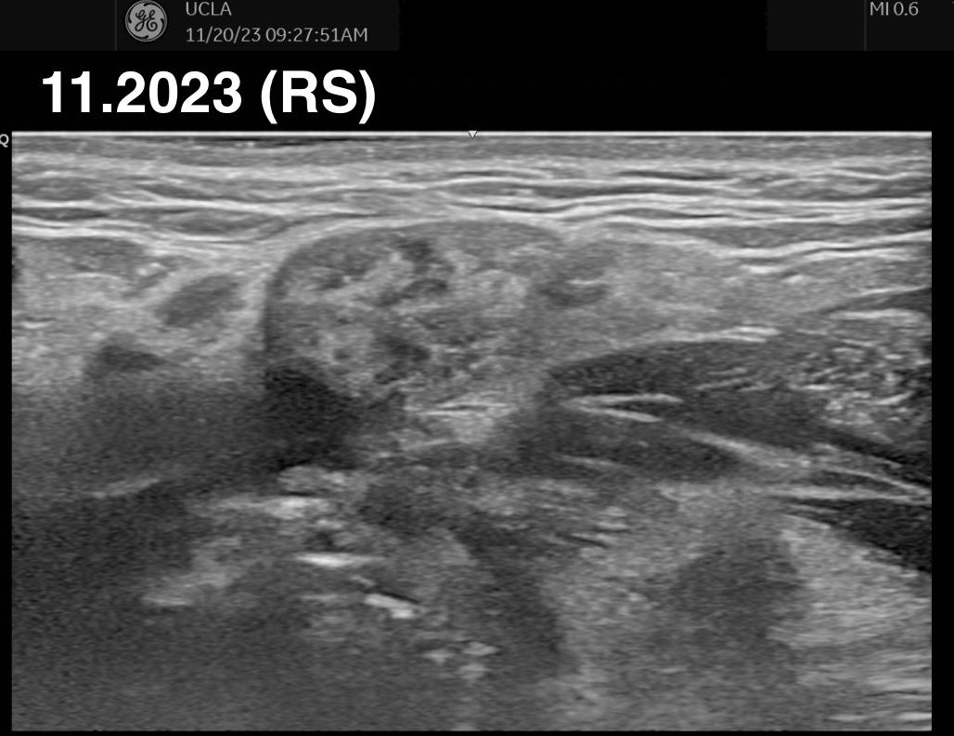
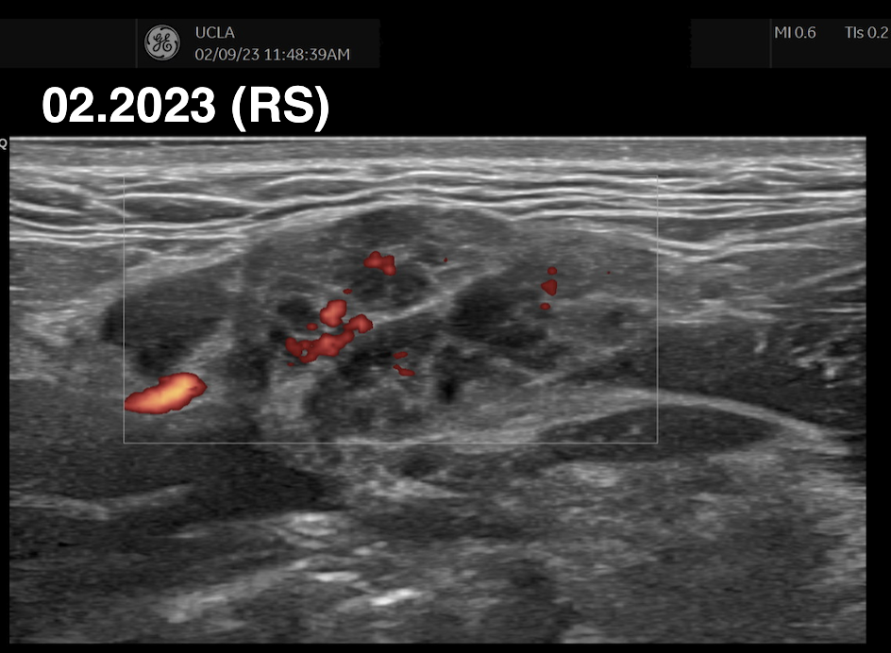
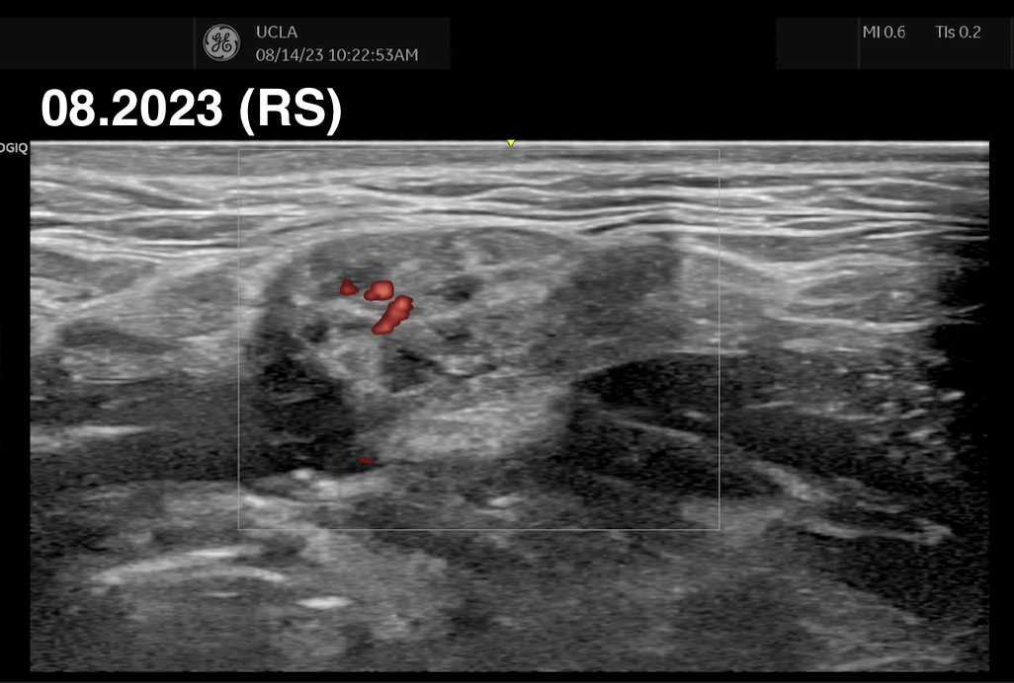
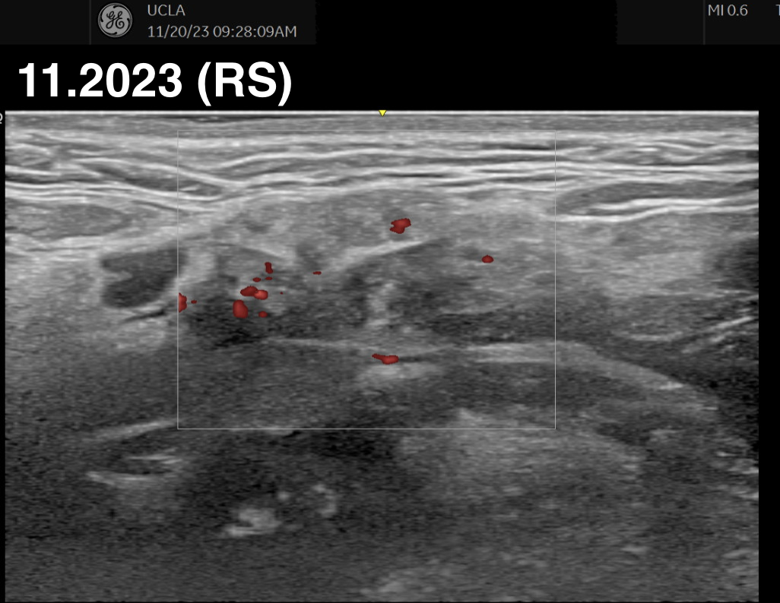
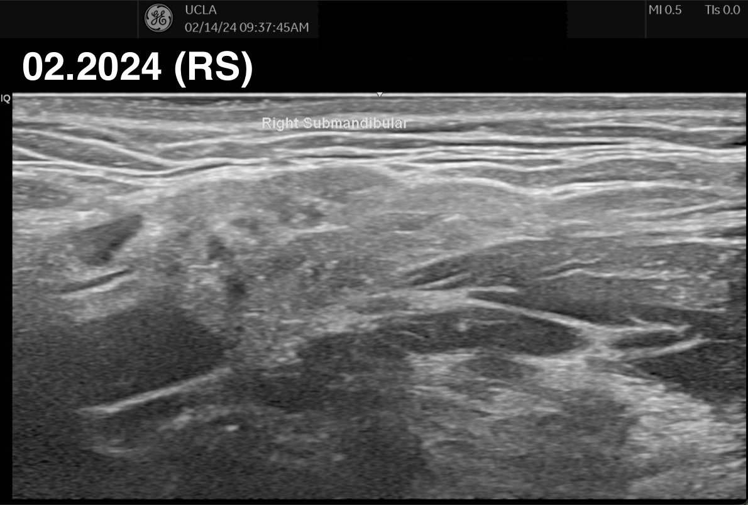
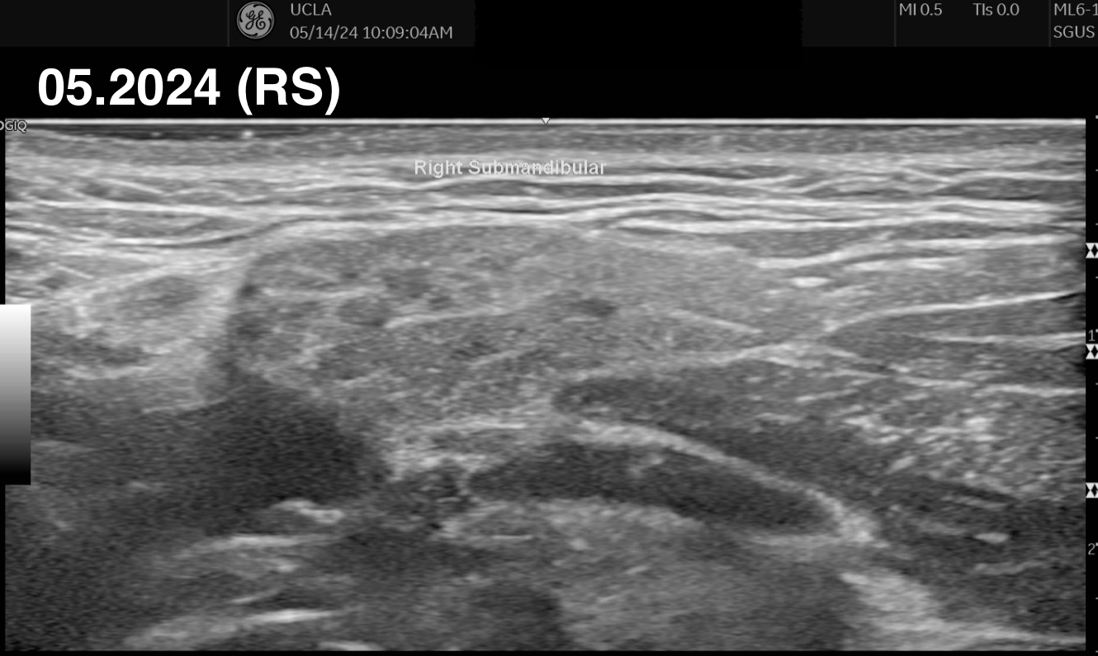
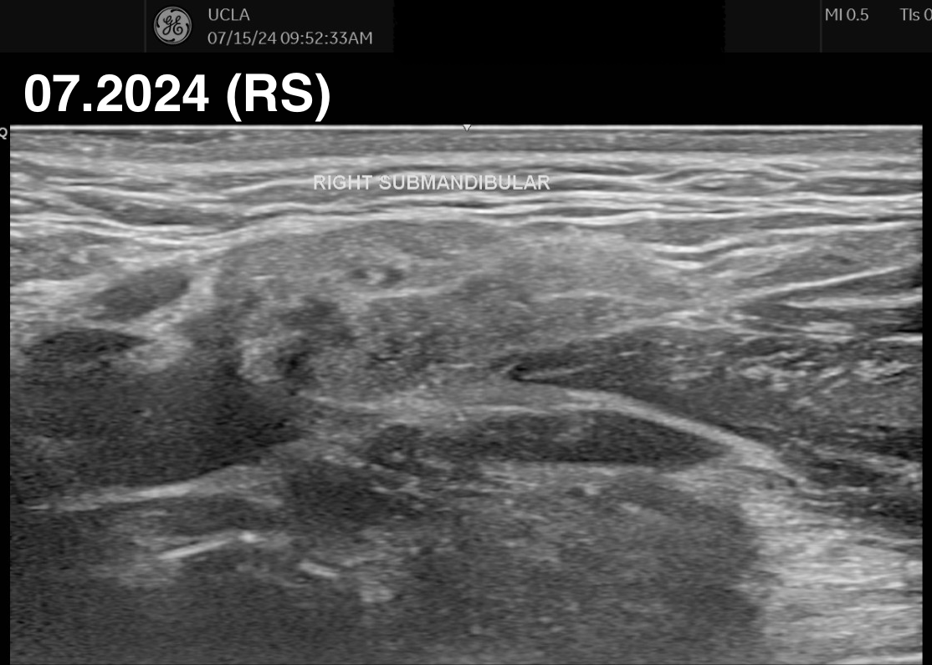
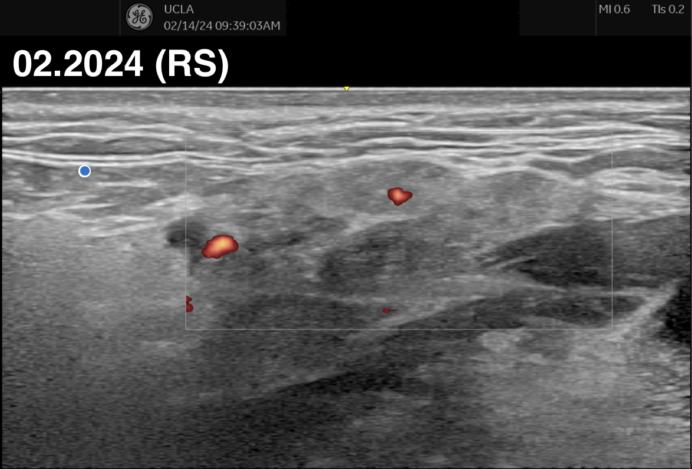
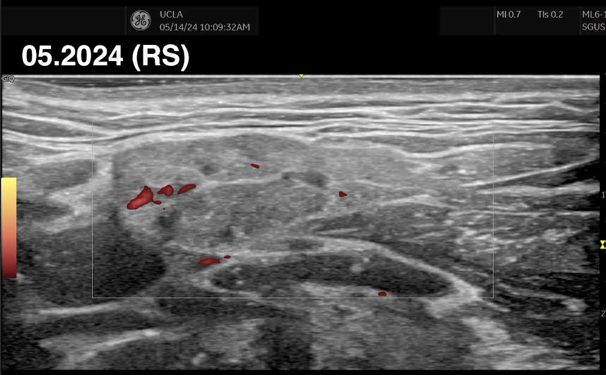
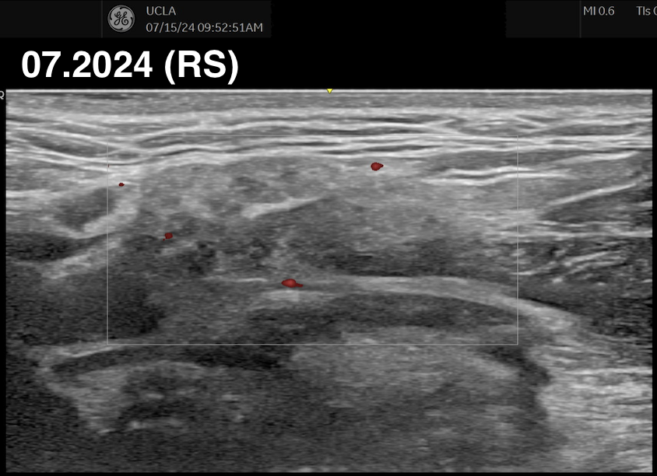
Right submandibular after rituximab
= IV rituximab 1 gram
05.09.23
05.22.23
12.08.23
12.21.23
02.21.24
09.23.24

Slide 15
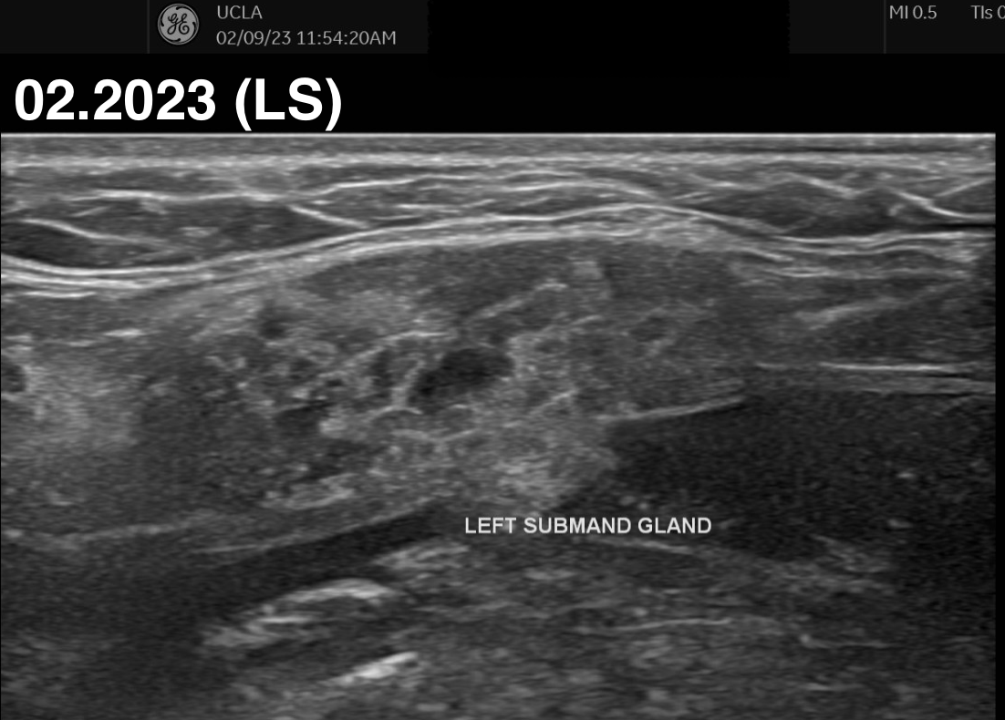
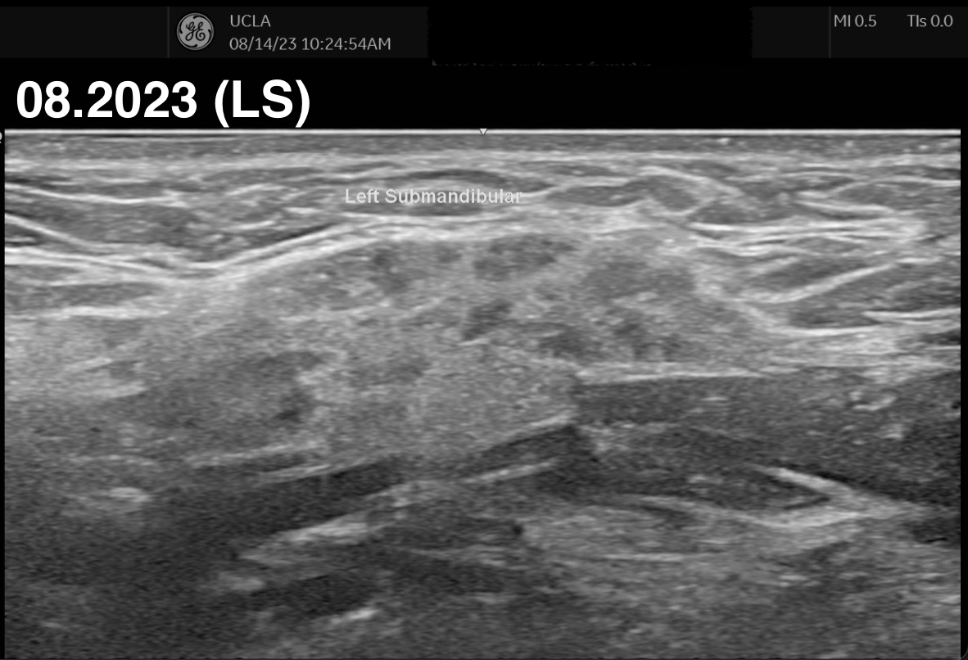
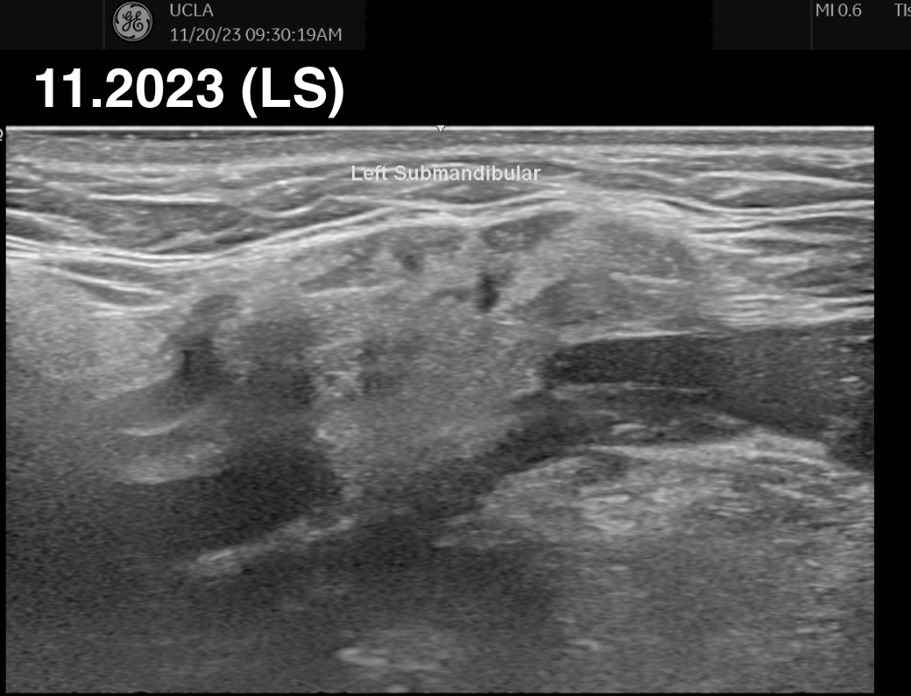
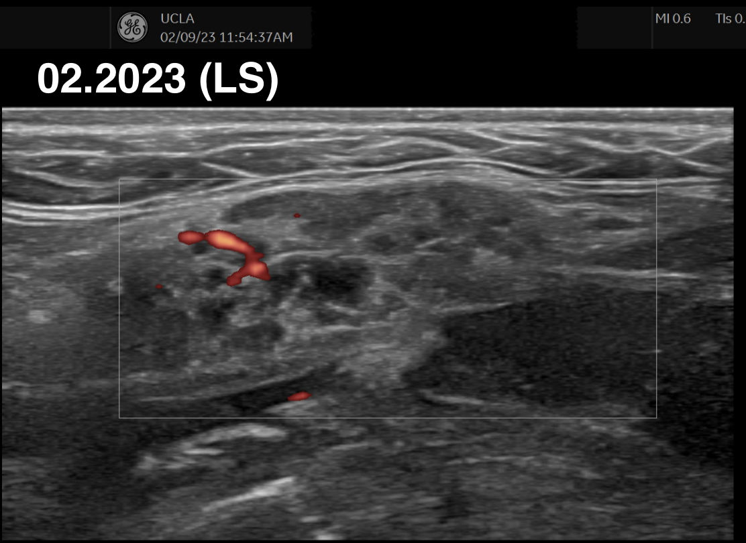
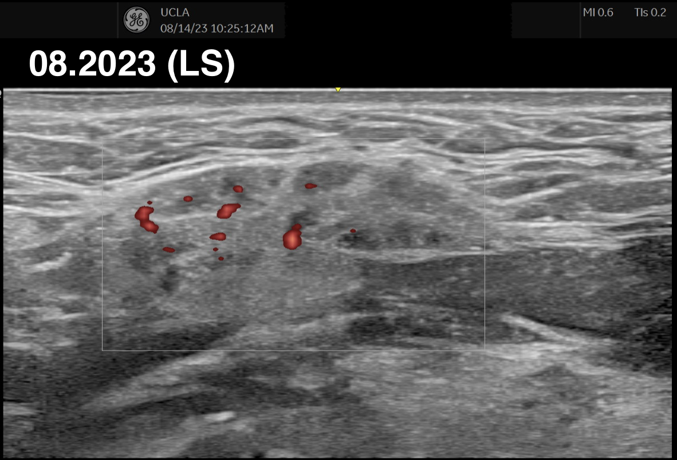
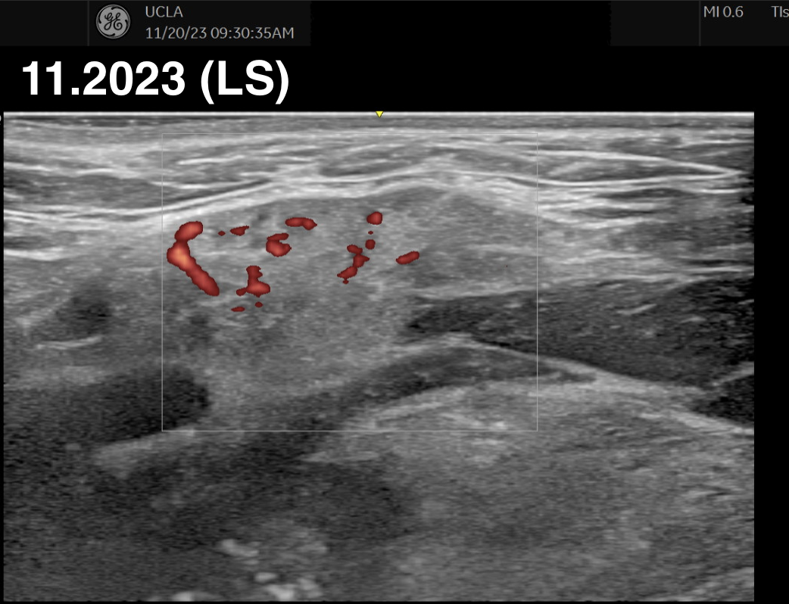
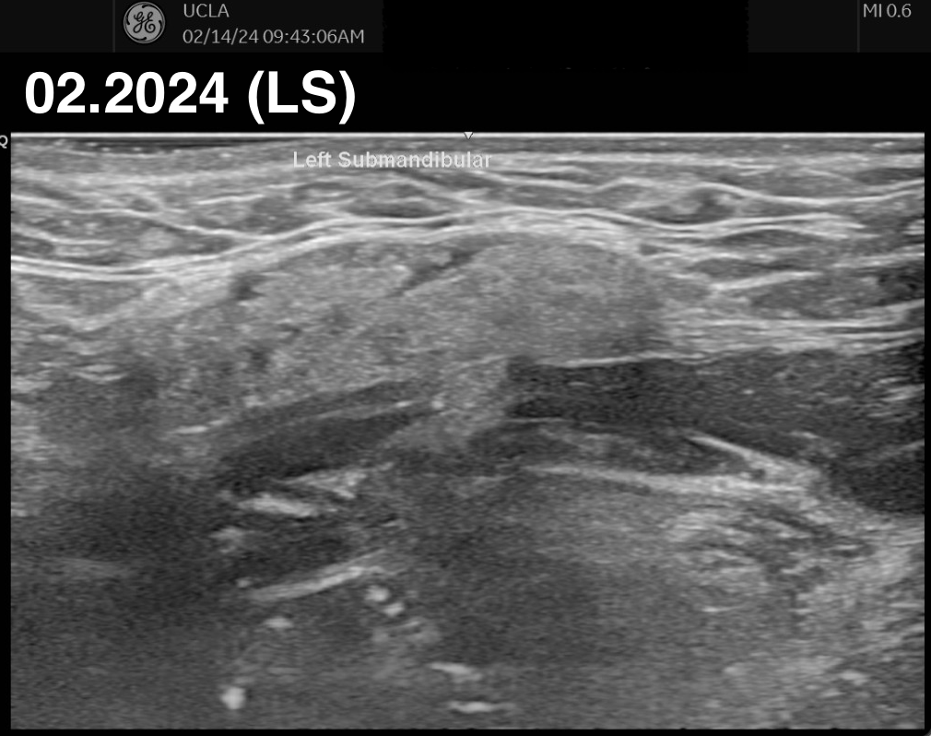
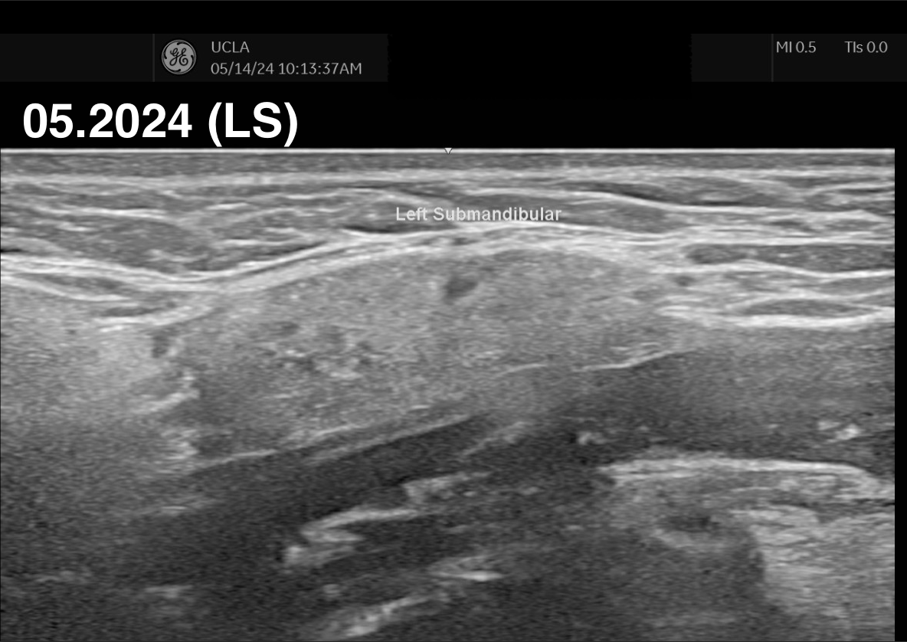
Left submandibular after rituximab
= IV rituximab 1 gram
02.2023 (P)
08.2023 (P)
05.09.23
05.22.23
12.08.23
12.21.23
09.23.24
02.21.24

Slide 16
Monitoring IgG4-RD
IgG4-RD is insidious
Serial imaging often needed for monitoring
SGUS can be an extension of our physical exams
“Serum IgG4 might not normalize and can remain elevated even in the absence of disease activity”²
Or are we just not picking up subclinical activity?
Greater incidence of malignancy in IgG4-RD patients (SIR 2.57)¹ when compared to general population
B cell lymphomas (DLBCL, MZL, MALT)
Pancreatic
Biliary tract
Yu T, Wu Y, Liu J, Zhuang Y, Jin X, Wang L. The risk of malignancy in patients with IgG4-related disease: a systematic review and meta-analysis. Arthritis Res Ther. 2022 Jan 5;24(1):14. doi: 10.1186/s13075-021-02652-2. PMID: 34986892; PMCID: PMC8728936.
2. Zachary S Wallace, Guy Katz, Yasmin G Hernandez-Barco, Matthew C Baker, Current and future advances in practice: IgG4-related disease, Rheumatology Advances in Practice, Volume 8, Issue 2, 2024, rkae020, https://doi.org/10.1093/rap/rkae020
Notes:
Zachary S Wallace, Guy Katz, Yasmin G Hernandez-Barco, Matthew C Baker, Current and future advances in practice: IgG4-related disease, Rheumatology Advances in Practice, Volume 8, Issue 2, 2024, rkae020, https://doi.org/10.1093/rap/rkae020
“serum IgG4 might not normalize and can remain elevated even in the absence of disease activity” (Wallace et al., 2024, p. 9)
“those with hypocomplementaemia, elevated IgE concentrations or peripheral eosinophilia at baseline, recurrent abnormalities can herald a flare” (Wallace et al., 2024, p. 9)
“aseline features can identify patients at high risk of relapse, including higher serum IgG4 concentrations, a greater extent of organ involvement, the presence of atopic features, peripheral eosinophilia and elevated serum IgE concentrations” (Wallace et al., 2024, p. 9)
“Many patients, however, have disease that is more apparent on imaging than on examination; in these cases, serial imaging is often necessary, and the preferred modality will vary by local practice and the organ affected.” (Wallace et al., 2024, p. 9)
“Disease relapses often affect previously involved organs, but new manifestations can occur, and clinicians should monitor for signs or symptoms thereof” (Wallace et al., 2024, p. 9)
“disease activity should be reassessed routinely every 3–6 months early on, even in the absence of symptoms, given the frequency of asymptomatic disease in IgG4-RD.” (Wallace et al., 2024, p. 9)
“management of serological relapse (e.g. rising IgG4 concentration) in the absence of a change in manifestations needs to be personalized” (Wallace et al., 2024, p. 9)
“prior involvement of organs that are prone to damage and difficult to assess for active disease (e.g. pancreas) might benefit from treatment, even in the absence of other features of disease activity. In other cases, closer monitoring after a serological relapse is warranted to detect a flare early in its course.” (Wallace et al., 2024, p. 9)
“Examples of damage include sicca syndrome from resection of a salivary gland,” (Wallace et al., 2024, p. 9)
“Two ways to differentiate damage from active disease include serial evaluations, with the expectation that damage will remain stable over time and active disease will worsen with time, and a trial of treatment with glucocorticoids, which would be expected to improve lesions that are attributable to active disease.” (Wallace et al., 2024, p. 10)
“Clinicians should be aware of any changes in activity that might suggest a possible malignancy developing at the site of prior IgG4-RD. A clue to this might be disease that was responsive to treatment in the past but now worsening despite resumption of previously effective treatment” (Wallace et al., 2024, p. 10)
A systematic review and meta-analysis by Yu et al. found that patients with IgG4-RD have a higher risk of overall cancer compared to the general population, with a standardized incidence ratio (SIR) of 2.57 (95% CI 1.72-3.84). Specifically, the risk for pancreatic cancer and lymphoma was notably higher, with SIRs of 4.07 (95% CI 1.04-15.92) and 69.17 (95% CI 3.91-1223.04), respectively.[1]
Additionally, a study by Keller-Sarmiento et al. reported that 18% of IgG4-RD patients developed cancer either before or after the diagnosis of IgG4-RD. The SIR for malignancy in these patients was 2.54, indicating a significantly higher prevalence compared to the general population.[2]

Slide 17
Not all glands respond the same to treatment
Prior studies showed parotid and lacrimal glands were restored to near normal after steroids
Submandibular glands were more resistant
Left submandibular gland before therapy (A) and 12 weeks (B) after starting oral steroids
Left parotid before therapy (H) and 12 weeks (I) after stating oral steroids.
Takagi Y, Nakamura H, Origuchi T, Miyashita T, Kawakami A, Sumi M, Nakamura T. IgG4-related Mikulicz's disease: ultrasonography of the salivary and lacrimal glands for monitoring the efficacy of corticosteroid therapy. Clin Exp Rheumatol. 2013 Sep-Oct;31(5):773-5. Epub 2013 Jun 26. PMID: 23806290.
Notes:
Fat infiltration doesn’t really occur in IgG4 MD, fibrosis/acinar destruction is minimal. --> in Sjogren’s, there might be more of this therefore leading to differences in MRI read for both diseases

Slide 18
Current uses of SGUS in pSS
Increasingly used in primary SS
Noninvasive
No radiation
Inexpensive
Easy to do in clinic
OMERACT group defined SGUS lesions in pSS with great intra-rater and inter-rater reliability¹
Adding SGUS into ACR-EULAR pSS criteria increased sensitivity from 95% to 97%¹
1. van Nimwegen JF, Mossel E, Delli K, van Ginkel MS, et al. Incorporation of Salivary Gland Ultrasonography Into the American College of Rheumatology/European League Against Rheumatism Criteria for Primary Sjögren's Syndrome. Arthritis Care Res (Hoboken). 2020 Apr;72(4):583-590. doi: 10.1002/acr.24017. PMID: 31254454; PMCID: PMC7155092.
Notes:
ven if many authors strongly believe that SGUS is relevant for the management of pSS, definite recommendations are still lacking, and this technique is not yet part of the classification criteria for pSS. This is mainly due to: (i) the absence of consensus on elementary SGUS lesions and scoring when pSS classification criteria were set up (12); (ii) the evidence of significant intra- and inter-rater disagreement (12–14); (iii) the use of old pSS cohorts for validation of pSS classification criteria, when SGUS was not yet fully developed (15). In order to overcome these issues, the Outcome Measure in Rheumatology (OMERACT) working group on the use of ultrasonography in pSS recently generated, after a three-round Delphi process, the definitions for the SGUS elementary lesions in pSS, and the scanning procedure (16). Lastly, the same OMERACT group developed a four-grade SGUS score, which showed excellent intra-rater reliability and a good inter-rater reliability between experts (16). By the possible addition of SGUS as a new criterion, the 2016 ACR-EULAR criteria for the classification of pSS may be ameliorated in sensitivity without modifying the specificity (17).
Currently, B-mode salivary gland ultrasonography (SGUS) is increasingly applied to assess structural changes of the salivary glands in primary SS. SGUS is noninvasive, nonirradiating, inexpensive, relatively easy to perform in an outpatient setting, and can be repeated for follow-up.
Receiver operating characteristic analysis showed an optimal cutoff value of ≥1.5 for SGUS. The optimal weight for SGUS positivity was 1. Cutoff for ACR/EULAR fulfilment remained ≥4. In patients who underwent a labial gland biopsy (n = 124), the original criteria showed an area under the curve (AUC) of 0.965, sensitivity of 95.9%, and specificity of 92.2%. After the addition of SGUS, the AUC was 0.966, with a sensitivity of 97.3% and specificity of 90.2%. In patients who underwent a parotid gland biopsy (n = 198), similar results were found. Sensitivity of the criteria decreased substantially when SGUS replaced salivary gland biopsy or anti-SSA antibodies, while performance remained equal when SGUS replaced the ocular staining score, Schirmer's test, or unstimulated whole saliva flow.

Slide 19
Differences between SGUS in pSS and IgG4
There are differences in imaging characteristics between IgG4-RD and pSS
IgG4
Reticular and nodal patterns that are easily seen, even by inexperienced observers¹
Submandibular involvement > parotid
High vascularity on power doppler
pSS
Hypoechoic and hyperechoic lines
Submandibular / parotid similarly involved
More atrophic glands
Normal parotid (p)
Reticular (p-IgG4)
Normal (s)
Reticular (s-IgG4)
Reticular/hypoechoic (p-SS)
Hypo/hyperechoic lines (s-SS)
Nodal (s-IgG4)
Shimizu M, Okamura K, Kise Y, Takeshita Y, Furuhashi H, Weerawanich W, Moriyama M, Ohyama Y, Furukawa S, Nakamura S, Yoshiura K. Effectiveness of imaging modalities for screening IgG4-related dacryoadenitis and sialadenitis (Mikulicz's disease) and for differentiating it from Sjögren's syndrome (SS), with an emphasis on sonography. Arthritis Res Ther. 2015 Aug 23;17(1):223. doi: 10.1186/s13075-015-0751-x. PMID: 26298875; PMCID: PMC4546818.
Notes:
Nodal and reticular patteners
“FDG-PET/CT revealed a tendency for abnormal 18F-FDG accumulation and swelling of both the parotid and submandibular glands in patients with IgG4-DS, particularly in the submandibular glands” (Shimizu et al., 2015, p. 1)
SS - MRI showed salt/pepper, multiple cystic areas in parotid

Slide 20
Updating IgG4-RD Classification Criteria
Including typical US imaging findings into criteria
Mottled or irregular net-like appearance¹
Reticular pattern²
Nodal patterns
Multiple hypoechoic foci
Next steps
Collect data prospectively within IgG4 and comparator diseases (pSS, lymphoma, tumors, etc)
Down the road
Expert panel review
Assigning specific weight to criteria
Validating criteria in independent cohorts
Asai S, Okami K, Nakamura N, Shiraishi S, Yamashita T, Anar D, Matsushita H, Miyachi H. Sonographic appearance of the submandibular glands in patients with immunoglobulin G4-related disease. J Ultrasound Med. 2012 Mar;31(3):489-93. doi: 10.7863/jum.2012.31.3.489. PMID: 22368140.
Shimizu M, Okamura K, Kise Y, Takeshita Y, Furuhashi H, Weerawanich W, Moriyama M, Ohyama Y, Furukawa S, Nakamura S, Yoshiura K. Effectiveness of imaging modalities for screening IgG4-related dacryoadenitis and sialadenitis (Mikulicz's disease) and for differentiating it from Sjögren's syndrome (SS), with an emphasis on sonography. Arthritis Res Ther. 2015 Aug 23;17(1):223. doi: 10.1186/s13075-015-0751-x. PMID: 26298875; PMCID: PMC4546818.
Notes:
a mottled or irregular netlike appearance on sonography of the submandibular glands is thus considered to suggest IgG4-related disease and can be helpful in the differential diagnosis at the initial manifestation. When the sonographic appearance in bilateral swollen submandibular glands reveals diffuse and multiple hypoechoic foci, then IgG4-related disease involvement should be considered.
Prospective Collection of Data: Candidate items are collected prospectively from patients with the disease of interest and comparator diseases. This data collection is crucial for understanding the prevalence and relevance of each candidate item in real-world settings

Slide 21
Conclusion
Looking into the future
It may be helpful to include typical IgG4 US findings in existing IgG4 classification criteria
When salivary glands are involved, US may be used to track the disease course and monitor for subclinical activity
US is inexpensive, safe, and quick to perform; it is a convenient resource as an extension of our physical exams
US may be used to monitor responses to therapies such as steroids, rituximab, inebilizumab, and new drug developments in the future

Slide 22
Questions? Amy Trang UCLA Rheumatology PGY IV atrang@mednet.ucla.edu

Slide 23
Thank you
Dr. Howard Yang – UCLA Rheumatology
Dr. Ben Glasgow – UCLA Pathology
RWCS Committee, Faculty, and Attendees

