Slide 1
A Case of IgA Vasculitis Presenting as Duodenal Perforation
2/13/2025
Audrey Liu, MD PGY-5
Rheumatology
RWCS

Slide 2
Case Presentation

Slide 3
Case Presentation
A 67-year-old man with CKD, HTN, testicular cancer s/p orchiectomy, and recent diagnosis of rheumatoid arthritis presented to the hospital with abdominal pain and diarrhea and was found to have a duodenal perforation on emergent laparotomy.

Slide 4
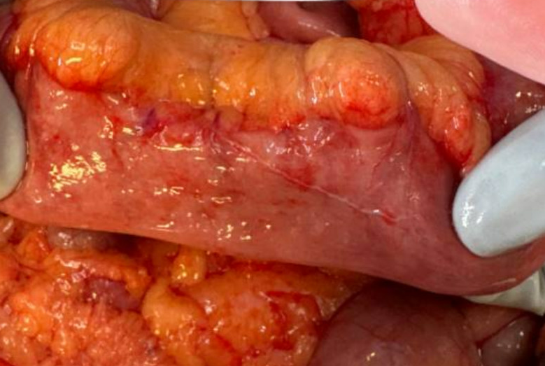
Case Presentation
During the surgery, the surgeons noted a 3mm perforated duodenal ulcer. Additionally, there were scattered areas of hyperemia of the small bowel namely at the hepatic flexure, and the terminal ileum appeared edematous and hyperemic. Fluorescence imaging with viable bowel throughout. He had some NSAID and steroid exposure.
Rheumatology was consulted for investigation if autoimmune etiology related to bowel perforation.
Intra-op small bowel showing areas of hyperemia
Notes:
Hyperemia of the bowel can indicate decreased blood flow to the bowel

Slide 5
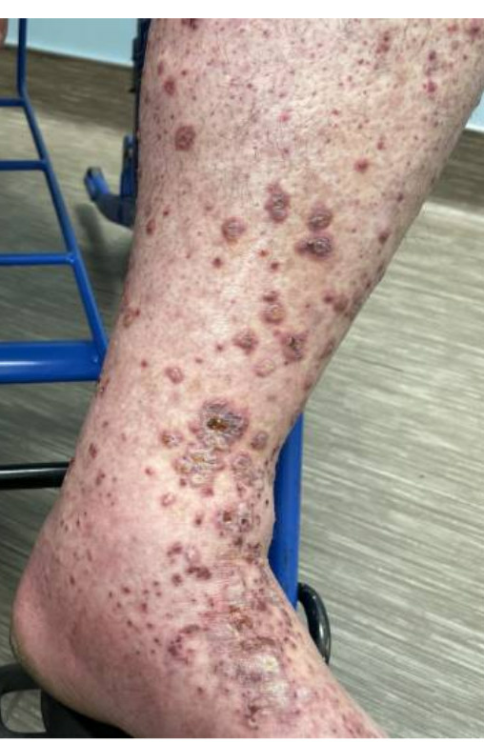
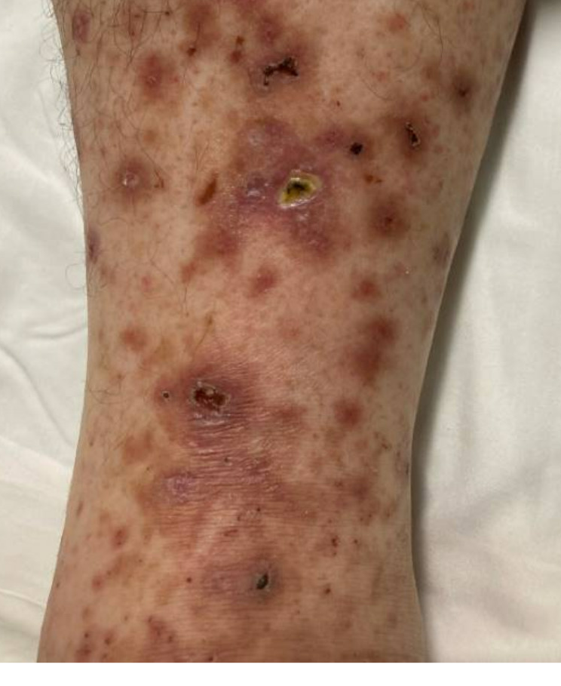
Case Presentation
1 month prior he had presented to the ED twice with a non-pruritic non-painful lower extremity rash. He was given prednisone 50mgQD x5 days and discharged from ED.
Polyarthralgia symptoms started ~1 year prior with weakly +RF and neg CCP at that time, however recent repeat was dual positive.
1 month
Rash at prior ED presentation
Rash at time of consultation

Slide 6
Objective Data
Physical Exam:
​Gen: anasarca, intubated
Abd: open abdomen
Skin: healing palpable purpura over abdomen and especially lower extremities

Slide 7
Objective Data
Lab Results:
CBC: WBC 15, Hgb 11 (baseline 14), Plt 426​
CMP: Cr 2.2 (baseline 1.3), normal LFTs​
UA: RBC>20, WBC 45, Leuk esterase 25, nitrite neg
Urine Protein/Creatinine: 4.6
CRP 4.68, ESR 69​
RF 40, CCP 131​
Negative: ANA, ANCA, MPO, PR3, Hep B/C, IgA, cryoglobulin
complements and SPEP were recommended to be checked by neph, but they were not checked by primary team

Slide 8
Imaging & Pathology
Chest x-ray negative
CT A/P with peritoneal free air, wall thickening and enhancement of the distal ileum and duodenum, and small amount of free fluid.
Pathology from the duodenal specimen from his laparotomy showed reactive changes of overlying duodenal epithelium.
Skin biopsy showed small vessel leukocytoclastic vasculitis.

Slide 9
Hospital course
The patient continued to have worsening renal function and proteinuria despite having been on IV methylprednisolone 40mg for 5 days. Due to high suspicion for worsening vasculitis, pulse dose steroids of IV methylprednisolone 1g daily x 3 doses were started. Renal biopsy was subsequently performed.

Slide 10
Renal biopsy showed....

Slide 11
Renal biopsy (7/31/2024)
IgA dominant Glomerulonephritis with extensive active crescent formation
Acute tubular injury
Mild to moderate arteriosclerosis
COMMENT: The glomerular lesion may represent IgA vasculitis or IgA nephropathy, requiring clinical differentiation between these two entities. The glomerular lesion is very active with approximately 80% fibrocellular crescents along with few glomeruli showing endocapillary hypercellularity. There is minimal chronicity with 3% (1/34) globally sclerotic glomeruli and no significant interstitial fibrosis and tubular atrophy.

Slide 12
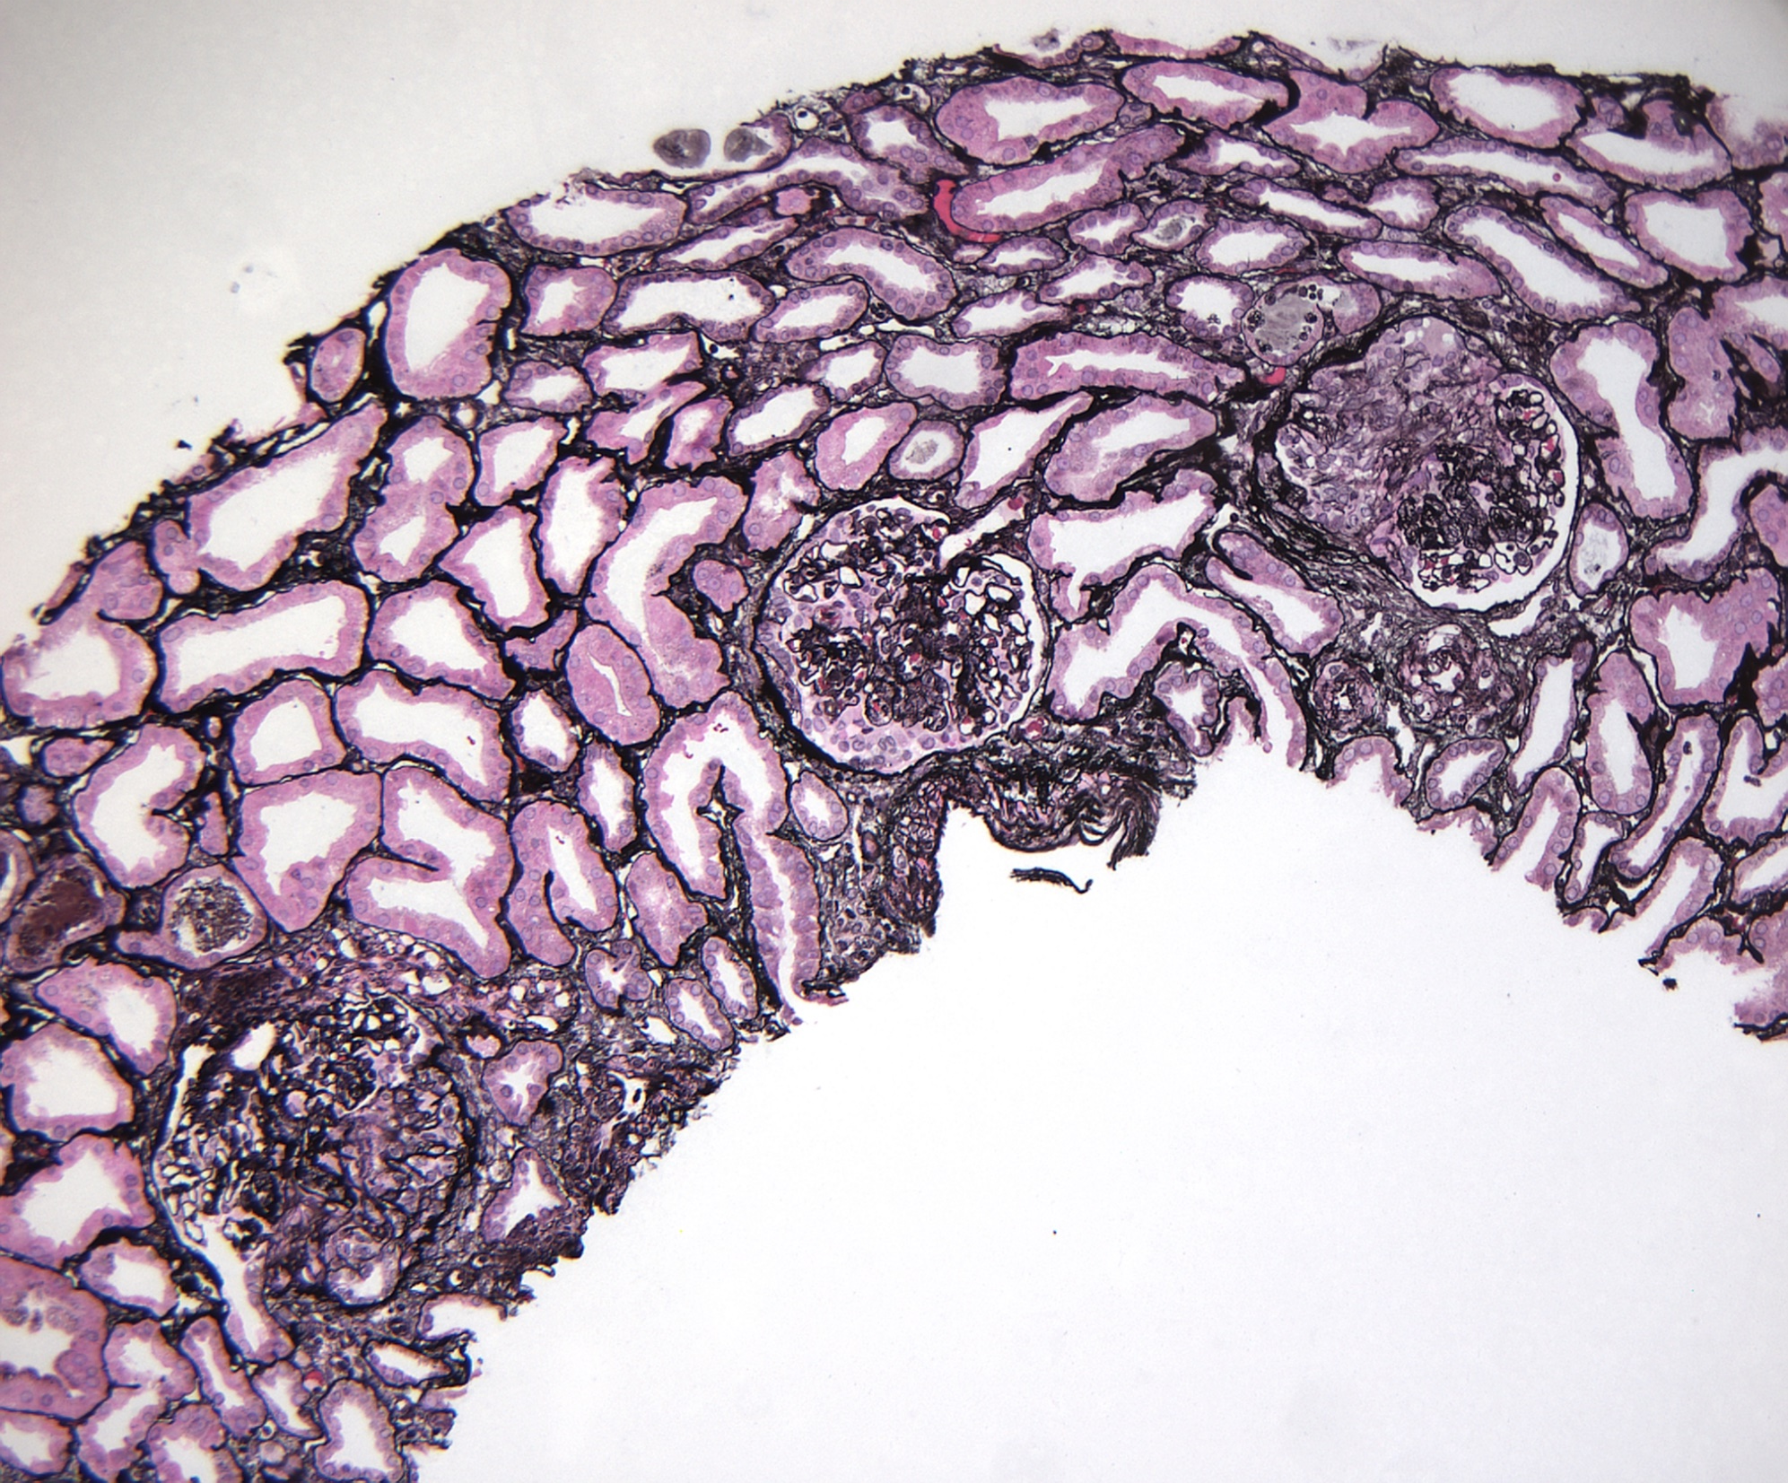
34 glomeruli
1 globally sclerotic
80% active (cellular/fibrocellular)
crescents
No interstitial fibrosis/tubular atrophy

Slide 13
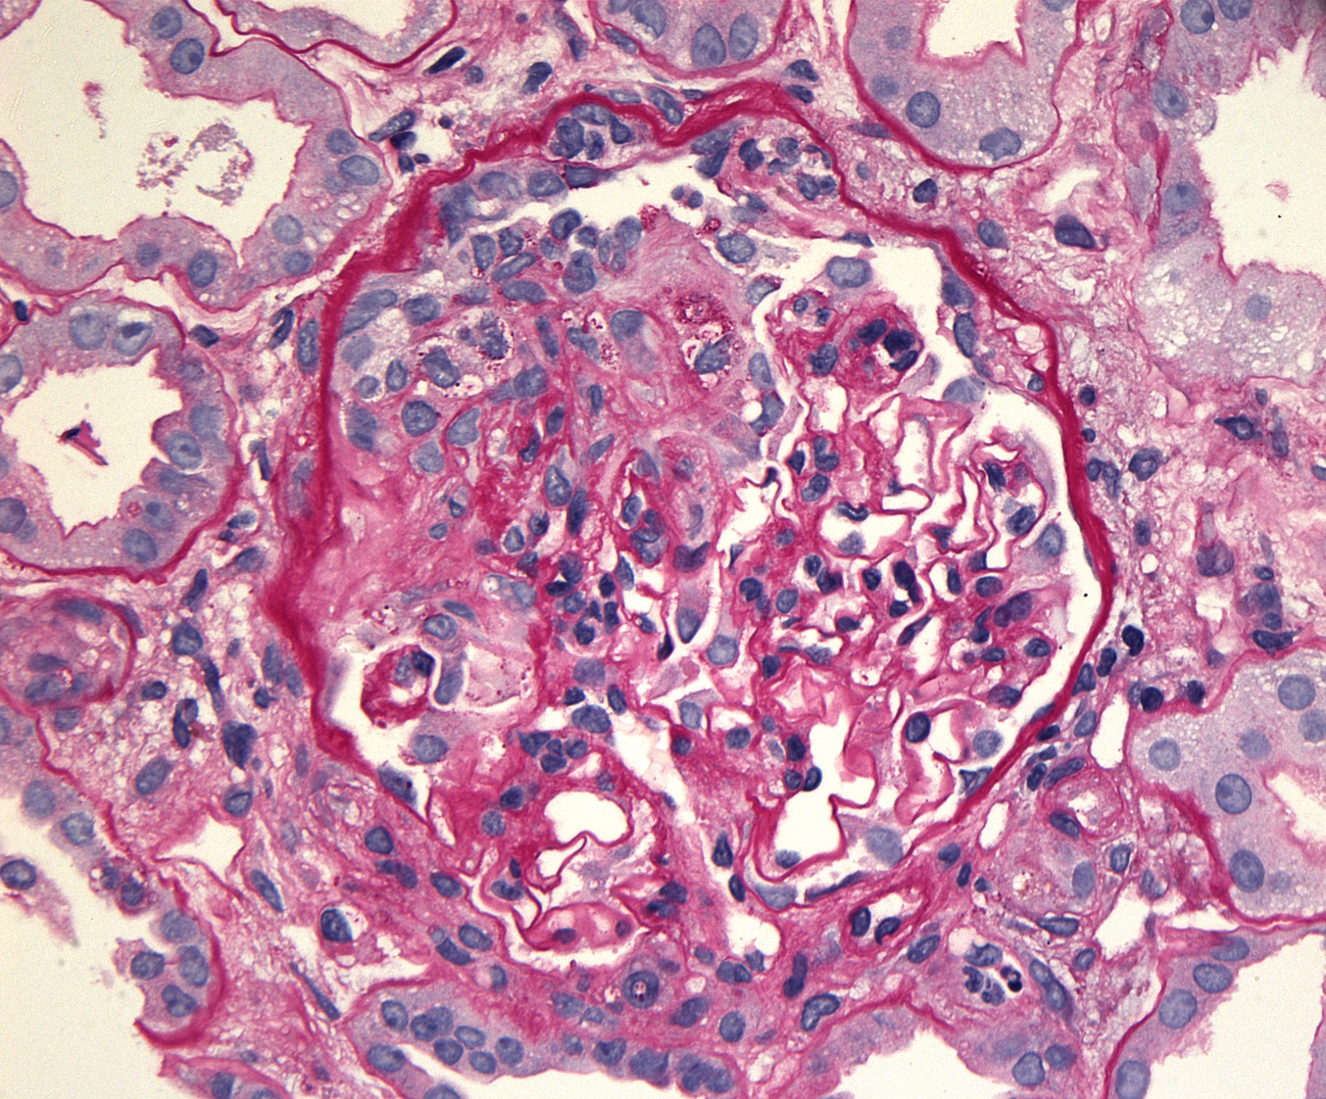
Cellular crescent
No mesangial hypercellularity

Slide 14
Endocapillary hypercellularity

Slide 15
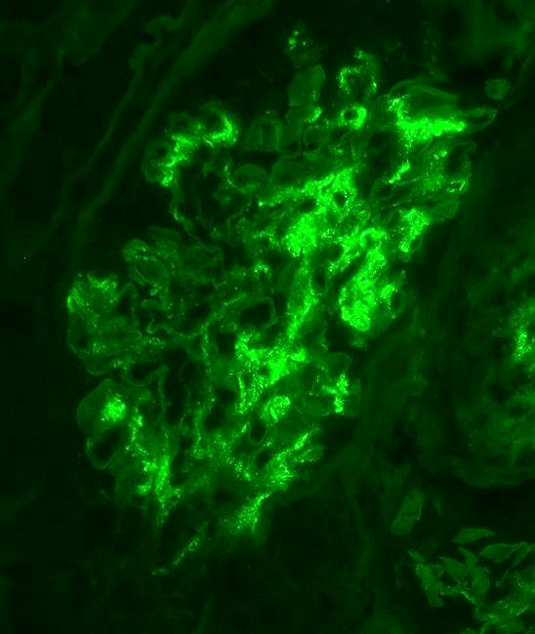
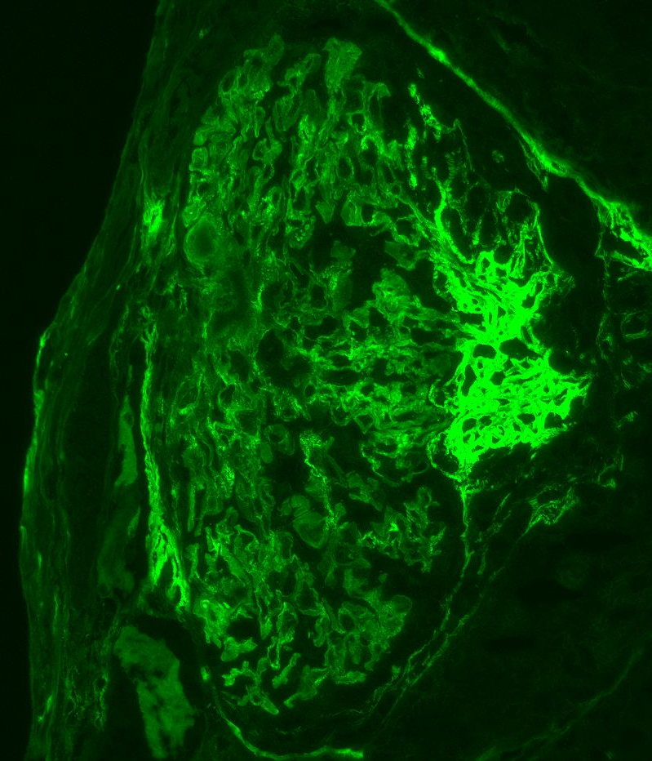
Mesangial IgA
Urinary space fibrin in active crescent

Slide 16
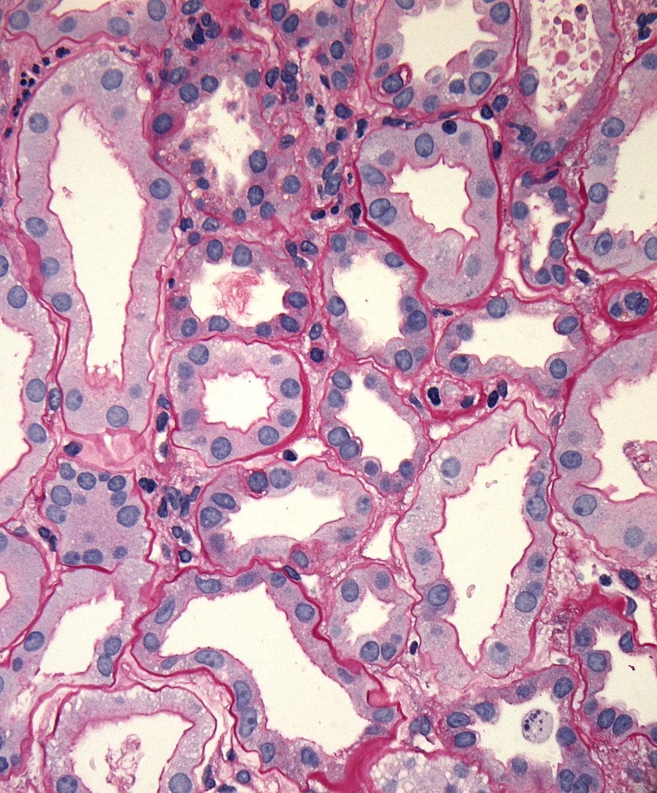
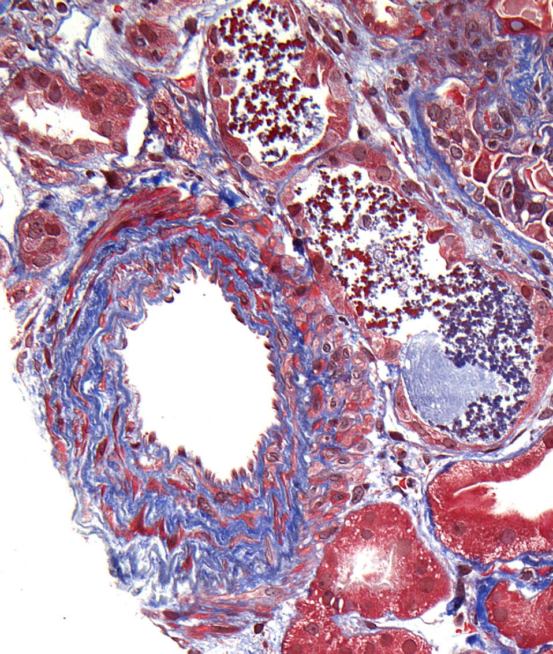
Acute tubular cell injury
Arteriosclerosis, tubular cell injury

Slide 17
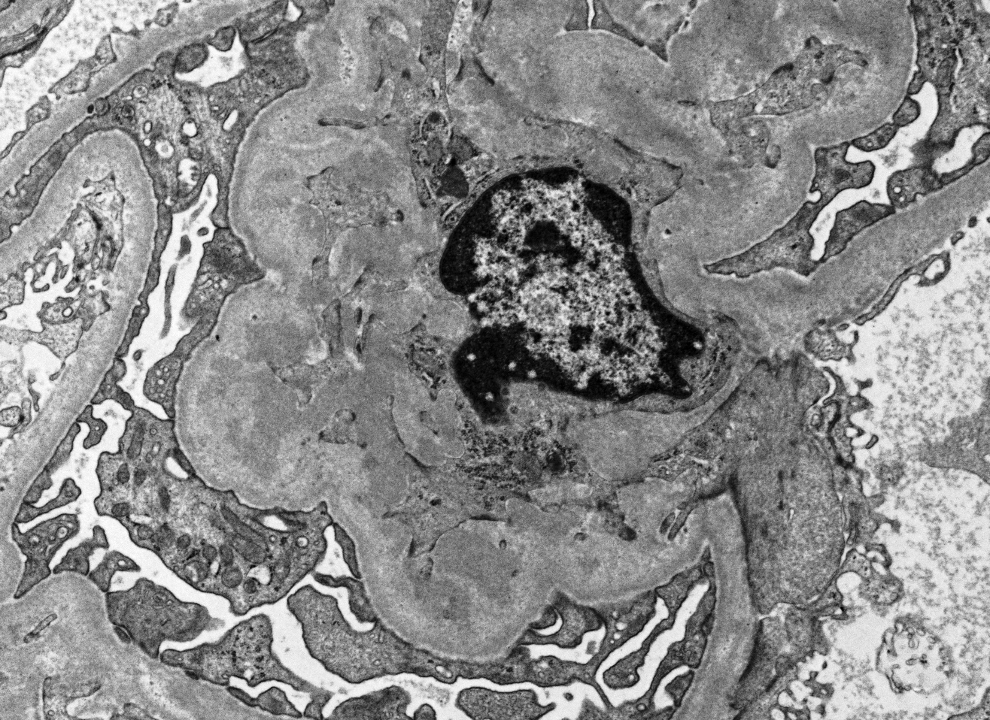
Mesangial deposits

Slide 18
RENAL BIOPSY DIAGNOSIS:
IgA DOMINANT GLOMERULONEPHRITIS WITH EXTENSIVE ACTIVE CRESCENT FORMATION
This is favored to be IgA vasculitis given the clinical findings. However, this could be IgA nephropathy and an ANCA negative vasculitis is not excluded.
The Oxford IgA score is M0 E1 S0 T0 C2. For IgAN, an E1 score (endocapillary hypercellularity) suggests a lesion which may improve with immunosuppressive therapy. C2, representing crescents in >25% of glomeruli, is associated with an increased risk of chronic renal failure even in patients treated with immunosuppressive therapy. In IgA vasculitis, the E1 score recently has been associated with initial improvement in eGFR followed by a late decline (Clin J Am Soc Nephrol. 2024;19:438).
2. ACUTE TUBULAR INJURY
3. MILD TO MODERATE ARTERIOSCLEROSIS
Notes:
In 2009, the Oxford classification of IgA nephropathy was published, as an internationally agreed, evidence-based, pathological classification, of help to clinicians.^{1,2} This required subjective assessments of four renal biopsy features, mesangial cellularity (M), endocapillary hypercellularity (E), segmental sclerosis (S), and interstitial fibrosis/tubular atrophy (T). Another feature, glomerular crescents (C), was added in 2017.³ In the 2009 study, crescents were uncommon, not associated with outcome, and not initially included.^{1,2} The classification was only intended to identify prognostic features, although it was recognized that such a classification may also in the future facilitate the identification of specific features that may predict response to immunosuppression or other specific treatments and refine recruitment to clinical trials by their capacity to stratify patients by their risk of progression.¹
The classification followed retrospective study of 265 patients. Renal biopsies were examined by pathologists using detailed score sheets.² Features finally included were derived from those that were reproducible after repeated comparisons, had least sampling error, were easiest to score, and were independently correlated with outcome. Agreement between the original pathologists for assessment of MEST is impossible to know because they did not specifically report MEST scores. Similarly, reproducibility of C scoring was not formally tested before this was introduced.^{3,4}
In brief, the scores are as follows^{1,3}: M1 means that more than half of glomeruli have more than three cells in a mesangial area. Otherwise, the score is M0. E1 means an increased number of cells within glomerular capillary lumina (otherwise, E0). S1 means sclerosis not affecting the whole tuft or presence of an adhesion (otherwise, S0), although the updated classification recommends addition of with/without podocyte hypertrophy/tip lesions to S1.³ T1 means that an estimated 26%–50% of the cortex contains tubular atrophy or interstitial fibrosis, and T2 means that more than 50% is affected (otherwise, T0). Crescents have extracapillary proliferation of more than two cell layers, cellular lesions with more than 50% occupied by cells, and fibrocellular with no more than 50% cells and less than 90% matrix. Fibrous crescents, with at least 90% matrix, are ignored. C0 means no crescents, C1 crescents in under 25% of glomeruli, and C2 crescents in at least 25% of glomeruli.

Slide 19
Hospital Course
Treatment:
Pulse dose methylprednisolone 1g IV QD x 3 days, followed by high dose prednisone
Cytoxan 500mg/m2 x 1
Unfortunately, hospital course was complicated by continued intrabdominal infections and bleeding related to his perforation and mucosal ulcers and ESKD required HD. 2 months into his hospitalization, he opted for hospice care and expired several days later.

Slide 20
Conclusion of Case
This 67M with recent dx of seropositive RA, with 1 mo of petechial/LCV type rash presented to the ER with abdominal pain due to duodenal perforation. He was also found to have sediment in his urine and about 4g UPCR. He had multiple biopsies.
Ultimately, he was ultimately diagnosed with IgA vasculitis on the basis of clinical findings and renal biopsy.
IgA Vasculitis is challenging to treat.

Slide 21
Discussion

Slide 22
What is IgA Vasculitis?
IgAV is an immune complex-mediated small vessel vasculitis characterized by a syndrome of abdominal pain, renal involvement, purpura and arthritis.
The etiology has been linked to infections and drugs.
For adults, there can be malignancies associated with IgAV, most commonly solid tumors. These patients tend to be male with a mean age of 60 years.
Our patient was an elderly male with testicular cancer.

Slide 23
GI involvement in IgAV
GI involvement is common, seen in ~51%-74% of patients.
In one retrospective study of 260 adults with IgAV, 53% of patients had GI involvement. Initial presentations included abdominal pain in 99% and acute surgical abdomen in only 4% of patients.
Abdominal imaging showed thickening of intestinal wall in 61%, and endoscopies revealed abnormalities in 87%, mostly mucosal ulcerations.
Endoscopic findings include frequent duodenal involvement, duodenal lesions (erythema, ulcer, hematoma-like protrusions) and gastric mucosal erythema.
Thickening of intestinal wall, intestinal bleeding, duodenal involvement, and acute surgical abdomen were seen in our patient.
While there is not data regarding the exact frequency of viscus perforation in IgAV, it is a severe and uncommon complication of IgAV.
Audemard-Verger, A., et al

Slide 24
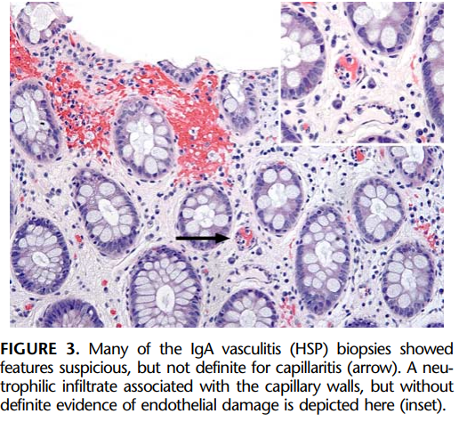
GI biopsies: histologic features
Common histologic features of GI biopsies include lamina propria hemorrhage and lamina propria fibrin deposition with red cell sludging and nuclear debris.
Vasculitis is generally rare in gastrointestinal biopsies of patients with IgAV.
In one study of GI biopsies from adult and pediatric patients with IgAV biopsies, leukocytoclastic vasculitis was only seen in 4/16 biopsies.
Biopsy findings typically include a neutrophilic infiltrate in the small bowel and colon, with the duodenum being the most frequently affected area.
Kawasaki, K., et al

Slide 25
Treatment for IgAV
Treatment of severe IgAV has limited data and no clinical practice guidelines.
First line treatment includes high dose or pulse steroids.
Other medications used, but with limited data include, azathioprine, mycophenolate mofetil, cyclophosphamide, or rituximab.

Slide 26
References
Firestein, G., Firestein & Kelley’s Textbook of Rheumatology - Electronic (11th ed.). 2020: Elsevier - OHCE.
Ebert, E.C., Gastrointestinal manifestations of Henoch-Schonlein Purpura. Dig Dis Sci, 2008. 53(8): p. 2011-9.
Audemard-Verger, A., et al., Gastrointestinal involvement in adult IgA vasculitis (Henoch-Schönlein purpura): updated picture from a French multicentre and retrospective series of 260 cases. Rheumatology (Oxford), 2020. 59(10): p. 3050-3057.
Kawasaki, K., et al., Gastrointestinal involvement in patients with vasculitis: IgA vasculitis and eosinophilic granulomatosis with polyangiitis. Endosc Int Open, 2019. 7(11): p. E1333-e1343.
Louie, C.Y., et al., Histologic Features of Gastrointestinal Tract Biopsies in IgA Vasculitis (Henoch-Schönlein Purpura). Am J Surg Pathol, 2018. 42(4): p. 529-533.

Slide 27
Thank you

