Slide 1
An Unusual Consult for Myopathy
Kelsey Lemmen, MD
UPMC

Slide 2
Clinical Case
48 year old woman presents with weakness and muscle pain

Slide 3
PCP Visit
48 year old woman with no significant past medical history presents to her primary care office with several days of muscle pain and weakness in her bilateral proximal > distal lower extremities
No bowel or bladder changes
No preceding illness, activity, travel, exercise/overuse or other trigger for symptoms
Exam notable for decreased strength, unable to flex hips against resistance

Slide 4
History
Past Medical History: IBS, history of appendectomy and colectomy
Social History: Former smoker (24 pack years, quit > 10 years ago), social alcohol use
Home Medications: none
Allergies: NKDA
Family History: No known autoimmune illness

Slide 5
Outside ER
CBC: WBC 6.1, Hgb 14.6, Plt 297
CMP: Na 134 (L) (137-145), K 2.3 (L) (3.5-5.1), Cl 94 (L) (98-107), CO2 31 (H) (22-30), BUN 4, Cr 0.6, Ca 9.1, Protein 7.6, Albumin 4.8, Tbili 2.0 (H) (0.2-1.3), AST 194 (H) (8-39), ALT 83 (H) (0-35), Alk Phos 59
Phos 4.9 (H) (2.5-4.5)
CPK 2317 (H) (30-135)
TSH 3.75 (0.465-4.680)
FT4 0.73 (L) (0.78-2.19)
Mg 1.3 (L) (1.3-2.3)
Lactate 1.8
UA bland, UDS negative
MR T & L spine ordered, recommended transfer for Neurosurgery evaluation
Prior to transfer was given IV fluids, electrolyte supplementation, and IV Solu-Medrol with improvement of symptoms
Labs at time of transfer: K 3.5, CK 1346, AST 125, ALT 55

Slide 6
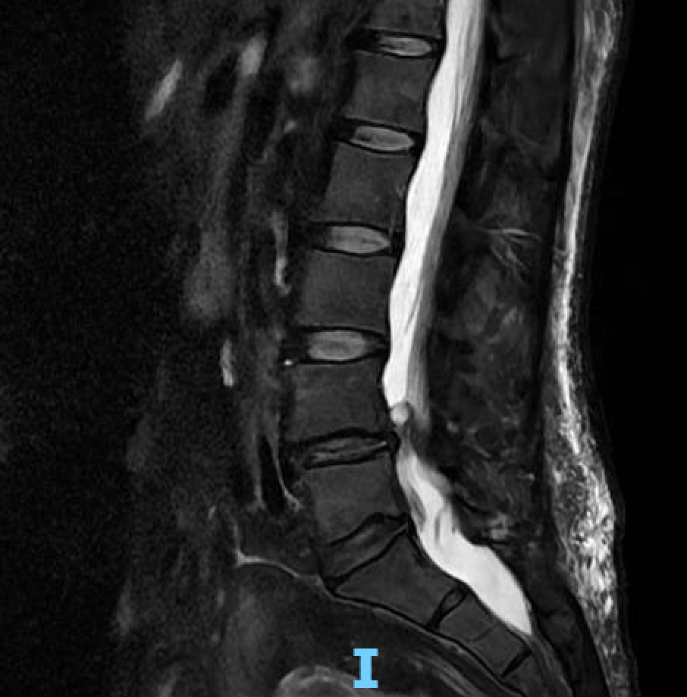
Admission
Neurosurgery evaluation: Initial exam with 4/5 strength in proximal lower extremities, 5/5 strength upper extremities. No hyperreflexia or other abnormality. No surgical intervention recommended.
On potassium supplementation, getting IV dexamethasone 4 mg q6h
Rheumatology consulted with concern for inflammatory myositis
Patient clinically improving

Slide 7
Differential?

Slide 8
Differential
Inflammatory Myositis
Hypokalemic periodic paralysis
Thyrotoxic Periodic Paralysis
Andersen Syndrome
Metabolic Myopathy
GBS
Myasthenia gravis
Tick borne paralysis
Botulism
Other secondary causes of hypokalemia

Slide 9
Next steps?
Notes:
Additional labs sent (including sent out myositis panel), EMG ordered

Slide 10
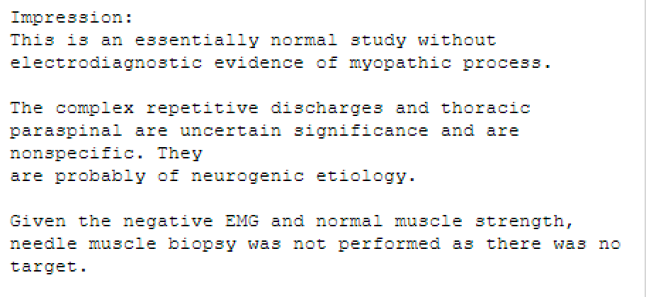
EMG

Slide 11
Discharge
Plan to discharge on Prednisone 60 mg daily x 2 weeks, then decrease to 40 mg daily until outpatient follow-up in several weeks
Also got discharged on K 40 mEq daily
Labs: CK 31, K 4.3, BMP unremarkable, TSH and FT4 WNL

Slide 12
Return Visit
No recurrent symptoms, exam with normal strength
Tapered off Prednisone rapidly without recurrent symptoms
Anti-Jo-1 negative, Lyme negative, myositis panel negative (Oklahoma), myasthenia panel negative
Genetic testing sent
Notes:
Stopped prednisone given side effects
Continued potassium supplementation

Slide 13
Teaching Points
This case is a reminder to keep a broad differential including non-autoimmune/rheumatologic conditions

Slide 14
Differential
Inflammatory Myositis
Hypokalemic periodic paralysis
Thyrotoxic Periodic Paralysis
Andersen Syndrome
Metabolic Myopathy
GBS
Myasthenia gravis
Tick borne paralysis
Botulism
Other secondary causes of hypokalemia
Notes:
CK normalized very quickly w/ treatment, sooner than would be expected for inflammatory myositis. Continued to be symptom free off steroids.
Lyme testing negative. No other travel or concerning history. Thyroid studies normal.
Lower concern for secondary K loss, potassium corrected quickly with supplementation.
Did not fit phenotype for Andersen syndrome. Absence of other features.
Favored dx: hypokalemic periodic paralysis

Slide 15
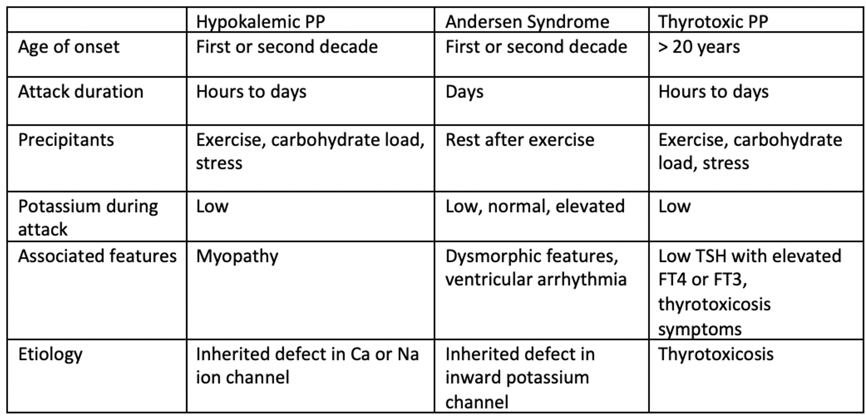

Slide 16
Hypokalemic Periodic Paralysis

Slide 17
Hypokalemic Periodic Paralysis
Rare channelopathy caused by skeletal muscle ion channel mutations, mainly affecting calcium or sodium channels
Most hereditary or familial
Triggers: strenuous exercise, high carbohydrate diet
Rare: 1/100,000
Typically autosomal dominant inheritance
Typical presentation 1st-2nd decade of life
Can have incomplete penetrance, more commonly in women. Women tend to have less attacks with muscle weakness than men.
Notes:
Familial type 1, mutation in skeleton muscle calcium channel gene (more common)
Type 2 - sodium channel gene (SCN4A)
Most cases are hereditary or familial, can have new mutations
Triggers include stress, strenuous exercise, high carbohydrate diet, cold temperatures, fear, alcohol etc. This leads to an increase in plasma epinephrine or insulin, lowering potassium and leading to episodes of weakness.
Myopathy is later
Women more common to have incomplete penetrance, less attacks with muscle weakness than men

Slide 18
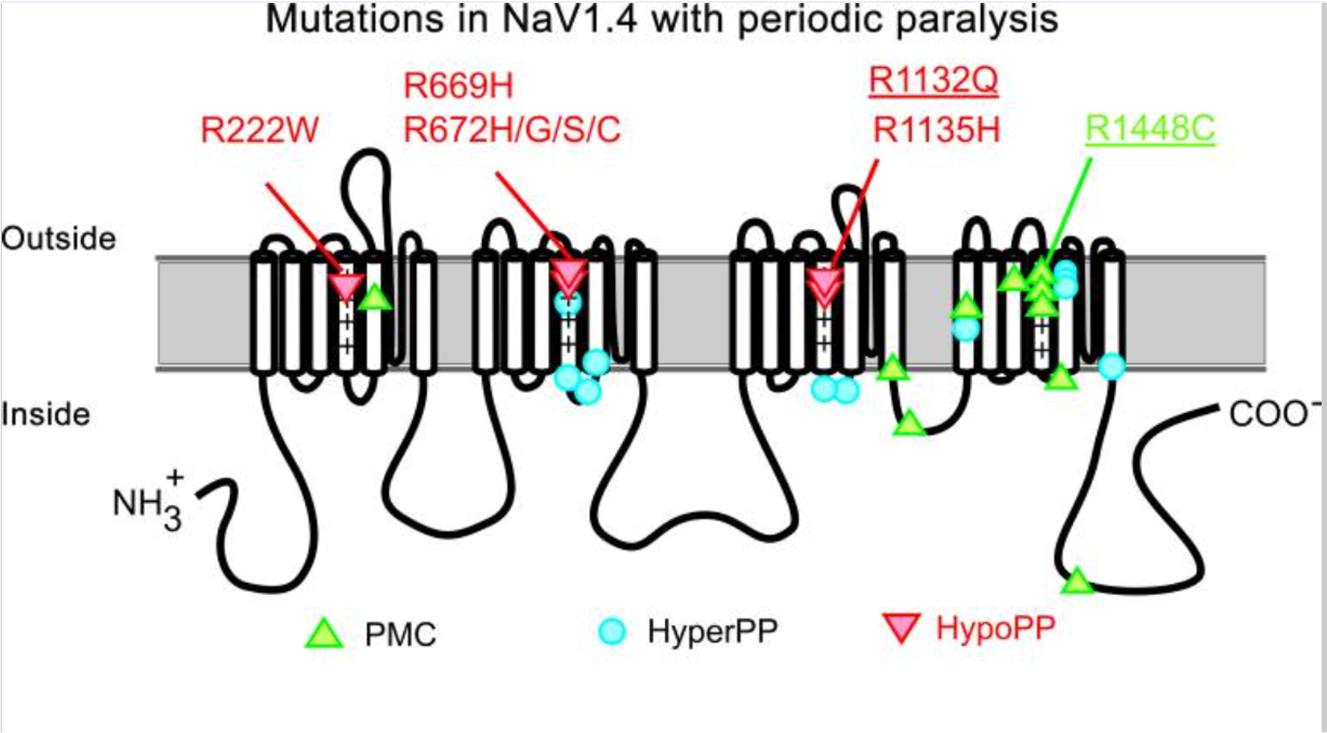
Hypokalemic Periodic Paralysis
Notes:
Most common mutation is missense mutation affecting positively charged residues (arginine) in S4 domain of skeletal muscle ion channel, disrupting the electric current and normal flow through the voltage sensor domain, resulting in muscle cell membrane inexcitability, leading to a failed action potential and flaccid paralysis.
Average K 2.3-2.4; if lower consider secondary cause of low K

Slide 19
Hypokalemic Periodic Paralysis
Many patients will have prodromal symptoms including fatigue for around a day prior to an attack
When attacks are incomplete, typically lower limbs are more affected than upper limbs
Usually does not involve bulbar, ocular, and respiratory muscles
Can do provocative testing including insulin or glucose administration, but can be dangerous. Exercise testing is generally safer
During an acute attack, EMG may reveal a reduced amplitude of compound muscle action potential
Genetic testing
Notes:
Exercise testing – provoke single muscle with vigorous exercise 2-5 minutes, measure EMG

Slide 20
Treatment
Potassium supplementation
Non-pharmacologic intervention
Carbonic anhydrase inhibitors, potassium sparing diuretics
Notes:
Non pharmacologic intervention: avoiding triggers, lifestyle modification
Acetazolamide typically first diuretic used

Slide 21
Genetic Testing
Notes:
Invitae panel, neuromuscular – 211 genes tested
Variants of uncertain significance identified
PGK1 mutation: phenotype does not fit, associated w/ glycogen storage disorder. Onset is in childhood, patients develop anemia, neuro symptoms. X linked recessive inheritance
PLEC mutation: AD inheritance, muscular dystrophy
SCN4a: unknown significance. Sodium channel mutation, assoc w/ hypokalemic PP. no described mutations in literature at same position. Unknown significance
Genetics referral – pending
No recurrent attacks with lifestyle modification, potassium supplementation

Slide 22
References
1.Francis DG, Rybalchenko V, Struyk A, Cannon SC. Leaky sodium channels from voltage sensor mutations in periodic paralysis, but not paramyotonia. Neurology. 2011 May 10;76(19):1635-41. doi: 10.1212/WNL.0b013e318219fb57. Epub 2011 Apr 13. PMID: 21490317; PMCID: PMC3100087.
2.Phuyal P, Bhutta BS, Nagalli S. Hypokalemic Periodic Paralysis. [Updated 2024 Mar 19]. In: StatPearls [Internet]. Treasure Island (FL): StatPearls Publishing; 2024 Jan-. Available from: https://www.ncbi.nlm.nih.gov/books/NBK559178/
3.Statland JM, Fontaine B, Hanna MG, Johnson NE, Kissel JT, Sansone VA, Shieh PB, Tawil RN, Trivedi J, Cannon SC, Griggs RC. Review of the Diagnosis and Treatment of Periodic Paralysis. Muscle Nerve. 2018 Apr;57(4):522-530. doi: 10.1002/mus.26009. Epub 2017 Nov 29. PMID: 29125635; PMCID: PMC5867231.

Slide 23
Thank you

