Slide 1
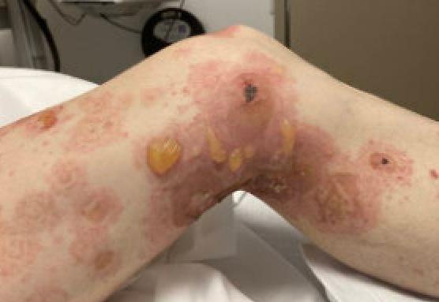
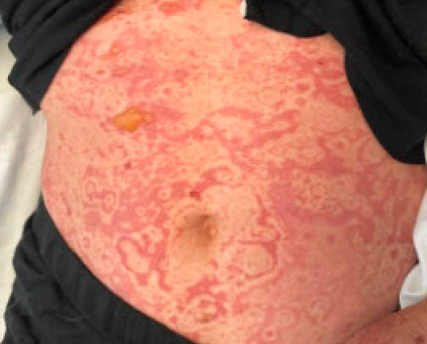
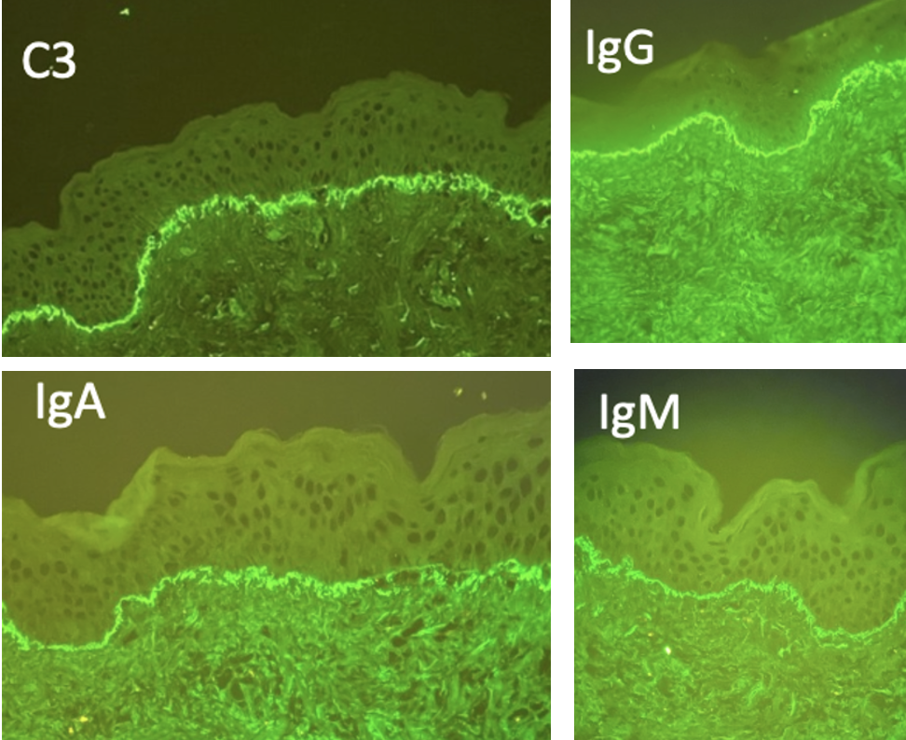
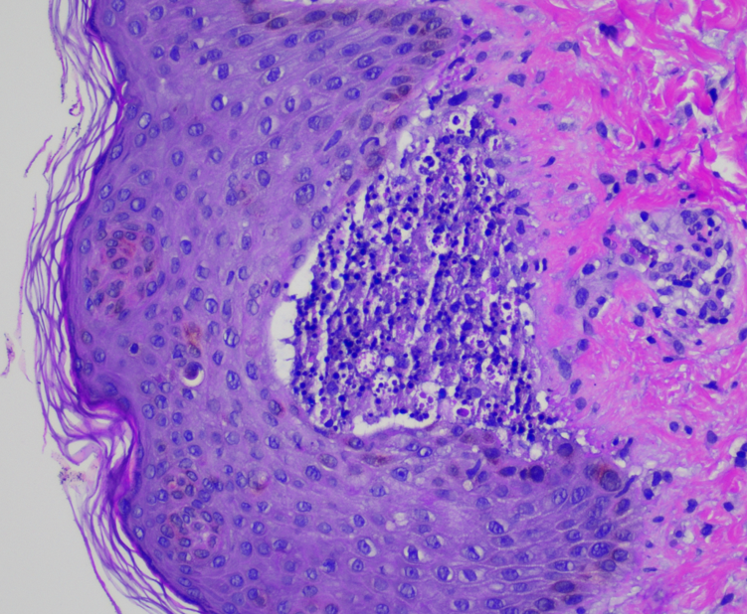
Bubble Trouble: When Bullous Lupus Bursts Onto the SLE Scene
Alana Haussmann MD¹, Malika Ibrahim MBBS MRCP¹, Oleg Stens MD², Jennifer Grossman MD¹
¹ University of California Los Angeles (UCLA) Department of Rheumatology, ² Harbor-UCLA Department of Rheumatology
Case 1
Discussion
50-year-old female with no prior medical history presented to dermatology with 2 months of tense bullae, erythematous papules, and vesicles on chest, abdomen, limbs, and soles, she denied other symptoms
Bullous pemphigoid was suspected and she was treated with prednisone 40mg and dupilumab
Her skin disease rapidly progressed to cover >90% of her body and an erythema gyratum repens-like pattern erupted, mucous membranes became involved, she was hospitalized
Skin biopsy revealed subepidermal bullae with neutrophilic infiltration; direct immunofluorescence (DIF) showed basement membrane staining + for C3, IgG, and IgG4
Serology showed ANA 1:640, nDNA 1:1280, dsDNA 631
BSLE is a rare blistering disorder characterized histologically by subepidermal bullae, neutrophilic infiltrate, interface dermatitis, and immunoglobulin and C3 deposition at the basement membrane
BSLE can be the first manifestation of SLE and can present without other clinical features of SLE
Erythema gyratum repens presents as wood grain-patterned plaques and is typically linked to malignancy, but can also occur with BSLE
Dapsone is an effective therapy for BSLE but carries a risk of methemoglobinemia which can present with unexplained shortness of breath and hypoxemia
Dupilumab, used for bullous pemphigoid, has been reported to induce acute cutaneous SLE; in case 1 dupilumab exacerbated our patient’s bullous SLE
BSLE can be life threatening and requires a multi-modal. individualized approach for treatment, relapse is common
a
b
c
C
d
Case 2
18-year-old female with childhood seizures presented with a 6–month bullous rash of her limbs, trunk, and face, oral ulcers and arthralgias; an outside biopsy suggested bullous systemic lupus erythematosus (BSLE) but the full report was not available
She was treated with hydroxychloroquine, prednisone 20mg, 2g mycophenolate mofetil, and dapsone but over six months, her bullae progressed and she was re-hospitalized
Labs were notablele for ANA 1:1280, dsDNA 1:320, +SM, low complements and proteinuria
Repeat biopsy revealed subepidermal bullae with neutrophilic infiltration, interface dermatitis, DIF showed basement membrane staining + for IgG, IgA, IgM, C3
Figure 1a-d: 1a) case 1, lower extremity bullae; 1b) case 1, erythema gyratum repens; 1c) case 2, DIF of basement membrane 1d) case 2 H&E 20x subepidermal blister neutrophils and perivascular lymphocytes
Case Progression
Case 1 Discontinued dupilumab, started 1mg/kg prednisone, rituximab, IVIG, and dapsone; Improved rapidly, particularly with dapsone but developed methemoglobinemia, leading to a switch to colchicine with persisting improvement
References
Belzer, Alex, and Matthew D. Krasowski. “Causes of acquired Methemoglobinemia – a retrospective study at a large Academic Hospital.” Toxicology Reports, vol. 12, June 2024,
Grover C, Khurana A, Sharma S, Singal A. Bullous systemic lupus erythematosus. Indian J Dermatol. 2013 Nov;58(6):492.
Rutnin S, Chanprapaph K. Vesiculobullous diseases in relation to lupus erythematosus. Clin Cosmet Investig Dermatol. 2019 Sep 4;12:653-667.
Sprow, Grant BAa,b; Afarideh, Mohsen MD, MPHa,b; Dan, Joshua BAa,b; Hedberg, Matthew L. MD, PhDa;
Werth, Victoria P. MDa,b,*. Bullous systemic lupus erythematosus in females. International Journal of Women’s Dermatology 8(3):p e034, October 2022
Paolino G, Ramirez GA, Yacoub MR, et al. Subacute cutaneous lupus erythematosus induced by dupilumab: a novel possible association with specific pathogenetic mechanisms. Ital J Dermatol Venerol 2022; 157(2): 201–202.
Case 2 Due to bullae progression, treatment was switched to rituximab but she had an infusion reaction, so she was changed to belimumab and methotrexate with remission of ulcers, arthralgias and bullae, her SLE labs normalized

