Slide 1
Inorganic Pyrophosphate Levels in Severe Calcinosis Phenotype of Systemic Sclerosis and Dermatomyositis
Srijana Davuluri MD MS

Slide 2
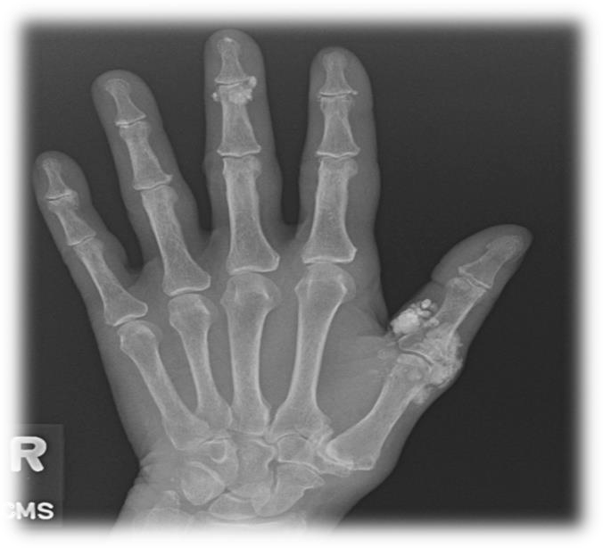
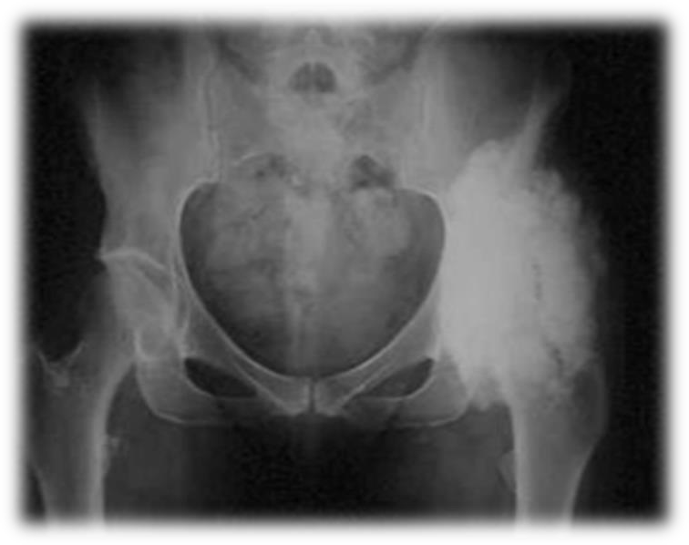
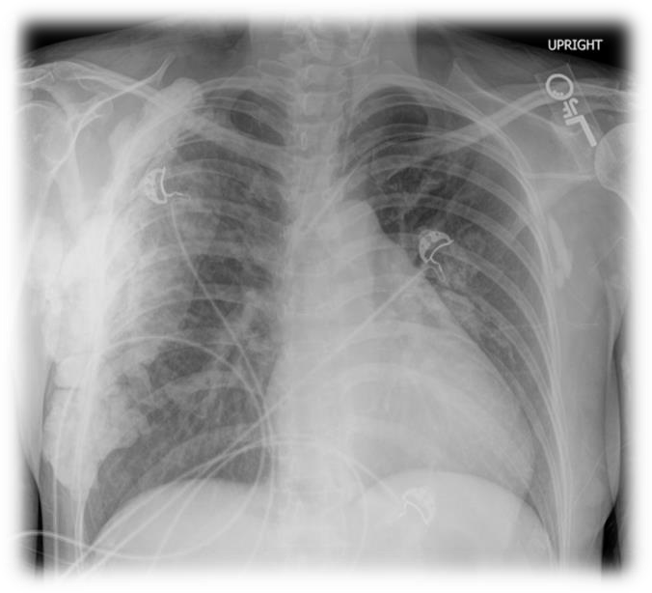
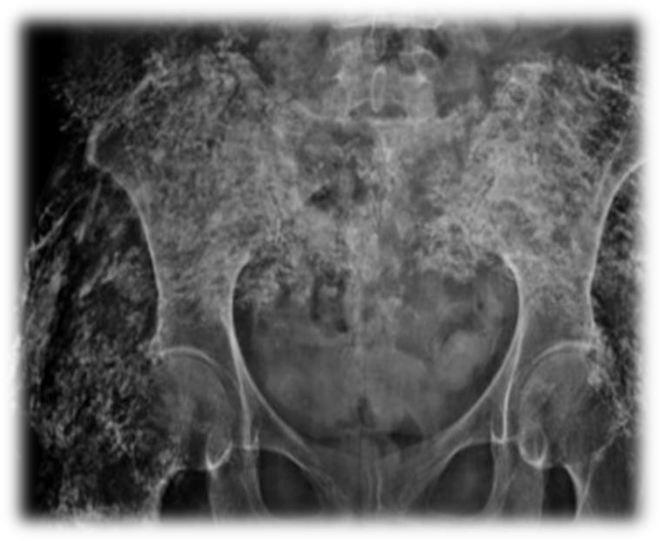
Calcinosis types
Superficial calcareal (‘sponge-like’) or superficial nodular
Tumoral or Deep
calcareal
Universalis
Exoskeleton
Reference-Blane, C.E., et al. AJR Am J Roentgenol, 1984. 142(2):p.397-400

Slide 3
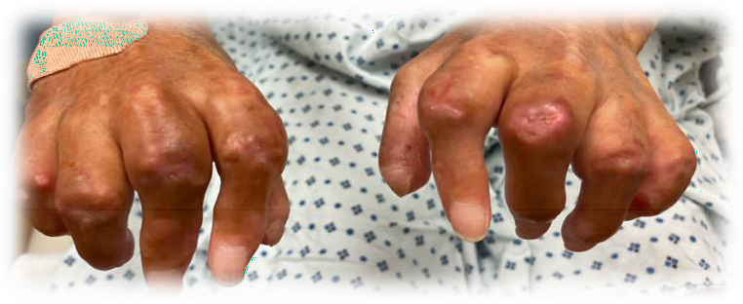
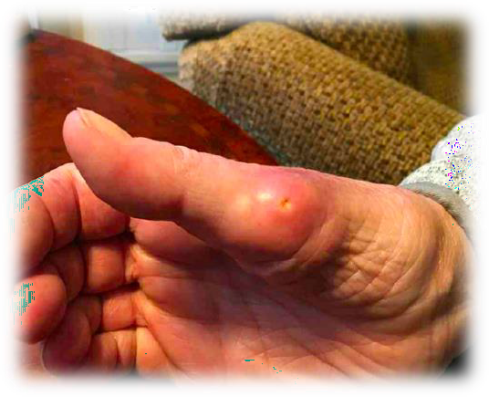
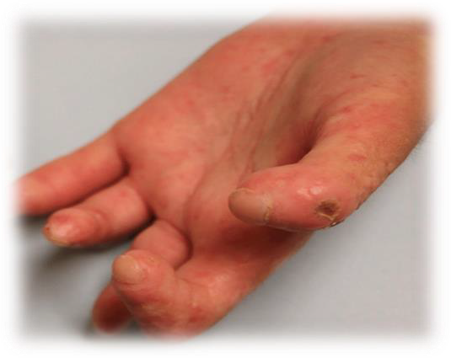
Calcinosis burden
Function
Decreased Quality of Life
Infection
Ulceration
Pain
Nerve compression
Image courtesy-friendlystock.com, orthosportsmed.com

Slide 4
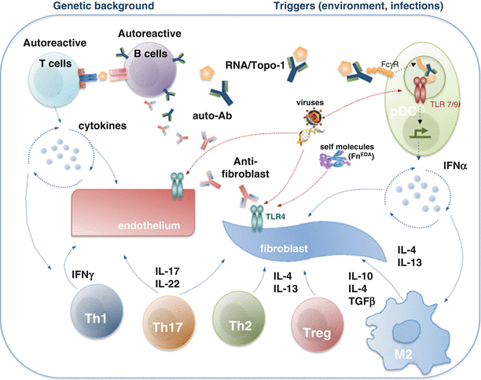
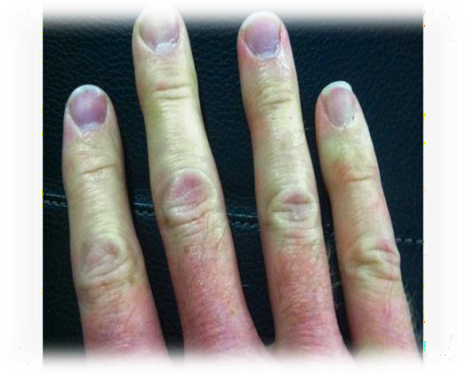
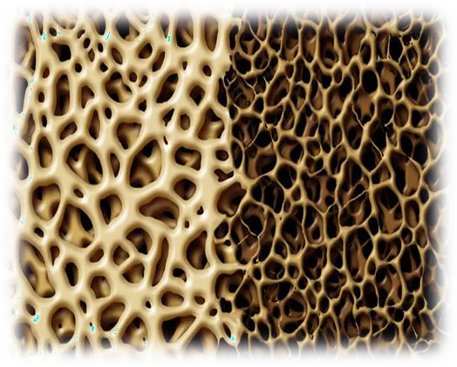
Calcinosis Pathogenesis
Prolonged state of inflammation
Mechanical stress or repetitive trauma
Vascular dysfunction or hypoxia
Dysregulated bone metabolism
Image courtesy: WaltFletcher, CC BY-SA 4.0, via Wikimedia Commons, 123RF.com. StepanPopov/Shutterstock
Boin, F., Chizzolini, C. (2017). Inflammation and Immunity: In Scleroderma.Springer

Slide 5
Background
Hsu Varga et al have studied plasma inorganic pyrophosphate (PPi) levels in patients with SSc (N=81 US cohort) + (N=45 in Hungarian cohort) and compared with controls (N=15 US cohort) + (N=26 in Hungarian cohort).
Found lower PPi levels in patients with SSc compared to matched healthy controls.
No significant difference of PPi in those with and without calcinosis.

Slide 6
Hypothesis and Aims
Measure plasma inorganic pyrophosphate levels in adult patients with SSc and DM
Compare the levels of inorganic PPi between patients with severe calcinosis and without calcinosis among the two subgroups
Image courtesy: artenot@dreamstime.com

Slide 7
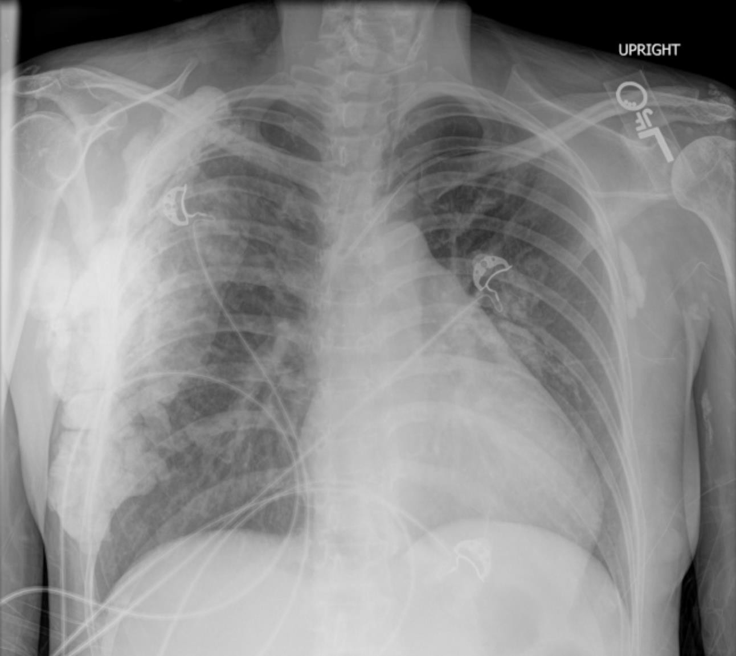
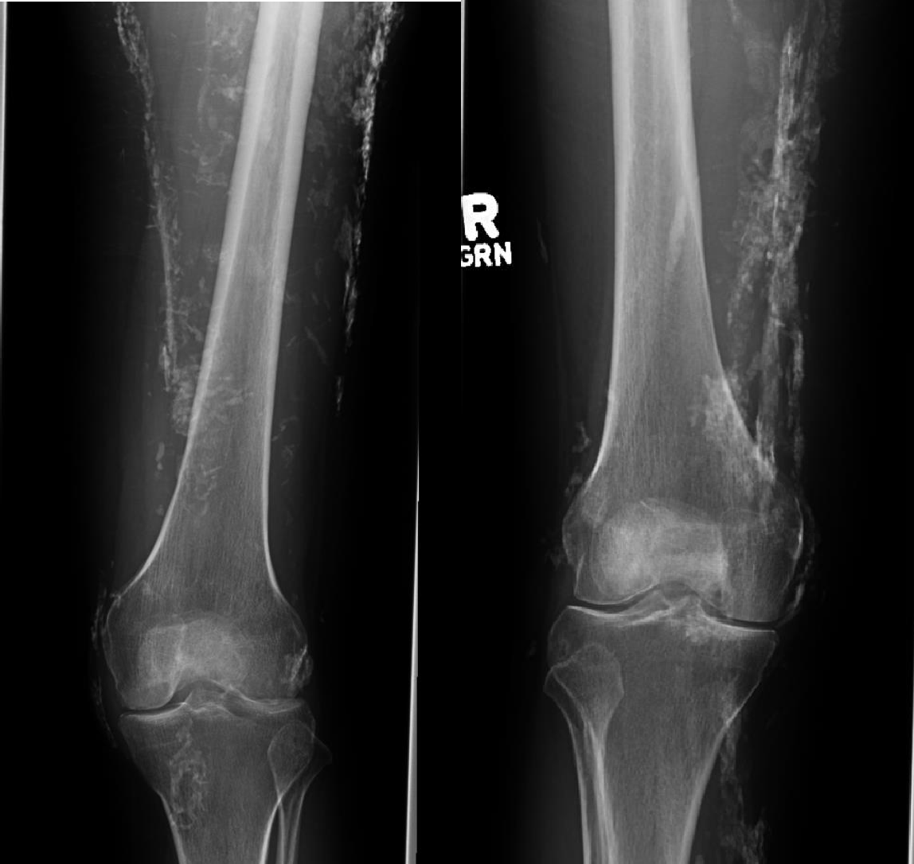
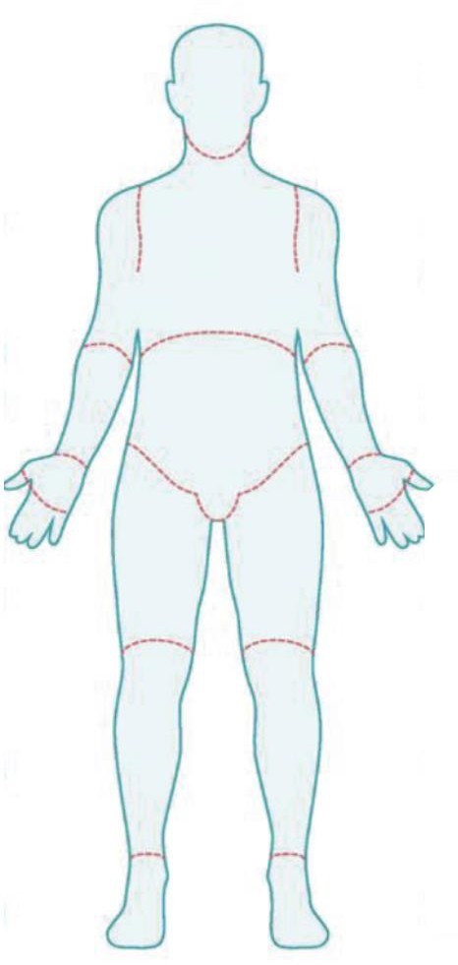
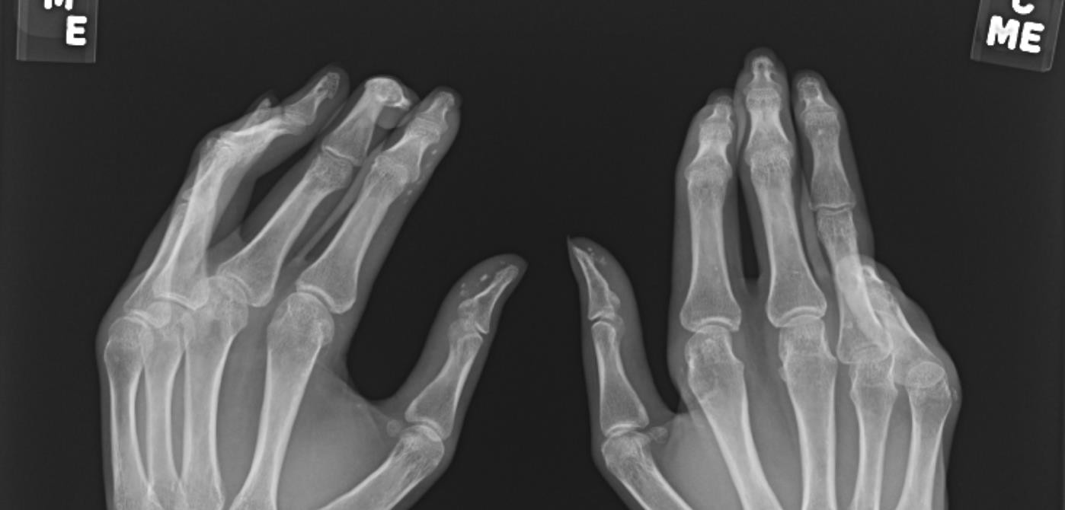
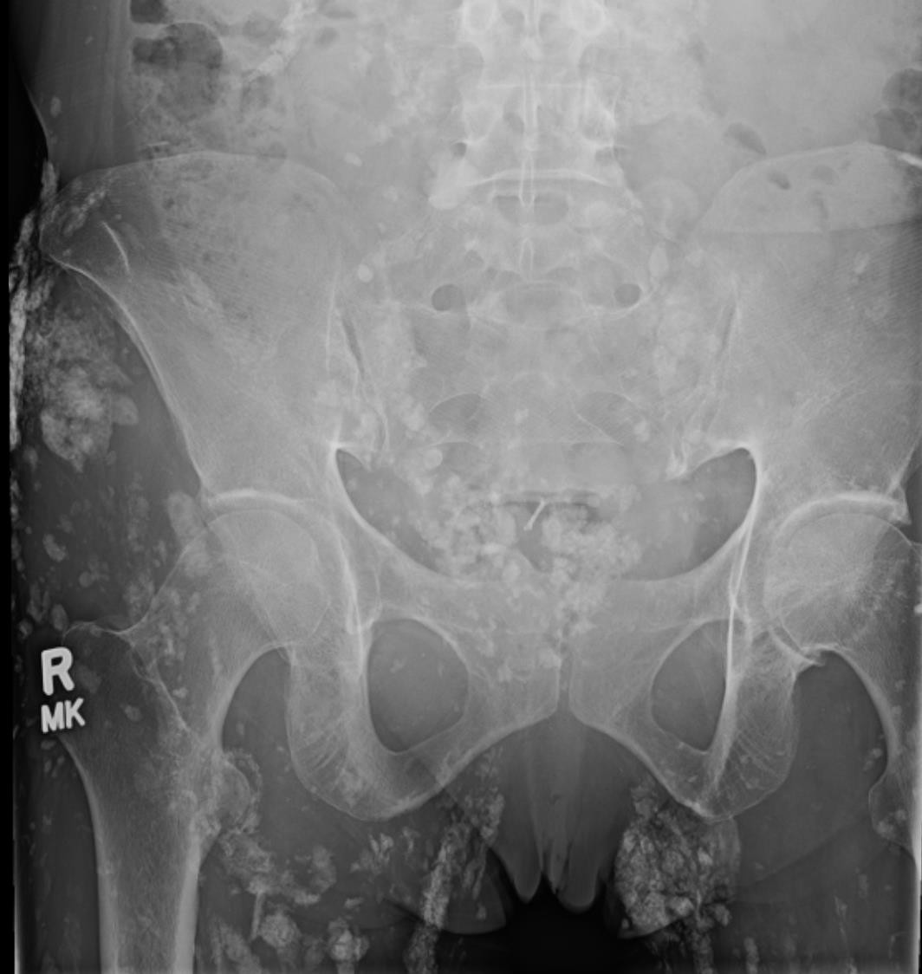
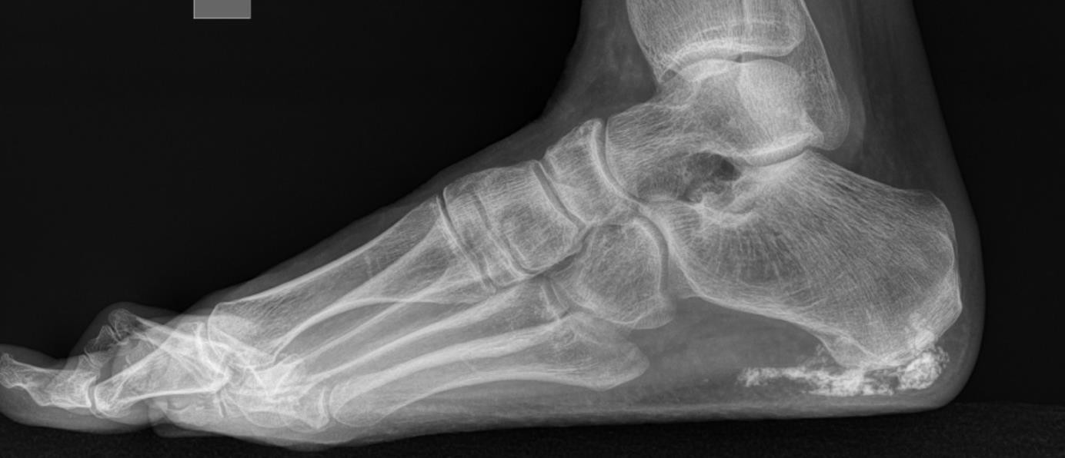
Methods
DNA samples from consented
patients
Severe calcinosis
Patient 1
- At least 3 areas of calcinosis
1
AND / OR
4
1
2
Patient 2
- More than 3cm of at least one calcinotic lesion at any time during the course of disease.
2
3
31 Scleroderma and 19 Dermatomyositis patients
3
Image courtesy: ClinMed International Library

Slide 8
SSc
DM
Cases : We were able to ship only 11 DM patients
Controls: 20 DM controls
Matching Criteria: Age, Biological Sex and Disease duration
Cases : We were able to ship only 7 SSc patients
Controls: 14 SSc controls
Matching Criteria: Age, Biological Sex, Subtype- Limited/Diffuse, Disease duration
Plasma levels of PPi were assessed using an in-house assay measuring the enzymatic conversion of PPi into ATP (adenosine triphosphate) by ATP sulfurylase in the presence of adenosine 5’ phosphosulfate.

Slide 9
SSc Demographics
SSc cohort | Severe calcinosis (N=7) | No calcinosis (N=14) | P-value
Mean Age in years (SD) | 63.4 (9.5) | 60.8 (10.5) | 0.596
Female biological sex, N (%) | 6 (85.7) | 12 (85.7) | 1
White race N (%) | 5 (71.4) | 9 (64.3)
Asian race N(%) |  | 2 (14.3)
Hispanic ethnicity, N (%) |  | 1 (7.1)
Limited scleroderma subtype, N (%) | 6 (85.7) | 12 (85.7) | 1
RNA polymerase III. |  | 1 (7.1)
Anti-centromere. | 4 (57.1) | 5 (35.7)
Scl-70 antibody. |  | 2 (14.3)
Median Disease duration in years (IQR) | 24.6 (12.9-31.8) | 19.0 (10.1-25.3) | 0.202
Disease specific features, N (%)
Digital ischemia | 4 (57.1) | 5 (35.7)
Interstitial lung disease | 2 (28.6) | 6 (42.9)
Pulmonary hypertension | 2 (28.6) | 2 (14.3)
GERD | 7 (100) | 14 (100)
Heart failure | 1 (14.3%) | 1 (7.1%)
Median Follow up duration in years (IQR) | 28 (23.1-36.7) | 20.5 (11.0-33.6) | 0.387
Death / Hospice (N,%) | 4 (57.1) | 1 (7.1)
Median PPi levels in uM (IQR) | 0.84 (0.54-0.91) | 0.61 (0.33-1.00) | 0.731

Slide 10
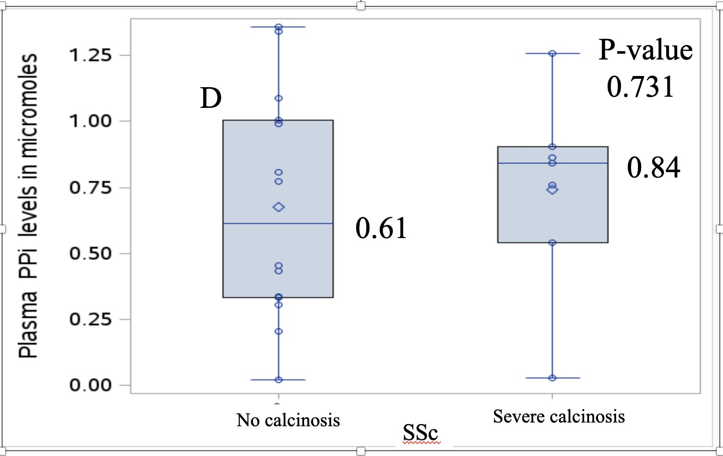
SSc cohort
Fig D: Median PPi levels show minimal difference between SSc patients with and without calcinosis, matched on age, sex, skin subtype, disease duration

Slide 11
DM Demographics
SSc cohort | Severe calcinosis (N=11) | No calcinosis (N=20) | P-value
Mean Age in years (SD) | 46.3 (11.0) | 47.9 (11.6) | 0.723
Female biological sex, N (%) | 9 (81.8) | 16 (80.0) | 1
White race N (%) | 5 (45.5) | 12 (60)
Asian race N(%) | 1 (9.1) | 4 (20)
Hispanic ethnicity, N (%) | 3 (27.3) | 6 (30)
MDA- 5 | 3 (27.3) | 6 (30.0)
NXP-2 | 4 (36.4)
TIF-gamma | 1 (9.1) | 8 (40.0)
Mi-2 | 1 (9.1) | 2 (10)
SAE1 | 2 (18.2) | 1 (5)
Median Disease duration in years (IQR) | 7.5 (4.3-16.7) | 4.0 (1.6-7.9) | 0.044
Disease specific features, N (%)
Digital ulcers | 5 (45.5) | 8 (40)
Interstitial lung disease | 3 (27.3) | 6 (30)
Raynauds symptom | 3 (27.3) | 7 (35)
Other skin ulcers | 8 (72.7)) | 4 (20)
Clinically Amyopathic | 1 (9.1) | 4 (20)
Median Follow up duration in years (IQR) | 11.7 (8.9-15.8) | 11.0 (5.7-14.7) | 0.554
Death / Hospice (N,%) | 1 (9.1)
Median PPi levels in uM (IQR) | 0.08 (0-0.33) | 0.33 (0-0.83) | 0.243

Slide 12
DM matched results (Sensitivity analysis)
 | Calcinosis (N=9) | No Calcinosis (N=16) | p-value
Biological Sex |  |  | 1
Females | 8 (88.9) | 16 (88.9)
Males | 1 (11.1) | 2 (11.1)
Mean age in years (SD) | 47.3 (12.1) | 47.6 (11.9) | 0.9458
Median duration in years (IQR) | 6.02 (4.3 - 8.9) | 4.0 (1.6 - 7.3) | 0.1478
Median follow-up in years from disease onset (IQR) | 11.1 (8.9 - 12.5) | 10.7 (4.9 - 13.4) | 0.9391
Median PPi in uM (IQR) | 0.08 (0 - 0.33) | 0.44 (0 - 0.91) | 0.2668

Slide 13
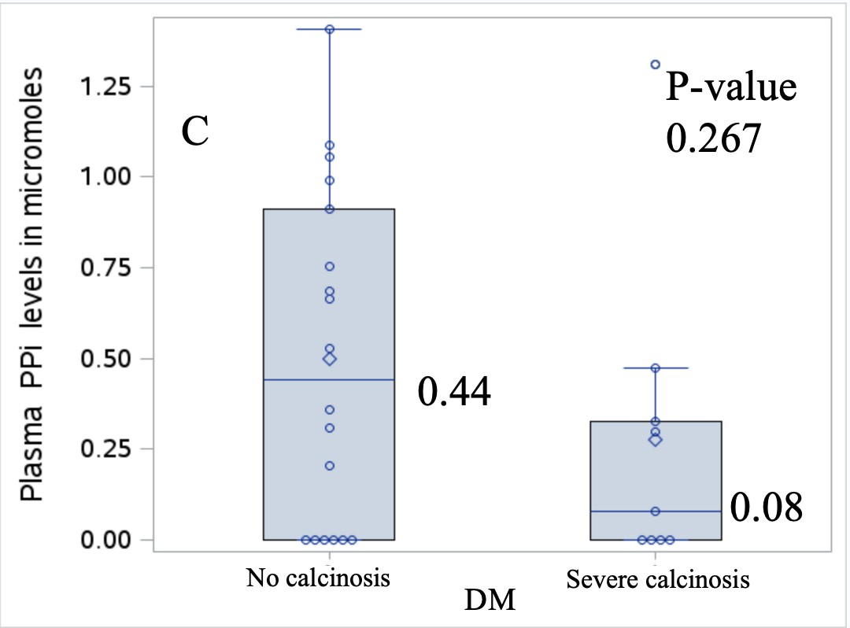
DM Cohort (matched)
Fig C: Median PPi is lower in DM patients with calcinosis compared to those without, matched on age, sex and disease duration (not statistically significant)

Slide 14
PPi (ALL DM vs ALL SSc)
 | All DM (N=31) | All SSc (N=21) | p-value
Biological Sex |  |  | 0.7236
Females | 25 (80.7) | 18 (85.7)
Males | 6 (19.3) | 3 (14.3)
Mean age in years (SD) | 47.3 (11.2) | 61.7 (10.0) | <.0001
Median duration in years (IQR) | 4.9 (2.1 - 12.7) | 20.2 (10.5 - 26.4) | <.0001
Median PPi in uM (IQR) | 0.20 (0.00 - 0.69) | 0.77 (0.34 - 0.99) | 0.0059

Slide 15
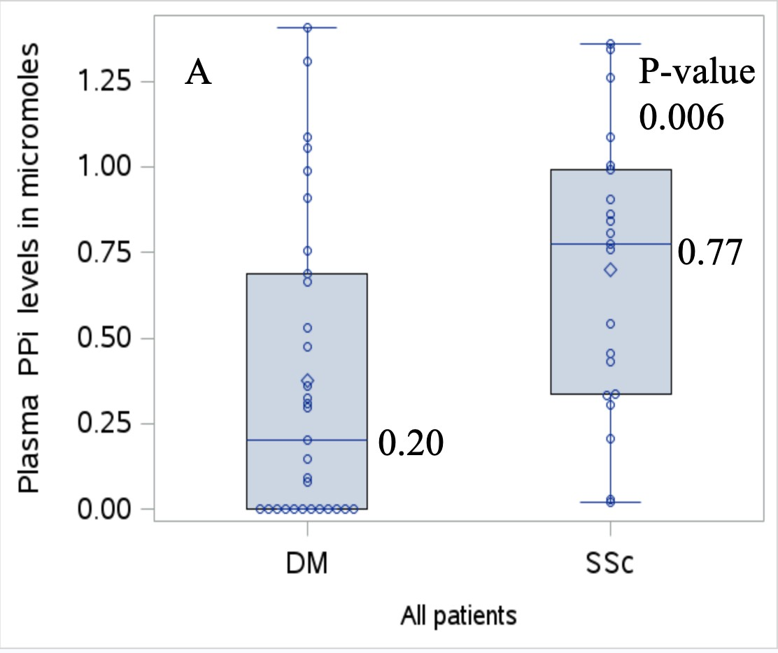
DM vs SSc (All patients)
Fig A: Median PPi is significantly lower in DM compared to SSc (includes all patients)

Slide 16
PPi (DM calcinosis vs SSc calcinosis)
 | DM calcinosis | SSc calcinosis | p-value
 | (N=11) | (N=7)
Biological Sex |  |  | 1
Females | 9 (81.8) | 6 (85.7)
Males | 2 (18.2) | 1 (14.3)
Mean age in years (SD) | 46.3 (11.0) | 63.4 (9.5) | 0.004
Median duration in years (IQR) | 7.5 (4.3 - 16.7) | 24.6 (12.9 - 31.8) | 0.103
Median follow-up in years from disease onset (IQR) | 11.7 (8.9 - 15.8) | 28.0 (23.1 - 36.7) | 0.053
Median PPi in uM (IQR) | 0.08 (0 - 0.33) | 0.84 (0.54 - 0.91) | 0.03

Slide 17
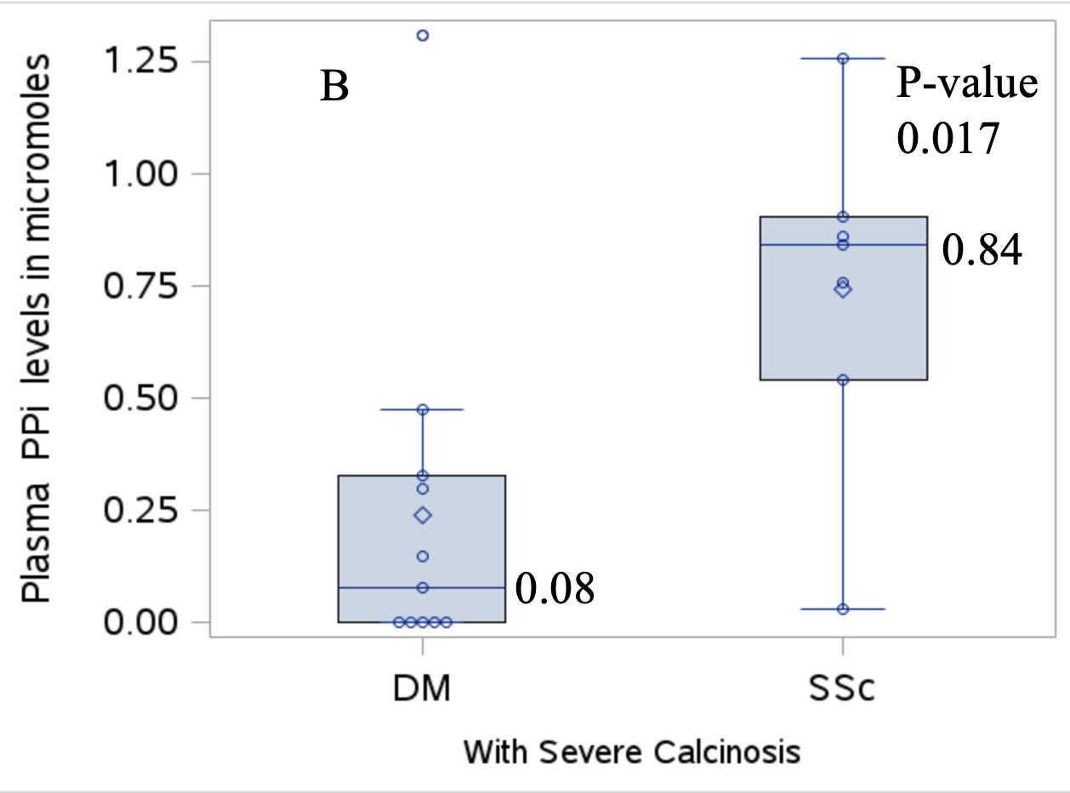
DM vs SSc (Only cases)
Fig B: Among severe calcinosis patients, median PPi is significantly lower in DM compared to SSc

Slide 18
Conclusions
Our findings suggest that the pathophysiology of calcinosis likely differs between DM and SSc.
PPi may play an important role particularly in DM-associated calcinosis but further studies are necessary.

Slide 19
Key References
Hsu VM, Kozák E, Li Q, Bocskai M, Schlesinger N, Rosenthal A, McClure ST, Kovács L, Bálint L, Szamosi S, Szücs G, Carns M, Aren K, Goldberg I, Váradi A, Varga J. Inorganic pyrophosphate is reduced in patients with systemic sclerosis. Rheumatology (Oxford). 2022 Mar 2;61(3):1158-1165. doi: 10.1093/rheumatology/keab508. PMID: 34152415; PMCID: PMC9052889.
Davuluri, Srijana; Lood, Christian; Chung, Lorinda. Calcinosis in systemic sclerosis. Current Opinion in Rheumatology: November 2022 - Volume 34 - Issue 6 - p 319-32.
Valenzuela A, Baron M, Rodriguez-Reyna TS, et al. Calcinosis is associated with ischemic manifestations and increased disability in patients with systemic sclerosis. Semin Arthritis Rheum. 2020;50(5):891-6
Davuluri S, Duvvuri B, Lood C, Kashani S, Chung L. Calcinosis in Dermatomyositis: origins and possible therapeutic avenues. In P. Machado and L.C.Stine(Ed.). Best Practice & Research Clinical Rheumatology. February 2022.
Blane, C.E., et al., Patterns of calcification in childhood dermatomyositis. AJR Am J Roentgenol, 1984. 142(2): p. 397-400.
Richardson C, Plass A, Varga J.. Calcinosis in systemic sclerosis: update in pathophysiology, evaluation and treatment. Curr Opin Rheumatol 2020;22:73
Federico A, Weinel S et al JAAD 2008: 58;4- 707-710.

Slide 20
Acknowledgments
Lorinda Chung David Fiorentino
Sara Faghihi-Kashani Shufeng Li
Swarna Nandyala Puneet Kapoor
Pravitt Gourh
Christian Lood
Jorge Armando Gonzalez-Chapa

