Slide 1
Neuropsychiatric Lupus
Daniel Carlson
PGY4

Slide 2
HPI
Our patient is a 26-year-old female who presented to the hospital with a fever to 39C and a left frontal headache.
A few days prior to her hospital presentation she established with rheumatology and was beginning evaluation for arthritis, lymphadenopathy, rash, fatigue and pleurisy and further workup was underway.

Slide 3
Physical Exam
Exam
General: Ill appearing and diaphoretic
Eyes: Injected sclera. PERRL
Lymph nodes: Axillary lymphadenopathy
CV: Tachycardic. RRR without murmurs
Pulm: Clear to auscultation bilaterally
MSK: No synovitis on presentation
Skin: Maculopapular rash on extremities
Neuro:
Impaired smooth pursuit with horizontal and vertical EOM
Cranial nerves otherwise normal
4+/5 strength in the right hip flexors and knee flexion/extension

Slide 4
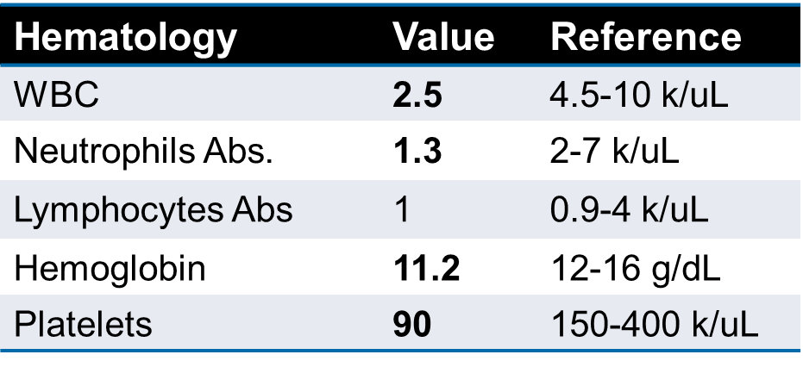
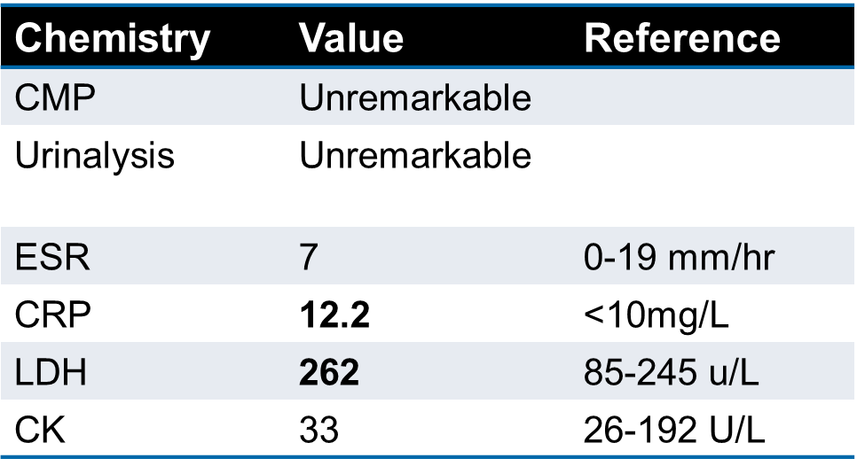
Labs
Notes:
CT head with a 5mm hyperdense focus adjacent to the left sylvian fissure with associated foci of linear hypoattenuation prompting further imaging

Slide 5
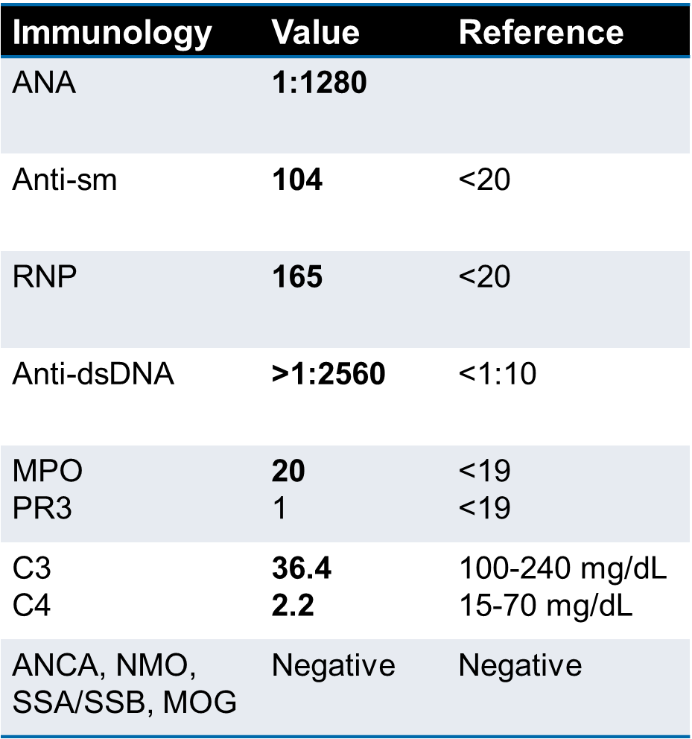
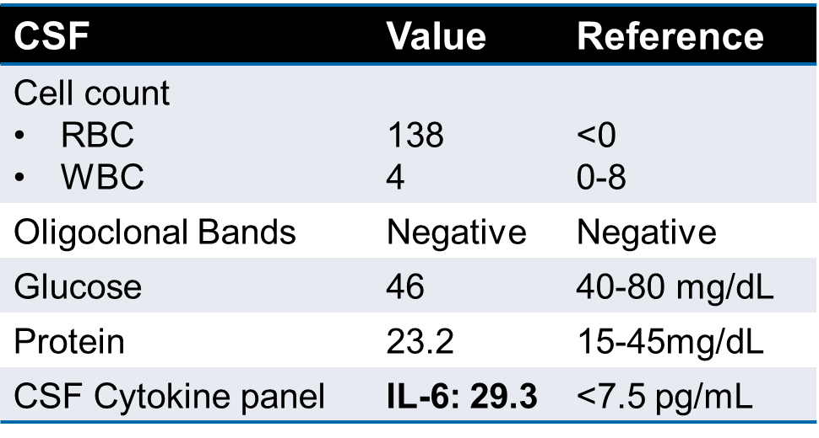
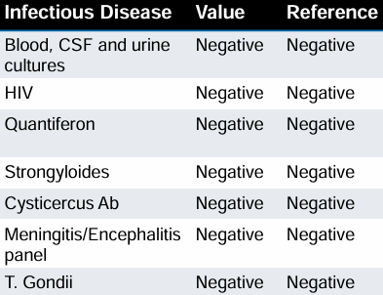
Labs
Notes:
MRI flair sequences showing left frontal and insular lesions with surrounding vasogenic edema
Infectious and malignancy work up was negative

Slide 6
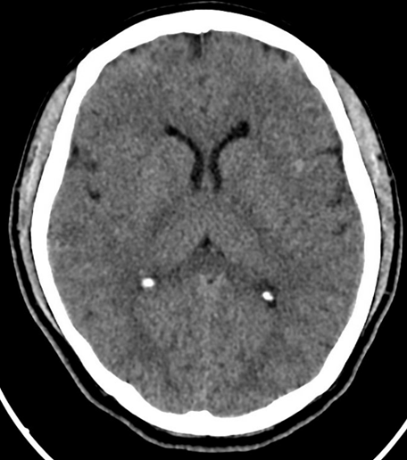
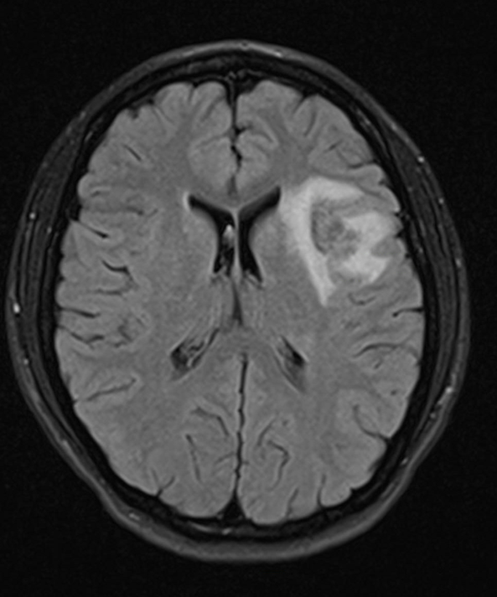
Imaging
Notes:
CT head with a 5mm hyperdense focus adjacent to the left sylvian fissure with associated foci of linear hypoattenuation prompting further imaging
Figure 2: MRI flair sequences showing left frontal and insular lesions with surrounding vasogenic edema

Slide 7
Case Continued
She was initially treated with IV antibiotics until infection was ruled out
Started on 250mg of IV methylprednisolone every 6 hours for 5 days
Transitioned to prednisone 1mg/kg with taper
Started hydroxychloroquine and MMF on discharge for neuropsychiatric lupus

Slide 8
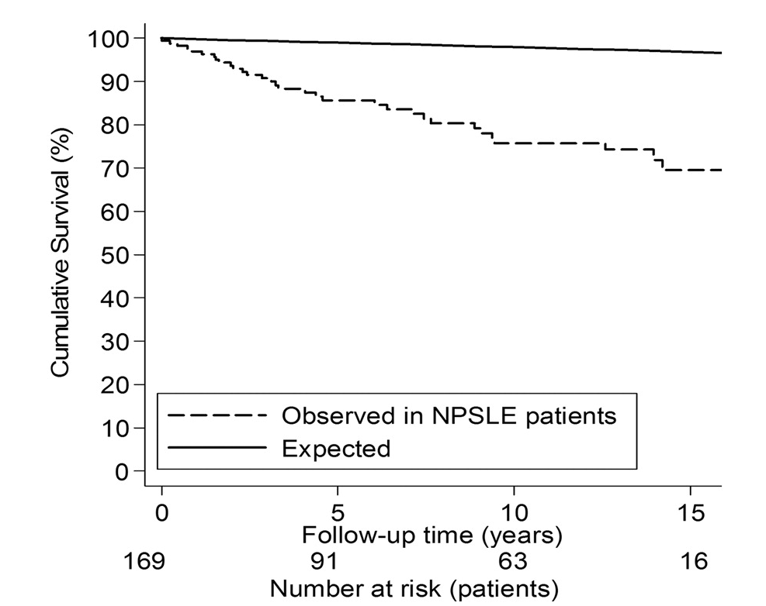
Background
Neuropsychiatric lupus (NPSLE) consists of a broad range of neurologic and psychiatric manifestations that can involve any aspect of the CNS or peripheral nervous system.
Accurate attribution of neuropsychiatric manifestations remains challenging
No laboratory or imaging study is sensitive or specific enough to confirm the diagnosis of neuropsychiatric SLE on its own
Treatment options, especially for severe cases of NPSLE, remain an understudied field
Notes:
Difficult to distinguish whether neuropsychiatric symptoms are the result of active SLE or other factors such as infection, metabolic abnormalities, severe hypertension, adverse effects of medications, or independent neurologic or psychiatric problems
Graph 1: Survival curves of all NPSLE patients and of the age, sex and year of diagnosis matching the general Dutch population. Leading cause of death was infection>NPSLE>SLE>malignancy. Retrospective study

Slide 9
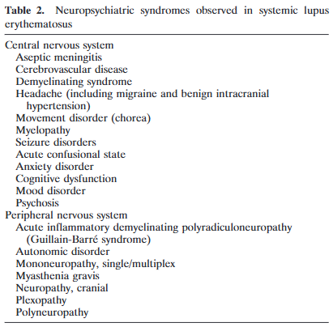
1999 Nomenclature and Definitions
In 1999 the ACR formed a committee to develop a standardized nomenclature system
This committee was represented by rheumatology, neurology, psychiatry, neuropsychiatry and hematology
Combined the multitude of prior terms used under NPSLE. Previously terms such as neuro lupus, lupus cerebritis, CNS lupus and others were used
Notes:
Used a pool of 108 NPSLE patients
The committee included 27 clinician investigators who represented rheumatology (19 members), neurology (3 members), hematology (1 member), psychiatry (1 member), and clinical psychology (3 members).
Further definitions and exclusion criteria located in the appendix of the paper for table 2
39 pages describing each clinical condition, diagnostic criteria, exclusions, associated conditions, and work up

Slide 10
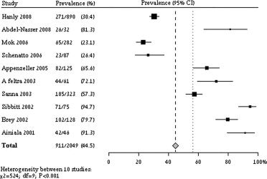
Epidemiology
There is a wide variability of reported incidence of NPSLE owing to the differences in interpretation of classification criteria
More recent data coming from a sub analysis of 10 prospective studies and a total of 2,049 patients with SLE found the pooled prevalence of NPSLE was 56.3% (95% CI 42.5–74.7%).
The frequency of CNS and PNS manifestations was 93.1% and 6.9%, respectively.
Notes:
NPSLE prevalence in the 10 prospective and elicited studies.
The diamond and dashed line mark the total prevalence and 95% CI
The dotted line represents the total prevalence according to random-effects model.
The second approach (used in 10/17 studies) combined a retrospective chart review with either a prospective follow-up or additional elicited information (eg, questionnaires about past medical history, additional physical or neuropsychologic evaluation, etc). The latter approach is generally more accurate but still has its limitations, eg, recall biases.
Examples include headache (23.3% in prospective or elicited studies vs 4.7% in retrospective chart-driven ones), mood disorders (14.9% vs 2.3%), cognitive dysfunction (13.9% vs 1.6%), and anxiety disorder (5.3% vs 0.4%).
High differences in the methods and reporting of the studies

Slide 11
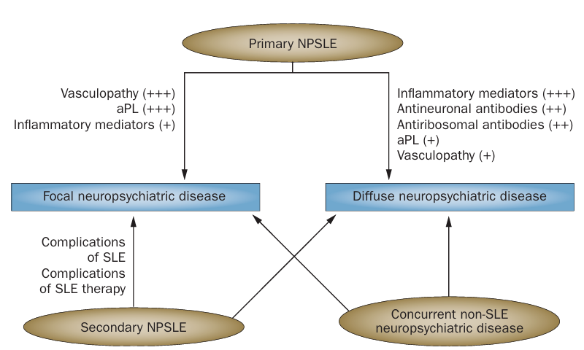
Pathogenesis
Multiple and interrelated pathophysiological mechanisms, including genetic susceptibility, account for the heterogeneous clinical phenotypic landscape of NPSLE
No single pathogenic mechanism can account for all the varying presentations of NPSLE
Complement
Notes:
2017 study on brain histopathology in SLE patients: there was deposition of complement activation products (C4d and C5b-9) on the endothelial cell surface and frank vasculitis in 31% of cases of NPSLE (3)
A MRI was unable to detect most small vessel injury that was visible histopathologically.
second mechanism is an autoimmune-mediated neuroinflammatory pathway with complement activation, increased permeability of the blood–brain barrier (BBB), intrathecal migration of neuronal autoantibodies, local production of immune complexes and pro-inflammatory cytokines and other inflammatory mediators. The clinical phenotypes associated with this pathway are mostly diffuse NP manifestations such as psychosis, mood disorders, cognitive dysfunction and acute confusional states

Slide 12
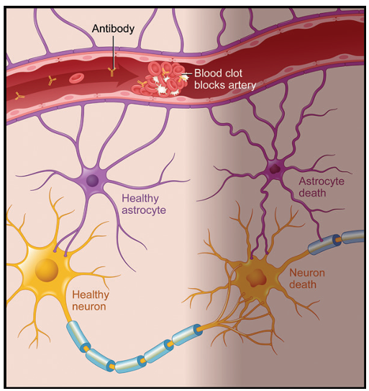
Ischemic Pathway
The ischemic pathway is associated with focal NPSLE events, including strokes, seizures, movement disorders and some myelopathies, primarily related to thromboembolic events
Vasculopathy and vasculitis cause endothelial dysfunction by way of immune complex formation and complement activation
Among patients with SLE, those with aPL antibodies are twice as likely as those without them to develop focal NPSLE
Notes:
vascular disease in particular brain regions, such as the amygdala and hippocampus, may yield some of the diffuse manifestations as well, such as memory decline and affective disturbances
vasculopathy is defined as endothelial cell proliferation, thickening of the vessel wall, and narrowing of the vessel lumen without inflammatory infiltrate.
Immune complexes in SLE can stimulate endothelial cells to express vascular cell adhesion molecule 1, which promotes the recruitment of monocytes into the arterial wall

Slide 13
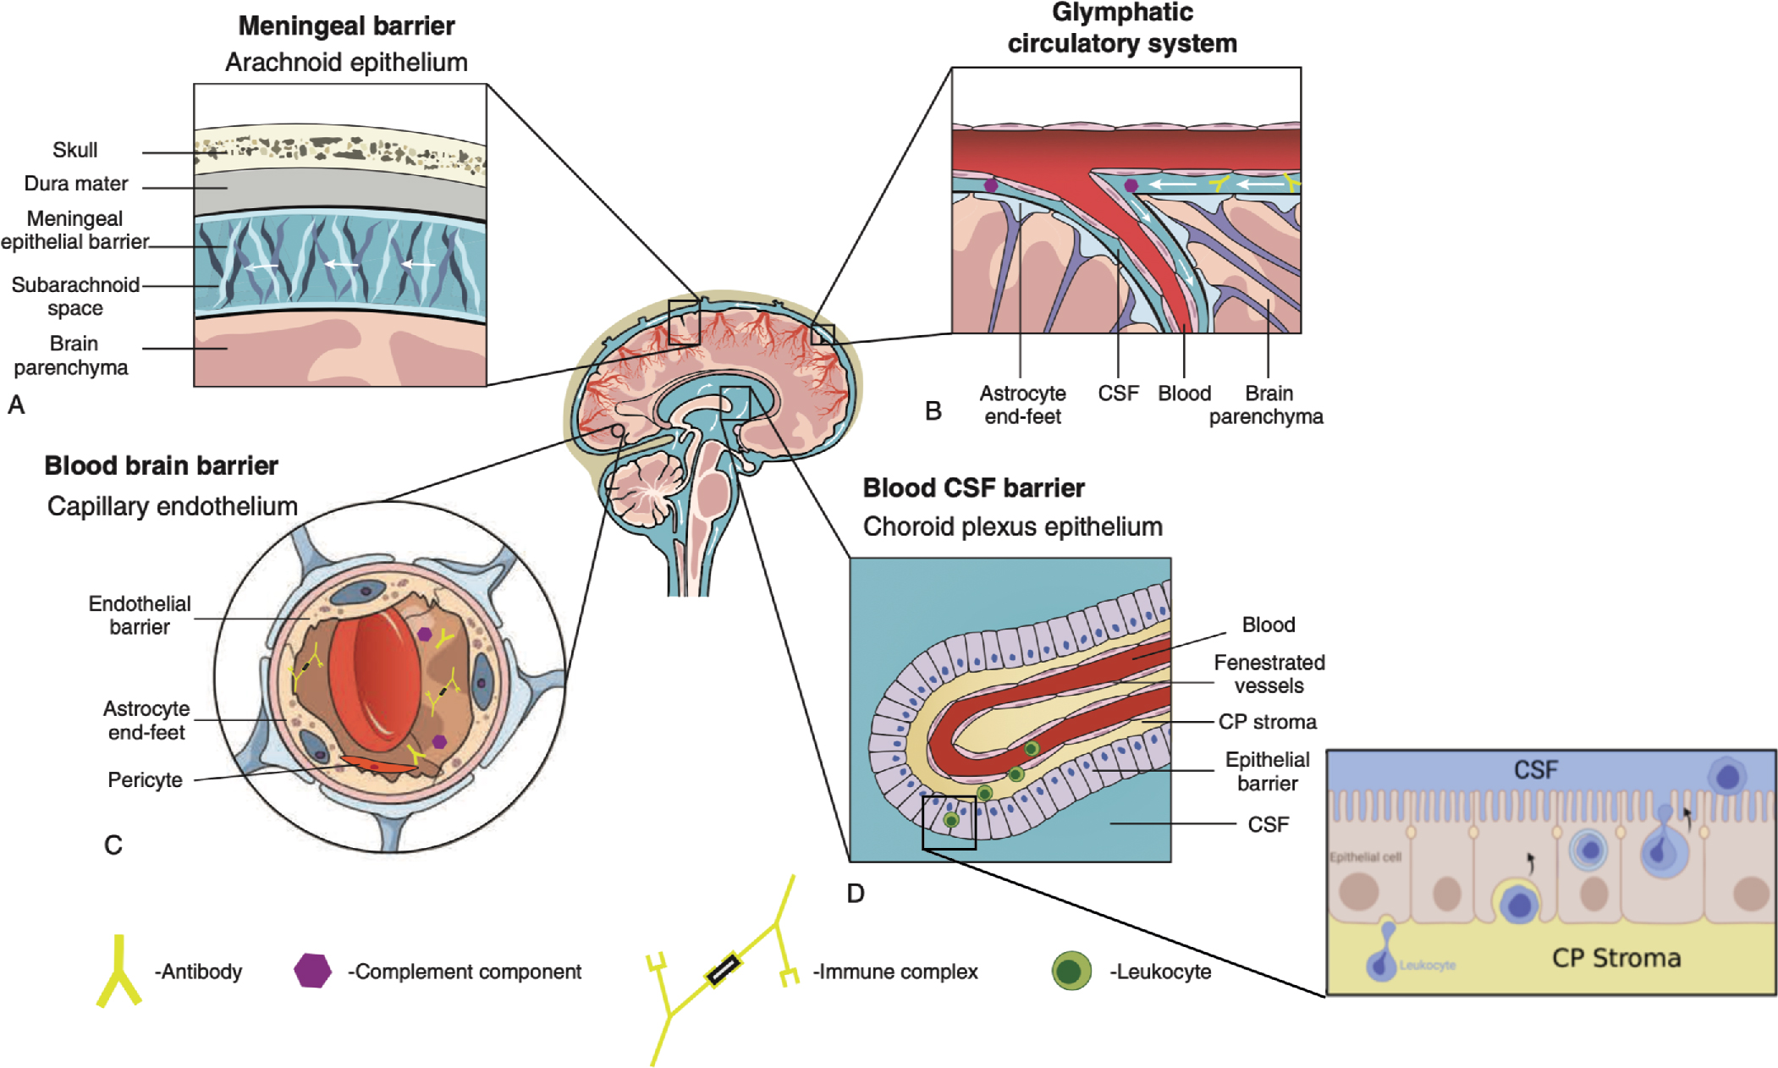
Blood Brain Barrier
Disruption of the blood brain barrier has been highlighted as an essential component of pathogenesis in NPSLE
The barriers of the CNS are continuously redefined as an increasingly complex network
Notes:
Brain reactive autoantibodies, including anti-NMDAR and anti-P antibodies, must gain entry into the CNS to exert their effects, further suggesting barrier disruption.
The barriers of the CNS are continuously redefined as an increasingly complex network, including the meningeal barrier, the perivascular “glymphatic” network, the lymphatic outflow in the dural sinuses, the classically defined blood-brain barrier (BBB), and the choroid plexus, which comprises the blood-cerebrospinal fluid barrier (BCSFB).
BBB is only a portion of the barriers

Slide 14
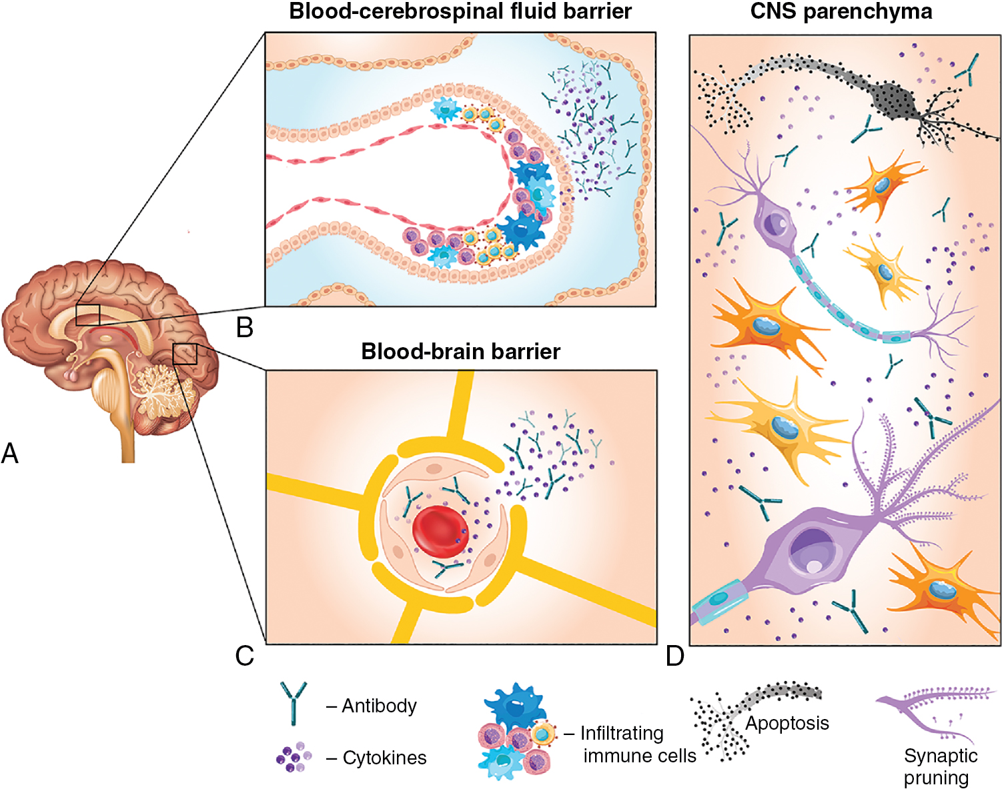
Inflammatory Pathway
The inflammatory pathway is associated with more diffuse NPSLE manifestations, such as psychosis and acute confusion
Primary injury to brain parenchyma can occur through the action of brain reactive autoantibodies, cytokines, chemokines, and infiltrating cells, often in the setting of a breached blood-brain barrier
Antibodies can be produced intrathecally or can be passively transferred from the systemic circulation following a breach in the blood brain barrier
Notes:
(A) Barrier disruption occurs by either the blood-brain barrier or the blood–cerebrospinal fluid barrier.
B–C ) This disruption permits immune mediators such as brain-reactive autoantibodies, inflammatory cytokines, and immune cells entry into the CNS parenchyma.
(D) Direct and indirect effects by cytokines and brain-reactive autoantibodies induce neuronal dysfunction or apoptosis and further propagate inflammation by activating glial cells that modulate neuronal function.
Key components include increased permeability of the blood–brain barrier (BBB), microglial activation and synaptic pruning–, and intrathecal formation of immune complexes leading to plasmacytoid dendritic cell activation and the production of type I interferons and other pro-inflammatory cytokines and mediators.

Slide 15
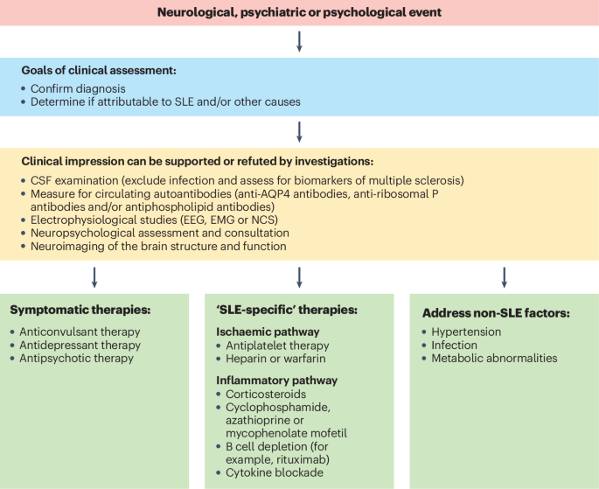
Approach to the Evaluation of NPSLE
There is no single diagnostic test to accurately diagnose NPSLE
The evaluation of SLE patients with signs or symptoms suggestive of neuropsychiatric disease is comparable to that in non-SLE patients who present with the same manifestations
Our goal is to exclude secondary causes such as infections, metabolic or endocrine disturbances and adverse drug reactions
Notes:
A clinical diagnosis of NPSLE can be supported by objective evidence of nervous system dysfunction based on neuropsychological testing, cerebrospinal fluid (CSF) analysis, neuroimaging, electrophysiological testing and/or tissue biopsy

Slide 16
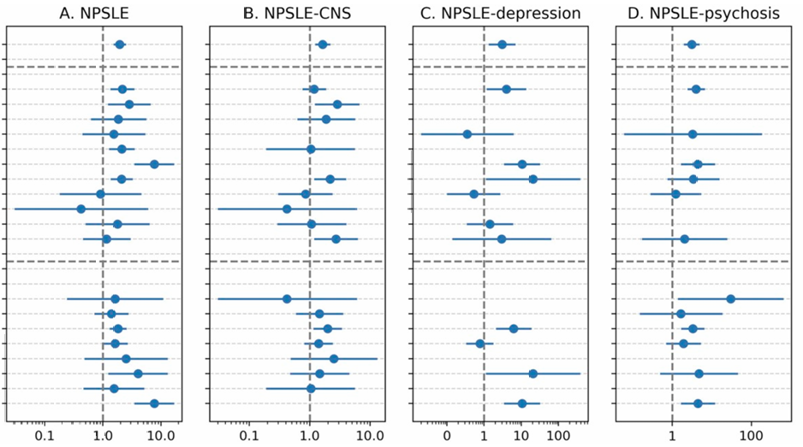
Autoantibodies Associated with NPSLE
Antiphospholipid antibodies
Create a procoagulant state by aPL associated with focal NPSLE causing intravascular thrombosis and cerebral ischemia
Can bind directly to neuronal cells, leading to neuronal cell damage.
Have been associated with diffuse cognitive impairment, even in the absence of an ischemic event.
Anti-ribosomal P antibodies
Associated with the CNS manifestations of psychosis,
depression, and mood disorders in some studies
2020 meta-analysis (shown to the right) found an
odds ratio of 3, especially for depression and psychosis
3. More data and standardization is needed for
improved clinical utility
3. Anti-AQP4 antibodies
1. Limited to 3% of all patients with NPSLE, they are found
in 27% of patients with NPSLE demyelinating syndromes
Notes:
Direct evidence of a pathogenic role for ribosomal P in humans is still lacking and there are variable results from studies
2020 Meta analysis showing it was associated with NPSLE. Included 62 studies
There was large variation in the type of antigenic targets and assays used in these studies, which contributed to the heterogeneity between studies particularly for NPSLE.
In general, studies that used an ELISA with all three of the P0, P1 and P2 ribosomal proteins combined with another test such as DID and/or IB, demonstrated a positive as sociation with anti-RibP with low heterogeneity
Marked differences in the reported frequencies of anti-P antibodies in the serum were thought to be attributable to the types of antigens used for detection (C22 peptide, P0, P1, P2) and the diagnostic methods employed, resulting in significant assay variability.
Anti-Rib-P antibodies have an affinity to neurons in the hippocampus, cingulate cortex and primary olfactory piriform cortex, and all parts of the limbic system. These autoantibodies are implicated in mood disorders
There is substantial diagnostic overlay between NPSLE and NMOSD.
Figure: Forest plot. ,stratified by antigenic target and testing method.

Slide 17
CSF
CSF is most useful for exclusion of an infectious etiology of symptoms
Viral PCR including HSV and JC virus
Pleocytosis: 22–36% [usually 20–100 cells/hpf]
↑ Protein: 30–66% [usually 70–110 mg/dL]
↓ Glucose: 8–42% [usually 30–40 mg/dL]
Notes:
Progressive multifocal leukoencephalopathy (PML) is a rare infection that also merits consideration in a patient with SLE who is seen with symptoms of CNS dysfunction. PML occurs more frequently in patients with SLE than in patients with other rheumatic diseases, even in the absence of significant immunosuppressive therapy
CSF findings are not sensitive or specific enough to confirm a diagnosis of neuropsychiatric SLE.
IgG Index: quantitative analysis of the relationship between CSF IgG and serum IgG, divided by the same relationship for albumin. As albumin is a smaller protein than IgG, it crosses the BBB more easily. In inflammatory CNS conditions, commonly MS, the IgG index is raised.
(IgG CSF/IgG serum)/(albumin CSF/albumin serum)
Marker of intrathecal IgG synthesis when >0.6
Numbers come from the 2010 NPSLE EULAR supplementary tables

Slide 18
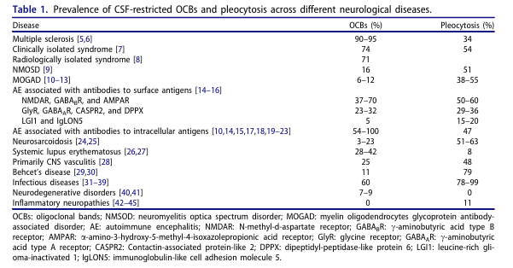
Oligoclonal bands
Notes:
OCBs can be detected in patients with CNS infections where they are thought to be related to antibody response against viral antigens or CNS antigens exposed after tissue damage
In particular, OCBs can occur in patients with Lyme disease (42%) [33], human immunodeficiency virus (HIV)-encephalopathy (60%) [34], SSPE (90%) (Rubeola), tropical spastic paraparesis, progressive multifocal leukoencephalopathy, herpes simplex virus (HSV)- encephalitis (80%), neurotuberculosis, and neurosyphilis (70%)

Slide 19
CSF Cytokine Measurements
IL-6 has been most described in the literature as being abnormal in NPSLE
Elevated in SLE and normal in corticosteroid–induced psychiatric disease
In mouse models was found to be associated with the development of depression, which was not responsive to traditional therapies for major depressive disorder.
Implicated in Seizure disorders, headache associated with NPSLE
IL-8
Elevated levels in the CSF of patients with NPSLE versus patients with non-neuropsychiatric SLE. Possibly correlates with activity
Others being investigated include IL-1, IL-2, IL-10, INF, tumor necrosis factor-like weak inducer of apoptosis (TWEAK), IP10, osteopontin, MMP-9, and others
More research is needed to further define their clinical utility
Notes:
Picture: A study correlating CSF cytokine levels with MRI imaging in NPSLE patients found that levels of IL-1β, IL-6, and IL-8 are all elevated in NPSLE patients relative to SLE patients without CNS disease, and they are associated with various MRI findings, including demyelinating plaques and focal areas of ischemia.
2016 study found: IL-6, IL-8, IP-10, MCP-1 and G-CSF are elevated in the CSF and not serum

Slide 20
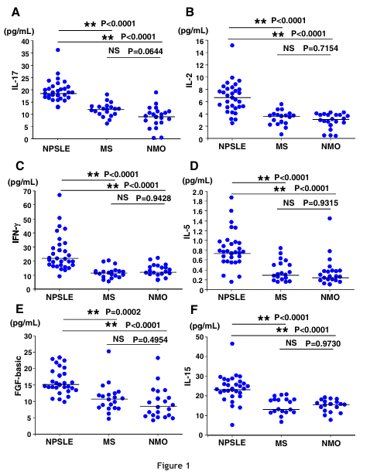
CSF Cytokines in NPSLE Compared with other CNS Inflammatory Diseases
Notes:
Picture: Study comparing the CSF cytokine levels in multiple central inflammatory diseases
neither IL-6 nor IL-8 were elevated in the CSF of NPSLE patients compared with other neuroautoimmune diseases, suggesting that these cytokines may be more generally related to aberrant neuroimmune interactions instead of unique to NPSLE.
Study published in 2016. Study took place in japan
32 NPSLE patients, 20 RRMS patients, samples from 22 patients with NMO

Slide 21
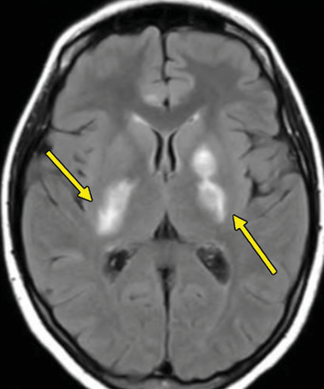
Imaging
MRI is the most useful tool for detecting intracranial abnormalities and assessing the chronicity and evolution of these abnormalities
The average sensitivity of MRI in active NPSLE is 57% and more commonly positive in focal manifestations
More advanced imaging techniques that can be considered include SPECT, PET/CT, MR spectroscopy, perfusion-weighted MRI, or diffusion-tensor imaging to name a few
Notes:
diffusion-tensor imaging: assess white matter tract integrity by means of fractional anisotropy and can show decreased fractional anisotropy in regions where conventional MRI findings appear to be normal, indicating acute microscopic tract injury in NPSLE
Dynamic contrast-enhanced susceptibility weighted perfusion MRI: explore the cerebral microcirculation with use of the param eters cerebral blood volume (CBV), cerebral blood f low (CBF), mean transit time (MTT), and time to peak (TTP)
MR Spect: More sensitive than conventional MRI and allows for quantification of the observed changes
SPECT: Functional. More sensitive than MRI for both major (83% versus 63%) and minor (65% versus 33%) NPSLE. Superior to MRI in diffuse (sensitivity 73% versus 54%) but not in focal (90% versus 86%) NPSLE
PET: More sensitive but limited by cost and radiation
Picture 1: Vasculitis. Axial FLAIR MR im age shows hyperintense lesions (arrows) in the basal ganglia and internal capsules.
Picture 2: Demyelinating syndrome (3% of NPSLE) 29-year-old woman with positive anti AQP4 antibody test results, SLE, and paraplegia. Sagittal T2-weighted fat-saturated MR image shows a hyperintense lesion (arrow) in the conus medullaris
suffer from variability in results between scanners and a lack of normative or standard ized guidelines for interpretation.
May play a larger role in the future

Slide 22
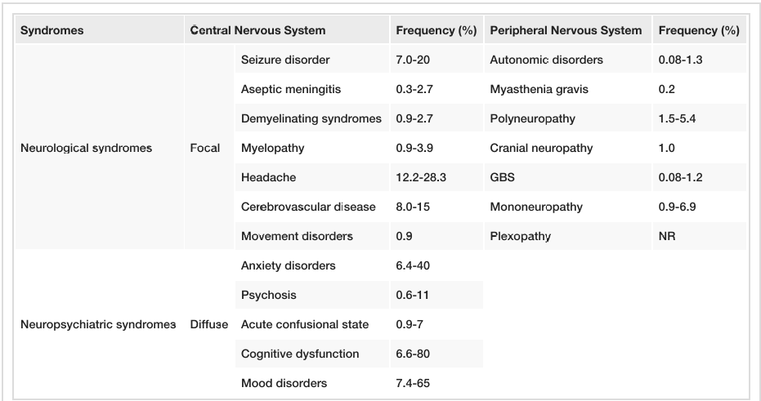
Clinical Features and Management of Individual Symptoms
Notes:
Table from 2021 review of NPSLE
Some NP syndromes that can occur in SLE, such as small fiber neuropathy, chronic inflammatory demyelinating polyneuropathy, posterior reversible encephalopathy syndrome and neuromyelitis Optica spectrum disorder are not included in this classification

Slide 23
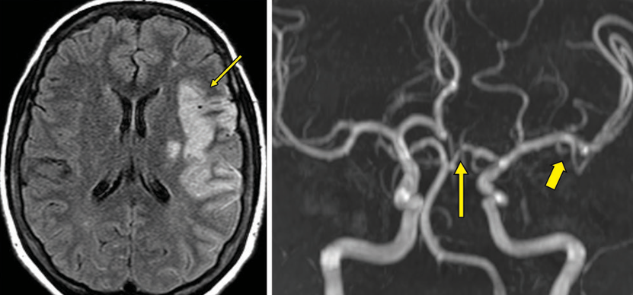
Cerebrovascular Disease
Ischemic stroke and/or TIA comprise over 80% of CVD cases, whereas CNS vasculitis is rare
Acute treatment of thromboembolic disease is treated no differently than other strokes
Treatment with warfarin is recommended with an INR goal 2-3 or 3-4 for an arterial thrombus
EULAR does also state to give consideration to a goal of 2-3 with low dose aspirin
Additional modification of cardiovascular risk factors is recommended including hypertension control, diabetes management, and lipid lowering therapies
Notes:
Cumulative Incidence
Two RCT of 114 and 109 patients with mixed (primary and SLE-related) APS have demonstrated no superiority of high-intensity warfarin (target international normalized ratio (INR) 3.1–4.0) over moderate intensity warfarin (target INR 2.0–3.0) for secondary thromboprophylaxis
Some experts still argue for the higher intensity option in arterial thrombus
Conversely, retrospective studies that included larger numbers of patients with arterial thrombosis or stroke concluded that high-intensity anticoagulation may be more effective without increasing the risk of major bleeding.
APS and arterial thrombus has a higher risk of recurrence. Tendency for same vascular bed

Slide 24
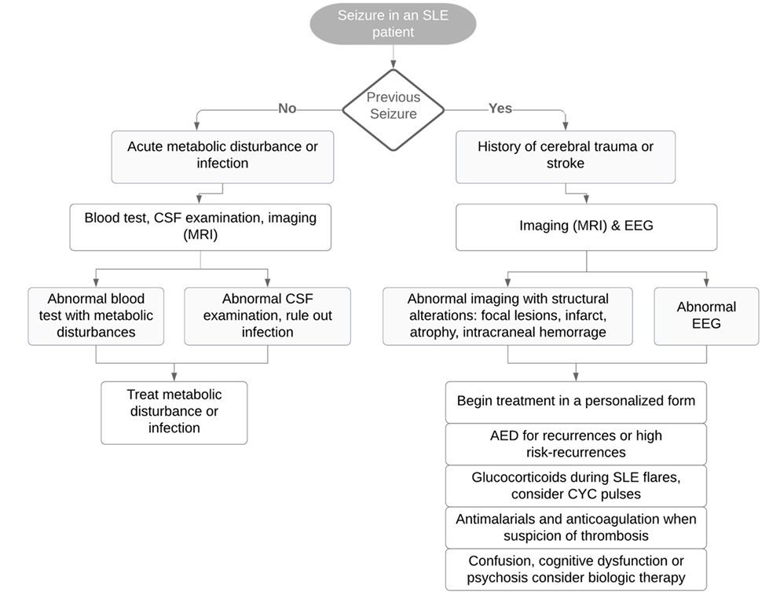
Seizure
Incidence: 0.3–31.5 per 100,000 individuals
Highest numbers observed in childbearing years women, predominantly those of African-American, Asian, Hispanic and Aboriginal ancestry
Typically generalized tonic–clonic seizures (67–88%) compared with partial (complex) seizures
EEG abnormalities are common (60–70%) in SLE patients with seizure disorder, but typical epileptiform EEG patterns are only present in 24–50% and are predictive of seizure recurrence
Treatment:
Anti-epileptic drug (AED): often not necessary in patients with single or infrequent seizures
Approximately a quarter of SLE patients will require a second AED to control seizure activity when needed
Steroids alone or in combination with immunosuppression
Anti-coagulation can be considered if aPL positive
Notes:
Increased risk compared to general population (OR 4.0)
Associated with anti-NR2, ribosomal P
high-risk for seizure recurrences: > 2 unprovoked seizures occurring in a 24 -h interval or either evidence of symptomatic or imaging recorded brain lesions or epileptiform discharge on EEG
Figure: Flow chart from the European Journal of epilepsy 2021 edition

Slide 25
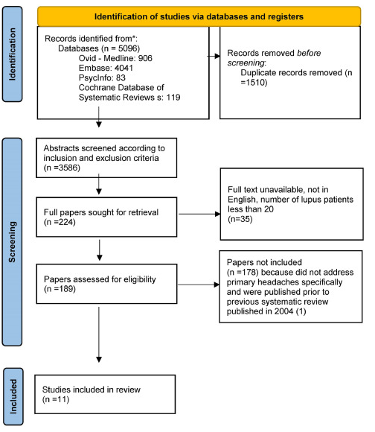
Headache
There was a systematic review published in 2004 regarding headaches in SLE and found that the prevalence of primary headache in SLE patients was not different from the general population, except for migraines with aura, which might be more frequent among SLE patients
Caution is needed to exclude aseptic or septic meningitis, sinus thrombosis, cerebral or subarachnoid hemorrhage, vasculitis, PRES, RCVS and others
Notes:
More recent systematic review and meta-analysis published this year
Funnel plot for first figure: However, the funnel plot analysis and the Egger test suggest a publication bias, which can affect the validity and generalization of this conclusion. P=0.06
Figure 2: In the comparison of lupus to other rheumatic diseases, the distribution was symmetrical when evaluated by the funnel plot analysis (Fig. 5) and the Egger publication bias was not statistically significant p < 0.05)
SLEDAI-2 K [22] which defines lupus headache as “a severe, persistent headache that may be migrainoid, but must be nonresponsive to narcotic analgesia”
British Isles Lupus Assessment Group (BILAG) 2004 index [23], which defines lupus headache as “a disabling headache that is unresponsive to narcotic analgesia and lasts 3 days”.
True lupus headache responds to pred (40-60)
Raynauds may be associated with headaches

Slide 26
Psychosis
Psychosis is a rare event in patients with SLE, with an incidence of .5–3.5%
Most presentations occur at onset or within the first year of diagnosis
Frequently associated with evidence of global SLE disease activity
In a patient with clinically and serologically active SLE, the onset of psychosis, especially in the absence of a psychiatric history or other identifiable cause, is usually indicative of NPSLE
Corticosteroid use should be considered a potential contributing factor in the development of psychotic symptoms
The prognosis for NPSLE psychosis is generally favorable, with 70% of cases achieving clinical resolution and responding to treatment within 2–4 weeks
The recurrence of psychosis is infrequent, and a mild chronic psychotic disorder occurs in only 20% of cases following an acute episode of NPSLE psychosis
Notes:
Daily prednisone equivalent of 40 mg or greater at the time of onset of psychotic symptoms. Other treatments reported include cyclophosphamide, azathioprine, methotrexate, mycophe nolate mofetil) in 17 of 28 patients (60.7%
Treatment is often steroids too
Characteristics: delusions (false beliefs refuted by objective evidence), hallucinations (perceptions in the absence of external stimuli)
Antidepressants/antipsychotics as indicated

Slide 27
Cognitive Impairment
The prevalence of cognitive impairment when patients underwent comprehensive neuropsychological testing was 38% (95% CI 33–43%). The prevalence in other literature is as high as 80%.
Cognitive impairment was found to be consistently higher in patients with SLE following the occurrence of other neuropsychiatric events.
The ACR neuropsychological test battery (ACR-NB) remains the gold standard for diagnosing cognitive impairment in patients with SLE, although its clinical use is limited owing to time constraints
Automated Neuropsychological Assessment Metrics (ANAM) is a low-cost, computer-based cognitive assessment tool that provides a more time-efficient alternative to the ACR-NB
Treatment:
Psycho-educational group intervention may result in improvement in memory self-efficacy, memory function and ability to perform daily activities
Memantine: did not result in improvements in cognitive function at 12 weeks
Notes:
systematic review and meta-analysis involving 2,463 patients with SLE
42% moderate-to-severe
Affected domains: attention, visual/verbal memory, psychomotor speed
Memantine: Randomized double-blind, placebo-controlled single center 12 week trial of memantine titrated to 20mg/day was performed, using a 2:1 randomization ratio, in 51 SLE patients. The primary outcome measures were change in the Automated Neuropsychological Assessment Metrics (ANAM) throughput scores at 12 weeks.
Dementia trials have extended on to 24 weeks
Trial noted the effects of the Anti-NR2 Ab and they measured in the serum (not CSF). Overall was found infrequently
Video game study: https://journals.sagepub.com/doi/10.1177/09612033221098534
MINDFULL (Mastering the Intellectual Navigation of Daily Functioning and Undoing the Limitations of Lupus) programme,

Slide 28
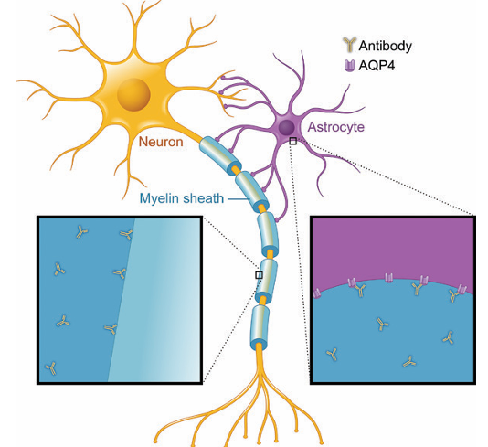
Demyelinating Syndromes
Demyelinating syndrome is seen in up to 3% of patients with NPSLE
27% with NMO antibody
Optic neuritis
Visual outcome in SLE associated optic neuritis is reported to be poor
Bilateral optic nerve involvement and extension into the chiasm are rarely seen compared with MS
Myelitis
Typically, three or more vertebral levels of the spinal cord are involved, usually at the higher thoracic levels
MS usually extends <3 vertebral levels and lesions in NMO primarily the central spinal cord on axial sections
Notes:
Figure: Illustration depicts the mechanism of demyelinating syndrome. The antibodies that breach neuroimmune interfaces adhere to their targets in astrocytes and myelin, resulting in demyelination due to loss of astrocyte support or injury to myelin.
In EULAR:
CYC is grade 1, others are grade 3 evidence
Treatment recommendations in EULAR guidelines:
Induction therapy: combination IV MP and IV CYC followed by a maintenance therapy
Consider rituximab as second line and anticoagulation in aPL positive patients

Slide 29
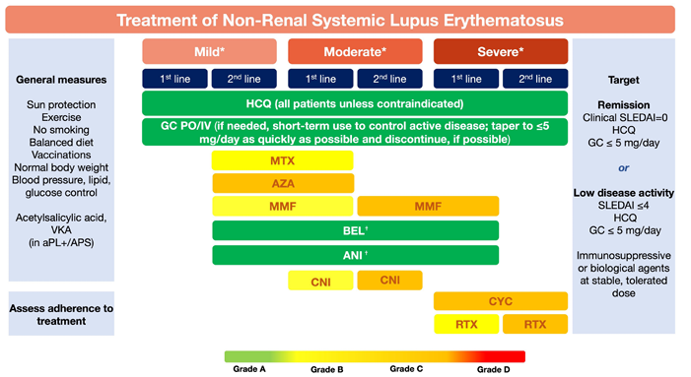
2023 EULAR SLE Treatment Guidelines
In active neuropsychiatric disease attributed to SLE, glucocorticoids and immunosuppressive agents for inflammatory manifestations (1b/A) and antiplatelet agents/anticoagulants for atherothrombotic/aPL- related manifestations (2b/C) should be considered.
For the approved biological drugs, anifrolumab and belimumab, there is a paucity of evidence regarding their efficacy in neuropsychiatric manifestations, because patients with active, severe forms of such manifestations were excluded from the RCTs of both drugs, and under- represented in real- life use of belimumab.
Notes:
Observational cohort studies [48, 65] have reported a lower risk of seizures in patients with SLE taking antimalarial drugs, even after adjusting for con founding variables. (3)
The precise mechanism responsible for this beneficial effect is unclear but it may result from a combination of the known anti-inflammatory [66, 67] and antithrombotic [68] properties of antimalarial drugs.
Another cohort study of NPSLE and SLE patients, using MRI, found less brain atrophy and loss of white matter fibre tract integrity among those taking antimalarials [69].
High-level evidence for the treatment of NPSLE is lacking. In the absence of such evidence, pragmatic management strategies should be used, based on observational data for NPSLE, expert opinion and experience from other organ system involvement in SLE.
A particular limitation is that all clinical trials in SLE exclude patients with active CNS manifestations (Dubois)
Patients with severe NPSLE were excluded from clinical trials of belimumab and anifrolumab. A post hoc analysis of two phase III belimumab studies that included 45 patients with mild NPSLE indicated a beneficial response, but only for headache and not for other NPSLE manifestations
More recently, a post hoc analysis of five phase III belimumab trials did not demonstrate a protective or predisposing effect of belimumab versus placebo for the occurrence of NPSLE flares during treatment
Post hoc analysis of patients with mild NPSLE enrolled in the anifrolumab clinical trial program, is awaited

Slide 30
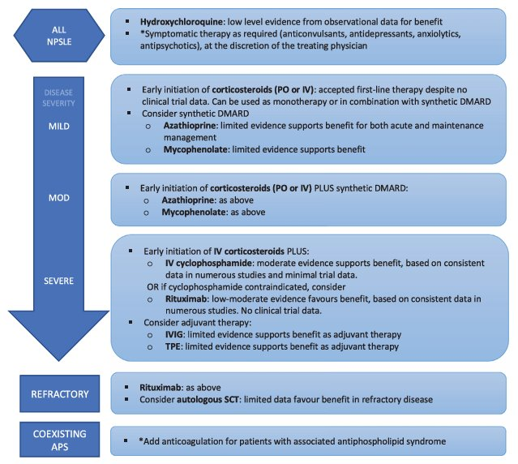
Notes:
Mycophenolate
Post-hoc analysis of a randomized controlled trial in 370 patients with lupus nephritis examined non-renal disease activity following mycophenolate mofetil versus IV cyclophosphamide. 3 patients received mycophenolate and 5 received cyclophosphamide. No significant difference
Azathioprine
Most often, it was used in combination with other immunosuppressive agents, such as cyclophosphamide
IVIG
Data limited to two case series with one including various manifestations and the other limited to SLE-related chronic inflammatory demyelinating polyneuropathy (CIDP)
Autologous stem cell transplant
Three studies including one non-controlled trial and two observational studies included refractory patients with NPSLE
Response after auto SCT was favorable overall; however, only one study reported responses for neurologic patients separately
frequency of CNS manifestations was 46%; this decreased to approximately 5% after six months and was approximately 10% at 24 months.
Intrathecal methotrexate
Data quality in the intrathecal MTX was low as The latter study should be interpreted with caution, as a number of patients (details were not provided in the study) also received cyclophosphanemide and intravenous immune globulin
this study was confounded by higher rates of intravenous pulse methylprednisolone therapy in the intrathecal treatment group. Until additional data become available, the contribution of intrathecal methotrexate and dexamethasone to the treatment of NPSLE remains unclear.

Slide 31
References
The American College of Rheumatology nomenclature and case definitions for neuropsychiatric lupus syndromes. Arthritis Rheum. 1999 Apr;42(4):599-608. doi: 10.1002/1529-0131(199904)42:4<599::AID-ANR2>3.0.CO;2-F. PMID: 10211873.
Bertsias GK, Ioannidis JP, Aringer M, Bollen E, Bombardieri S, Bruce IN, Cervera R, Dalakas M, Doria A, Hanly JG, Huizinga TW, Isenberg D, Kallenberg C, Piette JC, Schneider M, Scolding N, Smolen J, Stara A, Tassiulas I, Tektonidou M, Tincani A, van Buchem MA, van Vollenhoven R, Ward M, Gordon C, Boumpas DT. EULAR recommendations for the management of systemic lupus erythematosus with neuropsychiatric manifestations: report of a task force of the EULAR standing committee for clinical affairs. Ann Rheum Dis. 2010 Dec;69(12):2074-82. doi: 10.1136/ard.2010.130476. Epub 2010 Aug 19. PMID: 20724309.
Govoni M, Hanly JG. The management of neuropsychiatric lupus in the 21st century: still so many unmet needs? Rheumatology (Oxford). 2020 Dec 5;59(Suppl5):v52-v62. doi: 10.1093/rheumatology/keaa404. PMID: 33280014; PMCID: PMC7719041.
Narváez J, Ríos-Rodriguez V, de la Fuente D, Estrada P, López-Vives L, Gómez-Vaquero C, Nolla JM. Rituximab therapy in refractory neuropsychiatric lupus: current clinical evidence. Semin Arthritis Rheum. 2011 Dec;41(3):364-72. doi: 10.1016/j.semarthrit.2011.06.004. Epub 2011 Aug 27. PMID: 21875742.
Ota Y, Srinivasan A, Capizzano AA, Bapuraj JR, Kim J, Kurokawa R, Baba A, Moritani T. Central Nervous System Systemic Lupus Erythematosus: Pathophysiologic, Clinical, and Imaging Features. Radiographics. 2022 Jan-Feb;42(1):212-232. doi: 10.1148/rg.210045. PMID: 34990324.
Faria R, Gonçalves J, Dias R. Neuropsychiatric Systemic Lupus Erythematosus Involvement: Towards a Tailored Approach to Our Patients? Rambam Maimonides Med J. 2017 Jan 30;8(1):e0001. doi: 10.5041/RMMJ.10276. PMID: 28178431; PMCID: PMC5298362.
Carta S, Ferraro D, Ferrari S, Briani C, Mariotto S. Oligoclonal bands: clinical utility and interpretation cues. Crit Rev Clin Lab Sci. 2022 Sep;59(6):391-404. doi: 10.1080/10408363.2022.2039591. Epub 2022 Mar 11. PMID: 35277112.
Vivaldo JF, de Amorim JC, Julio PR, de Oliveira RJ, Appenzeller S. Definition of NPSLE: Does the ACR Nomenclature Still Hold? Front Med (Lausanne). 2018 May 31;5:138. doi: 10.3389/fmed.2018.00138. PMID: 29904630; PMCID: PMC5991071.

Slide 32
References
Sarwar S, Mohamed AS, Rogers S, Sarmast ST, Kataria S, Mohamed KH, Khalid MZ, Saeeduddin MO, Shiza ST, Ahmad S, Awais A, Singh R. Neuropsychiatric Systemic Lupus Erythematosus: A 2021 Update on Diagnosis, Management, and Current Challenges. Cureus. 2021 Sep 14;13(9):e17969. doi: 10.7759/cureus.17969. PMID: 34667659; PMCID: PMC8516357.
Wallace, Daniel J., and Bevra Hahn. Dubois’ Lupus Erythematosus and Related Syndromes. Elsevier, 2024.
Unterman, A. et al. Neuropsychiatric syndromes in systemic lupus erythematosus: a meta-analysis. Semin. Arthritis Rheum. 41, 1–11 (2011).
Zirkzee EJ, Huizinga TW, Bollen EL, van Buchem MA, Middelkoop HA, van der Wee NJ, le Cessie S, Steup-Beekman GM. Mortality in neuropsychiatric systemic lupus erythematosus (NPSLE). Lupus. 2014;23(1):31-8. doi: 10.1177/0961203313512540. Epub 2013 Nov 15. PMID: 24243776.
Sato S, Temmoku J, Fujita Y, Yashiro-Furuya M, Matsuoka N, Asano T, Kobayashi H, Watanabe H, Migita K. Autoantibodies associated with neuropsychiatric systemic lupus erythematosus: the quest for symptom-specific biomarkers. Fukushima J Med Sci. 2020 Apr 22;66(1):1-9. doi: 10.5387/fms.2020-02. Epub 2020 Mar 13. PMID: 32173681; PMCID: PMC7269884.
Choi MY, FitzPatrick RD, Buhler K, Mahler M, Fritzler MJ. A review and meta-analysis of anti-ribosomal P autoantibodies in systemic lupus erythematosus. Autoimmun Rev. 2020 Mar;19(3):102463. doi: 10.1016/j.autrev.2020.102463. Epub 2020 Jan 9. PMID: 31927088.
Conceicao CTM, Meinao IM, Bombana JA, Sato EI. Psychoanalytic psychotherapy improves quality of life, depression, anxiety and coping in patients with systemic lupus erythematosus: a controlled randomized clinical trial. Adv Rheumatol 2019;59:4
Seizures in systemic lupus erythematosus: A scoping review Rodriguez-Hernandez, Adrian et al. Seizure - European Journal of Epilepsy, Volume 86, 161 – 167
Yoshio T, Okamoto H, Kurasawa K, Dei Y, Hirohata S, Minota S. IL-6, IL-8, IP-10, MCP-1 and G-CSF are significantly increased in cerebrospinal fluid but not in sera of patients with central neuropsychiatric lupus erythematosus. Lupus. 2016 Aug;25(9):997-1003. doi: 10.1177/0961203316629556. Epub 2016 Feb 3. PMID: 26846690.
Ichinose K, Arima K, Ushigusa T, Nishino A, Nakashima Y, Suzuki T, Horai Y, Nakajima H, Kawashiri SY, Iwamoto N, Tamai M, Nakamura H, Origuchi T, Motomura M, Kawakami A. Distinguishing the cerebrospinal fluid cytokine profile in neuropsychiatric systemic lupus erythematosus from other autoimmune neurological diseases. Clin Immunol. 2015 Apr;157(2):114-20. doi: 10.1016/j.clim.2015.01.010. Epub 2015 Feb 3. PMID: 25656641.
Feld J, Tayer-Shifman OE, Su J, Anderson M, Touma Z. Primary headache in SLE -systematic review and meta-analysis. Semin Arthritis Rheum. 2024 Oct 28;69:152566. doi: 10.1016/j.semarthrit.2024.152566. Epub ahead of print. PMID: 39476557.

