Slide 1
When Meningitis Strikes Twice
RWCS Case Presentation
Feb 2024
Amanda Moyer, MD
Adult & Pediatric Rheumatology Fellow

Slide 2
Chief Complaint
51-year-old male admitted for encephalopathy (ataxia, expressive aphasia, altered mental status/personality changes), headache, and fever.

Slide 3
HPI
6-day history of intermittent fever attributed to the patient’s known h/o of panniculitis
5-day history of imbalance and near falls
4-day history of worsening headache
3-days of difficulty speaking and word-finding issues with confusion and personality changes (acting more childish)
2-day history of spastic movements in the BUE

Slide 4
PMH
Started to develop “boils” around the age of 37
Eventually diagnosed with Weber-Christian disease ~ 40 years of age in the setting of intermittent fevers & biopsy-proven neutrophilic panniculitis
Hospitalized at the age of 38 with headache, nausea, double vision, fever & balance issues and was ultimately diagnosed with a lymphocytic meningitis
MRI with cerebellar lesions
No infectious etiology was identified → treated with long-term abx for a potential brain abscess with improvement
Some residual primary motor defects
Hospital course complicated by DVT with thrombophlebitis & folliculitis
Remote history of positive PPD s/p treatment for latent tuberculosis
Notes:
Weber-Christian disease is an eponym for a form of panniculitis, idiopathic nodular panniculitis, which is characterized by subcutaneous nodules, inflammatory cells in the fat lobules, and systemic symptoms.

Slide 5
PMH
Panniculitis suspected to be secondary to Weber-Christian disease
Treated with varying success and side effects in the past with colchicine, NSAIDs, steroids, & dapsone
Most success with etanercept and more recently adalimumab
On adalimumab until ~3 months ago when he was no longer able to afford it
Worsening rash off TNF inhibitor
Intermittent prednisone for flares –
Recently completed a burst & taper
Taking prednisone routinely since stopping adalimumab
Notes:
Weber-Christian disease is an eponym for a form of panniculitis, idiopathic nodular panniculitis, which is characterized by subcutaneous nodules, inflammatory cells in the fat lobules, and systemic symptoms.

Slide 6
PSHx:
Social Hx:
Non-contributory, none
Lives in San Jose, California with his wife
Born in Mexico and moved to the US in 1995
Used to work in a machine shop but was recently laid off
Active, lifts weights, fit
Has a pet chameleon
No recent travel outside of the region
Sexually active only with his wife
Denies drug or alcohol use
Remote 5 pk/year smoking history
FHx:
Non-contributory
Home Meds
Adalimumab – hadn’t taken in ~ 3 months
Prednisone – varying doses

Slide 7
ROS
Pertinent Positives: Fever, chills, altered mental status (acting more child-like), balance issues, oral ulcers, rash, and skin lesions
Pertinent Negatives: weight loss, sick contacts, new medications, chest pain, SOB

Slide 8
2011 Hospitalization
1st LP: WBC 2625, 49% neutrophils, 36% lymphocytes, 18 RBCs, glucose 50, total protein 114
2nd LP: WBC 83, 2% neutrophils, 93% lymphocytes, 10 RBCs, glucose 56, protein 34
1st MRI: with “mass lesion” concerning for atypical infection (fungal vs. TB) → started on RIPE which was later DC’ed after studies returned negative
2nd MRI: with a decrease in the mass lesion presumed to be due to antibiotic therapy
Folliculitis improved with abx
Headache and mentation improved rapidly but some ataxia persisted

Slide 9
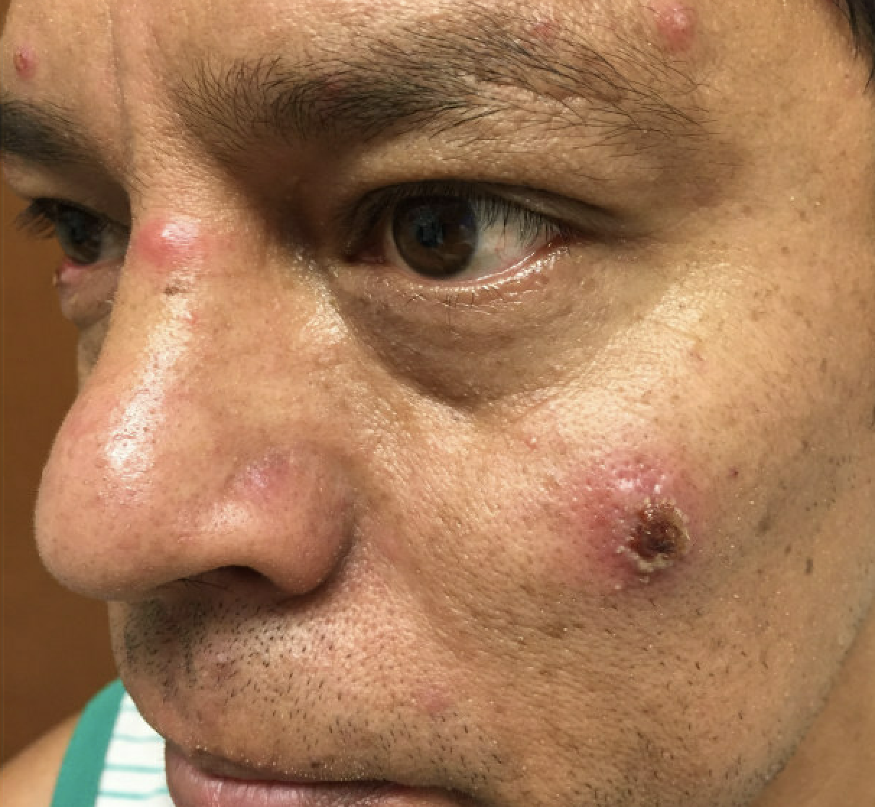
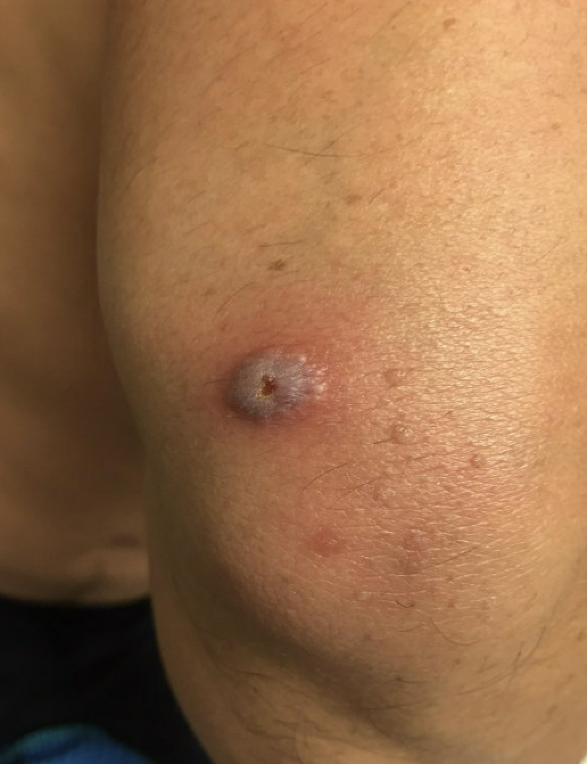
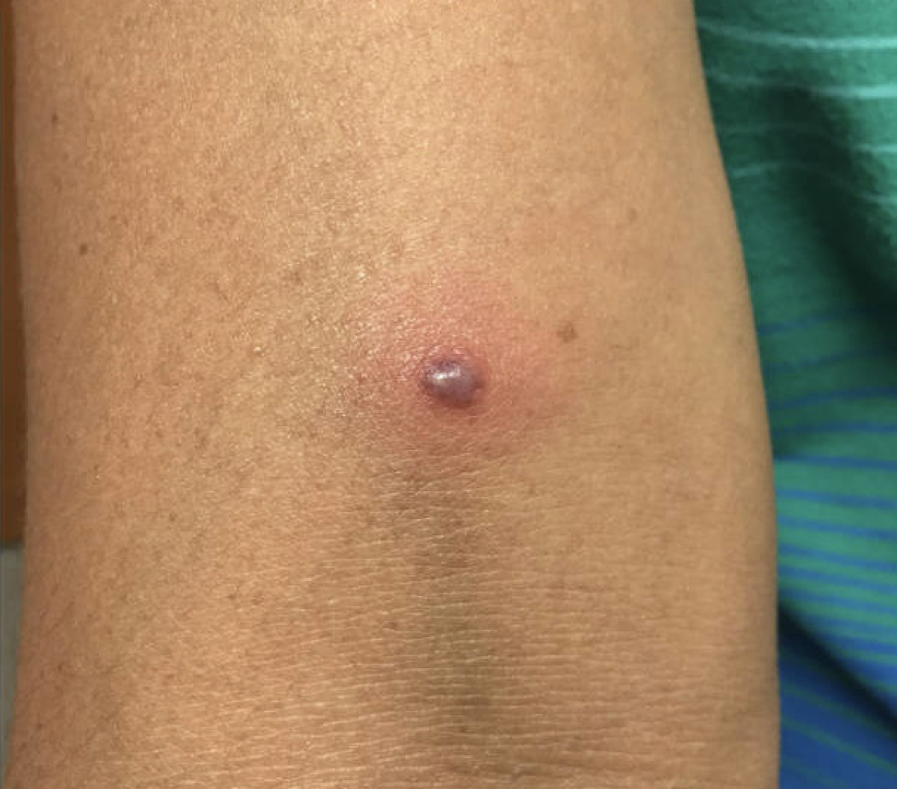
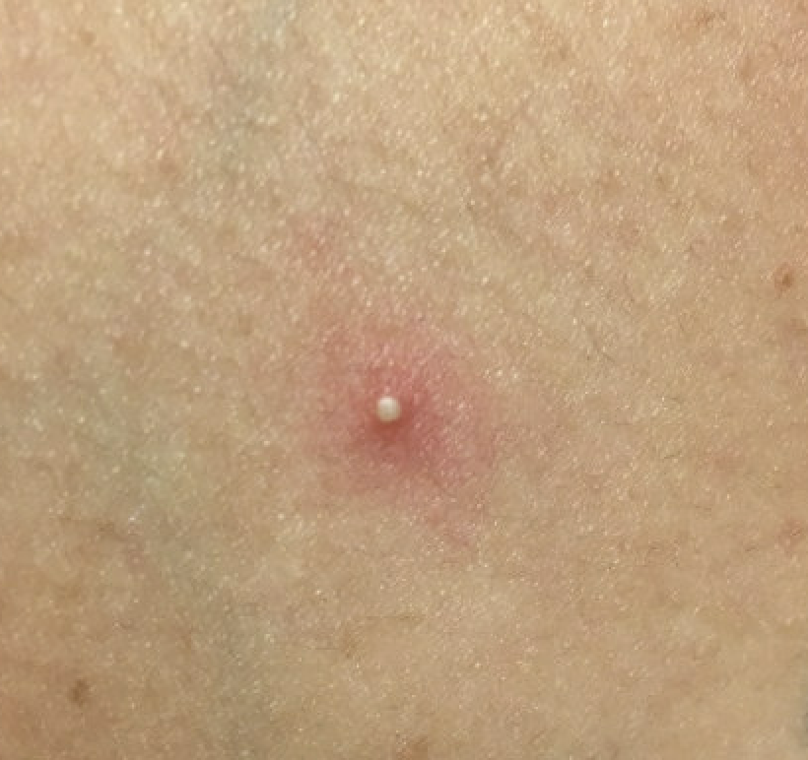
2016
2011 Skin biopsy: Neutrophilic Panniculitis
Diffuse septal and lobular neutrophilic panniculitis in the deep fat
2012 Skin biopsy: Neutrophilic Panniculitis
Expanding fibrous septae consisting of predominately neutrophils a mixed lymphocytic/histiocytic inflammatory infiltrate.
No definite vasculitis. No organisms. No giant cells
The inflammatory infiltrate appears to extend into the fatty lobules, but it is predominately a septal process.
Notes:
2011 skin left wrist, punch biopsy: Multiple-step sections show a bisected punch biopsy of the skin. The surface epidermis is unremarkable with basket weave stratum corneum. The superficial and reticular dermis show a perivascular lymphocytic infiltrate. There is also a periadenxal infiltrate present. However, the main pathology is in the deep fat where one sees a diffuse septal and lobular neutrophilic panniculitis. No organisms on gram stain. The common cause of neutrophilic panniculitis is infectious. The findings should be correlated with culture results. However, other differential dx includes weber-Christian disease. It can also be seen in pancreatitis.
2012 skin biopsy: Multiple step-leveled section show skin with an unremarkable epidermis. The fibrous septae of the panniculitis are expanding and contained mixed inflammatory infiltrates consisting of predominately neutrophils with some lymphocytes and histiocytes. A mixed inflammatory infiltrate composed of predominantly of lymphocytes and histiocytes surrounds the superficial adnexal structures. While are extravasated RECs in the septae, there is no obvious vasculitis. The inflammatory infiltrate appears to extend into the fatty lobules, but it is predominately a septal process. No organisms. No giant cells. Findings could be compatable with early erythema nodosum or infective panniculitis.

Slide 10
Vitals
Temp: 37.1
Pulse: 65
BP: 119/64
Resp: 18
SpO2: 100%

Slide 11
Physical Exam
General: NAD, well developed, well nourished, pleasant but mostly speaking in one-word sentences or repeating “I don’t know.”
Neuro: CN intact, choreic activity in the right arm, strength 5/5 throughout, dysmetria on right w/ finger-to-nose testing, aphasia, positive dysdiadochokinesia
HEENT: PERRL, EOMI, scattered shallow oral ulcers
Neck: shotty anterior lymphadenopathy
Lungs: CTAB, no increased WOB
Cardiac: warm and well perfused, RRR, no murmur
Abdomen: NBS, soft, NTTP
Skin: multiple tattoos, scattered erythematous pustules on the chest, neck, and scalp; tender palpable nodules on the LE
MSK: No arthritis or synovitis, normal ROM

Slide 12
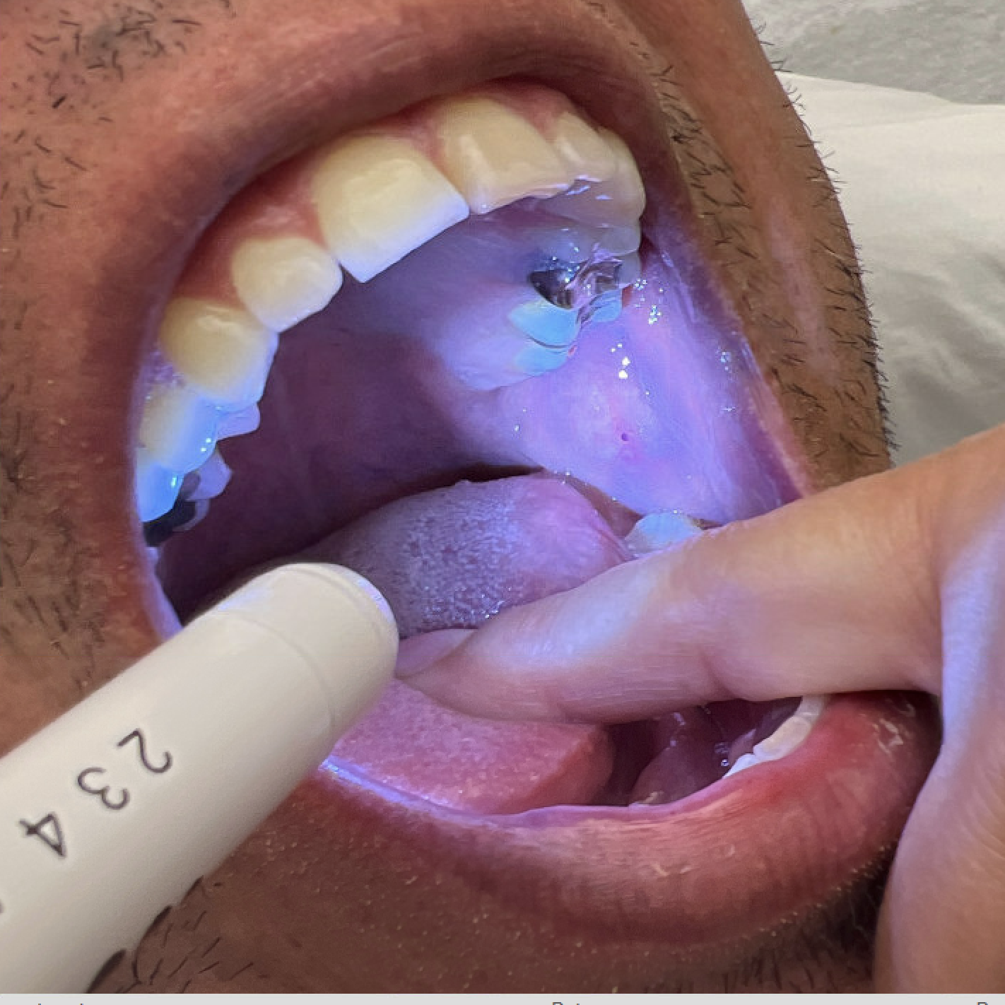
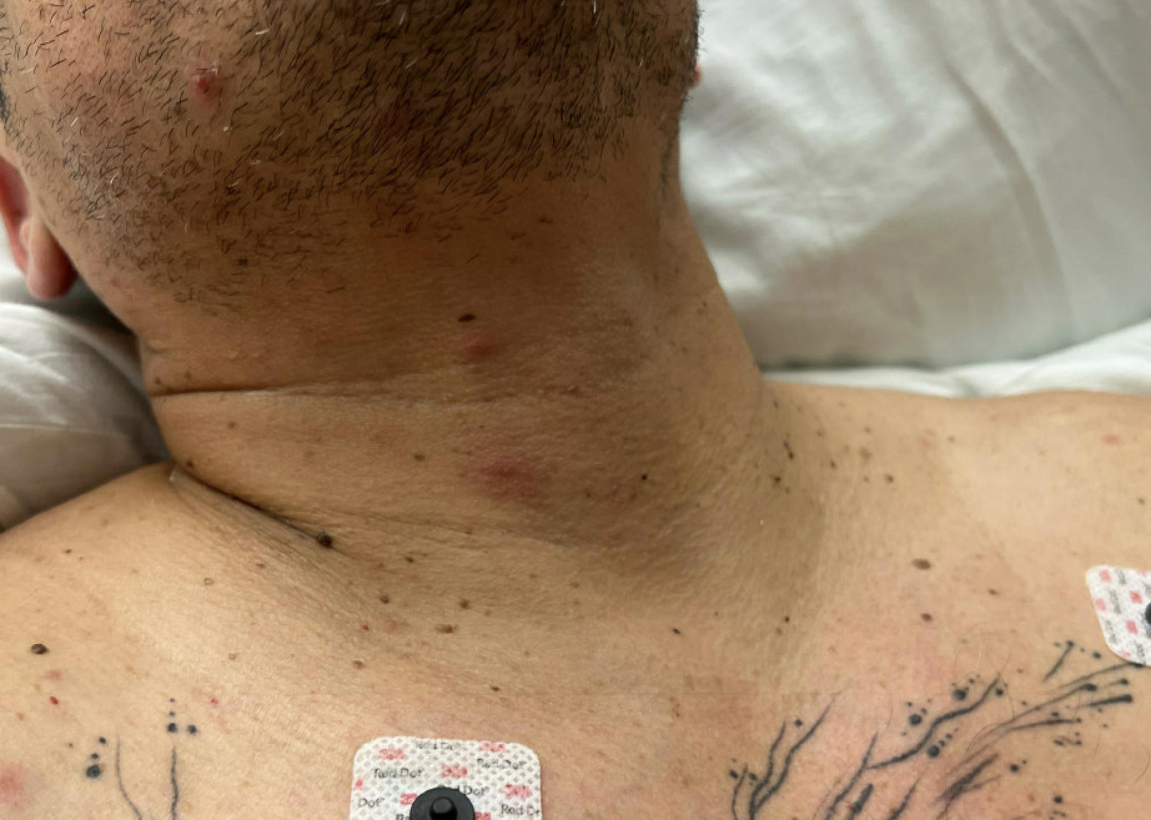
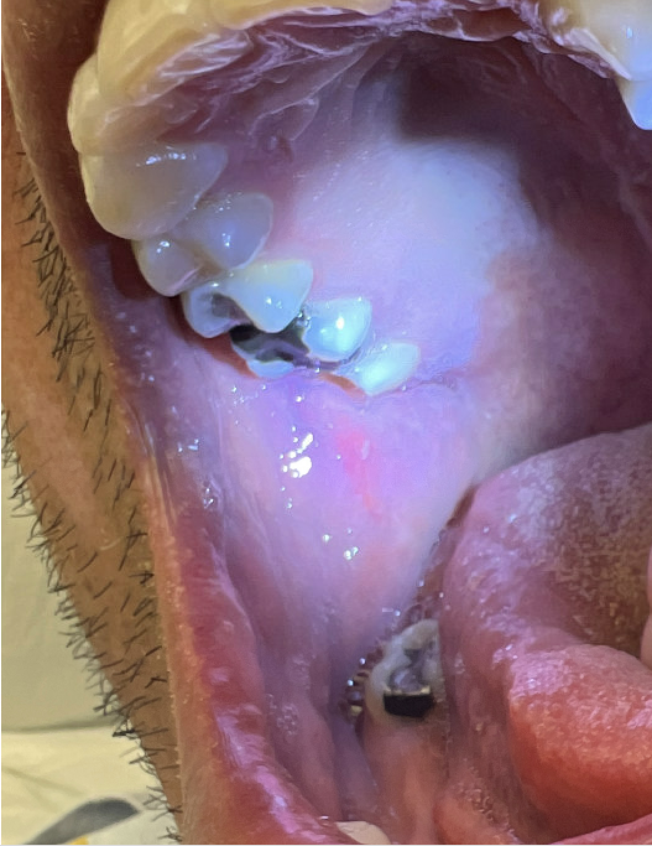
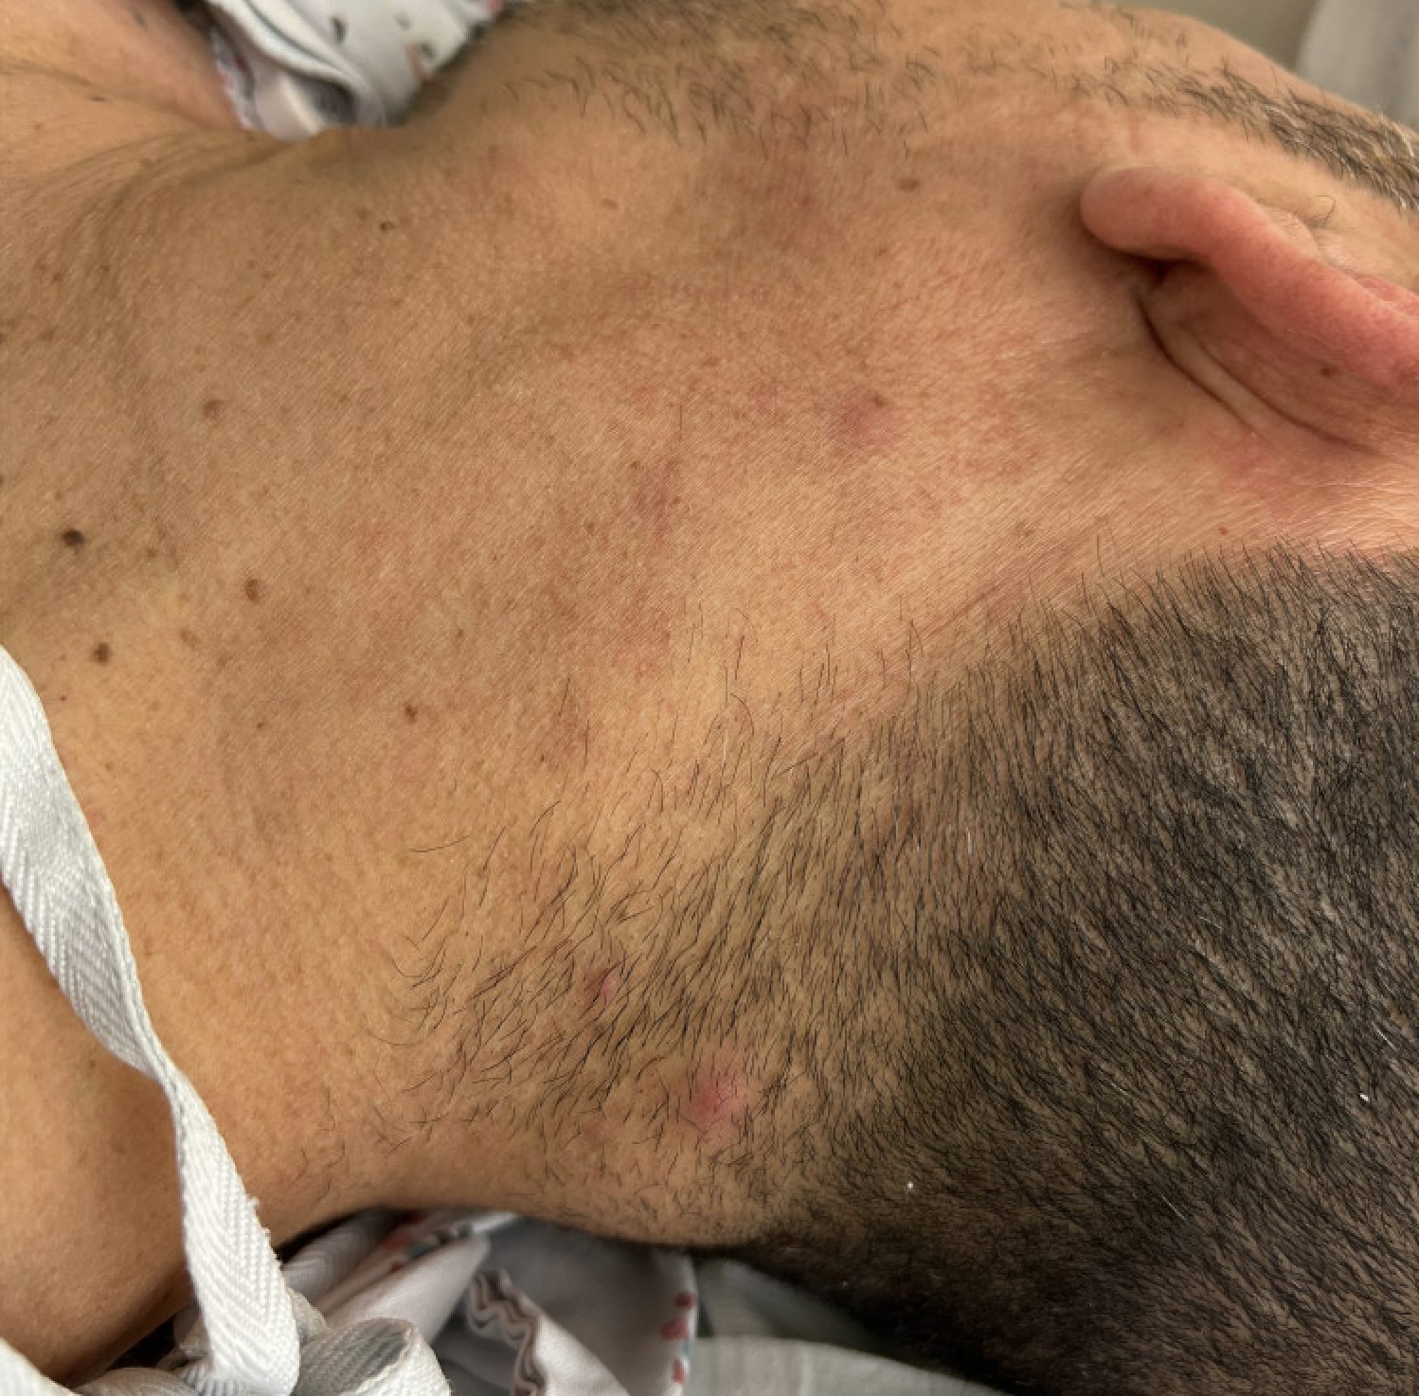
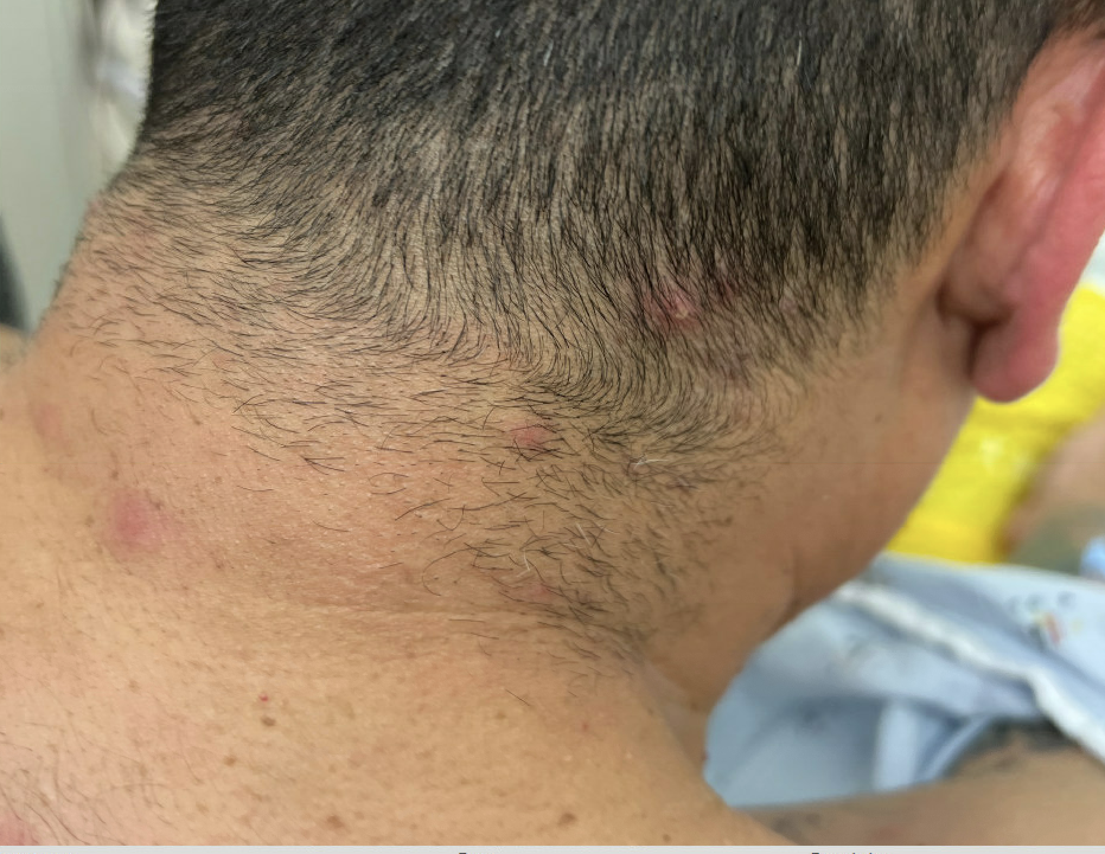

Slide 13
Initial Labs
Heme | Result | Ref
WBC Neut Lymph | 11.83 86.7 10.6 | 3.9-10.6 K/$μ$L 51.0-75.0 % 24.0-44.0 %
Hb | 15.0 | 13.5-17.5 g/dL
Hct | 46.0 | 41.0-53.0 %
Plt | 255 | 140-450 K/$μ$L
Chem | Result | Ref
CMP | normal | normal
ESR | 24 | < 20 mm/hr
CRP | 1.1 | 0.0-0.5 mg/dL
Ferritin | 408 | 30-400 ng/mL
LDH | 153 | 118-242 $μ$/L
A1C | 5.8 | 4.2-5.6 %
Notes:
-dimer = 1.2
TSH wnl
SPEP wnl
UPEP wnl
UDS negative

Slide 14
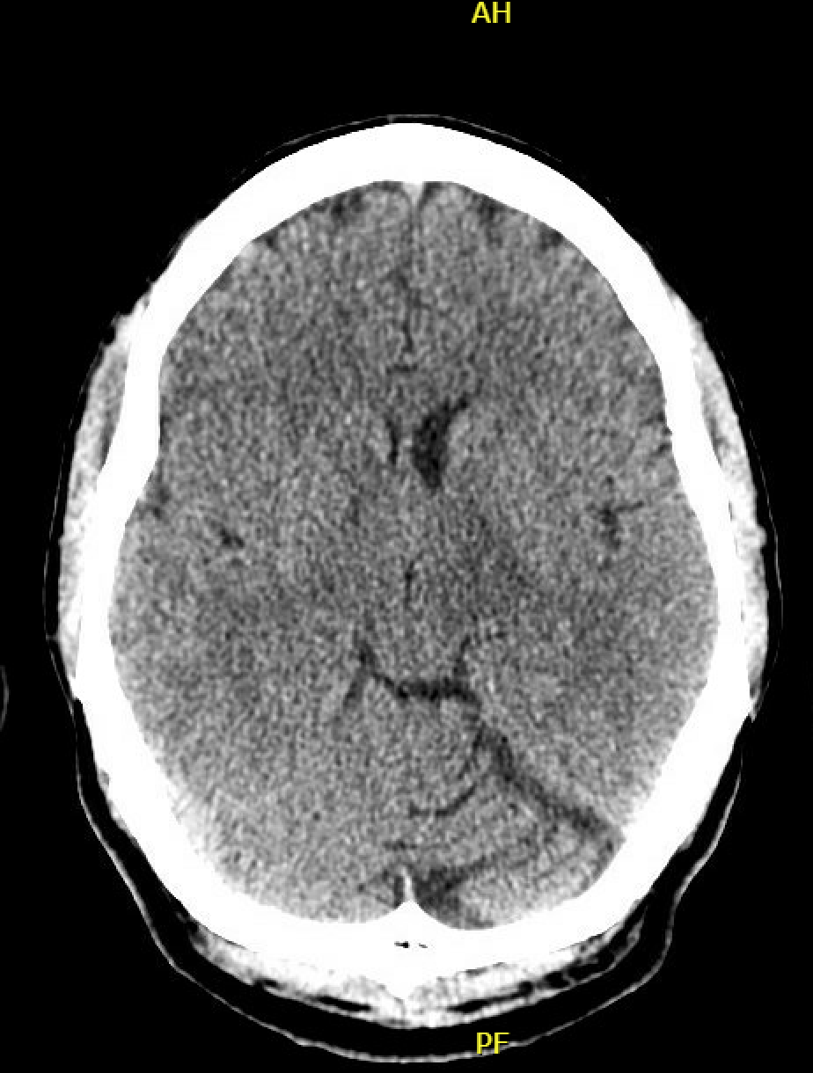
CT Head
No acute abnormality
Hypodensities at the bilateral internal capsule, left thalamus, midbrain, and pons which are mildly expansile on the left
Moderate volume loss in the left cerebellar hemisphere, new from 2012 study

Slide 15
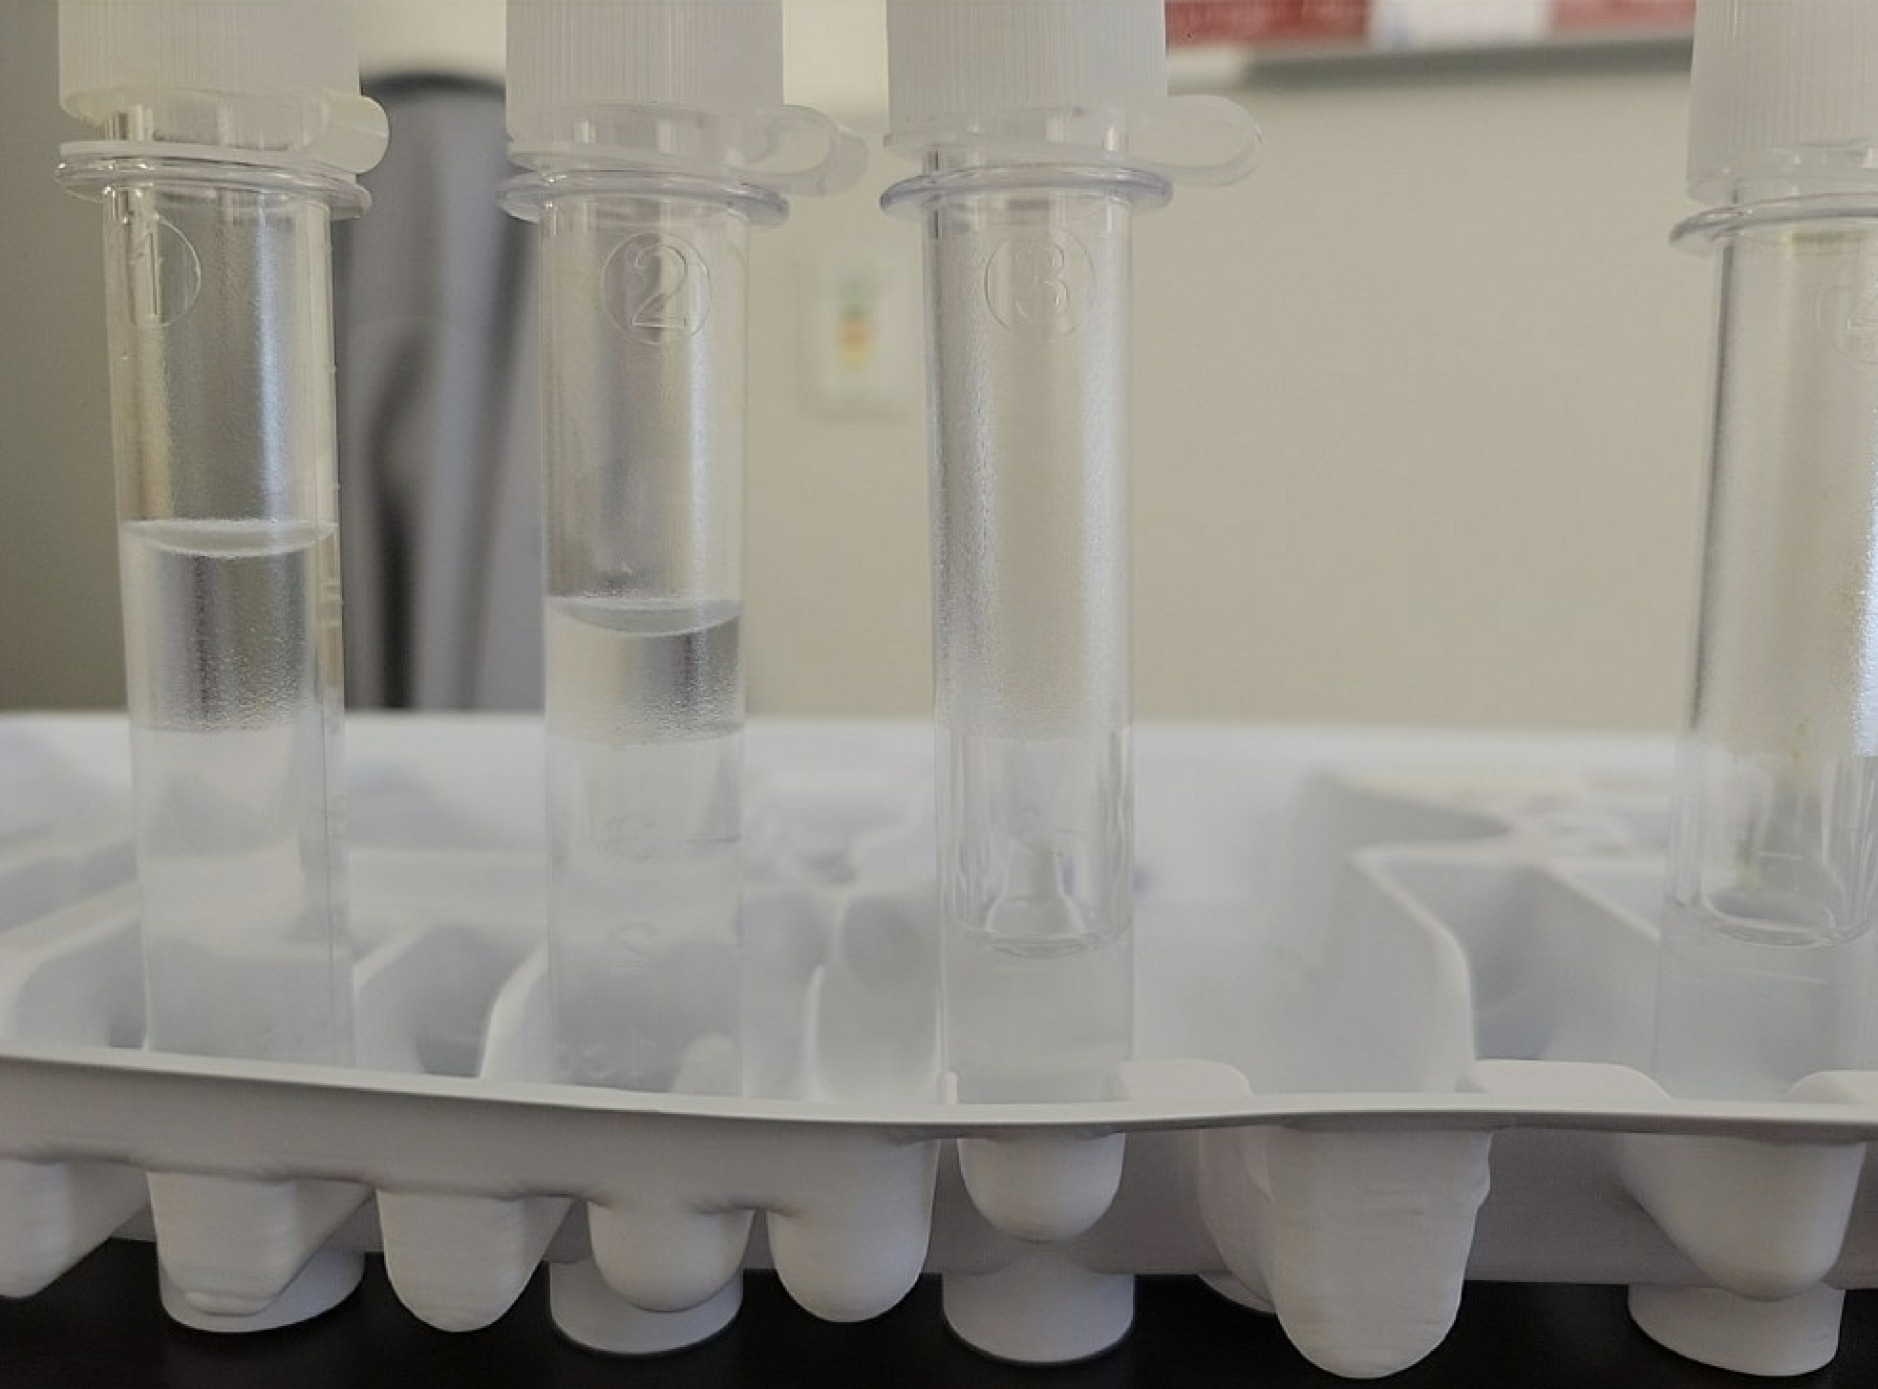
CSF Studies
CSF flow interpretation:
Manual diff
Seg/bands: 30%
Lymphocytes 54%
Monocytes 16%
Predominately lymphocytes, monocytes, & polymorphonuclear cells
No evidence of hematolymphoid neoplasm
MS banding path interpretation unremarkable
CSF Studies | Result | Ref
RBCs | 5
WBCs Neutrophils % Lymphocytes % Mononuclear % | 273 49.9 36.0 14.5 | K/$μ$L % % %
Glucose | 49 | 40-70 mg/dL
Protein | 43 | 10-45 mg/dL
Notes:
Granulocytes are seen by the cytospin slide & flow cytometry without a concurrent increase in peripheral blood cells – correlation with concurrent infectious disease testing is suggested

Slide 16
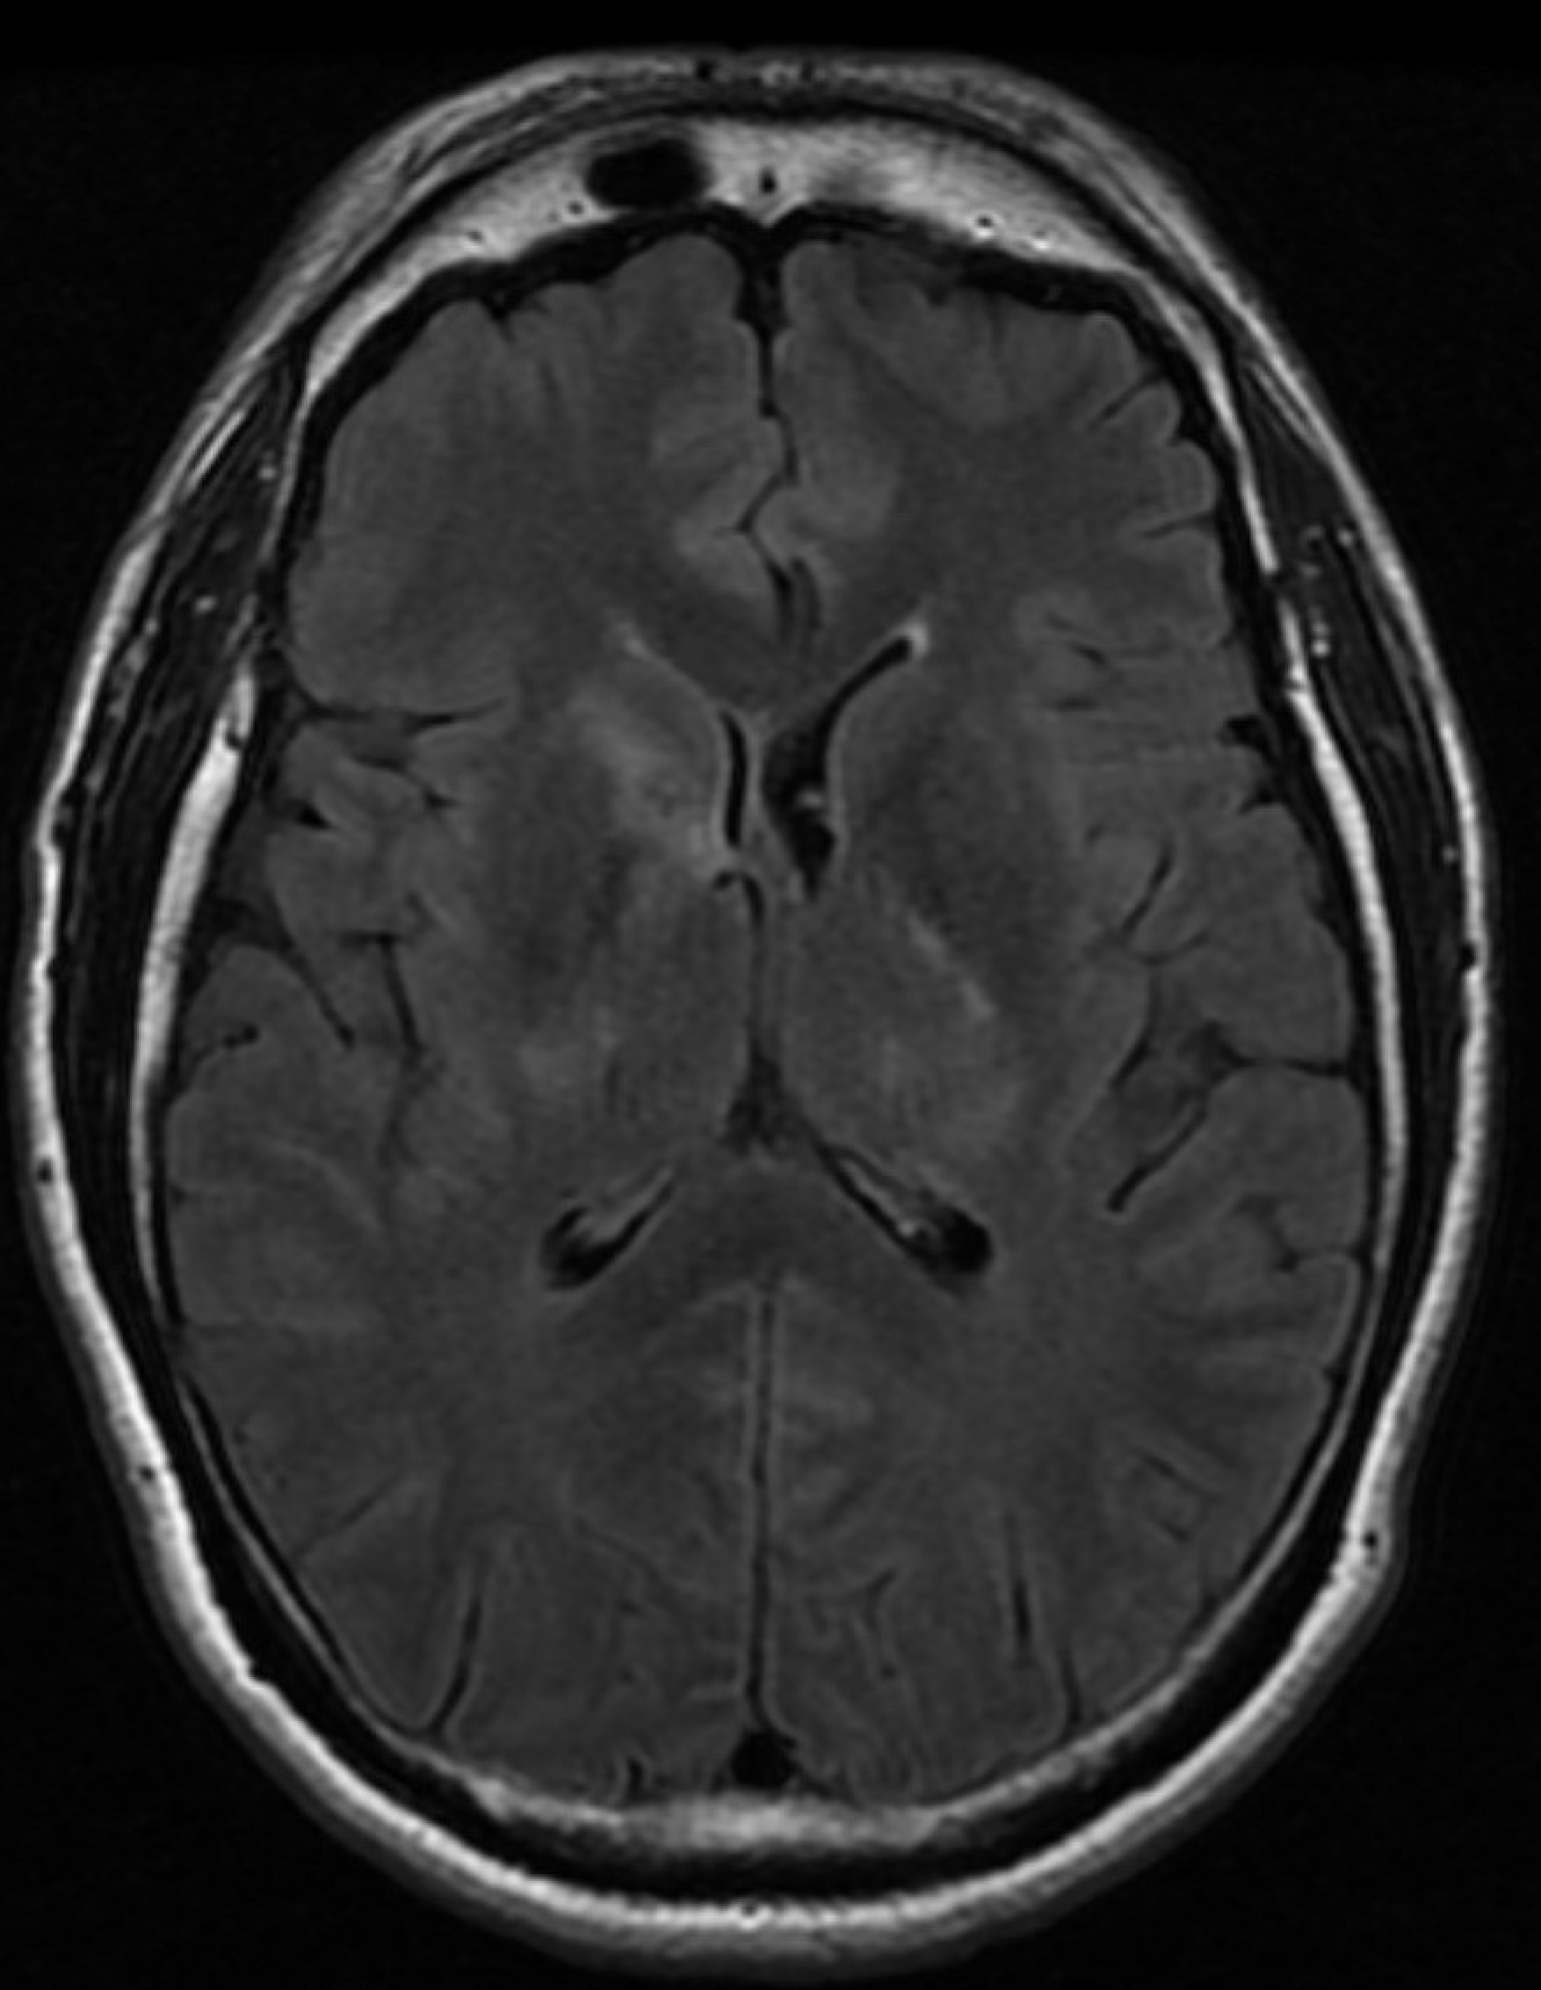
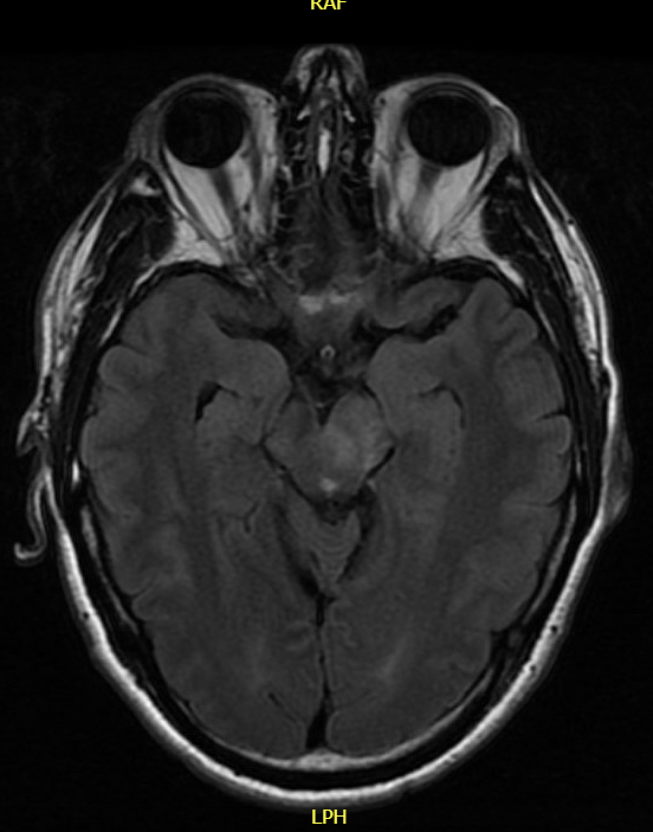
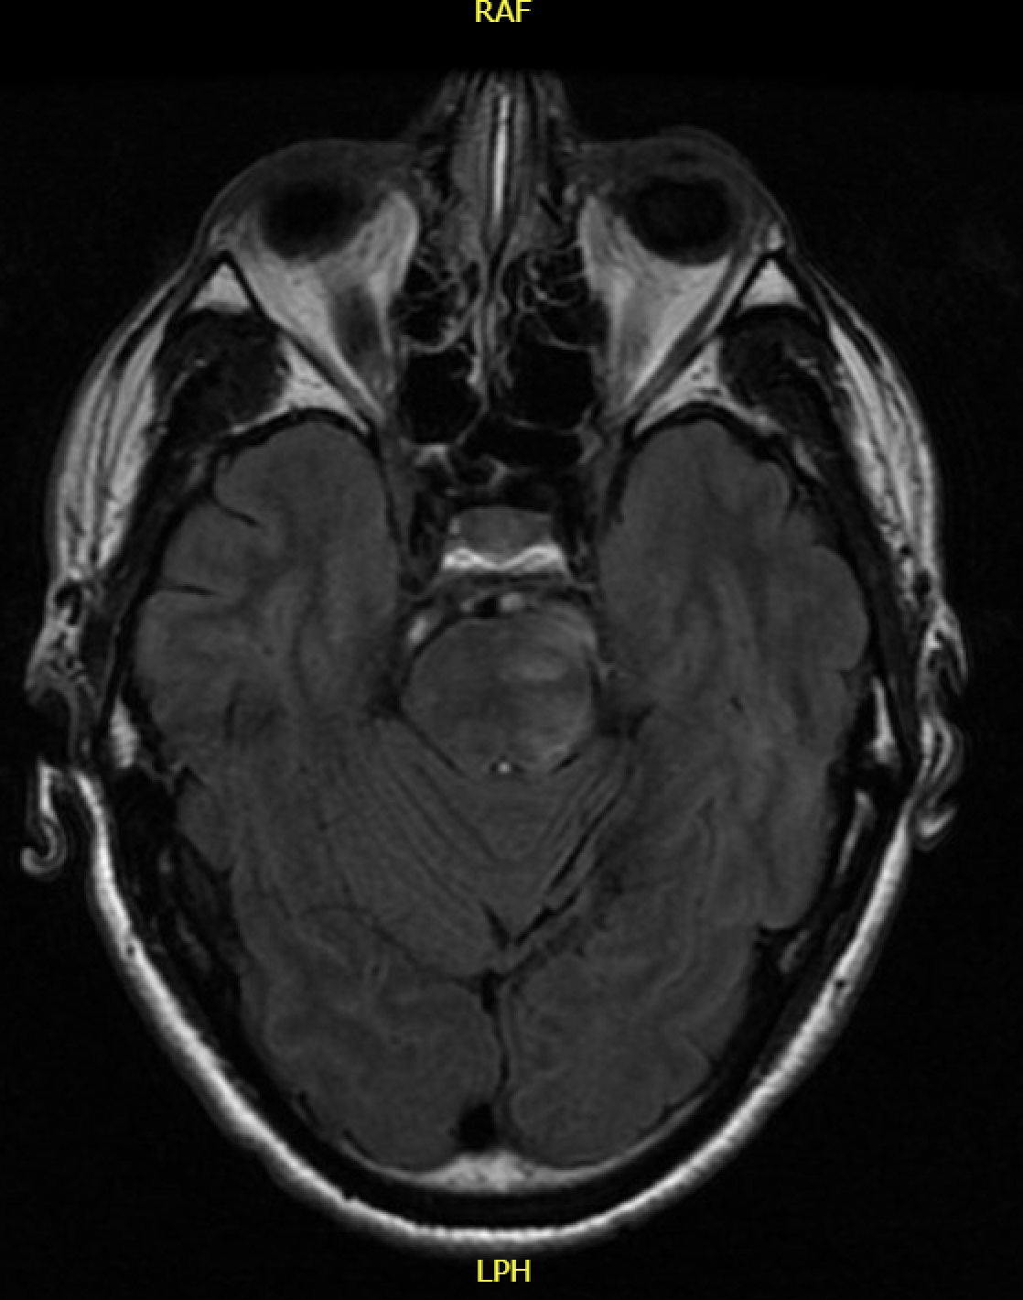
MRI T2 Flair
Notes:
Multifocal nodular rim-enhancing lesions with restricted diffusion in the bilateral internal capsules, right caudate head, & left pons.
Expansion of the left cerebral peduncle & left half of the pons.
A faint signal abnormality within the right medullary olive suggests hypertrophic olivary degeneration.

Slide 17
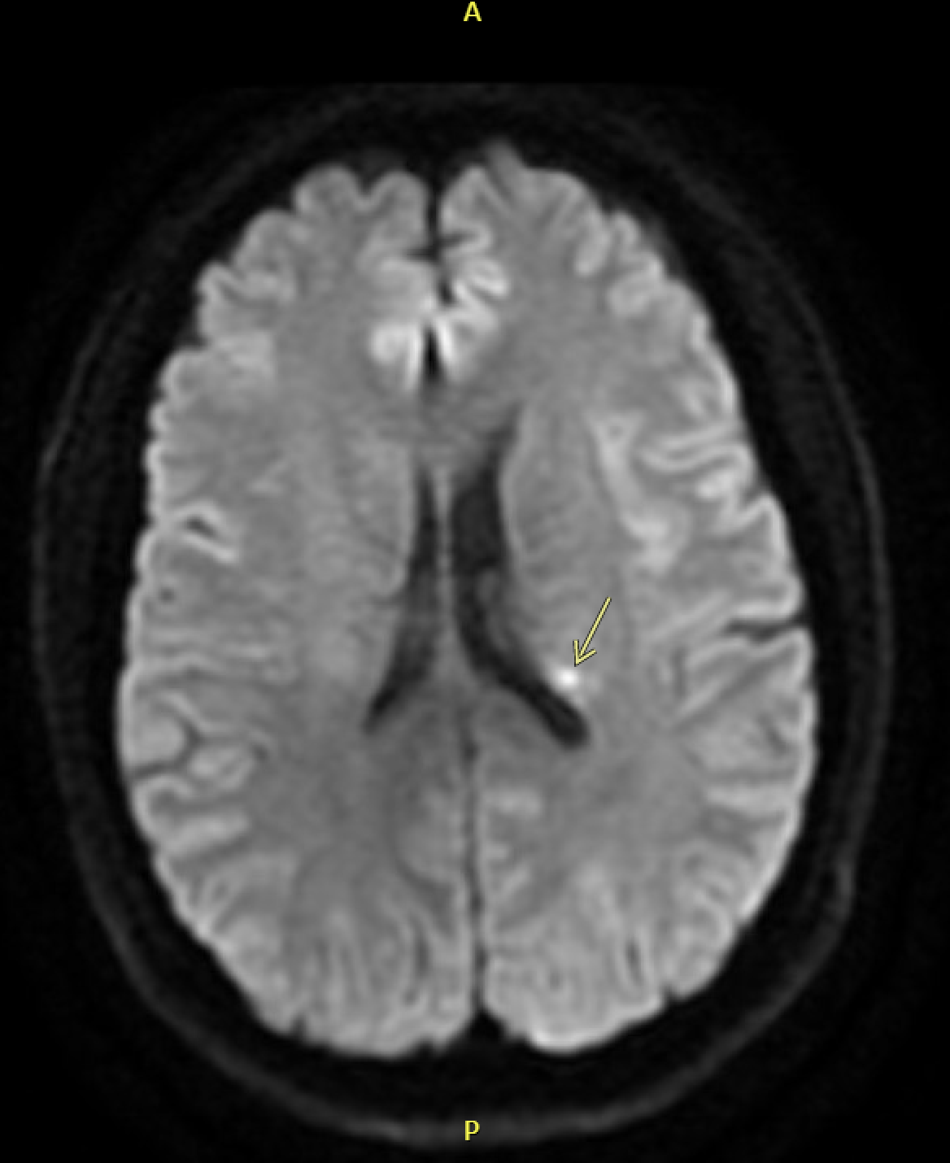
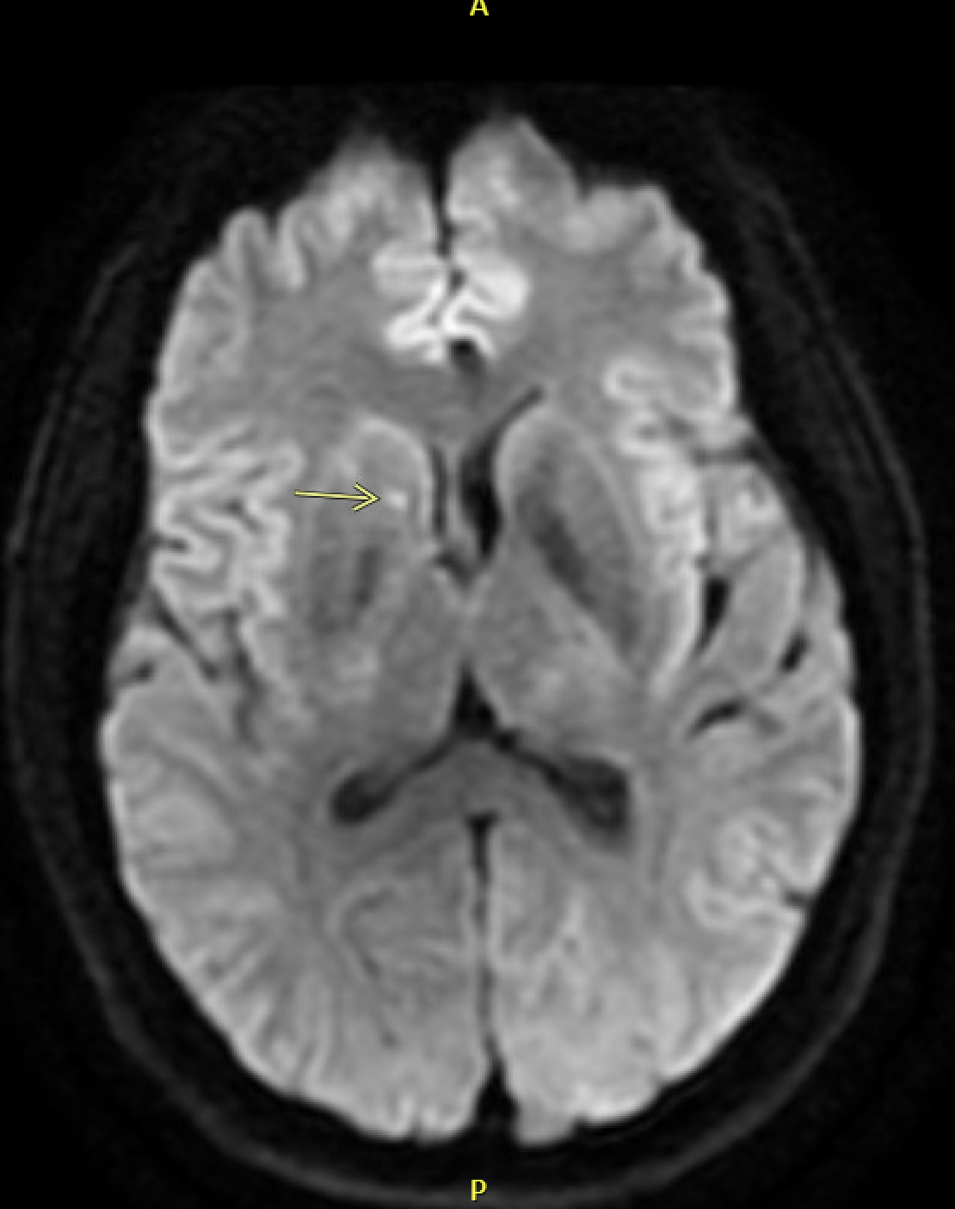
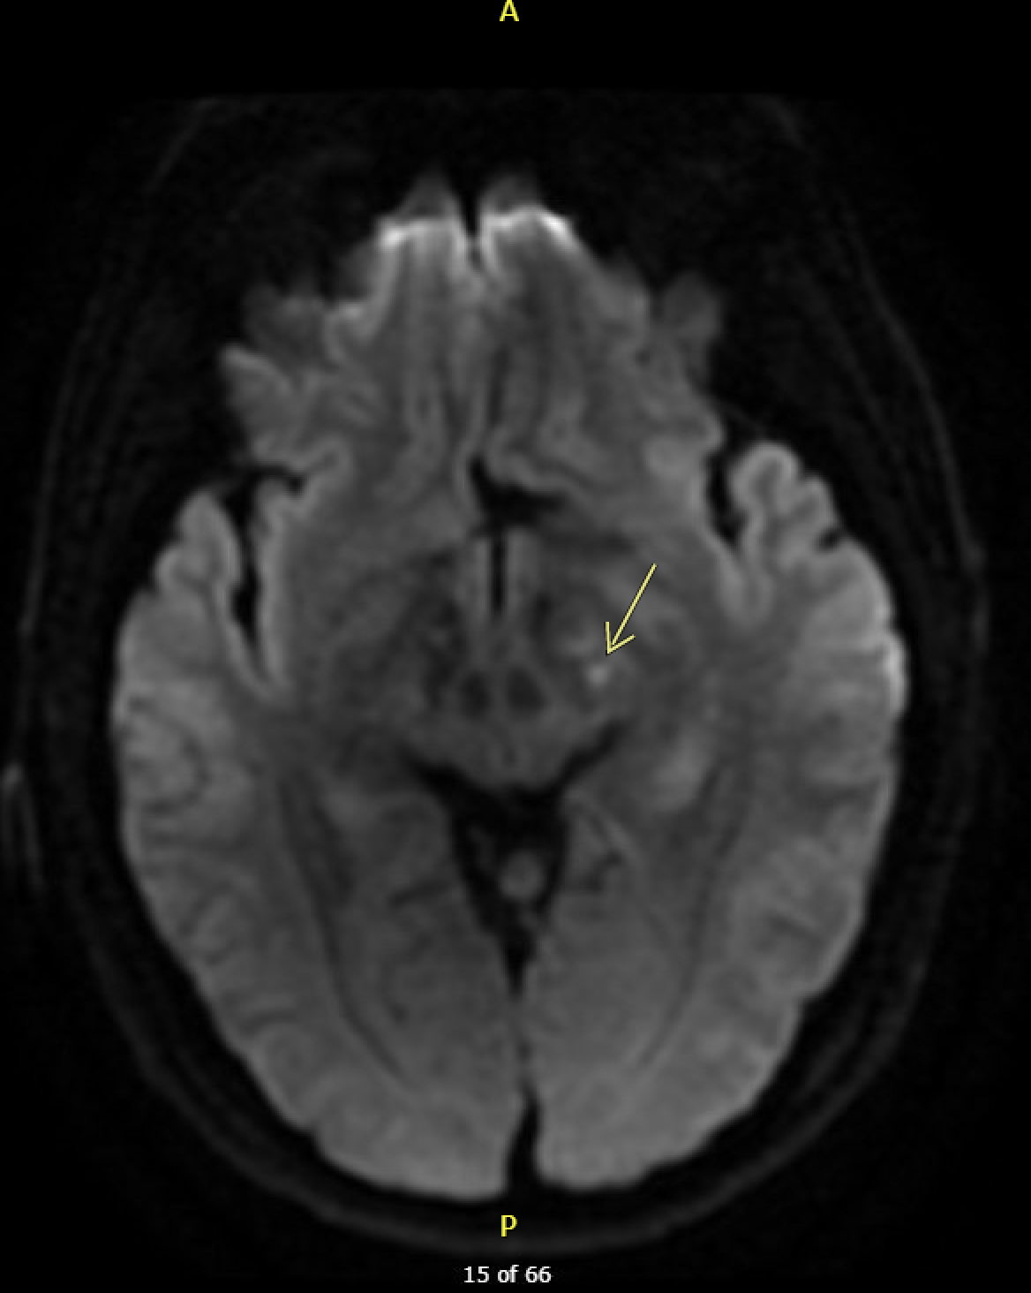
MRI DWI
Notes:
Multifocal nodular rim-enhancing lesions with restricted diffusion in the bilateral internal capsules, right caudate head, & left pons.
Expansion of the left cerebral peduncle & left half of the pons.
A faint signal abnormality within the right medullary olive suggests hypertrophic olivary degeneration.

Slide 18
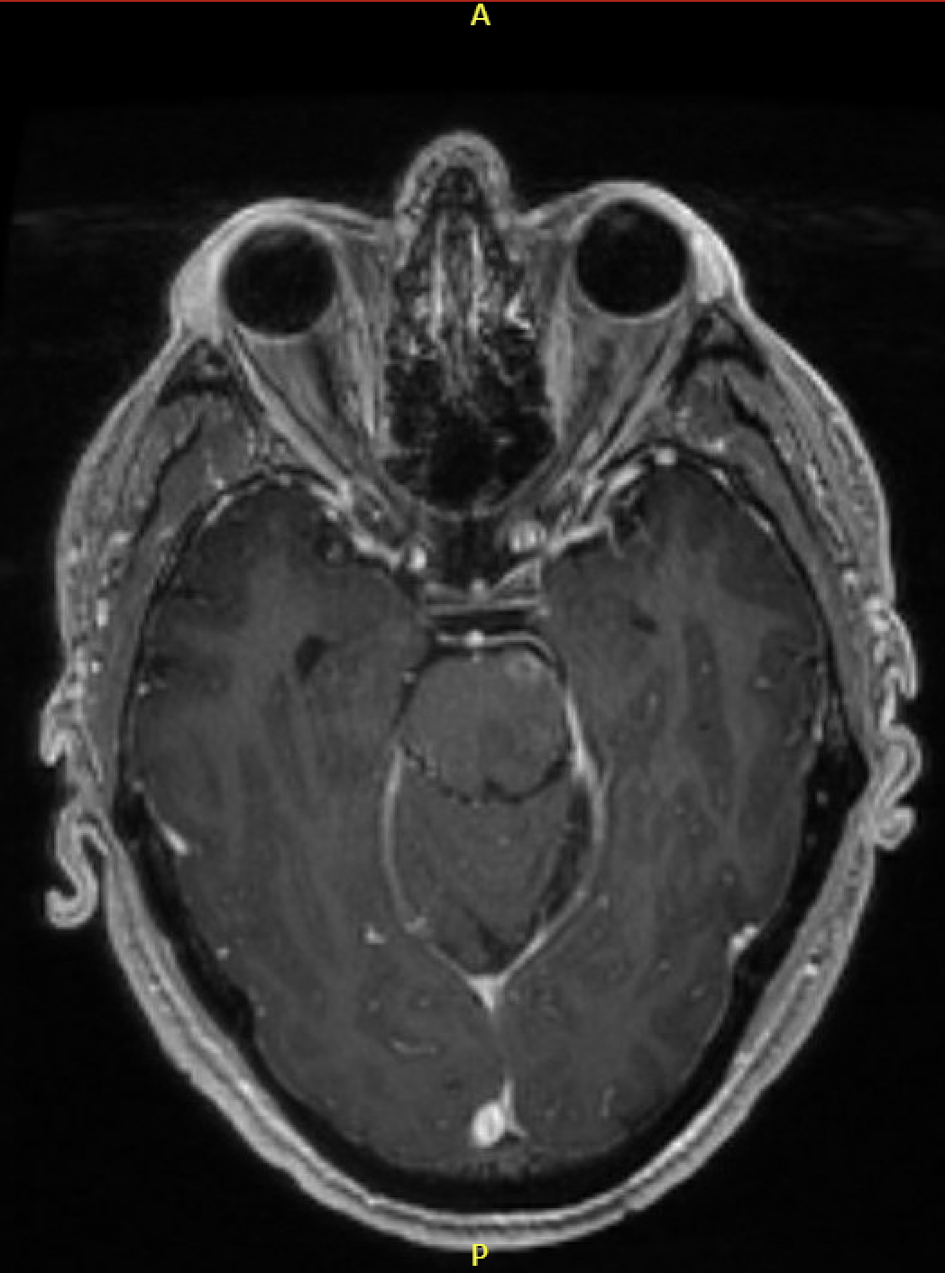
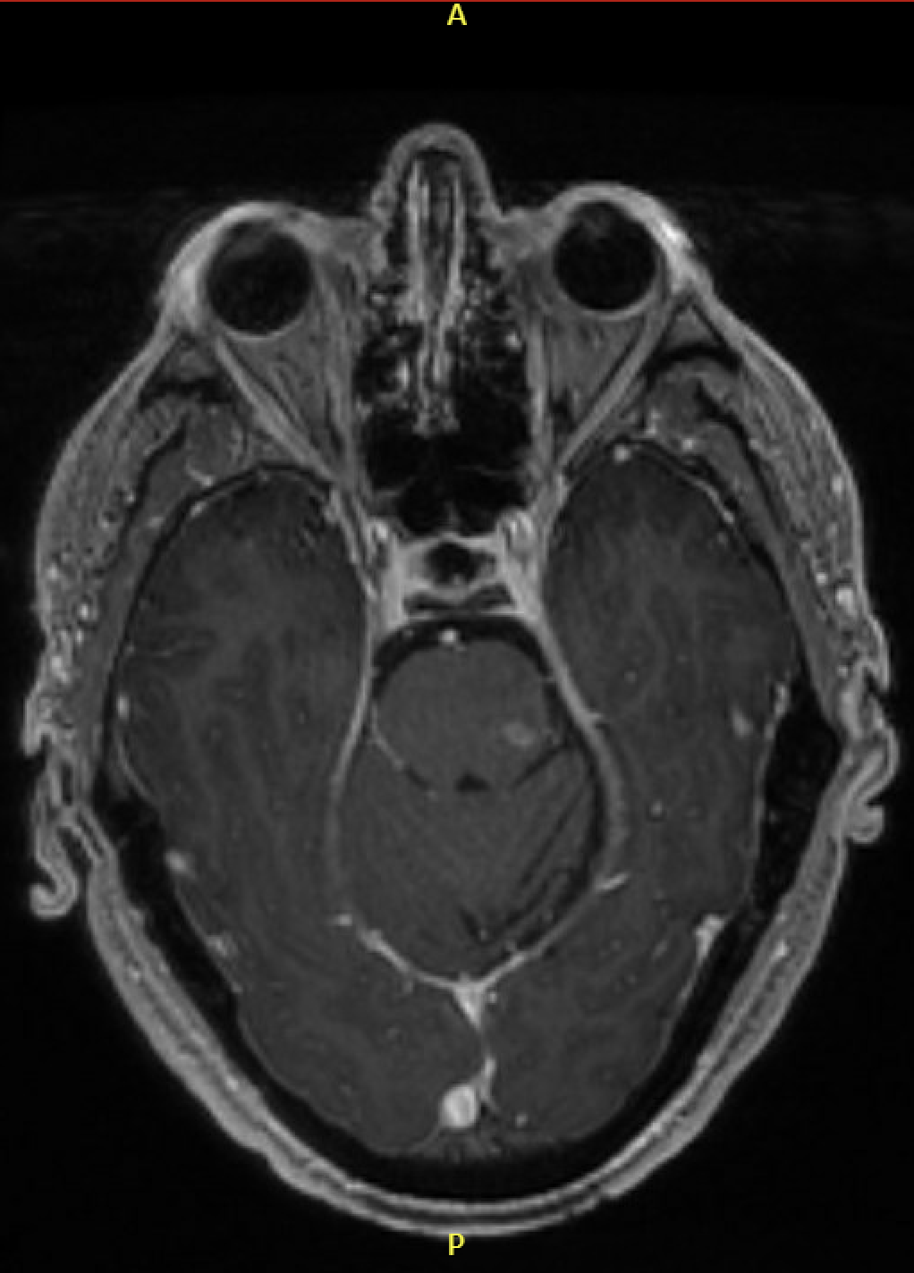
MRI Ax Bravo
Report:
Multifocal nodular rim-enhancing lesions with restricted diffusion in the bilateral internal capsules, right caudate head, & left pons.
Expansion of the left cerebral peduncle & left half of the pons.
A faint signal abnormality within the right medullary olive suggests hypertrophic olivary degeneration.
Notes:
Multifocal nodular rim-enhancing lesions with restricted diffusion in the bilateral internal capsules, right caudate head, & left pons.
Expansion of the left cerebral peduncle & left half of the pons.
A faint signal abnormality within the right medullary olive suggests hypertrophic olivary degeneration.

Slide 19
Additional Labs
Lab | Result | Ref
Meningitis/Encephalitis panel | Negative | Negative
NMO/AQP4-IgG | Negative | Negative
Acute Hepatitis | Negative | Negative
RPR/VDRL serum & CSF | Non-reactive | Non-reactive
HSV-1/2 serum & CSF | Negative | Negative
1,3 Beta-D-glucan | Negative | Negative
Cryptococcal antigen | Negative | Negative
Histoplasma antigen | Not detected | Not detected
Galactomannan antigen | Not detected | Not detected
Interferon Gamma Release assay | Positive | Negative
All cultures (blood, urine, CSF) | Negative | Negative
Notes:
Meningitis/Encephalitis panel includes: E.coli K1 strain, H. influenza, Listeria, N. miningitidis, S. agalactiae, S. pneumonia, CMV, enterovirus, HSV 1 and 2, HHV-6, human parechovirus, C. gatti/neoformans, VZV
ANA by IFA negative

Slide 20
Additional History Deep chart dive and from multiple family members
Prescribed prednisone in 2011 around the time of hospitalization
Wife and patient both state that “cortisone” is what finally made the patient better & helped the most during the 2011 hospitalization
Develops painful nodules on his LE with minor trauma
Got a sleeve tattoo ~ 7 months prior and his whole arm broke out in “small red bumps like zits.”

Slide 21
Summary
51-year-old immunocompromised male with a diagnosis of Weber-Christian disease and a history of lymphocytic meningitis admitted for encephalopathy and fever with inflammatory CSF findings, brain lesions primarily affecting internal capsules, caudate, and pons in the setting of worsening panniculitis type skin lesions, oral ulcers, and fever.

Slide 22
Diagnosis…….
Neuro-Behçet Syndrome

Slide 23
Hospital Course
Ophthalmology evaluation without eye involvement
250 mg of IV methylprednisolone x 3 days
Transitioned to 80 mg PO prednisone
5 mg/kg of infliximab was given prior to DC
Returned to baseline mental status, fevers/chills resolved, skin manifestations improved, dysmetria w/ finger-to-nose testing resolved
Residual ataxia but close to baseline and improved

Slide 24
Final Studies to Result
HLA-B51 → Negative
Autoimmune Neurologic Disease Reflex Panel → Negative
Autoinflammatory Genetic Panel – 156 genes → Reassuring
monogenic autoinflammatory syndromes
monogenic autoimmunity
periodic fever syndromes
familial cold autoinflammatory syndromes
familial Mediterranean fever
monogenic inflammatory bowel disease

Slide 25
Behçet Syndrome
Recurrent autoinflammatory illness involving the skin, mucosa, eyes, joints, gut & CNS
Type of systemic vasculitis that can affect the small and large vessels of the venous and arterial systems
Notes:
Concept of Behcets spectrum disorder

Slide 26
Behçet Syndrome
HLA-B*51 is a genetic risk factor but is only present in ~ 50% of cases of true disease
Concept of Behçets Spectrum Disorder – useful to move forward with treatment
Onset most common between the ages of 20 – 40
M = F but males tend to have more severe disease
Yazici Y, et al. Behçet syndrome. Nat Rev Dis Primers. 2021 Sep 16;7(1):67
Notes:
Concept of Behcets spectrum disorder

Slide 27
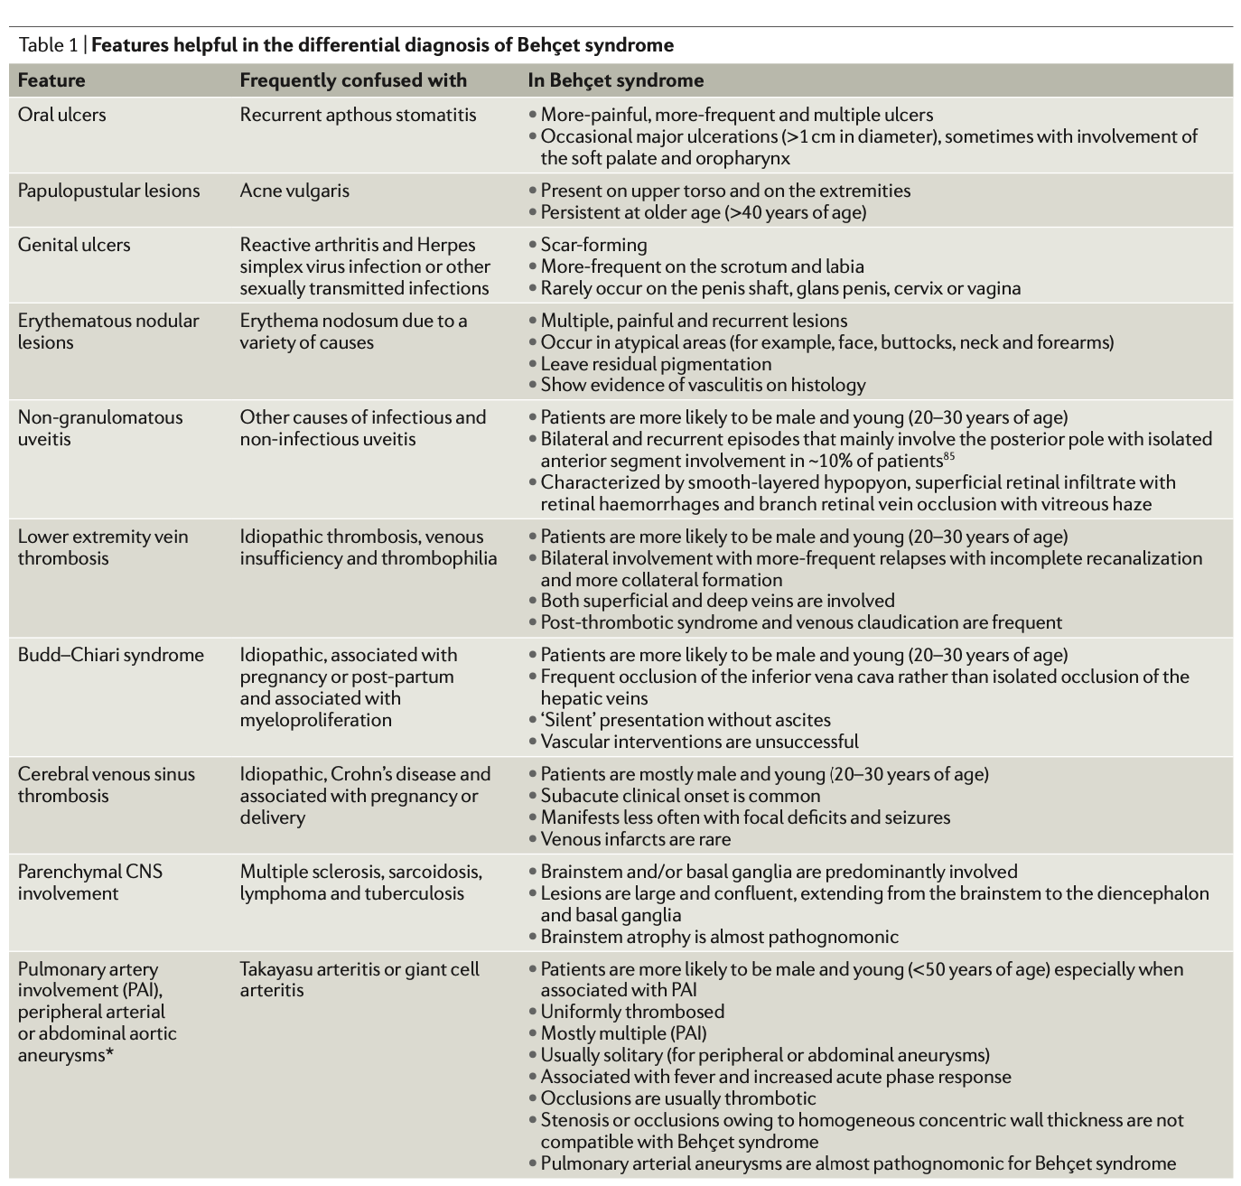
Clinical Features & Differential Diagnosis
Yazici, H., et al. Behçet syndrome: a contemporary view. Nat Rev Rheumatol 14, 107–119 (2018).

Slide 28
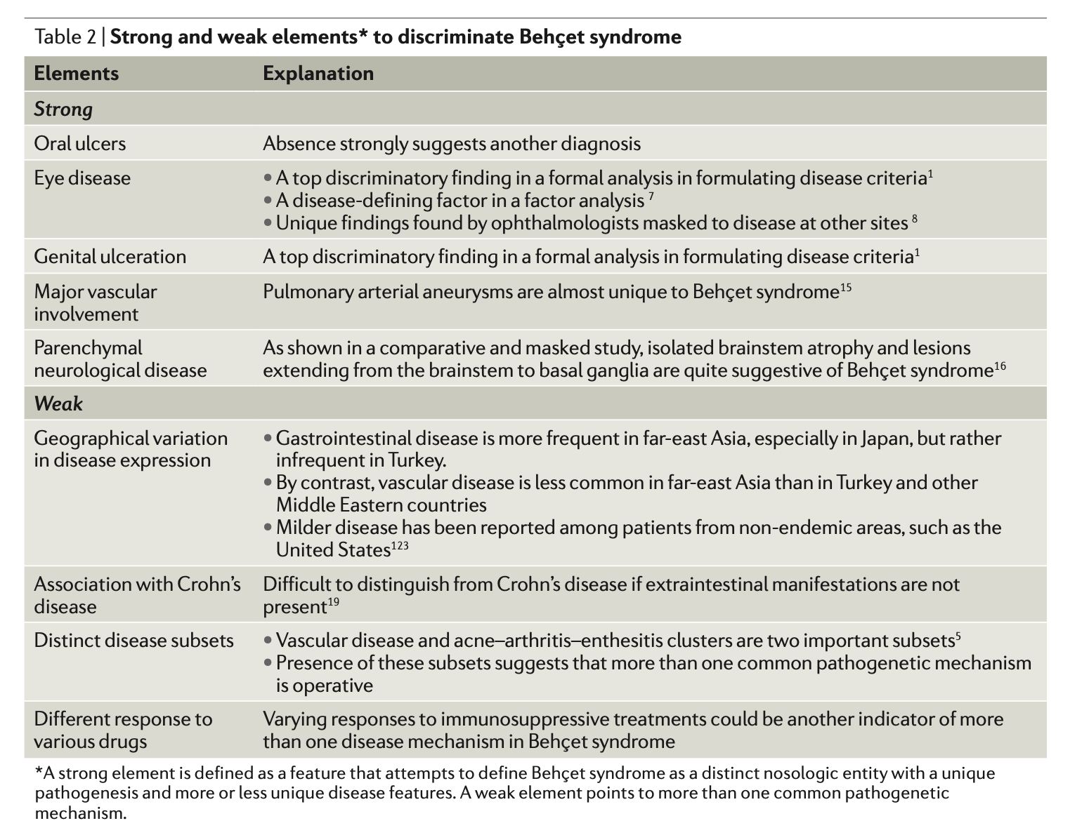
Clinical Features & Differential Diagnosis
Yazici, H., et al. Behçet syndrome: a contemporary view. Nat Rev Rheumatol 14, 107–119 (2018).

Slide 30
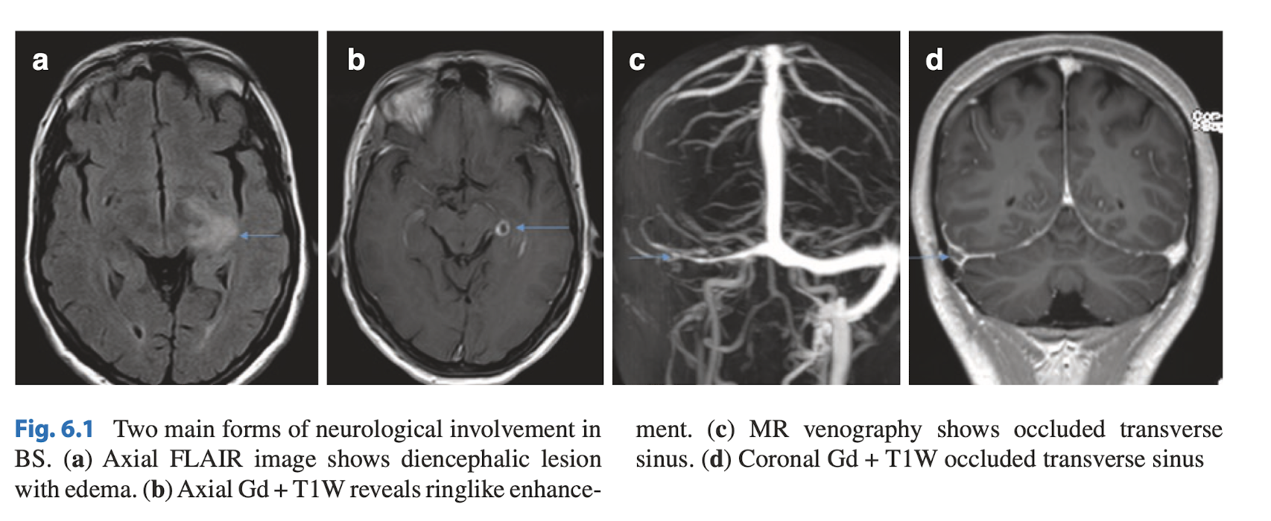
CNS Involvement
Occurs in 5–10% of patients with Behçet syndrome, mostly in the form of parenchymal brain involvement (~ 75%)
Brainstem involvement is the most characteristic
Pyramidal signs, dysarthria, ataxia, headache, hemiparesis, behavioral–cognitive changes, sphincter disturbance, impotence, & psychiatric problems
Aseptic meningitis is rare but can be part of the clinical picture
MRI findings typically show lesions in the mesodiencephalic junction, pons, medulla
Uygunoğlu U, Siva A. Nervous system involvement in Behçet's syndrome. Curr Opin Rheumatol. 2019 Jan;31(1):32-39
Notes:
Approximately 75% of patients with nervous system involvement have parenchymal nervous system lesions and the rest have vascular lesions, mainly dural sinus thrombosis, and much less frequently arterial occlusions and aneurysms
Signs of pyramidal tract dysfunction include spasticity, weakness, slowing of rapid alternating movements, hyperreflexia, and a Babinski sign.

Slide 31
CNS Involvement
Multiple Sclerosis: Vs.
Optic neuritis, sensory symptoms and spinal cord involvement
Discrete, smaller brainstem lesions
White matter lesions tend to be supratentorial & periventricular with corpus callosum involvement
CSF with pleocytosis and oligoclonal band +
Behçets Syndrome
Seldom observed in Behçet syndrome
Can have large extensive lesions
White matter lesions tend to be small, bihemispheric & subcortical
Oligoclonal bands are rare

Slide 32
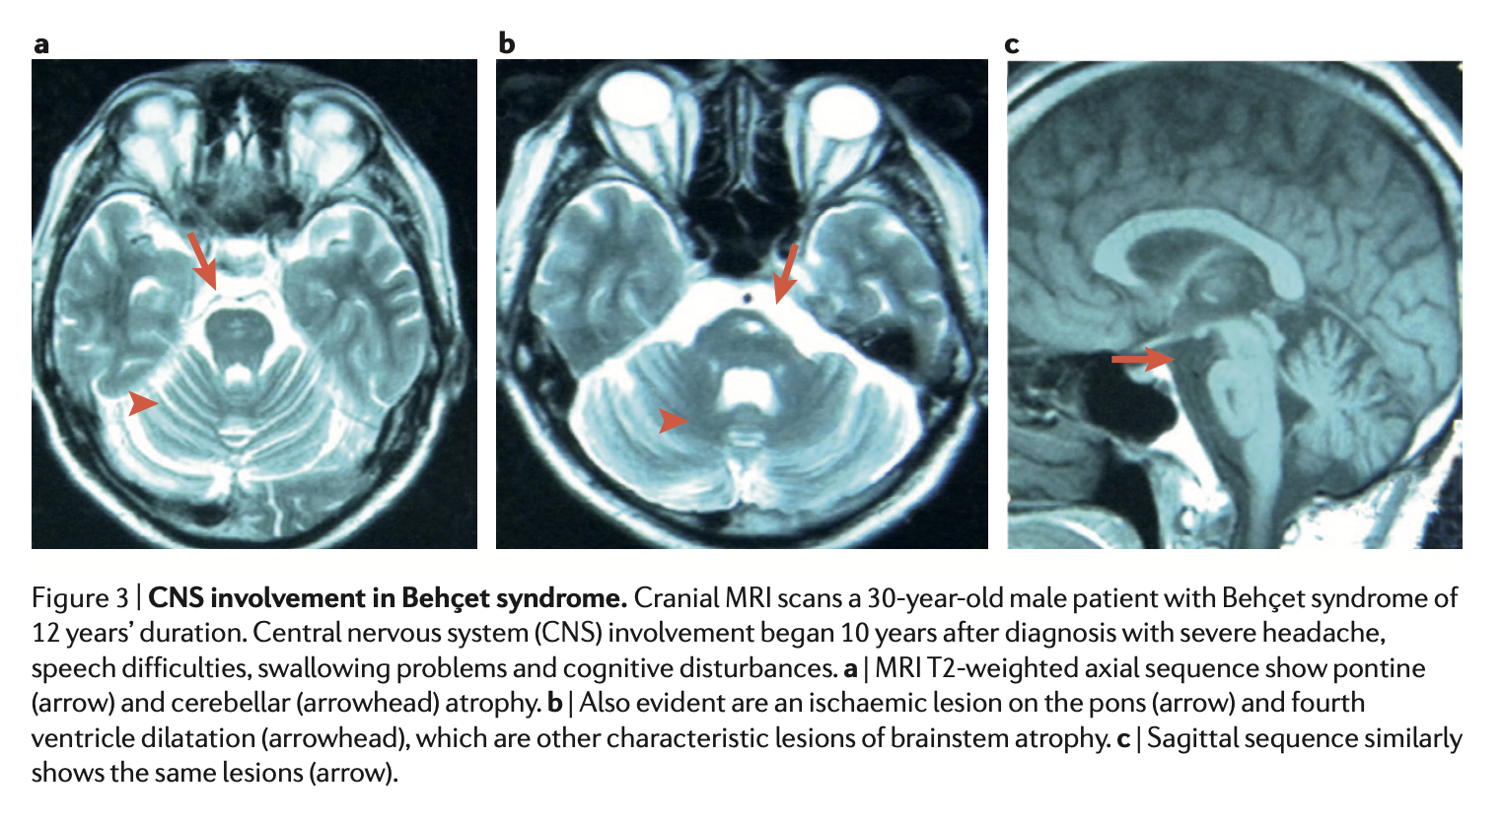
CNS Involvement
Relapses are observed in ~40% of patients and may result in cumulative damage
Mortality ~10%
~50% of patients have moderate to severe disability & impairment in cognitive function within 10 years
Yazici, H., et al. Behçet syndrome: a contemporary view. Nat Rev Rheumatol 14, 107–119 (2018).

Slide 33
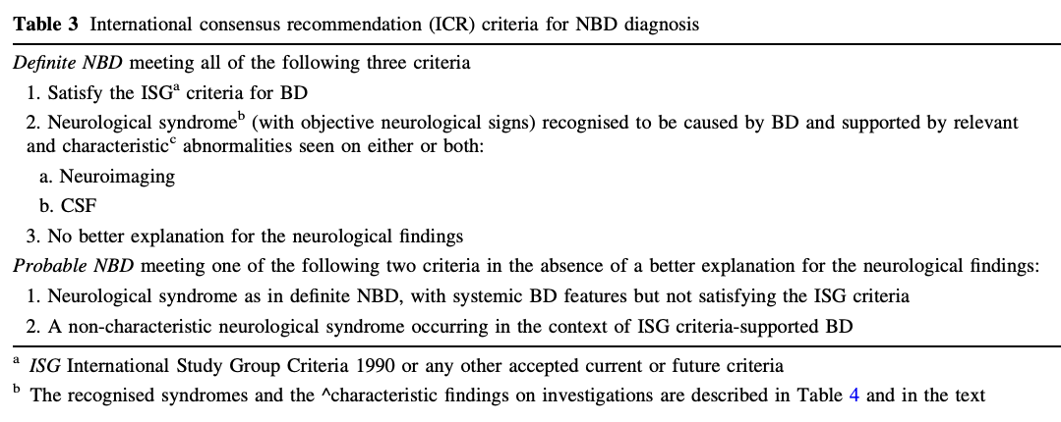
Kalra S, et al. Diagnosis and management of Neuro‑Behcet’s disease: International consensus recommendations. J Neurol 2014;261:1662‑76.

Slide 34
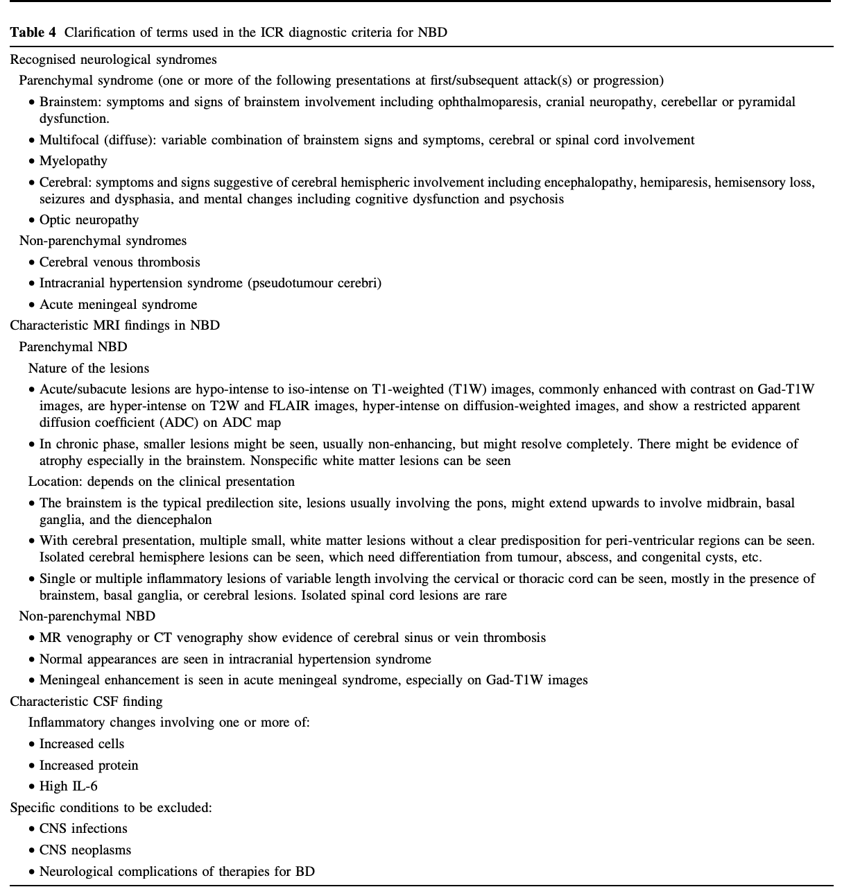
Kalra S, et al. Diagnosis and management of Neuro‑Behcet’s disease: International consensus recommendations. J Neurol 2014;261:1662‑76.

Slide 35
Treatment
Yazici, H., et al. Behçet syndrome: a contemporary view. Nat Rev Rheumatol 14, 107–119 (2018).

Slide 36
References
Yazici Y, Hatemi G, Bodaghi B, Cheon JH, Suzuki N, Ambrose N, Yazici H. Behçet syndrome. Nat Rev Dis Primers. 2021 Sep 16;7(1):67. doi: 10.1038/s41572-021-00301-1. PMID: 34531393.
Borhani-Haghighi A, Kardeh B, Banerjee S, Yadollahikhales G, Safari A, Sahraian MA, Shapiro L. Neuro-Behcet's disease: An update on diagnosis, differential diagnoses, and treatment. Mult Scler Relat Disord. 2019 Dec 23;39:101906. doi: 10.1016/j.msard.2019.101906. Epub ahead of print. PMID: 31887565.
Caruso P, Moretti R. Focus on neuro-Behçet's disease: A review. Neurol India. 2018 Nov-Dec;66(6):1619-1628. doi: 10.4103/0028-3886.246252. PMID: 30504554.
Uygunoğlu U, Siva A. Nervous system involvement in Behçet's syndrome. Curr Opin Rheumatol. 2019 Jan;31(1):32-39. doi: 10.1097/BOR.0000000000000562. PMID: 30407226.
Hatemi G, Seyahi E, Fresko I, Talarico R, Uçar D, Hamuryudan V. Behçet's syndrome: one year in review 2022. Clin Exp Rheumatol. 2022 Sep;40(8):1461-1471. doi: 10.55563/clinexprheumatol/h4dkrs. Epub 2022 Jul 26. PMID: 35894066.
2023 ViTLs Lecture 2 Recording over Behcets Disease: https://youtu.be/9POdBlxfL_A
Yalcin Kehribar D, Gunaydin S, Ozgen M. Infliximab therapy in parenchymal neuro-Behçet's disease: A single-center experience. Int J Rheum Dis. 2021 Oct;24(10):1302-1307. doi: 10.1111/1756-185X.14209. Epub 2021 Aug 24. PMID: 34427044.
Hirohata S. [Chronic Progressive Neuro-Behçet's Disease]. Brain Nerve. 2021 May;73(5):568-575. Japanese. doi: 10.11477/mf.1416201800. PMID: 34006690.
Imabayashi K, Ayano M, Higashioka K, Yokoyama K, Yamamoto K, Takayama K, Mitoma H, Kimoto Y, Akahoshi M, Arinobu Y, Akashi K, Horiuchi T, Niiro H. Infliximab for reversible dementia in acute onset of neuro-Behçet's disease: A case report and cytokine analysis. J Neuroimmunol. 2021 Aug 15;357:577631. doi: 10.1016/j.jneuroim.2021.577631. Epub 2021 Jun 8. PMID: 34153801.
Yazici, H., Seyahi, E., Hatemi, G. et al. Behçet syndrome: a contemporary view. Nat Rev Rheumatol 14, 107–119 (2018). https://doi.org/10.1038/nrrheum.2017.208
Kalra S, Silman A, Akman-Demir G, Bohlega S, Borhani-Haghighi A, Constantinescu CS, Houman H, Mahr A, Salvarani C, Sfikakis PP, Siva A, Al-Araji A. Diagnosis and management of Neuro-Behçet's disease: international consensus recommendations. J Neurol. 2014 Sep;261(9):1662-76. doi: 10.1007/s00415-013-7209-3. Epub 2013 Dec 24. PMID: 24366648; PMCID: PMC4155170.

