Slide 1
Rheumatology Winter Clinical Symposium: A mastery-learning based simulation workshop for the instruction of knee arthrocentesis to internal medicine residents
Brian Jaros, MD
Adult Rheumatology Fellow, PGY-5
Division of Rheumatology
Northwestern University, Feinberg School of Medicine

Slide 2
Background
Musculoskeletal (MSK) complaints comprise roughly 1 out of 4 PCP visits¹
Arthrocentesis is a key skill to evaluate and treat many common joint complaints
Diagnostic evaluation of joint pain and swelling
Therapeutic treatment of joint pain (ie osteoarthritis)
Internal medicine (IM) residents report low levels of confidence in independently performing arthrocentesis²
Outsourcing of procedures to consultants
Removal of procedure “requirements” by ACGME
Lack of formal/intentional procedural training
Why is this a problem?

Slide 3
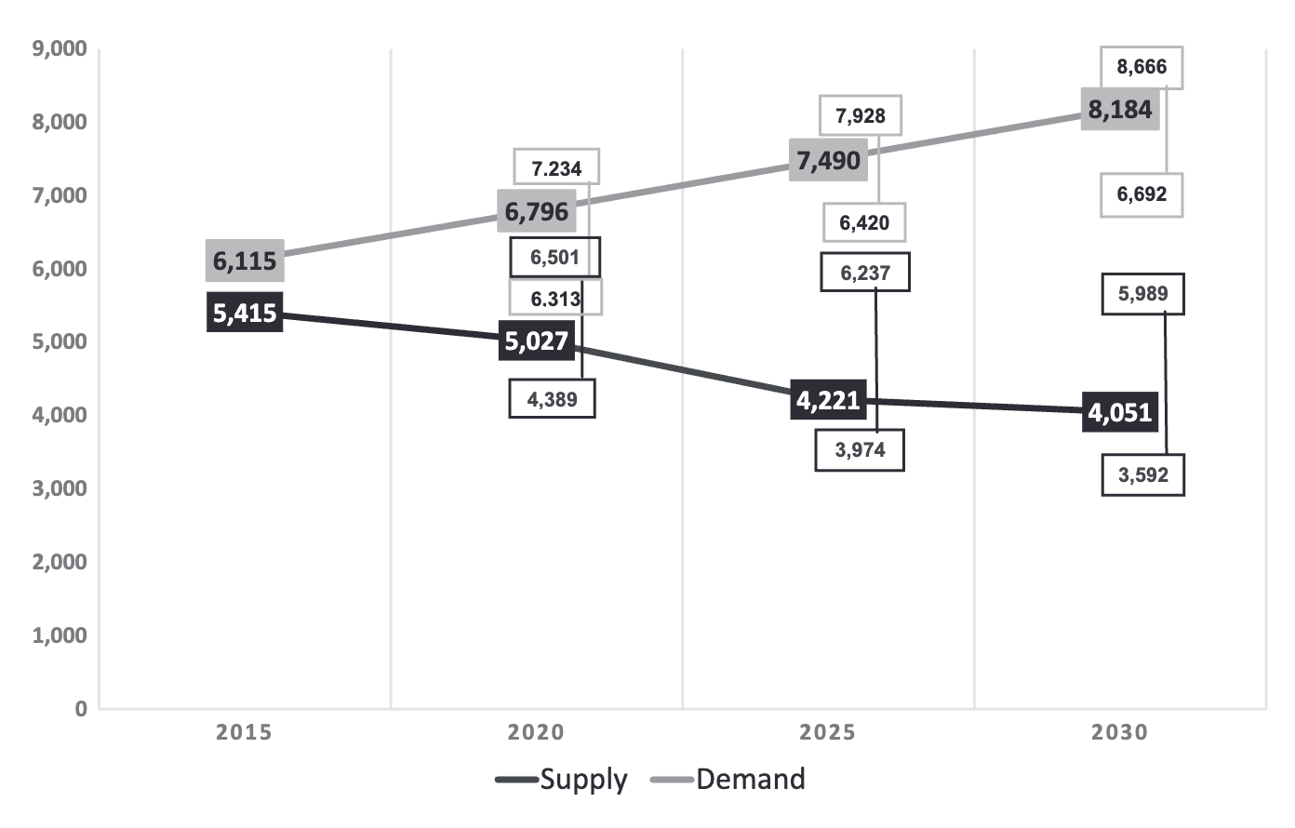
Background
Rheumatology workforce shortage
Projected 100% supply to demand mismatch by 2030³
Increased reliance on primary care physicians (PCPs) to field complaints / referrals
Battafarano et al. 2018

Slide 4
Background
What has been done thus far?
Simulation-based joint arthrocentesis workshops have been designed for IM residents
What are these lacking? Retention
Preisner et al. designed knee/shoulder workshop⁴
Retested between 6 and 30 mo: decline in skill proficiency
Decline only slightly mitigated by review of web-based instructional material
Other simulation-based arthrocentesis workshops often only test confidence at long-term time points, which does not reliably correlate with skill proficiency
Notes:
Other simulation-based arthrocentesis workshops only test confidence at long-term time points, which does not reliably correlate with skill proficiency

Slide 5
Mastery Learning
How is our intervention different?

Slide 6
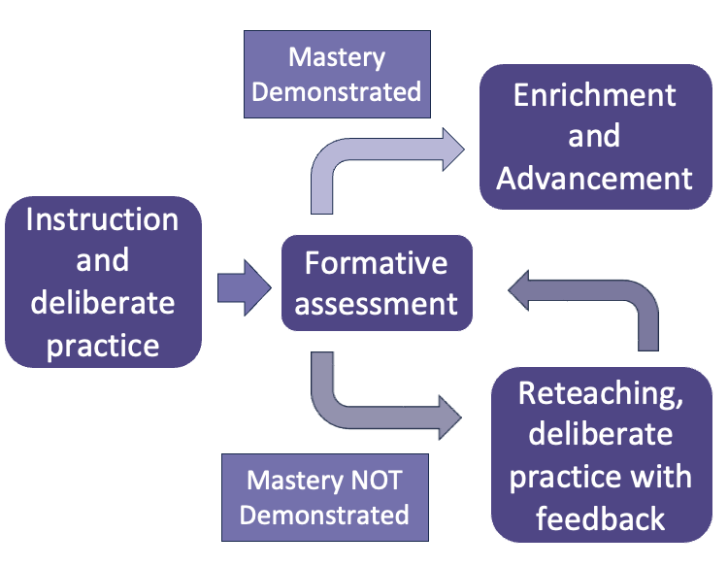
What is ”Mastery Learning?”
Stringent form of competency-based learning
All learners accomplish pre-defined, specific educational objectives
The amount of time needed to accomplish these objectives is not defined and VARIES by learner
Learners use deliberate practice to achieve these objectives and reinforce acquisition of skills
Pre-defined time interval

Slide 7
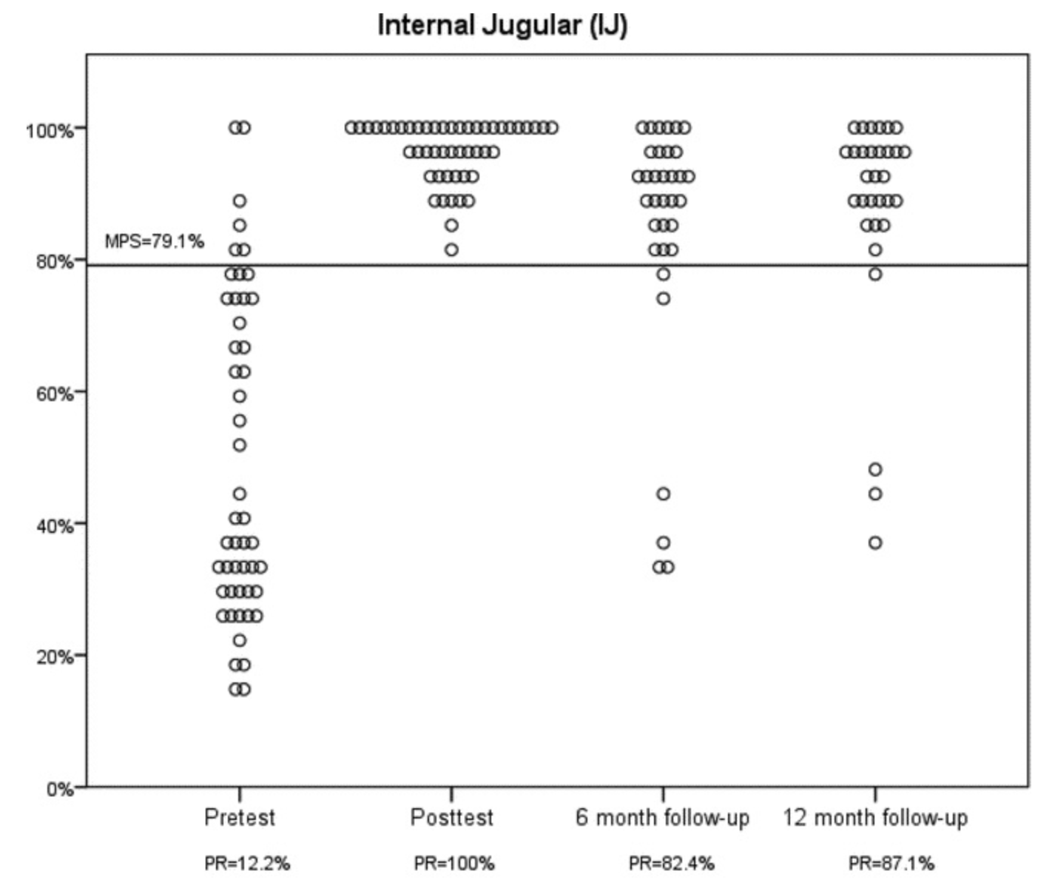
Mastery Learning and Retention
Does mastery learning improve simulation-based skills retention?⁵

Slide 8
Competency vs. Mastery Learning
Traditional Competency Learning | Mastery Learning
General: perform knee arthrocentesis | Specific: palpate landmarks of tibial plateau and patella, insert 25g needle at perpendicular angle… etc
Static: designated 1 hour | Flexible: as much time as needed to achieve skill
Variable: some trainees perform better than others | Fixed: all trainees will meet a minimum passing standard
Poor: low independence at 6 months | Superior?
Outlined skill
Workshop intervention
Outcomes measure
Retention measure

Slide 9
Mastery learning simulation-based knee arthrocentesis curriculum for IM residents

Slide 10
PICO
Population:
Internal medicine residents (or preliminary interns) who partake in an optional procedural elective
Intervention:
Arthrocentesis workshop
Powerpoint and video recorded didactic
Hands on simulation learning
Deliberate practice with real-time feedback until minimum passing standard (MPS) on checklist is met
Control:
Same residents prior to workshop
Outcome:
Ability to achieve MPS at 6 mo and 12 mo
Written knowledge assessments at 0, 6, and 12 mo
Number of knee arthrocenteses performed in real world

Slide 11
Mastery Learning Checklist
Intention: if a learner can reasonably perform a vast majority of these steps, in chronologic order, on a simulated model (with external validity), they should be able to apply this to real world practice
Creating a checklist:
1) Use previously validated, existing checklist for skill
OR
2) Create your own checklist and validate with group of experts (masters) in that skill
What do these checklists look like?
Consent patient for knee arthrocentesis explaining at least two risks and benefits
Prepare 3 cc syringe containing 1cc of Kenalog and 1-2cc of lidocaine for injection
Verbalize how you will position patient – pt supine, knee in extension, can be supported w/ towel
Put on non-sterile gloves
Identify anatomical landmarks – patella, joint line, tibial plateau
Make target mark on mannequin using dry erase pen

Slide 12
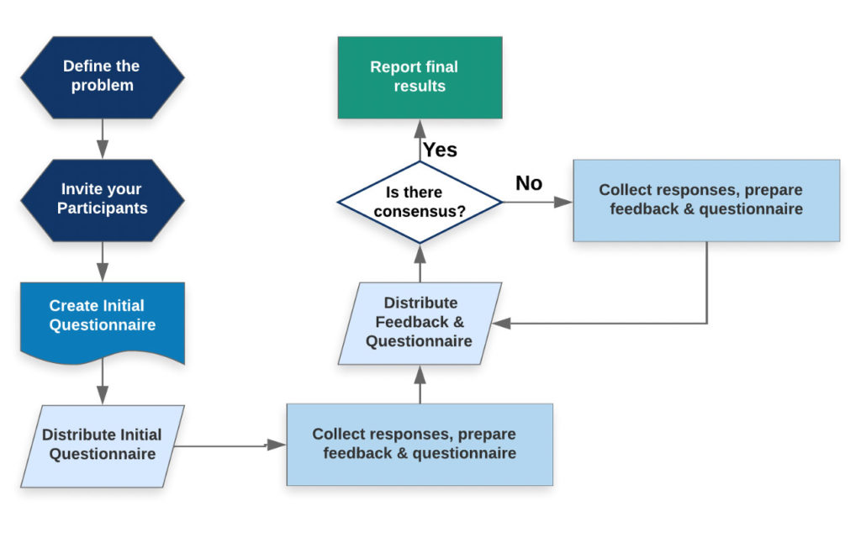
Mastery Learning Checklist – Modified Delphi Analysis
IM trainees have low confidence in joint arthrocentesis
Mixed panel of rheumatologists, sports medicine, orthopedics, PM&R, primary care
Pre-defined consensus: 75% strongly agree (7-9) or strongly disagree (1-3)
Step 1) explain risks and benefits of knee arthrocentesis to patient
Step 2) prepare syringe containing 40mg kenalog
More emails
Comments: experts disagree about the need for local lidocaine
Revision: lidocaine numbing is optionally offered to patients
Lots of emails
Likert scale – please rate each step from 1 (strongly disagree) to 9 (strongly agree)
Room for free-text comments
Credit: Robert Hirst, RECM Learning

Slide 13
Mastery Learning Checklist – Minimum Passing Standard
Safety-based Angoff method using panel of experts
Criteria identified for what constitutes an “essential” step
Panel uses criteria to classify each step as essential vs. non-essential
Panel determine passing score for essential and non-essential items
To meet minimum passing standard:
Learners will accomplish X% of essential items + Y% of non-essential items
For example:
Achieving return of synovial fluid may be essential to adequately achieve mastery of arthrocentesis
Adequately listing studies to send on synovial fluid sample may be non-essential to achieve mastery

Slide 14
Mastery learning simulation-based arthrocentesis curriculum for IM residents
Methodology

Slide 15
Workflow
IM Resident enrolls in procedural elective
Recruitment:
Anticipate 2-4 residents per month
minimum 12 months to obtain 25 or more trainees
Approached for study
Pre-Test
Knowledge exam
Simulation using checklist

Slide 16
Knowledge Exam
Ensures learners know not just how to perform a procedure BUT:
When a procedure is appropriate
How to address patient-facing concerns

Slide 17
Workflow
IM Resident enrolls in procedural elective
Recruitment:
Anticipate 2-4 residents per month
minimum 12 months to obtain 25 or more trainees
Approached for study
Pre-Test
Knowledge exam
Simulation using checklist

Slide 18
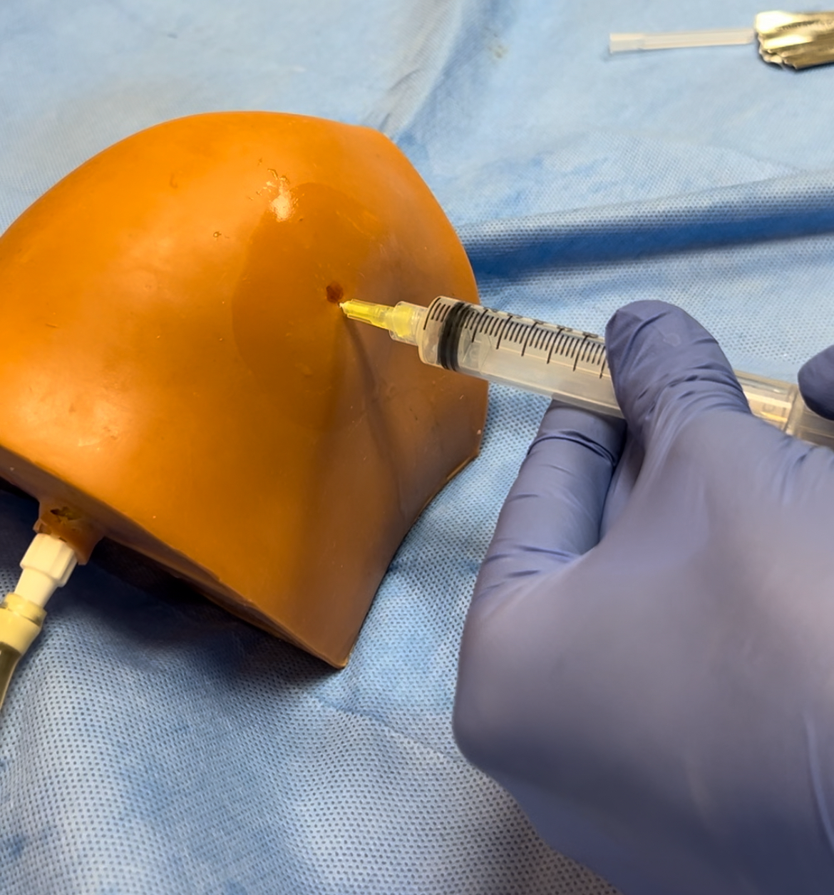
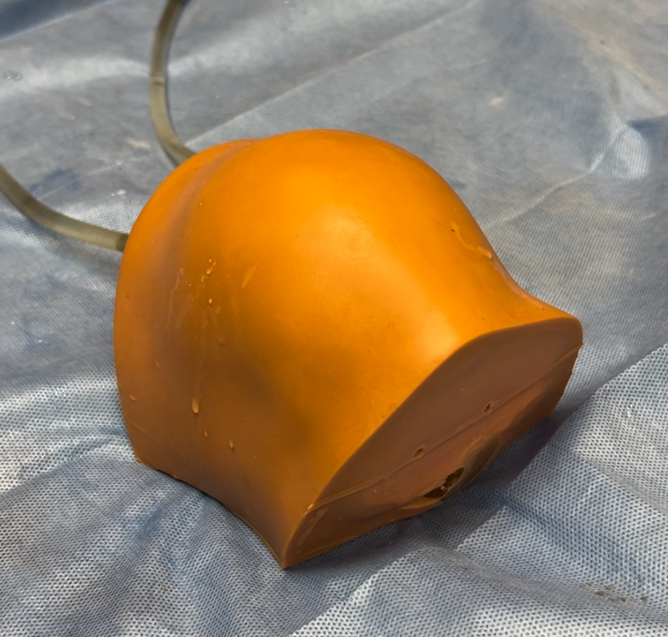
Simulation Model
External validity:
Knee in nearly full extension
Palpable landmarks
Filled with “synovial fluid”
Requires precision to access joint space
Expect most trainees to not pass on pre-test based on needs assessment!

Slide 19
Workflow
IM Resident enrolls in procedural elective
Approached for study
Pre-Test
Knowledge exam
Simulation using checklist
Workshop
Didactic
Supervised practice

Slide 20
Diagnostic Arthrocentesis
Routine studies:
Cell count/differential
Crystal exam
Gram stain/culture
Tantillo, StatPearls
+
*often but not always
Differential Diagnosis | Osteoarthritis Mechanical injury Physiologic fluid | RA Crystalline Psoriatic arthritis Reactive arthritis Viral arthritis Gonorrhea/Chlamydia | Trauma Coagulopathy Post-operative Neoplastic | Bacterial

Slide 21
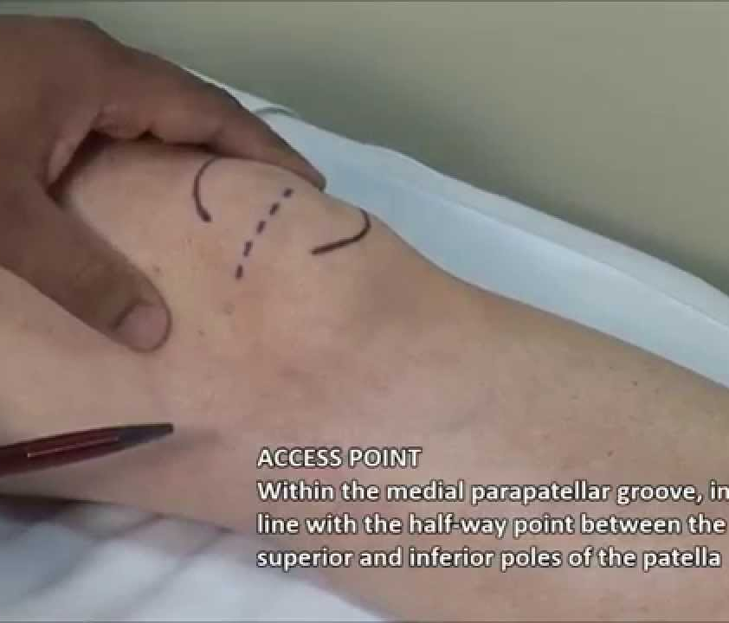
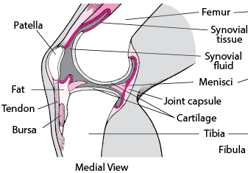
Medial Parapatellar Approach - Landmarks
Patella – identify midline between superior and inferior poles
Palpate area of fluid in midline about 2 fingerbreadth dorsal (towards popliteal fossa) to patella on medial aspect of leg
Femur proximally, tibial plateau distally
Make target mark
Villa-Forte, Merck Manuals
Tasyurek, iEM

Slide 22
Workflow
IM Resident enrolls in procedural elective
Retention
Knowledge exam
Testing using checklist
Procedure logger
Approached for study
Pre-Test
Knowledge exam
Simulation using checklist
6 and 12 months later
Post-Workshop
Knowledge exam
Testing using checklist
Workshop
Didactic
Supervised practice
1-2 weeks later
MPS? NO
MPS? YES

Slide 23
How else can we promote retention?
More real world practice = higher skill retention
Half-day in rheumatology clinic – supervised knee exam
Rheumatology elective rotation
Buy-in from IM folks who are doing this procedure
Rheumatology fellow incorporation of IM teams during taps
Barsuk et al.

Slide 24
Workflow
IM Resident enrolls in procedural elective
Retention
Knowledge exam
Testing using checklist
Procedure logger
Approached for study
Pre-Test
Knowledge exam
Simulation using checklist
Real-world practice with feedback
6 and 12 months later
Post-Workshop
Knowledge exam
Testing using checklist
MPS? NO MPS? YES
Workshop
Didactic
Supervised practice
1-2 weeks later

Slide 25
Outcomes
Primary:
Minimum passing standard at 6 and 12 month time points
If not, which aspects were lost?
Do we see a correlation between real world practice and retention, or other factors?
Secondary:
Knowledge exams at 6 and 12 month time points
Confidence measures at 6 and 12 month time points
New Innovations Procedural Log
Extract resident data of number arthrocentesis performed
Compare this to # prior to workshop

Slide 26
Timeline
IRB Exempt
Preliminarily checklist
Didactic material, knowledge exams, and sim lab preparation
Delphi analysis -> minimum passing standard
Recruitment starting February 2024
Expect average of 2 participants per month
Run for at least 12 months, maximum 24 months (as part of study)

Slide 27
Future Aims
Train IM leadership (chiefs, APDs, attending) to facilitate workshop to create self-sustaining pipeline
Incorporation of other learners who would benefit from knee arthrocentesis skills
EM
Junior IM attendings (PCP, hospitalists)
Expand to other high-yield joints
Shoulder
Incorporation of ultrasound

Slide 28
References
1. Haas R, Gorelik A, Busija L, et al. Prevalence and characteristics of musculoskeletal complaints in primary care: an analysis from the population level and analysis reporting (POLAR) database. BMC Prim Care. 2023;24(1):40.
2. Bretagne V, Delapierre A, Cerasuolo D, et al. Randomized Controlled Study of a Training Program for Knee and Shoulder Arthrocentesis on Procedural Simulators with Assessment on Cadavers. ACR Open Rheumatol. 2022;4(4):312-21.
3. Battafarano DF, Ditmyer M, Bolster MB, et al. 2015 American College of Rheumatology Workforce Study: Supply and Demand Projections of Adult Rheumatology Workforce, 2015-2030. Arthritis Care Res (Hoboken). 2018;70(4):617-26.
4. Preisner R, Jasti H, Elnicki M, et al. Impact of web-based review on long-term retention of simulation-acquired knee and shoulder aspiration and injection skills. J Grad Med Educ. 2012;4(4):460-6.
5. Barsuk JH, Cohen ER, McGaghie WC, et al. Long-term retention of central venous catheter insertion skills after simulation-based mastery learning. Acad Med. 2010;85(10 Suppl):S9-12.
6. Hirst, R. (2020, March 9). (Delphi) method man. RCEMLearning. https://www.rcemlearning.co.uk/foamed/delphi-method-man/

Slide 29
Thank you!
Rheumatology mentor: Dr. Christine Hsieh
Internal Medicine mentors: Drs. Debi Mitra and Jeffrey Barsuk
Medical Education mentors: Drs. Mark Adler and Karen Mangold
Also to Drs. Irene Blanco and Anisha Dua for support
Department of Rheumatology

Slide 30
Questions?

