Slide 1
A singular case of pleural effusion
Shashank Suresh, MD

Slide 2
Case presentation
A 31-year-old woman with a diagnosis of psoriasis only on topicals presents with recurrent right-sided pleural effusion.
Rheumatology is consulted for a positive anti-centromere antibody.

Slide 3
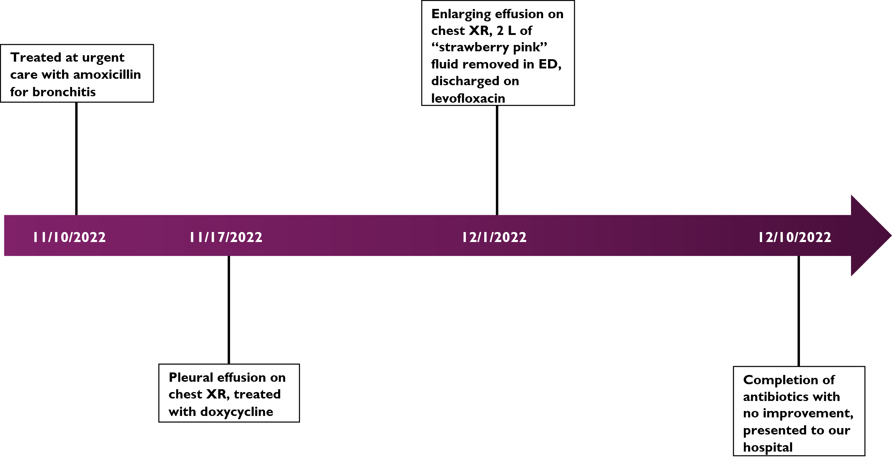
Timeline

Slide 4
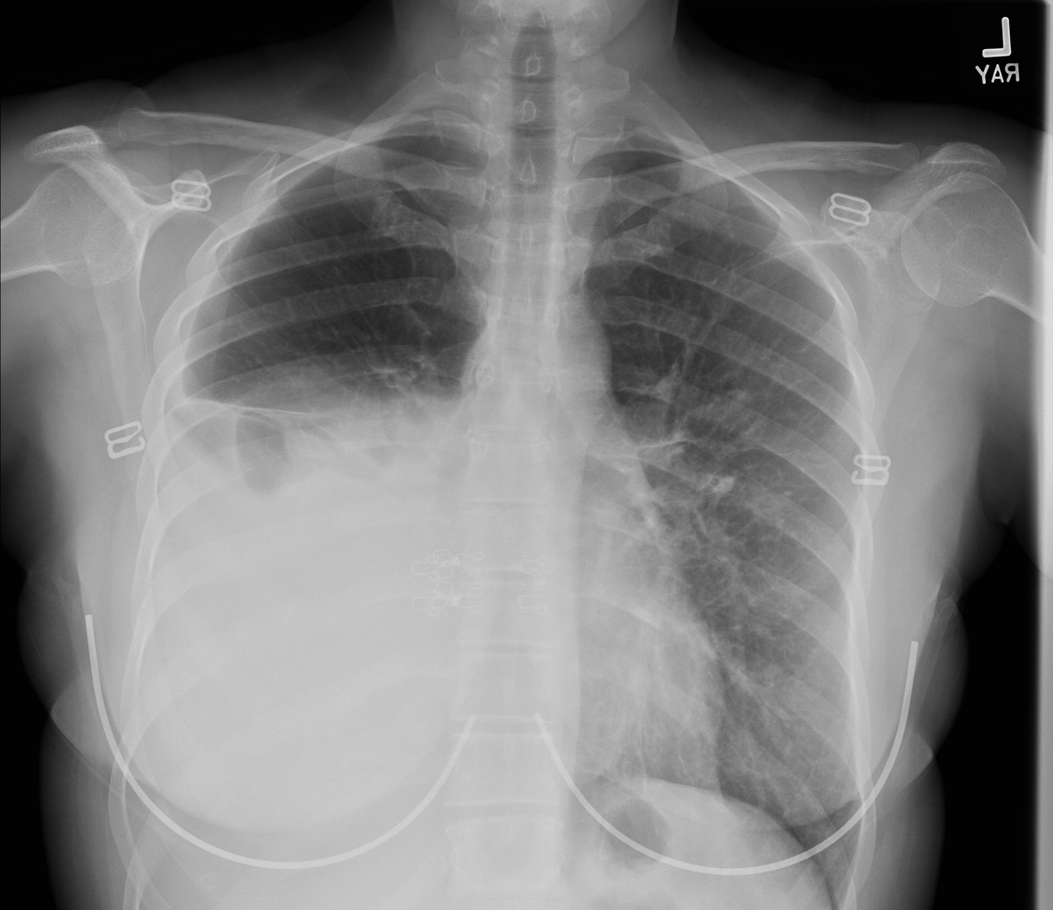
CXR

Slide 5
Work-up at outside hospital
Exudative effusion, cultures negative
Negative
  ANA, Sm/RNP, SSA/B, dsDNA, ribosomal P
  Scl-70, Jo-1
  RF
  Beta-2-glycoprotein I
Positive: anti-centromere Ab

Slide 6
Histories
Rheumatologic review of systems
  Psoriasis
  Back pain with morning joint stiffness: had begun to see a chiropracter regularly
Family history
  Brother PsO (but not PsA)
  Multiple family members (≥second-degree) with CTD including SSc, SLE, AS
Social
  Never-smoker
  Rare, social EtOH
  No recreational drug use

Slide 7
Evaluation
Physical exam
  Negative: Rash, oral ulcers, FABER, SI joint pain
  Positive: Absent right basilar breath sounds
Labs
  Infectious, serologic, and malignancy work-up negative
Pleural fluid
  Turbid; 3500 nucleated cells, 85000 RBCs; pH 7.8
  Gram stain: no organisms
  Protein: 3.6 (serum: 6)
  LDH: 194 (serum: 228; 2/3 ULN: 113)
  Triglycerides: 1890; cholesterol 79

Slide 8
Differential diagnosis
Psoriatic arthritis – axial SpA
  Few case reports of exudative pleural effusion (rare)
Infectious
  Bacterial, COVID, TB, fungal, parasitic
RA
  Lack of other signs/symptoms
Malignancy
Chylous leak

Slide 9
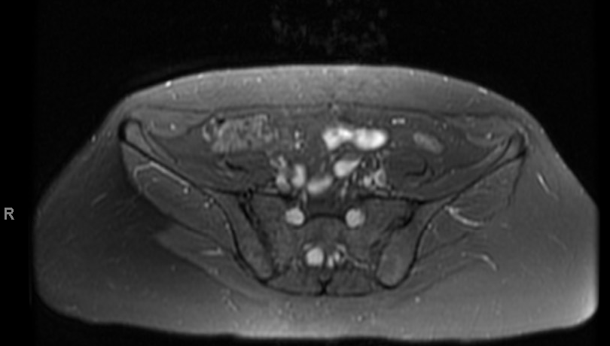
Imaging

Slide 10
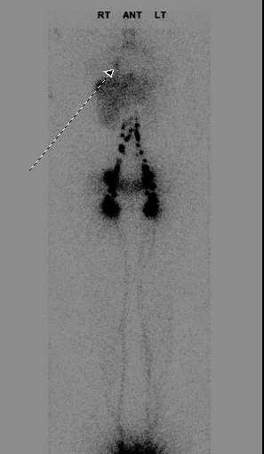
lymphoscintigraphy
Accumulation of radiotracer is right lower chest on planar images which on SPECT/CT images localized to right para-aortic/retrocrural region with spread/extension to left hemithorax indicating chyle leak.

Slide 11
Diagnosis
Thoracic duct leak
Etiology
  Cough began day after her first chiropractic manipulation

Slide 12
Clinical course
Started on octreotide drip
  Initially lead to reduction in chest tube output
  Short-lived
Unsuccessful thoracic duct embolization due to inability to cannulate
Further improvement on octreotide and low-fat diet
  Surgical management deferred
Readmission 1 month after discharge with reaccumulation of effusion
  Confirmed to be chylothorax with elevated triglyceride level of 1900 mg/dL
Surgical ligation

Slide 13
Discussion
Exudative pleural effusion associated with rheumatic disease
  Occurs fairly frequently in SLE pleuritis
  Associated with RA, often uncontrolled disease
  Case reports of exudative effusion in psoriatic arthritis
    One patient in series of four presented concurrently with PsA and exudative effusion
    Described pustular psoriasis presenting with pleural and pericardial effusion
  Typically, either joint involvement or medication-related (MTX, adalimumab)
Venetsanopoulou, 2021
Kuriyama, 2017

Slide 14
Differential diagnosis of exudative pleural effusion
Infectious
  Parapneumonic
  Tuberculous pleurisy
  Viral (COVID-19)
Malignancy-related
  Mesothelioma
  Paraproteinemia
  Paramalignant
Traumatic
  Central line
  Esophageal perforation
  Enteral feeding tube
Inflammatory
  Pancreatitis
  PE
  Uremic pleurisy
Strange, 2022

Slide 15
Discussion
Chylothorax
  Pleural fluid TG > 110 mg/dL, cholesterol < 200 mg/dL
Traumatic: surgery or blunt force, particularly when related to lymphatic vessel injury
  Thoracic spine hyperextension
Nontraumatic
  Malignancy most common
  RA, SLE, sarcoidosis, IgG4-RD
  Psoriasis: case series of 6 patients, but related to herbal medicines
  Can be seen in longstanding exudative effusion that later becomes lipid-rich
Heffner, 2022
Sakata, 2021
Agrawal, 2022
Xiao, 1994

Slide 16
discussion
No described cases of chylothorax related to chiropractic manipulation described in the literature
Our patient had started to see a chiropractor for back pain that persisted after her first pregnancy
Thoracic spine manipulation temporally related to development of cough and subsequent shortness of breath
  In retrospect, the most likely cause of thoracic duct rupture
Illustrative of the importance of taking a detailed history – considering both rheumatic and nonrheumatic disease

Slide 17
Discussion
Mortality of prolonged high-output chylothorax 25-50% (higher in some series)
Conservative management: chest tube, low-fat diet
  Particularly medium-chain triglycerides
Percutaneous lymphatic interventions or surgery
Octreotide: somatostatin
Agrawal, 2022

Slide 18
references
Heffner JE. Etiology, clinical presentation, and diagnosis of chylothorax. In: UpToDate, Broaddus VC (Ed.), UpToDate, Waltham, MA. (Accessed February 6, 2023.)
Strange C. Epidemiology, clinical presentation, and diagnostic evaluation of parapneumonic effusion and empyema in adults. In: UpToDate, Broaddus VC & Ramirez JA (Eds.), UpToDate, Waltham, MA. (Accessed on February 6, 2023.)
Sakata K, Kikuchi J, Emoto K, Kotaki T, Ota Y, Nishina N, Hanaoka H, Otomo K, Suzuki K, Kaneko Y, Takeuchi T. Refractory IgG4-related Pleural Disease with Chylothorax: A Case Report and Literature Review. Intern Med. 2021 Jul 1;60(13):2135-2143. doi: 10.2169/internalmedicine.6313-20. Epub 2021 Feb 1. PMID: 33518567; PMCID: PMC8313917.
Agrawal A, Chaddha U, Kaul V, Desai A, Gillaspie E, Maldonado F. Multidisciplinary Management of Chylothorax. Chest. 2022 Dec;162(6):1402-1412. doi: 10.1016/j.chest.2022.06.012. Epub 2022 Jun 20. PMID: 35738344.
Xiao CY, Yong Q, Li SL. [Analysis of patients of psoriasis coexisting with chylothorax]. Zhonghua Nei Ke Za Zhi. 1994 May;33(5):320-1. Chinese. PMID: 7835144.
Venetsanopoulou AI, Markatseli TE, Iliou C, Tziortzioti Z, Argyropoulou MI, Drosos AA, Voulgari PV. Pleural effusion in psoriatic arthritis patients: a case series and review of the literature. Clin Rheumatol. 2021 Nov;40(11):4741-4748. doi: 10.1007/s10067-021-05712-9. Epub 2021 Mar 29. PMID: 33782750.
Kuriyama Y, Ohnishi K. Case of generalized pustular psoriasis presenting with both pleural effusion and pericardial effusion collection. J Dermatol. 2017 Nov;44(11):e284-e285. doi: 10.1111/1346-8138.13949. Epub 2017 Jun 21. PMID: 28636215.
Pakula AM, Phillips W, Skinner RA. A case of a traumatic chyle leak following an acute thoracic spine injury: successful resolution with strict dietary manipulation. World J Emerg Surg. 2011 Mar 28;6:10. doi: 10.1186/1749-7922-6-10. PMID: 21443785; PMCID: PMC3072950.

