Slide 1
Mycobacterium Tuberculosis Osteomyelitis in a Patient on Pembrolizumab: A Case Report
Jourdan Frankovich MD

Slide 2
Background
Immune checkpoint inhibitors (ICIs) are revolutionizing oncologic care, with increasing recognition and attention to immune-related adverse events (irAEs).
Concomitantly there have been several case reports and case series of mycobacterial tuberculosis (TB) during ICI use.
Majority pulmonary TB, in patients with non-small cell lung cancer (NSCLC), melanoma, lymphoma
Small, single-center retrospective reviews have had mixed findings
Only 1 case each of pericardial, hepatic and vertebral TB

Slide 3
Purpose
Recognize the rare infectious musculoskeletal complications in lymphoma patients on pembrolizumab

Slide 4
Case Description
51 year old Filipino female presenting with
Subacute fever for 3 months, associated with left ankle pain and swelling
Inflammatory pattern: prolonged AM stiffness, mild improvement throughout the day
2 week episode of non-bloody diarrhea that self-resolved
Remote trauma to left ankle as a child in Philippines, treated by a local healer

Slide 5
Relevant Past Medical History
Primary CNS lymphoma (DLBCL), in remission
Pembrolizumab monotherapy for 18 months
Prior treatment: high dose chemotherapy, autologous stem cell transplant (HDC-ASCT), ibrutinib, nivolumab
Chronic hepatitis B on entecavir
History of CMV pneumonitis on valacyclovir

Slide 6
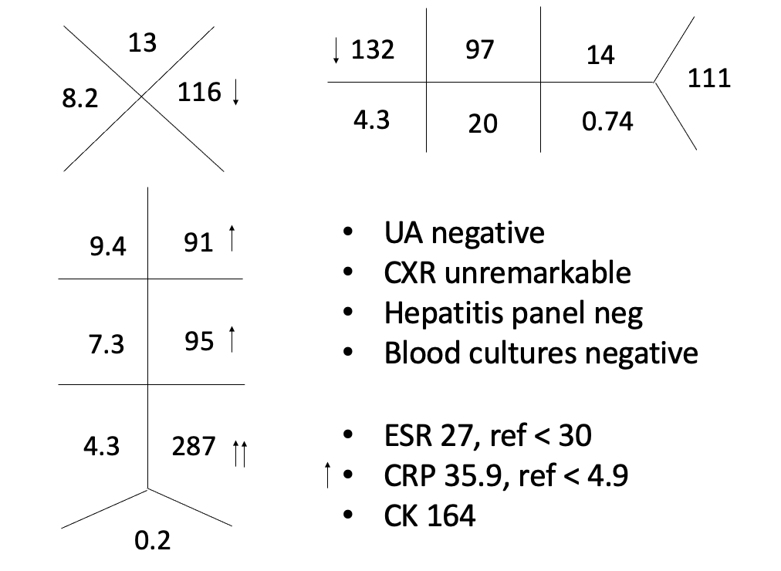
Initial Evaluation
Temp 102.7F HR 113 BP 118/52 RR 13 SpO2 95%
Edema, warmth, tenderness of left lateral ankle without overt erythema
Otherwise unremarkable, relatively well-appearing

Slide 7
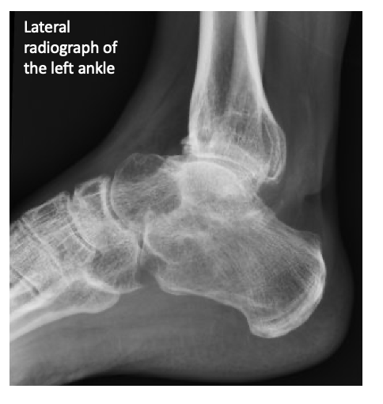

Slide 8
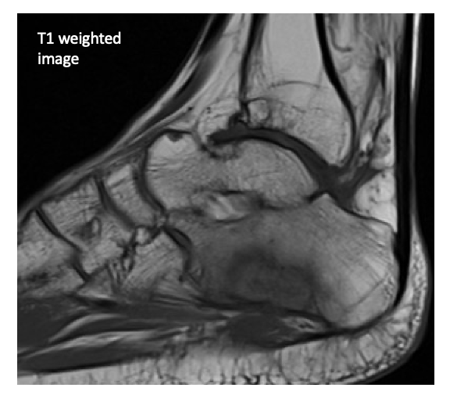
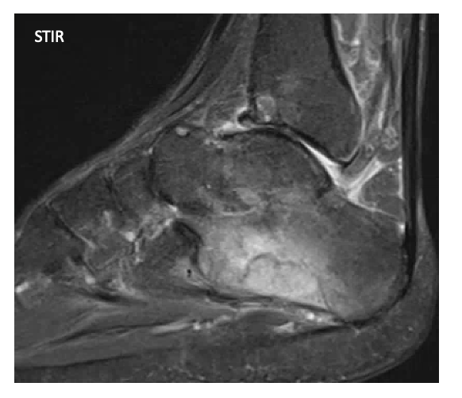
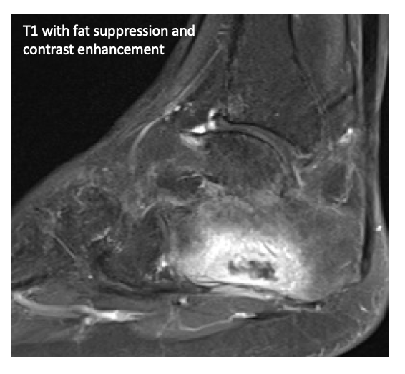
MR: Bone marrow edema throughout the calcaneus. Osseous erosion within the lateral calcaneal body with low T1, high STIR signal intensity consistent with osteomyelitis. T1 post contrast imaging demonstrates multiloculated fluid collection/interosseous abscess. Diffuse peroneal tenosynovitis.

Slide 9
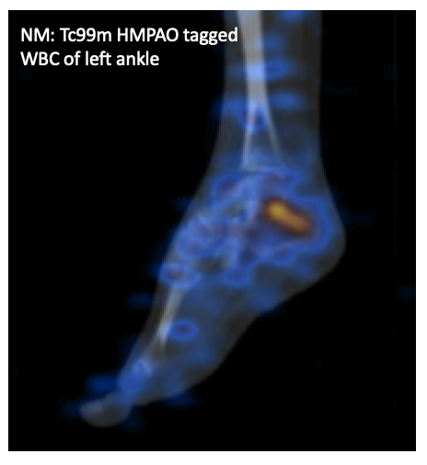

Slide 10
Hospital Course
Evaluated by Podiatry, Infectious Disease and Heme/Onc
HOD#4: OR I&D and bone biopsy by Podiatry, who intra-operatively found:
Tophus-like material
No abscess, no purulence
Viable, non-necrotic bone
Cultures negative
Bone, left calcaneal biopsy:
- Viable bone with chronic inflammation.
- Negative for acute osteomyelitis.
Soft tissue, left ankle biopsy:
- Granulation tissue with acute necrosis and acute and chronic inflammation.

Slide 11
Rheumatology Consulted
HOD#10
To evaluate for crystal arthropathy
Uric acid normal
Unable to perform crystal analysis as sample was sent in formalin fixative
Overall felt to be very unlikely
Differential: irAE inflammatory arthritis due to pembrolizumab
Considered prednisone but ultimately deferred
Feeling much better, discharged home with plans for outpatient follow up.

Slide 12
1 month later
Persistent serous discharge from incision
Repeat debridement by Podiatry
Significant tenosynovitis along peroneus brevis
2.5cm defect within lateral calcaneus
Soft tissue, left ankle biopsy:
-Gangrenous soft tissue (necrosis and acute inflammation)
Bone, left calcaneus biopsy:
-Acute osteomyelitis
Tendon, left ankle biopsy:
-Granulomatous inflammation, necrotizing.

Slide 13
1 week later
Culture from inpatient I&D: +AFB, mycobacterium tuberculosis
Referred back to ID: 3 months RIPE → 6 months rifampin + isoniazid

Slide 14
Discussion
TB presents a diagnostic challenge due to poor culture yield and limited reliability of IGRA in immunocompromised patients with poor mitogen response.
Our patient had:
Negative PPD at time of immigration to US
Negative IGRA (Quant) and AFB by BAL 2 years prior during workup for CMV pneumonitis

Slide 15
Discussion
Proposed theories of ICI-TB association:
Disruption of cellular immune response due to concurrent medications (steroids, chemo) and/or cancer-induced immunosuppression
Direct effect of ICIs
Immune reconstitution-like reaction to subclinical TB, similar to patients with AIDS during recovery of their CD4 T-cell population

Slide 16
Discussion
Need improved recognition and early engagement of rheumatologists in evaluating potential musculoskeletal irAEs in patients on ICIs.
Prior to hospitalization she had been evaluated by Oncology, 2 Orthopedists and a Podiatrist for ankle pain.

Slide 17
Conclusion
Although ICIs are “immune-activating” and not “immunosuppressive” in the sense of traditional chemotherapy, the downstream effects of these immunomodulatory drugs are not yet well understood.
Further investigation is needed as we continue to weigh the risks and benefits of combining ICIs with steroids, anti-metabolites or biologic medications for patients who (a) develop irAEs or (b) have concomitant cancer and pre-existing autoimmune diseases, especially as ICI use becomes more prevalent in TB endemic regions.

Slide 18
References
Anastasopoulou, A., et al. Reactivation of tuberculosis in cancer patients following administration of immune checkpoint inhibitors: current evidence and clinical practice recommendations. Journal for Immunotherapy of cancer (2019) 7:329.
Langan, E.A., et al. Immune checkpoint inhibitors and tuberculosis: an old disease in a new context. Lancet Oncol (2020) 21:e55-65.
Stroh, G., et al. Active and latent tuberculosis infections in patients treated with immune checkpoint inhibitors in a non-endemic tuberculosis area. Cancer Immunology, Immunotherapy (2021) 70:3105-3111.

Slide 19
Thank you
FamilyID=Office_ArchiveTorn

