Slide 1
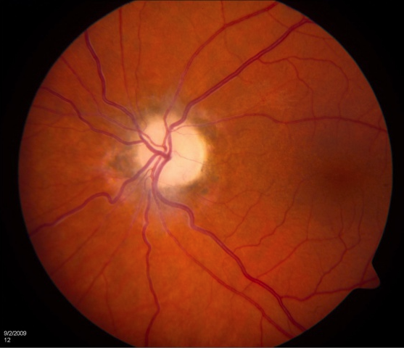
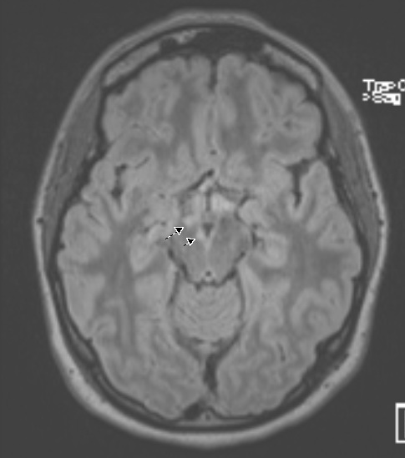
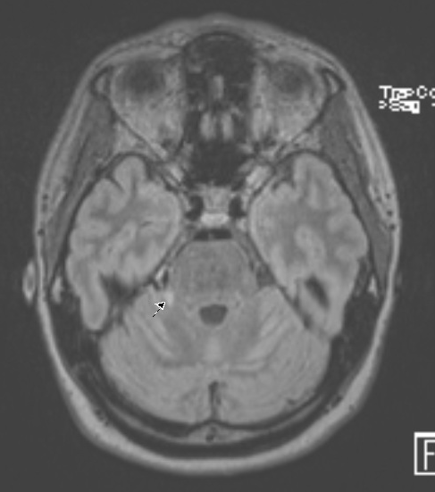
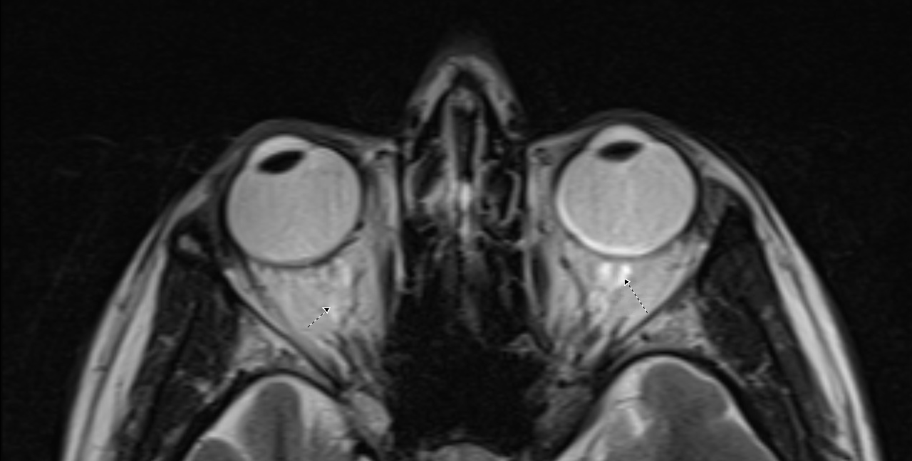
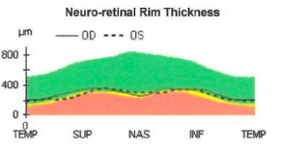
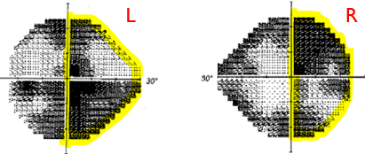
Optic Neuritis in SLE
Ki Suk Eum (Peter), DO, Manisha Kumar, DO, Peter Weis, MD
Department of Rheumatology, Scripps Clinic
Introduction
A
B
Discussion
Optic Neuritis is inflammatory, demyelinating condition
Highly associated with MS. Presenting feature of MS in 10-20%. 50% of MS patient develop optic neuritis at some point
Female predominant (77%). Typically affect 20-40 years old.
Acute onset, unilateral (95%) vision change. Eye pain (92%). Abnormal MRI (49%).
NPLE/APS, APS, MS: Clinically challenging to distinguish
Reported cases of APS misdiagnosed as MS. Some patients improved drastically with anticoagulation.
NPLE, APS, MS: chronic, immune mediated, relapsing, remitting diseases affecting female of childbearing age
MRI, immune serologies can be indistinguishable.
Uhthoff’s phenomena: Seen in demyelinating disease.
MS exacerbation -> segmental demyelination. Newly assembled sodium channels exhibit altered physiologic properties. Temperature induced pore closure. 0.2-0.5°C: sufficient to terminate depolarization of action potential. Reversible by cooling. Patient’s vision sx worse with shower
McDonald criteria for MS : Dissemination of lesions in space and time. Patient did not meet this criteria for MS.
Not all brain lesions count: periventricular, juxtacortical, infratentorial lesions needed for McDonald criteria. Pt had abnormalities of MRI of uncertain significance.
Optic Neuritis Treatment Trial: More brain lesion -> higher risk of MS development in 5 years. 51% ≥3 lesions.
No other SLE symptoms. Normal C3, C4. Low suspicion for complement mediated SLE. Cannot rule out NSLE as 1% of NSLE manifest as demyelination.
Reported cases of APS misdiagnosed as MS. Drastic response with anticoagulation. If atypical for MS (isolated neurological syndrome, headache, epilepsy, unusual progression, absent oligo band, normal MRI), check aPL ab.
Optic neuritis treated with methylprednisolone 1g for 3 days then prednisone taper.
C
Case Presentation
Figure 1. Signal abnormality in A: Right cerebral peduncle B: Right cerebellar peduncle C: Optic nerve
32-year-old Chaldean female with history of SLE with 3-month history of gradually worsening left vision.
Missing letters, color desaturation headache.
Insurance industry. Frequent calculation mistakes.
Similar right vision issue in 2017. Near complete resolution.
Vision symptoms worse with hot shower (Uhthoff’s phenomena)
SLE diagnosed in 2012. Thrombocytopenia, malar rash, fatigue. RTX x4, IVIG, transfusion in 2014. HCQ monotherapy since then. aPL triple positive.
FH Mom: RA, DVT. Maternal cousin: MS
Monthly left eye exam 20/20 -> 20/50 -> 20/60
Visual field deficit: Right homonymous hemianopia
Retinal exam: Left optic atrophy. Negative for retinal vasculitis, optic nerve ischemia, HCQ toxicity.
Optical Coherence Tomography: Optic nerve thinning
Optic atrophy, optic nerve thinning consistent with optic neuropathy
Brain MRI: multiple nonspecific signal abnormality in cerebral peduncle, cerebellar peduncle, left optic nerve, optic chiasm, 3rd cranial nerve
Exam: NAD. Able to read with left eye however missing words.
Solu-Medrol 1g for 3 days. Prednisone tapered.
Vision gradually improved. She did not meet McDonald criteria for MS. Repeat MRI looked improved.
Aspirin for primary prevention. Continued HCQ
Labs
Immune Serologies
ANA | 1:640
DsDNA, ENA | Negative
C3, C4 | Normal
aCL, aβ2GPI, LA | Triple +
Neuronal cell ab | >400
AQP4, MOG ab | Negative
CSF
Protein | Normal
Nucleated cells | Normal
Glucose | Normal
Myelin Basic Protein | 2.71
Oligo Bands | 10
IgG Index | 0.76
Basic Serologies
CMP | Normal
CBC | Normal
ESR, CRP | Normal
UA, UPC | Normal
Conclusion
Differentials
Finding exact etiology for optic neuritis can be challenging.
Uhthoff’s phenomena suggests demyelination.
NSPE, PAPS, MS may show similar MRI, immune serology
Evaluate for APS in atypical MS cases.
Patient’s visual symptom, MRI lesions improved over time
Given her numerous MRI lesions, at risk for developing MS.
Differentials | Antiphospholipid syndrome | NPLE/APS | Multiple sclerosis
Antiphospholipid syndrome antibody (aPL) | 100% | 50-60% | 2.5-25%
CSF oligo bands/IgG | Usually negative | 15-50% | 98%
Brain MRI | High-signal lesions Subcortical | High-signal lesions Subcortical | High-signal lesions Periventricular, corpus callosum, brainstem
Anti-Neuronal ab | N/A | 55% | 25-70%
References
Balcer LJ. Clinical practice. Optic neuritis. N Engl J Med. 2006 Mar 23;354(12):1273-80. doi: 10.1056/NEJMcp053247. PMID: 16554529.
Frohman TC, Davis SL, Beh S, Greenberg BM, Remington G, Frohman EM. Uhthoff's phenomena in MS--clinical features and pathophysiology. Nat Rev Neurol. 2013 Sep;9(9):535-40. doi: 10.1038/nrneurol.2013.98. Epub 2013 Jun 4. PMID: 23732530.
S. Ferreira, D. P. D'Cruz, G. R. V. Hughes, Multiple sclerosis, neuropsychiatric lupus and antiphospholipid syndrome: where do we stand?, Rheumatology, Volume 44, Issue 4, April 2005, Pages 434–442, https://doi.org/10.1093/rheumatology/keh532
Figure 3. Visual Field Testing :
Right incongruous homonymous hemianopia
Figure 2. Optical Coherence Tomography : Optic nerve thinning
The views expressed in this abstract/poster are those of the author(s) and do not reflect the official policy or position of the Scripps Clinic.
Notes:
DL has 42% mortality at 18 months

Slide 2
Basic Serologies
CMP | Normal
CBC | Normal
ESR, CRP | Normal
UA, UPC | Normal
Immune Serologies
ANA | 1:640
DsDNA, ENA | Negative
C3, C4 | Normal
aCL, aβ2GPI, LA | Triple +
Neuronal cell ab | >400
AQP4, MOG ab | Negative
CSF
Protein | Normal
Nucleated cells | Normal
Glucose | Normal
Myelin Basic Protein | 2.71
Oligo Bands | 10
IgG Index | 0.76
 | PAPS | NPLE/APS | MS
aPL | 100% | 50-60% | 2.5-25%
CSF oligo bands/IgG | Usually negative | 15-50% | 98%
Brain MRI | High-signal lesions Subcortical | High-signal lesions Subcortical | High-signal lesions Periventricular, corpus callosum, brainstem
Anti-Neuronal ab | N/A | 55% | 25-70%

