Slide 1
Systemic sclerosis with pulmonary arterial hypertension due to pulmonary capillary hemangiomatosis
Jason Melehani¹, Veronica Nicholas², Tamiko Katsumoto¹
1 – Department of Medicine, Division of Immunology and Rheumatology
2 – Department of Pathology

Slide 2
Learning Objectives
To recognize the pulmonary manifestations of systemic sclerosis
To raise awareness of PVOD/PCH as rare causes of pulmonary hypertension

Slide 3
Brief history of present illness
62yF with dyspnea on exertion
Baseline very healthy, active and physical job, ran marathons well into her 50s
8mo prior to presentation - had mild difficulty breathing, was told likely asthma but albuterol inhaler not helpful
2mo prior to presentation – rapid decline in activity tolerance to walking at most 300ft, dry cough, 10lb weight loss, fatigue and pain in hands

Slide 4
Brief history of present illness
62yF with dyspnea on exertion
Baseline very healthy, active and physical job, ran marathons well into her 50s
8mo prior to presentation - had mild difficulty breathing, was told likely asthma but albuterol inhaler not helpful
2mo prior to presentation – rapid decline in activity tolerance to walking at most 300ft, dry cough, 10lb weight loss, fatigue and pain in hands

Slide 5
Initially presented to clinic for second opinion
Very dyspneic, not able to speak full sentences, crackles on lung auscultation, 1+ pitting edema in lower extremities
ROS notable for purple discoloration of digits of hands and feet, difficulty swallowing and severe reflux
No exposure risk factors for interstitial lung disease or pulmonary hypertension
Recommended admission to the hospital for further evaluation and treatment

Slide 6
Past History
PMH: None
PSH: None
Medications: albuterol inhaler PRN
Allergies: None
FH: Sister with multiple sclerosis

Slide 7
Initial evaluation
Physical Exam:
General appearance: in mild respiratory distress
HEENT: NCAT, EOMI, no conjunctival injection or icterus, dry mucous membranes, purse string and thin lips, no oral ulcers or alopecia
Neck: supple
Lungs: crackles on auscultation, visibly short of breath
Cardiac: RRR, prominent S2
Abdomen: Soft, NT, ND
Extremities: 1+ pitting edema in lower extremities
Neuro: AOx3, fluent speech, CN3-12 intact, full strength in all extremities
Skin: Warm, dry, no rashes noted, skin tightness in lower extremities below knees, purple discoloration of several distal digits on hands and feet
MSK: Full range of motion in neck, shoulders, elbows, wrists, hands, knees, ankles, no synovitis or tender joints

Slide 8
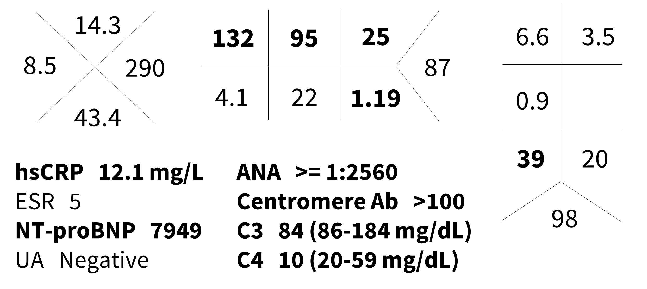
Initial labs

Slide 9
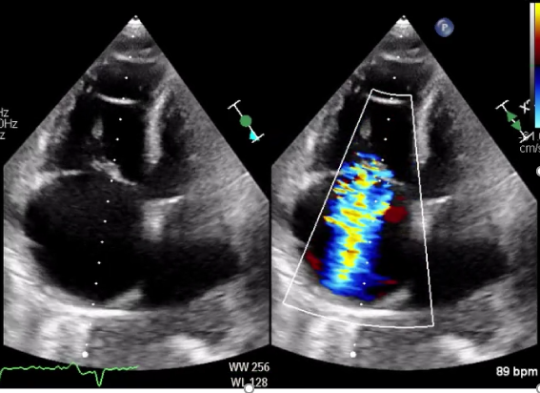
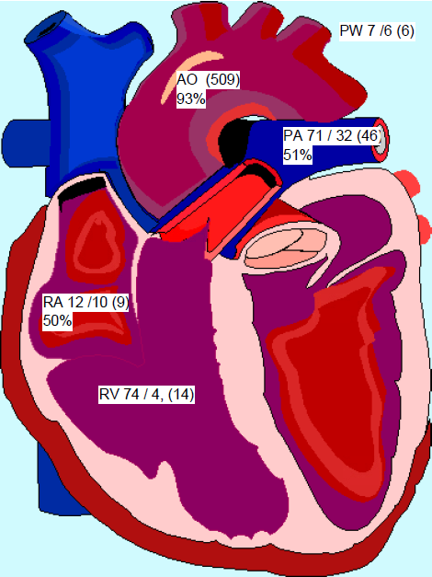
Cardiac Evaluation

Slide 10
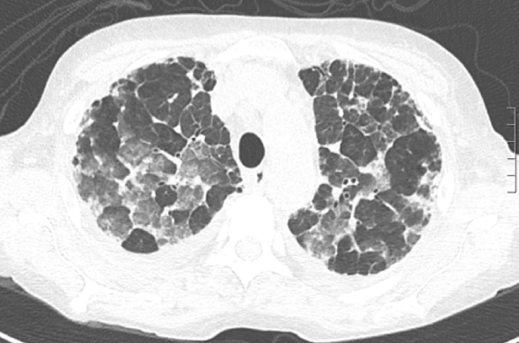
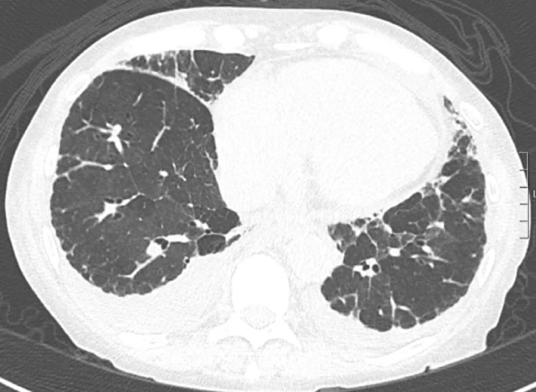
Pulmonary Evaluation
Mild fibrotic disease in the lungs with mild bilateral peripheral reticulation/traction bronchiolectasis, indeterminate for UIP pattern
Increased mild interlobular septal thickening with increased groundglass pulmonary opacities bilaterally likely representing superimposed interstitial and alveolar pulmonary edema.

Slide 11
Initial treatment
Patient was diagnosed with systemic sclerosis with pulmonary arterial hypertension
Patient was given diuretics for several days to remove excess fluid
Upon initiation of pulmonary vasodilator therapy with sildenafil, patient had worsening hypoxia and pulmonary edema
Patient was given further diuretics for several more days
Upon initiation of IV epoprostenol, patient again had worsening hypoxia and pulmonary edema
This prompted referral for lung transplant evaluation

Slide 12
Follow up
Patient ultimately was able to tolerate pulmonary vasodilators without complications and was discharged from the hospital to continue lung transplant evaluation as an outpatient
Respiratory status worsened as an outpatient due to CA wildfires and fluid accumulation. She was twice readmitted for diuretics.
During the second admission, she experienced a sudden cardiac arrest, likely after a vasovagal event, and did not achieve ROSC on resusitation

Slide 13
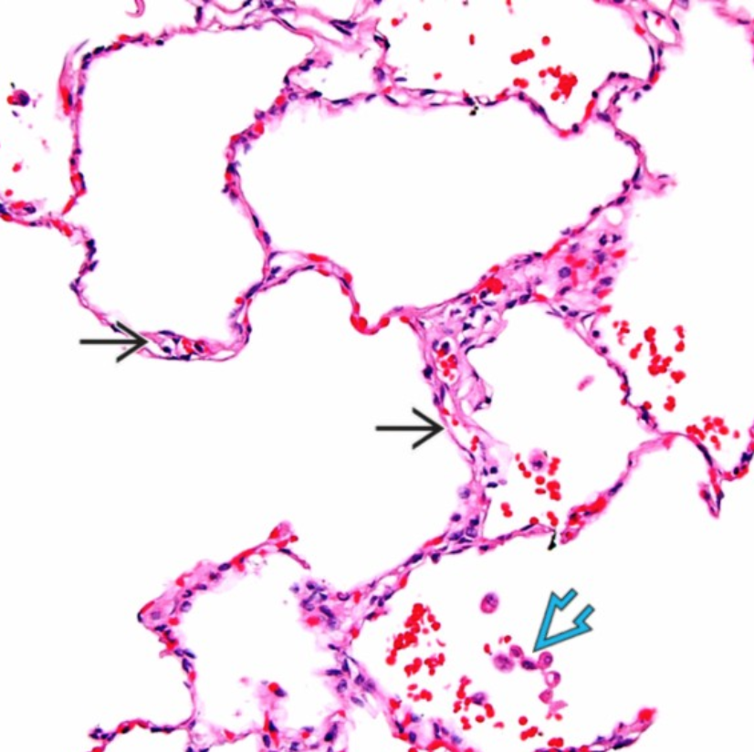
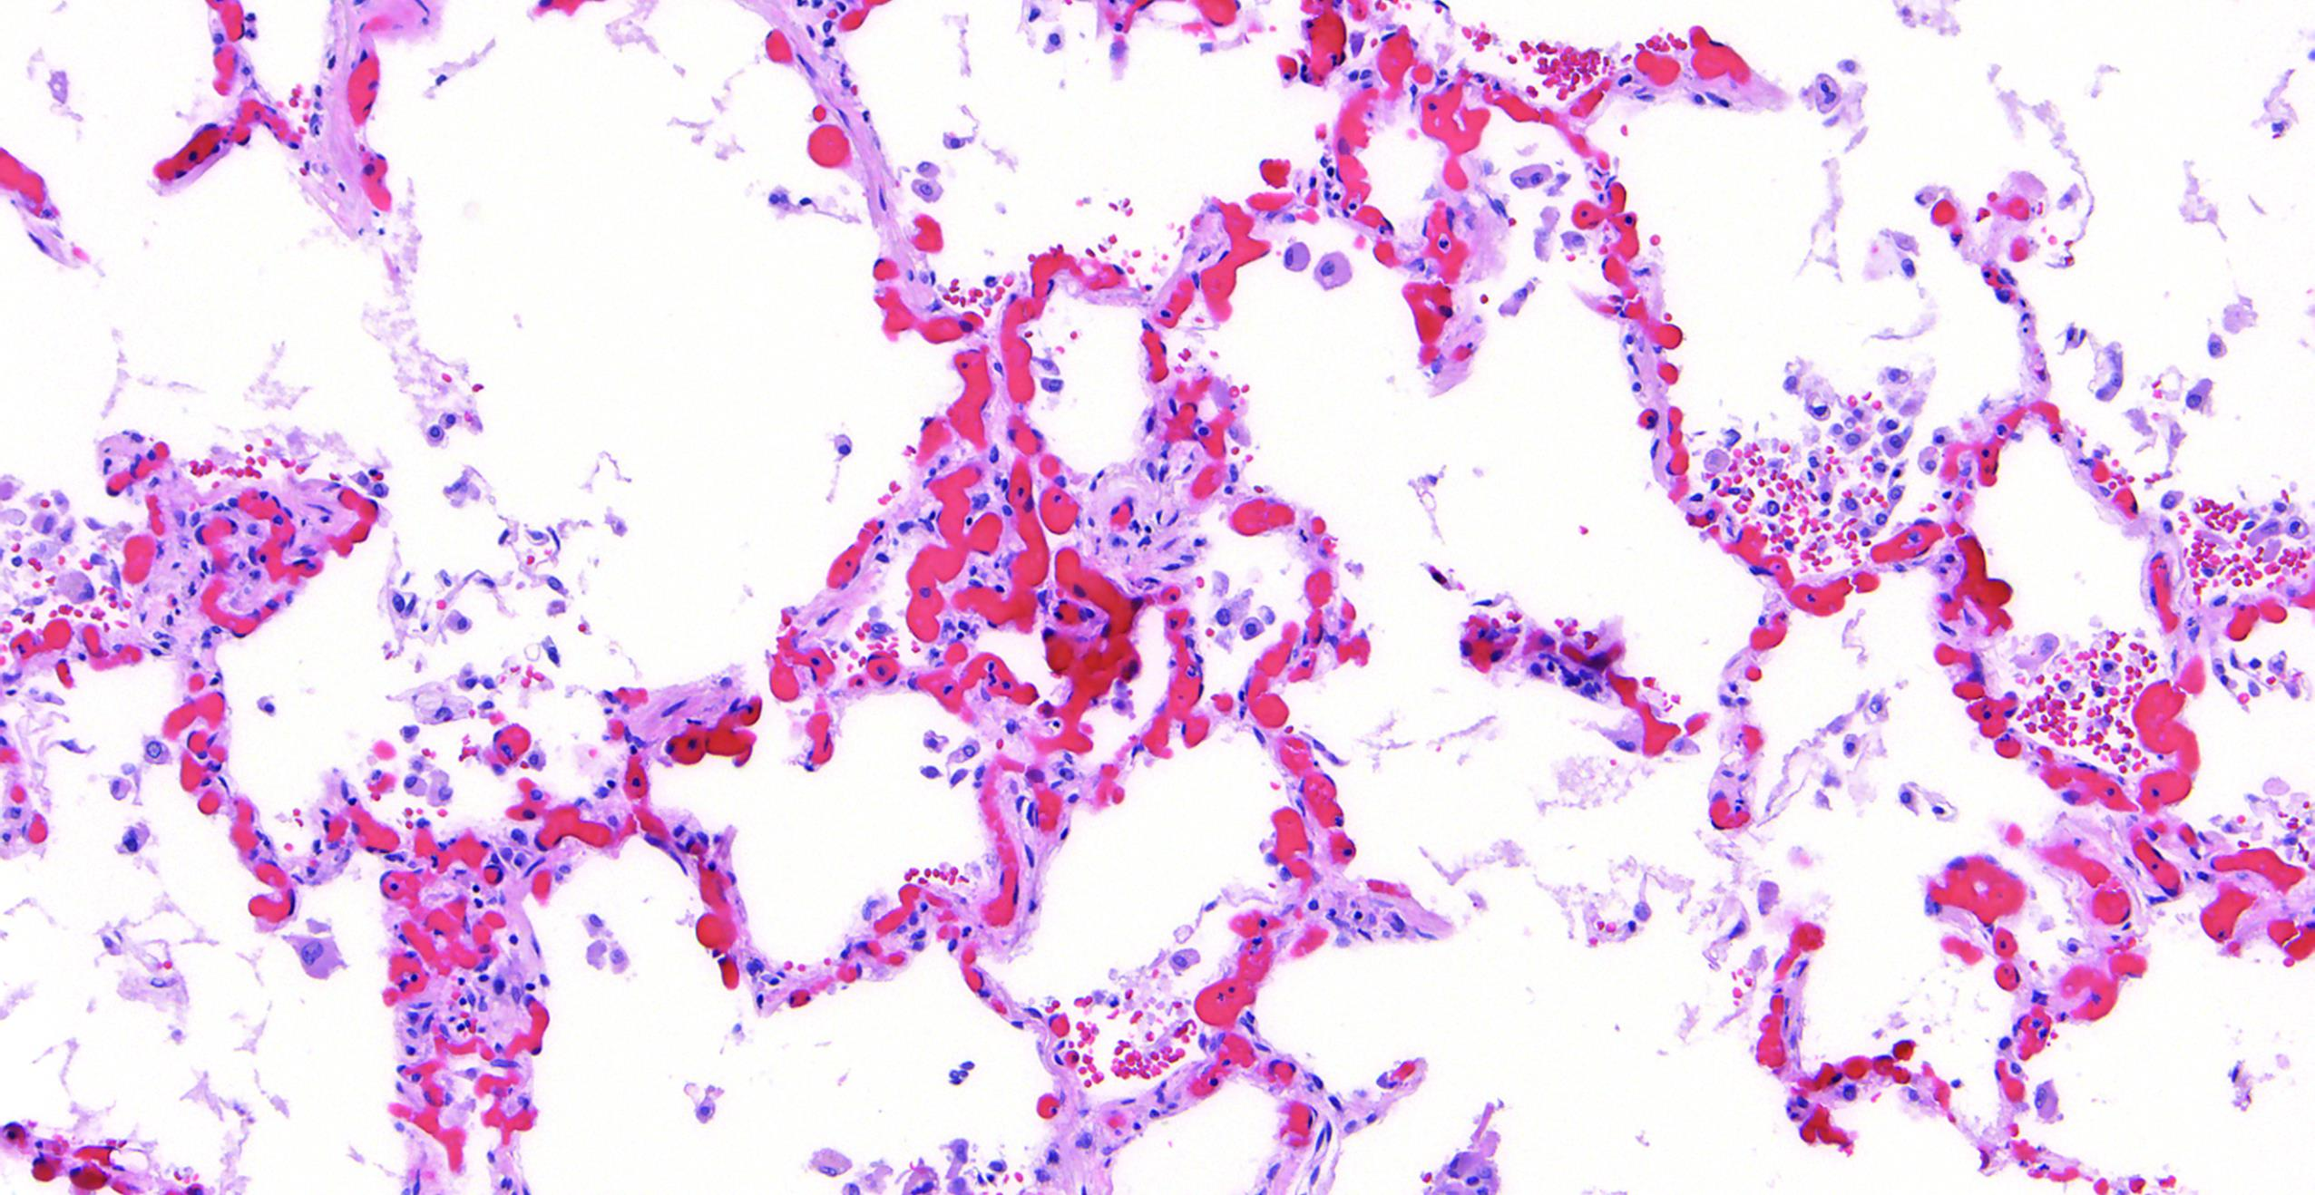
Autopsy findings
Dominant finding: pulmonary capillary hemangiomatosis
Normal Lung
Pulmonary capillary hemangiomatosis

Slide 14
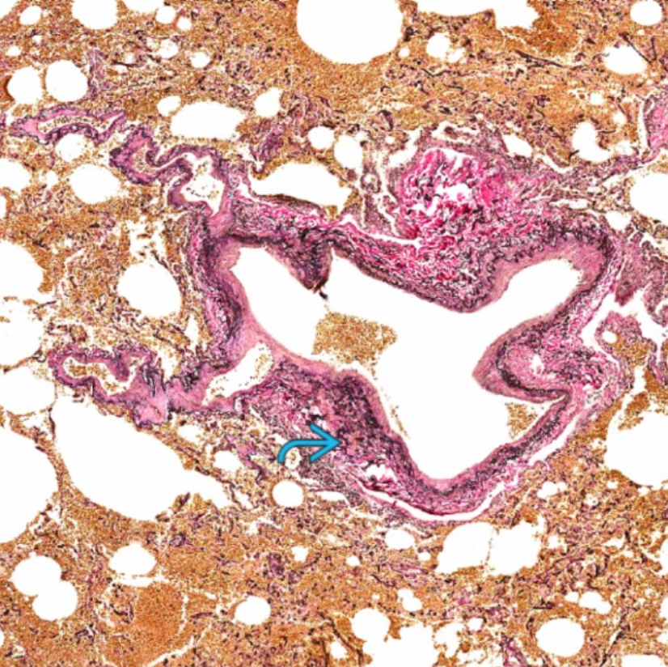
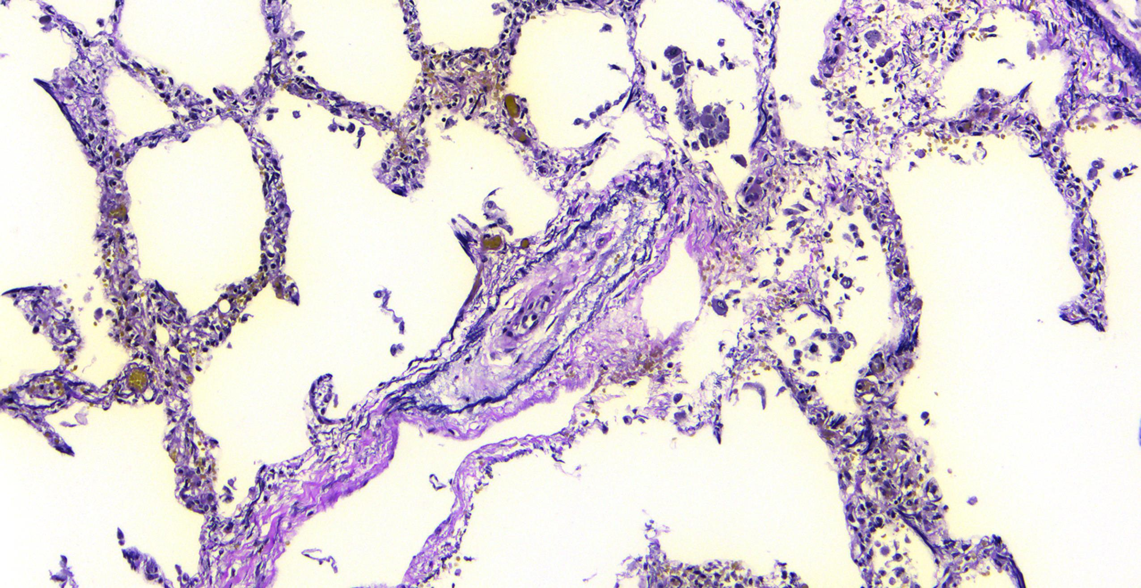
Autopsy findings
Minor finding: pulmonary veno-occlusive disease
Normal Lung
Pulmonary veno-occlusive disease

Slide 15
Discussion: PCH & PVOD Introduction
Characterized by aggressive clinical course
Vasodilator therapy can lead to life-threatening pulmonary edema
Associated with high-dose chemotherapy, organic solvent exposure, EIF2AK4 biallelic mutations, tobacco exposure and connective tissue diseases, especially systemic sclerosis
Suspicion should lead to early referral for lung transplant evaluation

Slide 16
Discussion: PCH & PVOD Testing
High-resolution CT Chest may show
Mediastinal lymph node enlargement
Centrilobular ground-glass opacities
Smooth thickening of the interlobular septa
75% of patients have at least 2 of 3
Bronchoalveolar lavage may show occult alveolar hemorrhage, hemosiderin-laden macrophages
PFTs typically show DLCO < 50% predicted
Montani, D. et al. European Respiratory Journal 47, 1518-1534 (2016).

Slide 17
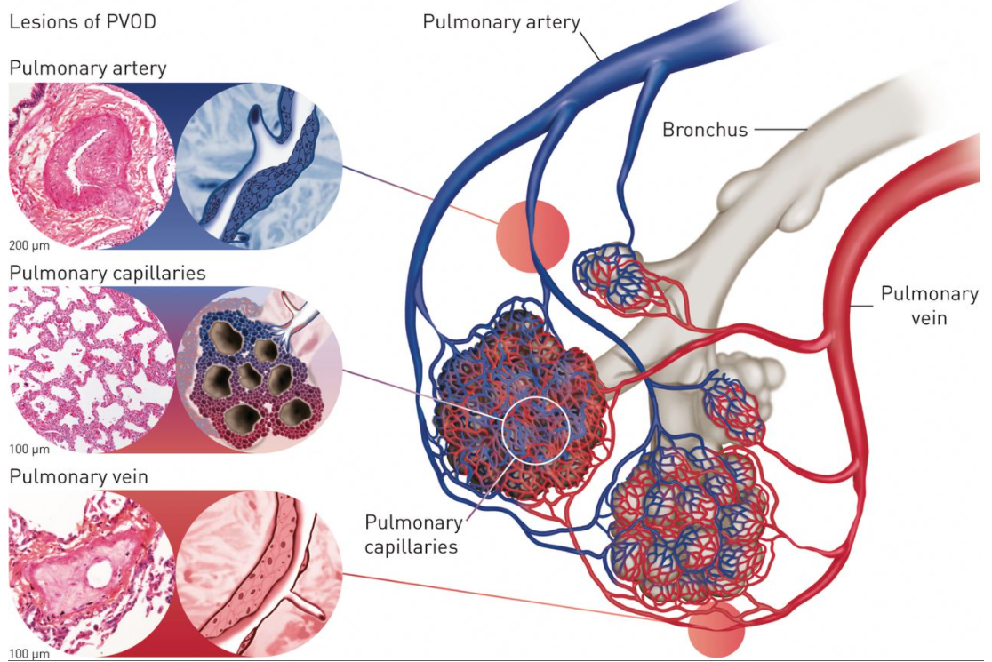
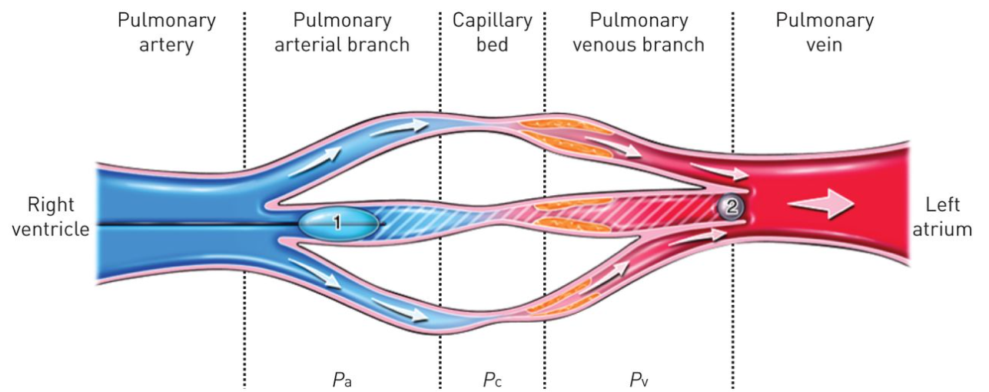
Discussion: PVOD
PVOD features intimal fibrosis of small pre-septal venules, exuberant proliferation of endothelial cells in capillaries, and intimal fibrosis and medial hypertrophy in the arterial circulation.
Small pulmonary veins are affected, thus not affecting pulmonary capillary wedge pressure measures of large veins
Montani, D. et al. European Respiratory Journal 47, 1518-1534 (2016).

