Slide 1
Proposal of a Novel Multimodal Outcome Instrument for Assessing Systemic Lupus Erythematosus Activity and Severity: Initial Derivation and Validation of the Wolfe Index Barbara Jacobs^{1,} Francisco Espinoza^{2,} Phildrich Teh³, Gavin Flynn¹, Jennifer Grossman ⁴, Maureen McMahon⁴, Veena Ranganath⁴, Bevra Hahn⁴ and Kenneth Kalunian¹ ¹Div. Rheumatology, Allergy & Immunology, University of California, San Diego, USA ² Universidad de los Andes, Santiago, Chile ³Div of Rheumatology, Scripps Health, ⁴Div of Rheumatology, University of California, Los Angeles, USA

Slide 2
Background
Clinical scientists are consistently frustrated by the challenges of detecting a clinically meaningful change between treatment groups that delineates the efficacy of new therapeutics from conventional therapy.¹⁻³
Currently used instruments designed to assess SLE disease activity have formidable pitfalls limiting their accuracy to detect such change: The British Isles Lupus Assessment Group (BILAG)-Index ⁴ misses critical laboratory features including dsDNA and complement levels, and under-representation of disease activity can happen if more than one manifestation within an organ system is present. Furthermore, it is rather cumbersome in use. In contrast, the SLE Disease Activity Index (SLEDAI) ⁵ and its derivate versions are fast and simple in use, but their clinical validity is limited by its dichotomous nature making it impossible to capture partial improvement in each organ domain. SLEDAI is heavily weighted towards neuropsychiatric and renal manifestations while missing other critical features including gastrointestinal involvement and hemolytic anemia.
Such shortcomings have contributed to failure of the lupus community to demonstrate effectiveness of novel treatments. By understanding which aspects of current instruments are useful and by determining additional clinically pertinent criteria, our goal is to develop a novel disease assessment tool that more accurately captures SLE disease activity and serves as more relevant outcome measure in clinical trials for SLE.

Slide 3
Objective
We herein describe the initial phase of development and preliminary validation of our novel instrument: the Wolfe-Index. We highlight future directions to further derive and validate this construct.
As initial exercise the authors of this poster including experts in the field of SLE outcome research, analyzed data from previous SLE trials and traditionally used outcome instruments and deconstructed these instruments to determine the relative merit of individual items of these instruments. Literature pertinent to SLE outcome research was reviewed using PubMed data base. Derived from these efforts, a preliminary construct of the Wolfe Index was created.
For initial validation, a cross-sectional analysis in the UC San Diego SLE cohort was conducted comparing global scores of the Wolfe Index to SELENA-Systemic Lupus Erythematosus Disease Activity Index (SELENA-SLEDAI).
Materials & Methods

Slide 4
Results
The overarching principle of the Wolfe Index is to achieve dynamic capturing of changes in disease activity and severity in a simple yet comprehensive fashion.
The backbone of the Wolfe Index is grounded on traditional lupus descriptors describing visceral organ, musculoskeletal and mucocutaneous involvement as well as constitutional symptoms and serologic activity. Beyond that, the instrument incorporates the domains of ‘Treatment Modifications’ to dynamically monitor treatment adjustments as additional measure of disease activity, as well as a ‘Physician Global Assessment (PGA) scores’ (Figure 1). To achieve dynamic grading that allows longitudinal assessment over time, a scoring system that requires scoring of each descriptor in each domain was implemented. Only descriptors identified as essential features that reflect lupus activity were included; features describing damage accrual were not taken into consideration. Key differences between traditional instruments and the Wolfe Index are highlighted in Figure 2.
Initial validation efforts showed good correlation between the Wolfe Index and SELENA-SLEDAI (r= 0.8, CI95% 0.63-0.89, p< 0.001) (Figure 3).

Slide 5
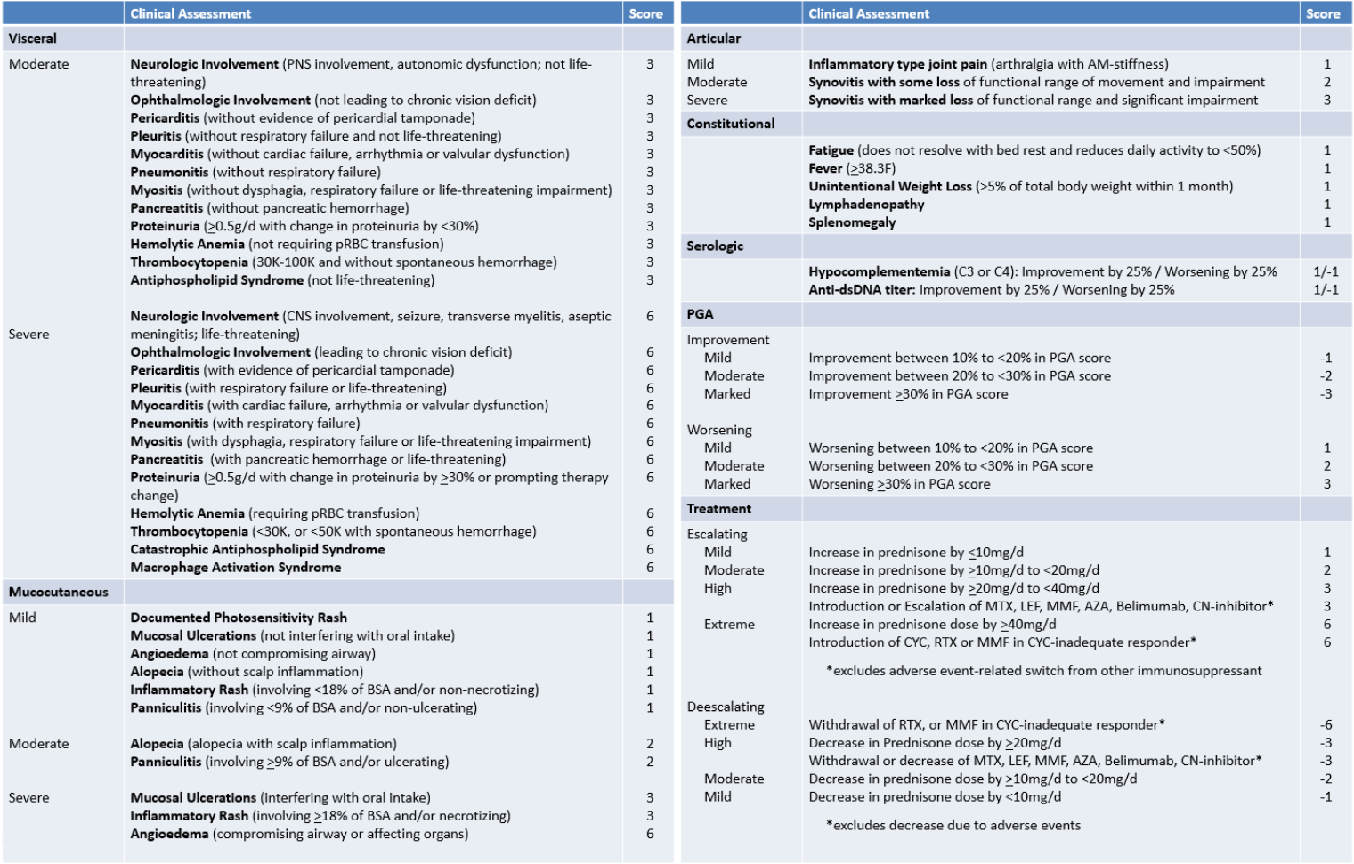
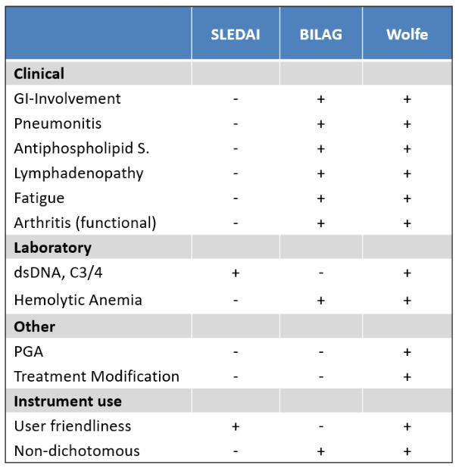
Results
Figure 2. Key differences between the Wolfe Index
and current disease assessment instruments.
Figure 3. Cross-sectional analysis shows good correlation between SLEDAI and Wolfe Index (r= 0.8, CI95% 0.63-0.89).
Figure 1. The initial construct of the Wolfe Index.

Slide 6
Conclusion
Better instruments to measure SLE disease activity and severity are needed to help delineate the efficacy of novel therapeutics from conventional therapy.
The Wolfe Index aims to enhance the conduct of clinical trials by enabling clinical scientists to utilize a less complex instrument that at the same time provides greater discrimination between interventions and serves as more relevant outcome measure in clinical trials for SLE.
Further refinement of the initial construct of the Wolfe Index are underway including a Delphi approach to determine the set of criteria that provide optimal clinical significance. Furthermore, the longitudinal performance of the instrument will need to be investigated.

Slide 7
References
[1] Askanase AD, Merrill JT. Measuring disease activity in SLE is an ongoing struggle. Nat Rev Rheumatol. 2019;15: 194–195. [2] Mahieu MA, Strand V, Simon LS, Lipsky PE, Ramsey-Goldman R. A critical review of clinical trials in systemic lupus erythematosus. Lupus. 2016;25(10):1122-1140. [3] Merrill JT, Manzi S, Aranow C, Askenase A, Bruce I, Chakravarty E, et al. Lupus community panel proposals for optimizing clinical trials: 2018. Lupus Sci Med. 2018;5(1):1–14. [4] Isenberg DA, Rahman A, Allen E, Farewell V, Akil M, Bruce IN et al. BILAG-2004: development and initial validation of an updated version of the British Isles Lupus Assessment Group’s disease activity index for patients with systemic lupus erythematosus. Rheumatology (Oxford). 2005;44:902-6. [5] Gladman DD, Ibanez D, Urowitz MB. Systemic Lupus Erythematosus Disease Activity Index 2000. J Rheumatol. 2002;29:288-91.

