Slide 1
Rituximab as Rescue Therapy in Treatment-Refractory CTD-ILD
Julia Sun¹, Charles Oshinsky², Nicole Garcia², Iazsmin Ventura², Renea Jablonski², Rekha Vij², James Curran², Mary Strek², Ayodeji Adegunsoye²
1. Northwestern University McGaw Medical Center, Chicago, IL
2. University of Chicago Medical Center, Chicago, IL

Slide 2
Disclosures
Julia Sun, Charles Oshinsky, Nicole Garcia, Iazsmin Ventura, Renea Jablonski, Rekha Vij, and James Curran: none
Mary Strek: Boehringer Ingelheim (grant, advisory board), Novartis (grant)
Ayodeji Adegunsoye: Boehringer Ingelheim (advisory board)

Slide 3
Introduction CTD-ILD
ILD in patients with CTD is common and dictates morbidity and mortality
Survival varies between ILD pattern
Five-year mortality in UIP is greater than 50%, while non-fibrotic NSIP carries more favorable prognosis¹
Disease progression is variable
Corticosteroids and DMARDs are routinely used, but treatment guidelines do not exist²
1. Strand MJ et al. Chest. 2014;146(3):775-785.
2. Mathai SC et al. BMJ. 2016;352:h6819.
Notes:
Interstitial lung disease (ILD) in patients with connective tissue disease (CTD) is common and dictates morbidity and mortality in these patients. Although it is generally thought that ILD develops later on in CTD, it is often the initial presentation, referred to as “lung dominant” CTD. It is also possible for ILD to be the sole manifestation of an otherwise occult CTD. The CTDs commonly affected by ILD include rheumatoid arthritis, systemic sclerosis, autoimmune myositis, systemic lupus erythematosus, Sjogren syndrome, mixed CTD, and undifferentiated CTD. The most common patterns of ILD observed in CTD include nonspecific interstitial pneumonia (NSIP), usual interstitial pneumonia (UIP), organizing pneumonia (OP), lymphocytic interstitial pneumonia (LIP), acute interstitial pneumonia (AIP)/diffuse alveolar damage (DAD), and rarely desquamative interstitial pneumonia (DIP).¹ Survival in CTD-associated UIP is similar to idiopathic pulmonary fibrosis (IPF), with reported 5-year mortality of greater than 50%.² Non-fibrotic NSIP is felt to carry a more favorable outcome compared to that of UIP but may be more challenging to diagnose due to less defined features seen on imaging. Disease progression is variable: while some patients have limited and/or stable disease, others see rapid progression to lung fibrosis.
Treatment guidelines do not exist for CTD-ILD. Corticosteroids remain the mainstay of clinical management of CTD-ILD.³ Few data exist to guide the use of additional immunosuppressive therapies, which remains largely based on the clinician’s experience and trial/error. At present there are no approved therapies for CTD-ILD.
Azathioprine is commonly used in combination with corticosteroids for CTD-ILD but its use as monotherapy is not supported.
Cyclophophamide is the only immunosuppressive agent that has been studied in RCTs in scleroderma-associated ILD; shows trend toward improvement in FVC, but this observed effect appears to wane over time.
MTX’s role in CTD-ILD is less clear and is tainted by its capacity to cause pulmonary toxicity.
MMF was studied in scleroderma lung study II and a retrospective case series of PM/DM-ILD suggesting stabilization of lung function. Although the drug is well tolerated, recent studies suggest that it may lead to hypogammaglobulinemia and thus puts patients at risk for recurrent infections.
Calcineurin inhibitors have been looked at in a Japanese population with PM/DM-ILD (prednisone and IV Cytoxan vs. prednisone and IV Cytoxan and tacrolimus) and found a significant improvement in event-free survival however given the high prevalence of anti-MDA-5 disease in Japan, the result may not be generalizable.
When ILD continues to progress despite conventional immunosuppression, prognosis is often poor. IV Cytoxan administered monthly for 6 months followed by maintenance oral immunosuppression is often given for severe, progressive ILD, but carries high toxicity profile and tends to not be very efficient in addressing articular disease.

Slide 4
Rituximab in CTD-ILD
RTX is anti-CD20 monoclonal antibody
Case studies suggest RTX is well-tolerated and leads to stability or improvement in pulmonary function in patients with CTD due to antisynthetase syndrome^{3,4}, RA⁵, and systemic sclerosis^{6,7}
Two larger (n=33 and n=49) retrospective cohort studies suggest RTX as a promising rescue therapy for progressive lung disease^{8,9}
3. Doyle TJ et al. J Rheumatol. 2018;45(6):841-850.
4. Marie I et al. Resp Med. 2012;106(106):581-587.
5. Yusof MYM et al. Rheumatology. 2017;56(8):1348-1357.
6. Jordan S et al. Ann Rheum Dis. 2015;74(6):1188-1194.
7. Daoussis D et al. Clin Exp Rheumatol. 2012;30:S17-22.
8. Keir GJ et al. Respirology. 2014;19(3):353-359.
9. Duarte AC et al. Clin Rheumatol. 2019;38(7):2001-2009.
Notes:
Two larger (n=33 and n=49) retrospective cohort studies done in Europe (UK and Portugal) looking at patients with progressive CTD-ILD treated with RTX are in agreement with these earlier studies and suggests RTX as a promising rescue therapy for patients with rapidly progressive lung disease refractory to conventional immunosuppression.^{9,10} We elected to evaluate this hypothesis in an independent U.S. cohort of patients with diverse CTD-ILD phenotypes by assessing lung function trajectories before and after RTX rescue therapy.
Keir et al:
- UK study
- 33 patients with progressive CTD-ILD of varying etiologies (excluding IPF) treated with RTX.
10 IIM
9 UCTD
8 systemic sclerosis
(also included 6 HP)
Median improvement in FVC of 6.7% at 12 months
Stabilization of DLCO at 12 months
Most were responders, but 14 continued to deteriorate following RTX
Duarte et al:
- Portugal study
49 CTD-ILD
Stabilization in DLCO at one year (mean +5.4%, p=0.12) and improvement in FVC (mean +4.3%, p=0.03), particularly in patients with NSIP
UIP at less promising result, but had at least stable DLCO (+2.5%, p=0.77) and FVC (4.2%, p=0.16) at one year

Slide 5
Objective
Evaluate the efficacy of RTX as rescue therapy in an independent U.S. cohort of patients with CTD-ILD by assessing lung function trajectories before and after RTX treatment

Slide 6
Design
Identify patients with CTD-ILD in the University of Chicago ILD registry from 2008 to 2018, treated with:
Prednisone alone
DMARD (azathioprine or MMF) ± prednisone
RTX ± DMARD ± prednisone
Compare pre- and post-RTX PFT data
FVC
DLCO
Oxygen requirement at rest
BORG dyspnea scale during 6 minute walk test
Notes:
We retrospectively identified patients in University of Chicago ILD Registry with CTD-ILD using ICD9 and ICD10 codes who were treated with prednisone alone, a DMARD (azathioprine or mycophenolate mofetil) with or without prednisone, and RTX without or without prednisone and/or a DMARD from 2008 to 2018.
ILD diagnosis was made at a multidisciplinary meeting including radiology, pulmonary, and rheumatology attendings.
Baseline demographics at the time of treatment initiation and pre/post-RTX pulmonary function test (PFT) results were extracted from the electronic medical record through 10/2018. RTX was re-dosed every 6 months after the initial administration of RTX, if felt necessary by the clinician. Patients with inadequate follow up PFTs and whose indication for RTX treatment was no ILD were excluded. Pre- and post-RTX forced vital capacity (FVC), diffusing capacity for carbon monoxide (DLCO), oxygen requirement at rest, and BORG dyspnea scale during 6-minute walk test were compared.
Pre-RTX was defined as 6 to 12 months prior to RTX administration. Post-RTX was defined as 6 to 12 months after RTX administration.

Slide 7
Results Baseline Characteristics
Baseline Characteristics (n=190) |  | Prednisone only (n=96) | Aza/MMF ± Pred (n=68) | RTX ± Aza/MMF ± Pred (n=26)
Mean Age (years) |  | 60.3 | 54.7 | 55.0
Female (no, %) |  | 73 (0.76) | 49 (0.72) | 19 (0.73)
Race | White (no, %) | 51 (0.53) | 27 (0.40) | 12 (0.46)
 | Black (no, %) | 32 (0.33) | 34 (0.50) | 11 (0.42)
 | Others (no, %) | 13 (0.14) | 7 (0.10) | 3 (0.12)
Smoking Status | Never Smoker (no, %) | 52 (0.54) | 33 (0.49) | 20 (0.77)
 | Smoker (no, %) | 44 (0.46) | 35 (0.51) | 6 (0.23)
 | Smoking duration (mean pack-year) | 20 | 20 | 33
CTD diagnosis | RA | 30 (0.31) | 11 (0.16) | 4 (0.15)
 | DM/PM | 7 (0.07) | 12 (0.18) | 3 (0.12)
 | AS | 1 (0.01) | 3 (0.04) | 5 (0.19)
 | MCTD | 15 (0.16) | 16 (0.24) | 3 (0.12)
 | UCTD | 5 (0.05) | 1 (0.01) | 5 (0.19)
 | Systemic Sclerosis | 22 (0.23) | 11 (0.16) | 0
 | SLE | 3 (0.03) | 3 (0.04) | 0
 | Sjogren's | 13 (0.14) | 11 (0.16) | 1 (0.04)
 | RA/Sjogren's | 0 | 0 | 2 (0.08)
 | IPAF | 0 | 0 | 3 (0.08)
 | IGG4-RD | 0 | 0 | 1 (0.04)
FVC at treatment initiation (% predicted, mean±SD) |  | 67±17 | 62±20 | 52±13
Notes:
96 patients were treated with prednisone alone.
68 were treated with aza/MMF with or without prednisone.
25 were treated with RTX with or without DMARD with or without prednisone.
All patient groups:
Average age is in the 5th decade of life
Female predominant
A significant portion of our patients were black, reflecting a diverse race
Half were never smokers
Diverse CTD-ILD diagnosis
Differences:
- we did not identify any patients with systemic sclerosis who received treatment with RTX; likely a reflection of the fact they do relatively well in response to MMF
- Baseline FVC at time of treatment initiation (hereon referred to as time 0) is lowest in RTX group, a reflection of the progressive nature of their ILD

Slide 8
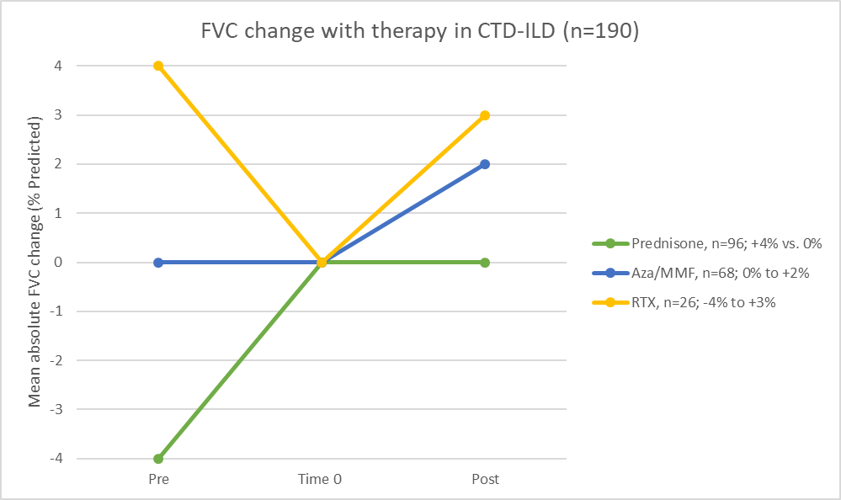
Comparison of FVC between treatment groups
6-12 months before
6-12 months after
Notes:
Figure one plots mean absolute change in FVC pre- and post-treatment.
Starting at time 0 which is the time of initiation of treatment, all treatment groups saw stabilization in FVC, with RTX group showing the most significant effect in potentially reversing the decline in FVC as seen in the 6-12 months pre-RTX.
One explanation for why patients in the prednisone group on average saw an improvement of 4% in FVC at time 0 compared to pre-treatment is that prednisone was likely started for extra-pulmonary manifestations of CTD rather than for progression of ILD.
I then wanted to take a closer look at this group of 26 patients in the RTX treatment group. Out of the 26 patients represented here, 14 had data at all three time points (pre-treatment, time 0, and post-treatment).

Slide 9
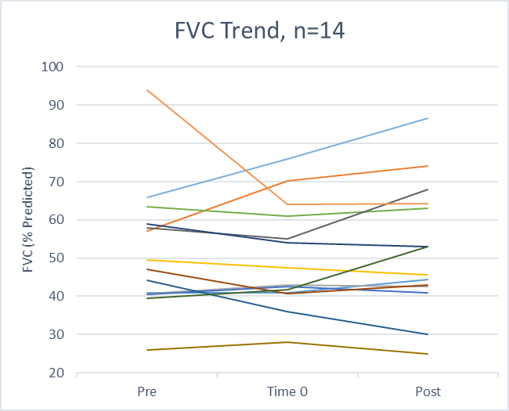
FVC trend in RTX group
6-12 months before
6-12 months after
6-12 months before
6-12 months after
 | Before | 0 | After
FVC (% predicted, mean±SD) | 52±16 | 50±14 | 52±17
Absolute Change in FVC (% predicted, mean±SD) | 2±10 | - | 2±6

Slide 10
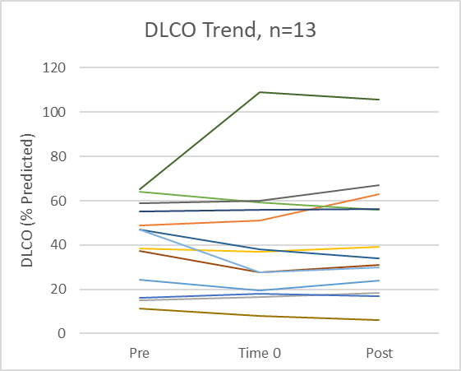
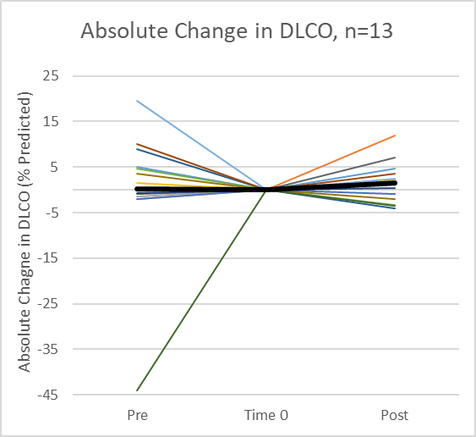
DLCO trend in RTX group
6-12 months before
6-12 months after
6-12 months before
6-12 months after
 | Before | 0 | After
DLCO (% predicted, mean±SD) | 41±19 | 41±27 | 42±27
Absolute Change in DLCO (% predicted, mean±SD) | 0.1±15 | - | 2±5

Slide 11
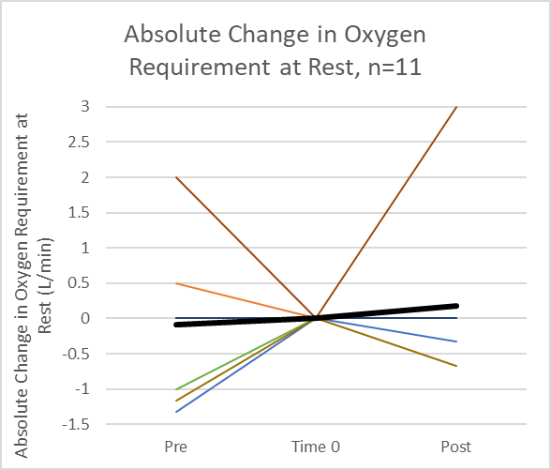
Oxygen requirement trend in RTX group
6-12 months before
6-12 months after
6-12 months before
6-12 months after
 | Before | 0 | After
Oxygen requirement (L/min) | 3.0±4.5 | 3.0±4.3 | 3.2±4.5
Absolute change in Oxygen requirement (L/min) | -0.1±0.9 | - | 0.2±1.0

Slide 12
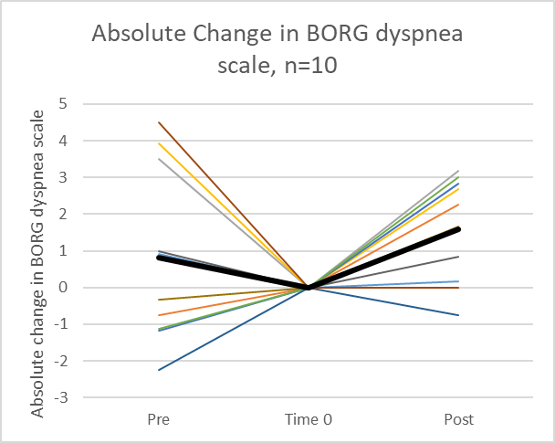
Dyspnea trend in RTX group
6-12 months before
6-12 months after
6-12 months before
6-12 months after
 | Before | 0 | After
BORG dyspnea scale | 3.5±2.4 | 2.7±1.7 | 4.3±2.3
Absolute change in BORG dyspnea scale | 0.8±2.4 | - | 1.6±1.4

Slide 13
Discussion
RTX may be an effective rescue therapy in patients with progressive ILD
Stabilization to slight improvement in FVC, DLCO
Does not appear to affect oxygen requirement and degree of dyspnea
Limitations
Not RCT
Small RTX group size
Heterogeneous CTD diagnoses and disease duration

Slide 14
Next Steps
Continued enrollment of patients in the ILD registry to allow for sub-group analysis by gender, race, CTD diagnosis, fibrotic pattern, etc.
Longer follow up to assess if stabilization of lung function persists past the first year
Better understanding of how B-cell depletion affects lung fibrosis
RCT comparing RTX vs. IV Cyclophosphamide: RECITAL trial¹⁰
10. Saunders P et al. Trials. 2017;18(1):275.
Notes:
Next steps:
Would like to have more patients to study different CTD subtypes: scleroderma and MCTD tend to have NSIP; IIM tend to have a combination of OP; RA frequently has fibrosis with UIP pattern and tend to be resistant to therapy with high-dose immunosuppression.
Longer follow up time, particularly for patients who have received multiple doses of RTX
Safety profile: adverse events, mortality rate
With increasing evidence for the safety and efficacy of RTX for CTD-ILD, it is arguable that RTX should now be considered earlier, before the development of physiologic impairment from advanced fibrosing lung disease. RECITAL trial sets out to answer this question:
Study is done in UK
Multicentre, prospective, randomized, double-blinded controlled trial
Randomize 116 pts with CTD-ILD 1:1 to IV Rituximab 1g Q2weeks x2 doses vs. IV Cytoxan 600mg/m2 body surface area monthly x 6 doses

Slide 15
Thank You
Email: julia.sun@northwestern.edu

